Slide 1

MATERIAL
Abdi dewa maha rupawan (05111840000003)
Geizka wahyu Fahriza (05111840000062)
Imam rafii’ al-dzakwan (05111840000067)
Emmanuel maximus yohanes (05111840000102)

Slide 2
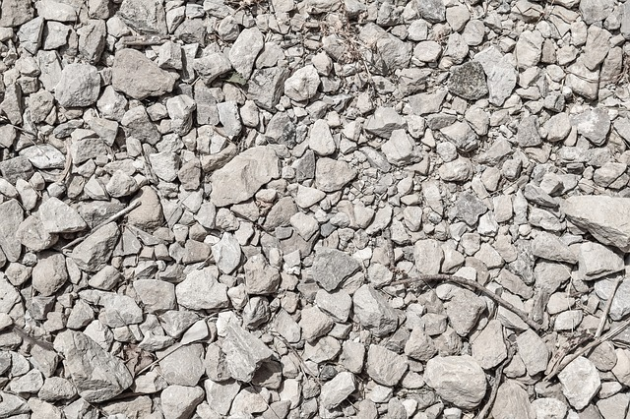
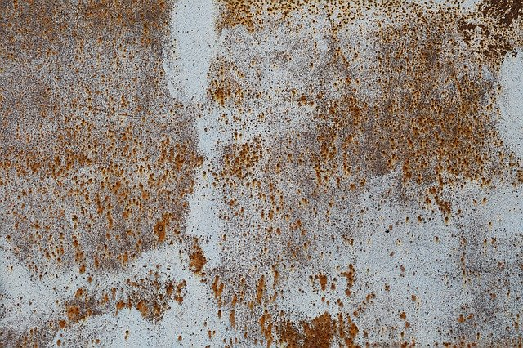
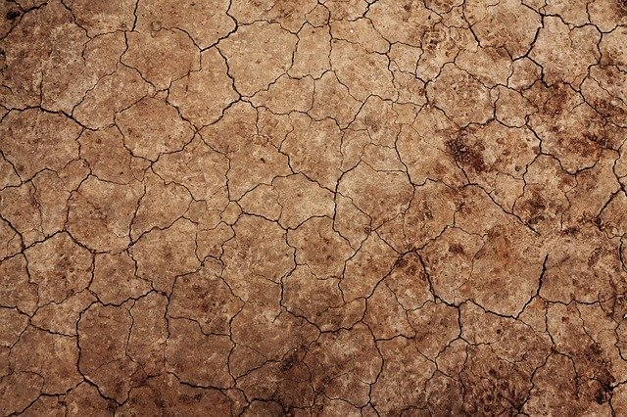
Apa itu material?
Objek material merepresentasikan permukaan geometri yang akan digambar.

Slide 3
Properti material
Properti | Fungsi
alphaTest : Float
blendDst : Integer
blendDstAlpha : Integer
blendEquation : Integer
blendEquationAlpha : Integer
blending : Blending
blendSrc : Integer
blendSrcAlpha : Integer
clipIntersection

Slide 4
Jenis jenis material
MeshBasicMaterial
MeshNormalMaterial
MeshLambertMaterial
MeshPhongMaterial
MeshStandardMaterial
LineBasicMaterial
MeshDepthMaterial
LineDashedMaterial
PointsMaterial
SpriteMaterial

