Slide 1
Geometry – Three JS
Oleh :
Hisam Widi Prayoga – 0026
Ammar Dwi Anwar – 0072
Claus Peter – 0090
Fachry Amir – 0084
Jaler Dio Fadhilah – 0173

Slide 2
Geometry
Plane Geometry
Circle Geometry
Ring Geometry
Shape Geometry
Box Geometry
Sphere Geometry
Cylinder Geometry
Torus Geometry
TorusKnot Geometry
Polyhedron Geometry

Slide 3
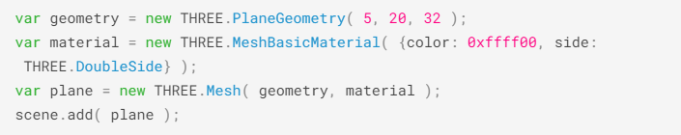
Plane Geometry
Properties :
Width
Height
WidthSegments
HeightSegments

Slide 4
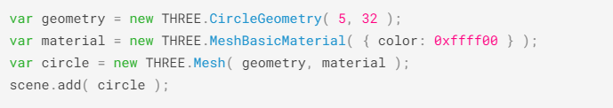
Circle Geometry
Properties :
Radius
Segments
ThetaStart
ThetaLength

Slide 5
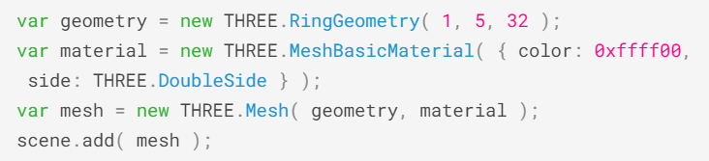
Ring Geometry
Properties
Inner Radius
Outer Radius
Theta Segments
Phi Segments
Theta Start
Theta Lenght

Slide 6
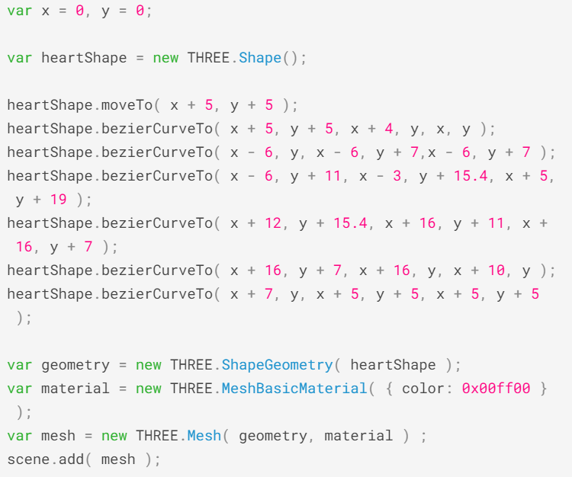
Shape Geometry
Properties
Shapes
Options

Slide 7
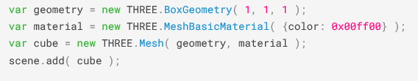
Box Geometry (Cube)
Properties :
Width
Height
Depth
WidthSegments
HeightSegments
DepthSegments

Slide 8
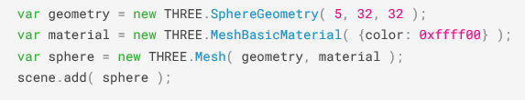
Sphere Geometry
Properties :
Radius
Width Segments
Height Segments
PhiStart
PhiLength
ThetaStart
ThetaLenght

Slide 9
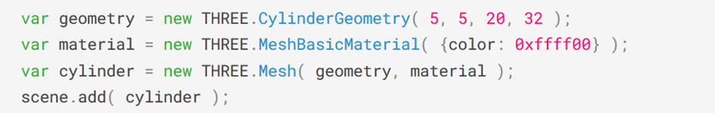
Cylinder Geometry
Properties :
Radius top
Radius bottom
Height
Radial segments
Height segments

Slide 10
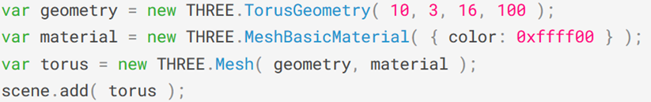
Torus Geometry
Properties :
radius
tube
radial segments
Tubular segments
arc

Slide 11
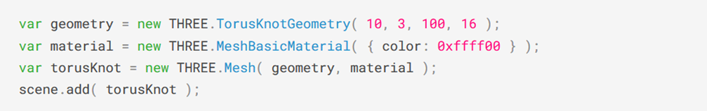
TorusKnot Geometry
Properties :
radius
tube
tubular segments
radial segments
p
q
arc

Slide 12
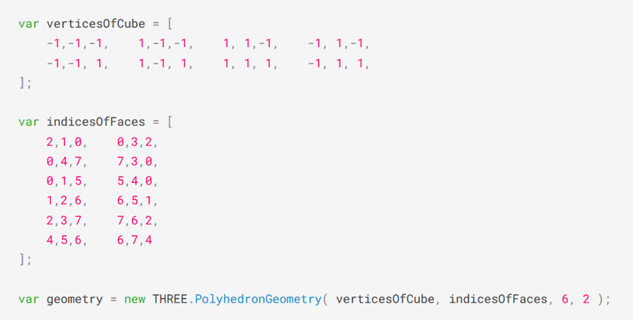
Polyhedron Geometry
Properties
vertices
indices
radius
detail

