Slide 1
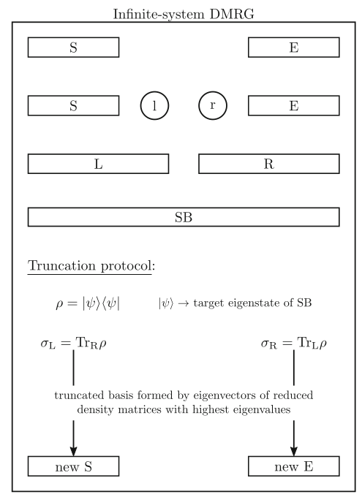
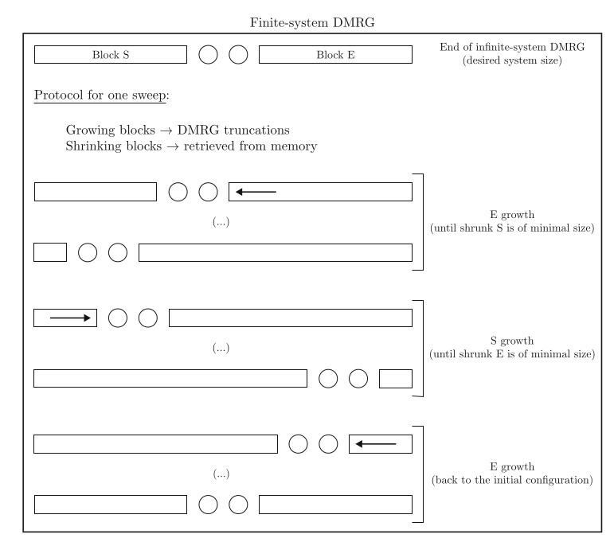
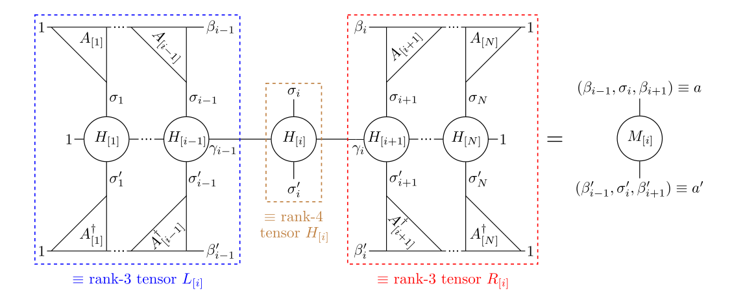
DMRG
Goal: find Groundstate and GS-Energy

Slide 2
Parallelization
H: MPO, make use of different sites
Before build of MPO, we can use so called SumTerms (datastructure in ITensor library)
Distribute the sumterms evenly between processors and use preimplemented MPISumTerm to make results coherent
Add of own implementation for excited states

Slide 3

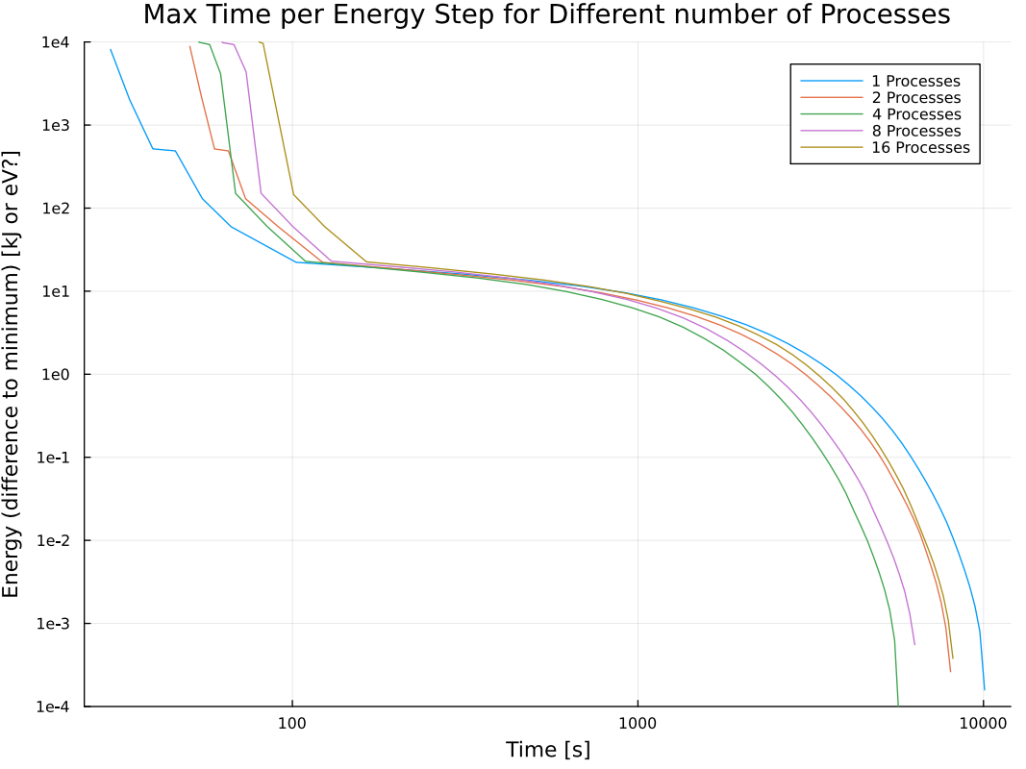
Speedup
J = 1 meV
N = 100

Slide 4
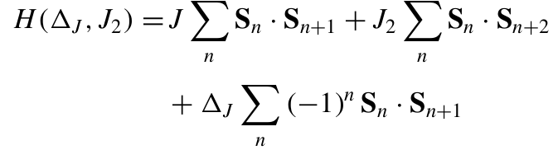
Dynamical correlator
EGS and |GS> from DMRG

Slide 5
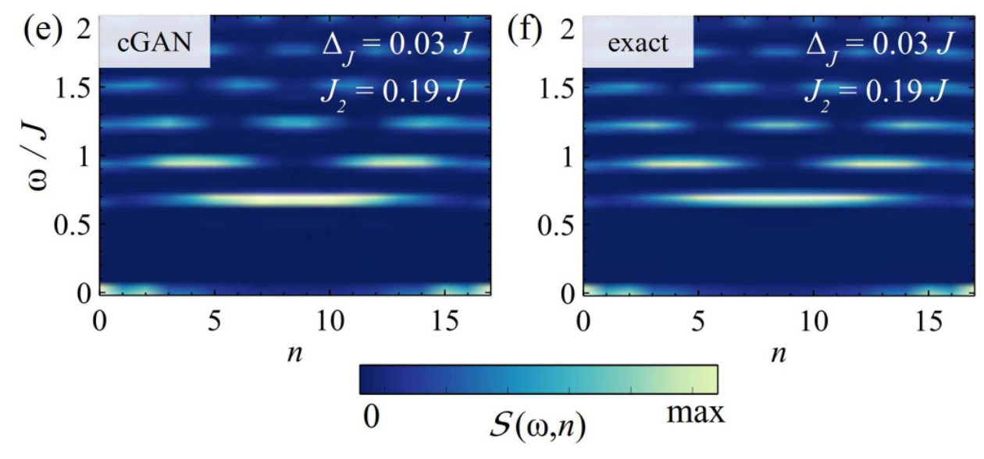
Goal: Reproduce this

Slide 6

Discretization
are the Jackson dampening factors to reduce numeric oscillations
‘ means rescaled to the array [-1, 1], because of chebyshev expansion

Slide 7
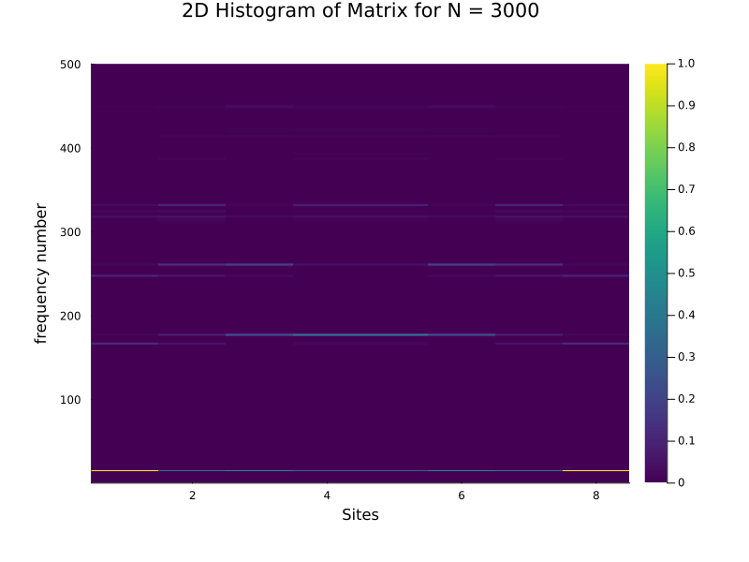
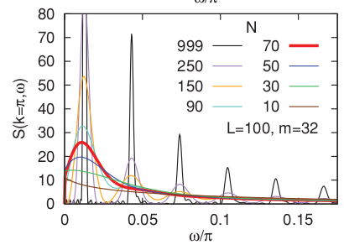
Plots

Slide 8
Plots

Slide 9
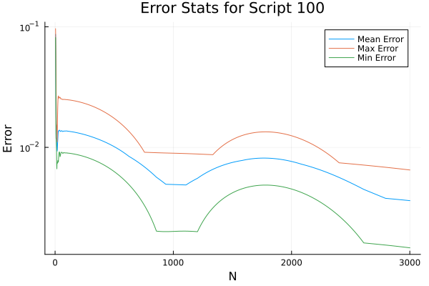
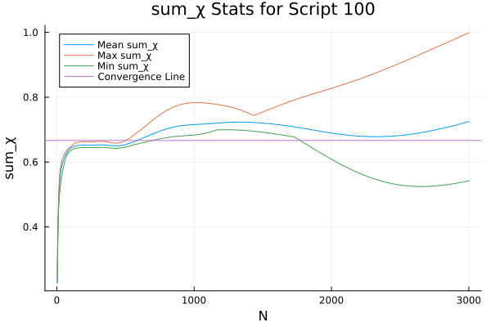
Problem: how many omegas?

Slide 10
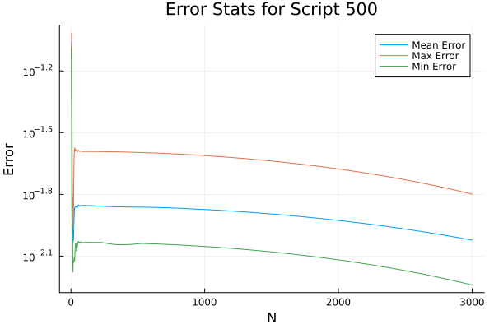
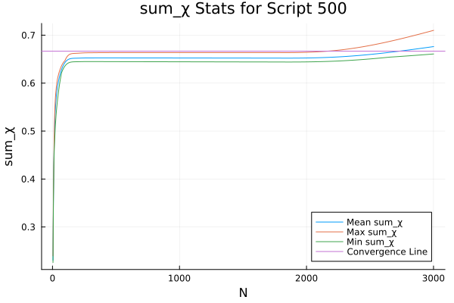
Problem: how many omegas?

Slide 11
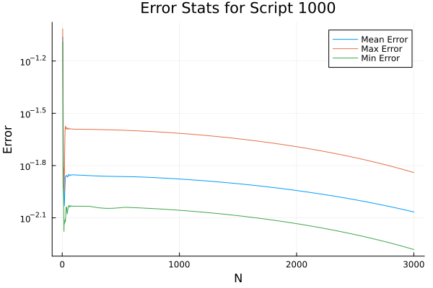
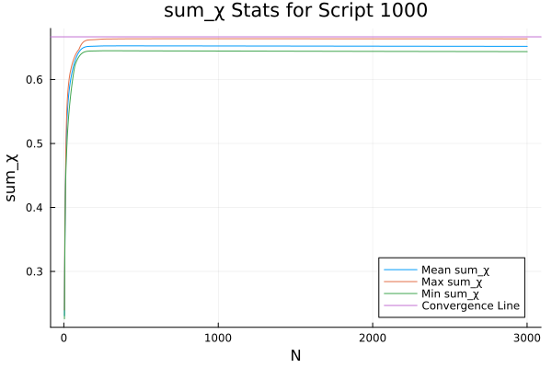
Problem: how many omegas?

Slide 12
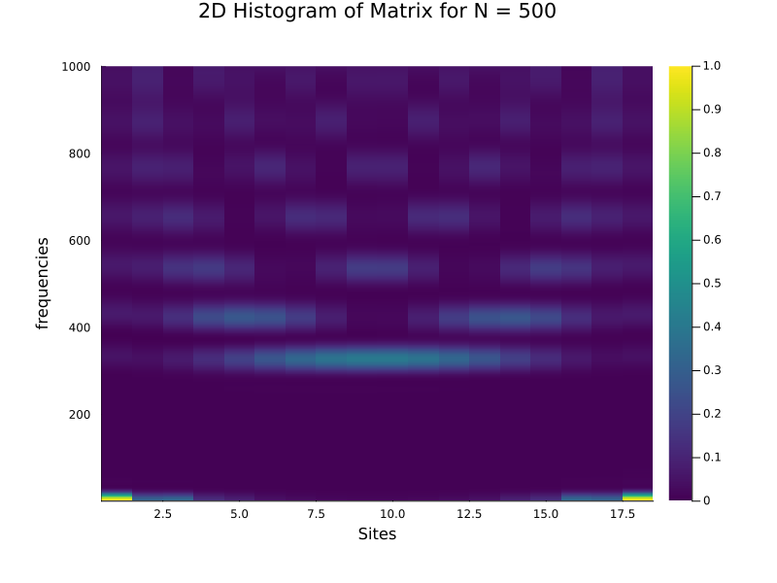
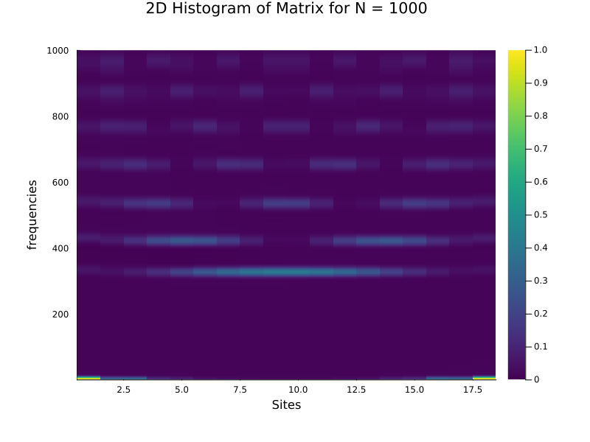
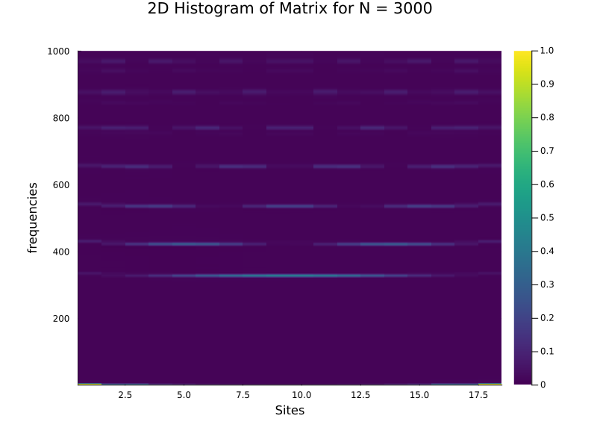
Problem: How many N?

