Slide 1

SCIPY 2026
Assessing the Entrepreneurship Option in Uncertain Times
Jocelyn Graf
Entrepreneur-in-Residence

Slide 2
How feasible is it to create steady, market-rate paid work for yourself outside of formal employment?

Slide 3
Entrepreneurship options
(Co)found a tech startup
●
Start a traditional small product or service business
●
Join a startup
●

Slide 5

Product
Customer

Slide 6
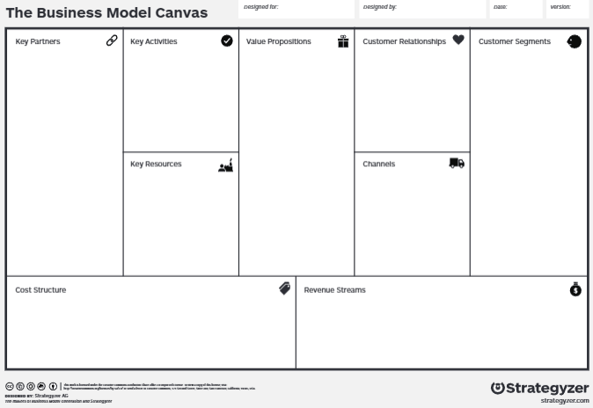


Business model canvas
Diagram of a set of hypotheses

Slide 7
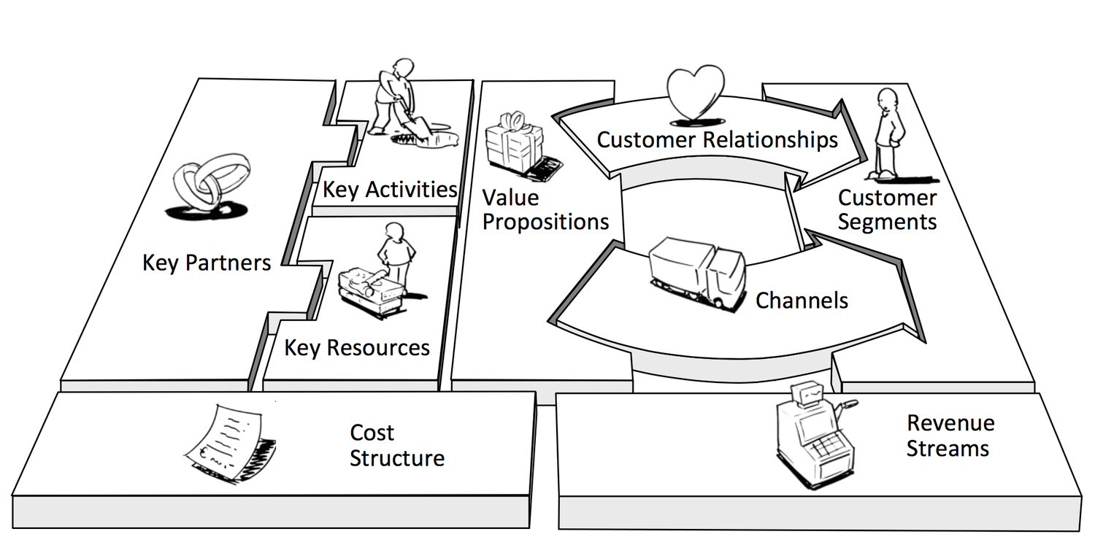
Business model canvas

Slide 8
Most of us are makers.

Slide 9
Most of us are makers.
We like to think about products.

Slide 11
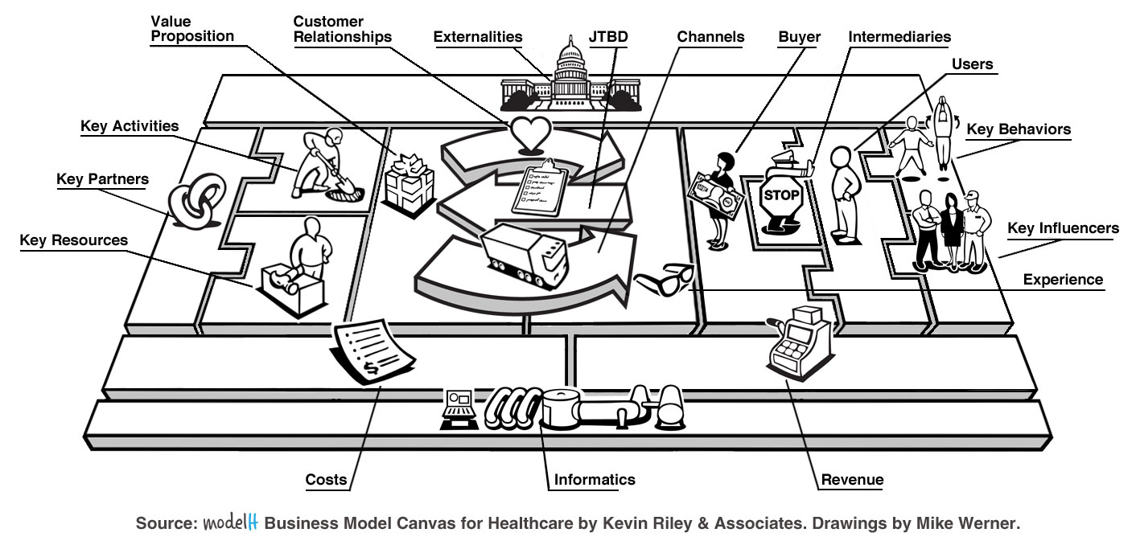
Business model canvas for healthcare

