Slide 1


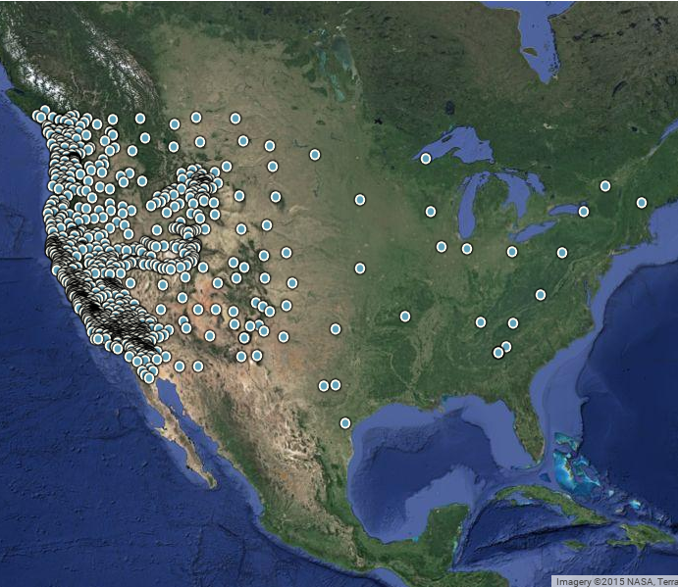
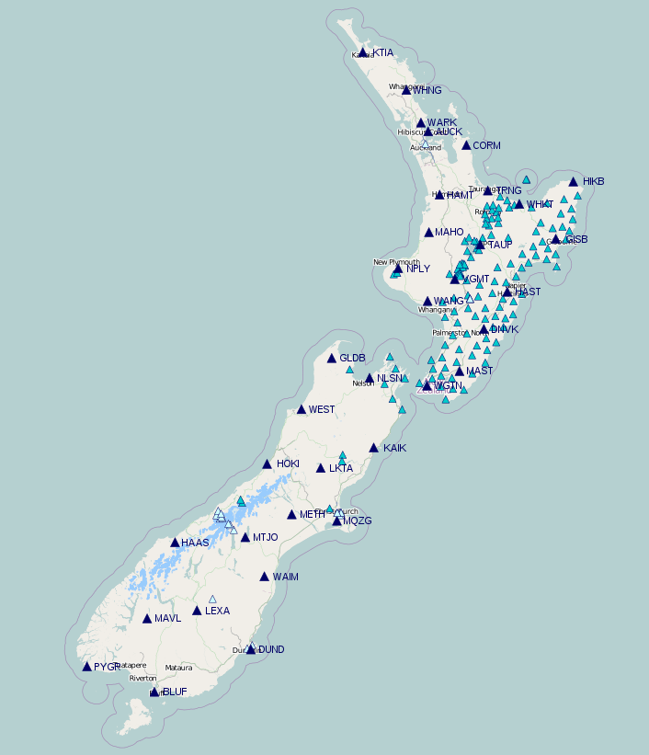
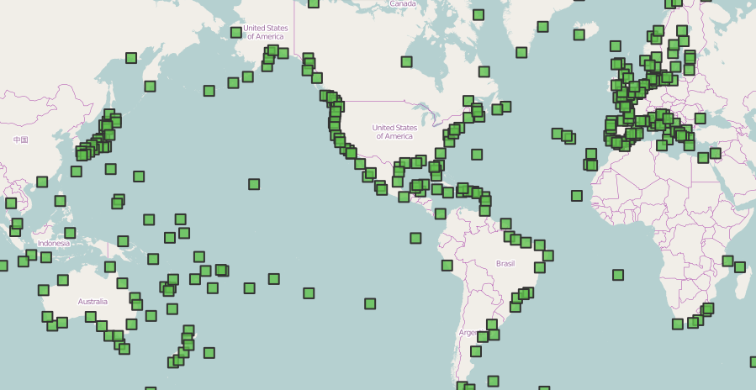
A Cohesive Method for Accessing Data from GPS Networks
PURE | github.com/gragas/gpsbro | airglow.ece.illinois.edu
Thomas Fischer, Alan Yang, Matthew Grawe
GPS Networks
UNAVCO
GeoNet
SONEL
GPSBro
Scientists
Overview
Masking
There are many GPS networks that hold data valuable to researchers. GPSBro provides researchers a cohesive method for accessing data from these networks.
A keyword argument allows users to retrieve only certain types of data. Currently, users can select any combination of four types of data.
Usage
Other Features
GPSBro is a (Python) software package. It aims to simplify the collection and processing of data. For example, the following code retrieves URLs of RINEX data on the UNAVCO network:
There are many other features that would be useful to add. Random sampling and latitude/longitude bounding are partially implemented. Both would significantly reduce the amount of data needed to be downloaded in order to conduct research.
It would also be useful to add more networks to GPSBro. Only UNAVCO, GeoNet have been implemented.
URLs = gpsbro.unavco.get_URLs_on(
datetime.date(2015, 10, 12),
)
URLs is a list of RINEX URLs in the UNAVCO network on 2015/10/12.
Accessing the same URLs, but from a different network, is very similar:
Compatibility
GPSBro is available as a Python package at github.com/gragas/gpsbro. It has been tested with Python 2.7 and Python 3.
URLs = gpsbro.geonet.get_URLs_on(
datetime.date(2015, 10, 12),
)
PURE Research Symposium
Department of Electrical and Computer Engineering
University of Illinois at Urbana-Champaign

