Slide 1
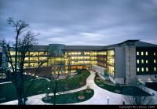

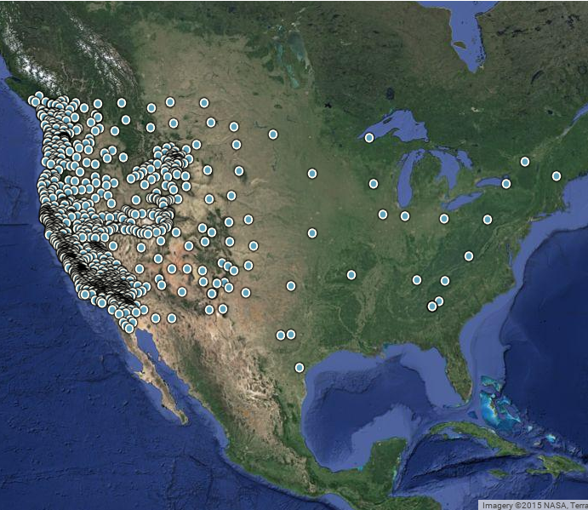
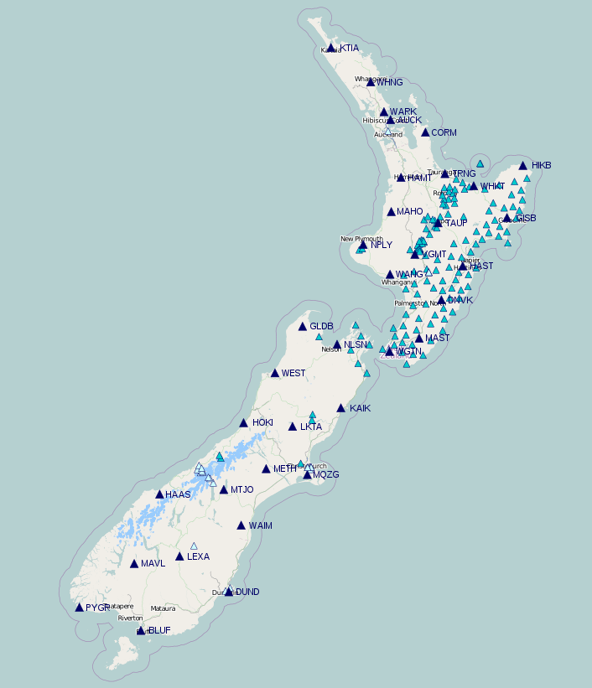
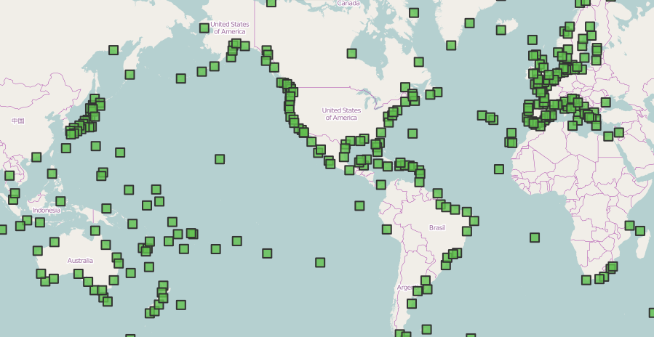

A Cohesive Method for Accessing Data from GPS Networks
github.com/gragas/gpsbro | airglow.ece.illinois.edu
Thomas Fischer, Alan Yang, Matthew Grawe
GPS Networks
UNAVCO
GeoNet
SONEL
UNAVCO image courtesy of NASA and unavco.org
GeoNet image courtesy of geonet.org.nz
SONEL image courtesy of sonel.org
GPSBro
Scientists
Overview
Masking
There are many GPS networks that hold data valuable to researchers. GPSBro is a software package that aims to make data collection from multiple networks easier.
An optional argument allows users to retrieve only certain types of data.
from gpsbro.unavco import MET, NAV, OBS
mask = MET | NAV | OBS
date = datetime.date(2015, 10, 12)
URLs = gpsbro.unavco.get_URLs_on(date, mask)
# URLs contains only meteorological,
# navigational, and observational URLs
mask = OBS | MET
URLs = gpsbro.unavco.get_URLs_on(date, mask)
# now URLs contains only observational and meteorological URLs
Examples
Retrieve URLs of RINEX data on the UNAVCO network:
date = datetime(2015, 10, 12)
URLs = gpsbro.unavco.get_URLs_on(date)
Retrieve URLs from a different network:
date = datetime(2015, 10, 12)
URLs = gpsbro.geonet.get_URLs_on(date)
Retrieve URLs in a range of dates:
Other Features
start_date = datetime(2014, 1, 1)
end_date = datetime(2014, 12, 31)
URLs = gpsbro.unavco.get_URLs_within(
start_date, end_date
)
Additional features would significantly reduce the amount of data needed to be downloaded in order to conduct research.
Usage
Random Sampling
Latitude/Longitude Bounding
More Networks
GPSBro is currently being used by the airglow group at Illinois to do a study on the noise distribution of filtered total electron content.
Random sampling and bounding have been partially implemented.
PURE Research Symposium
Department of Electrical and Computer Engineering
University of Illinois at Urbana-Champaign

