Slide 1
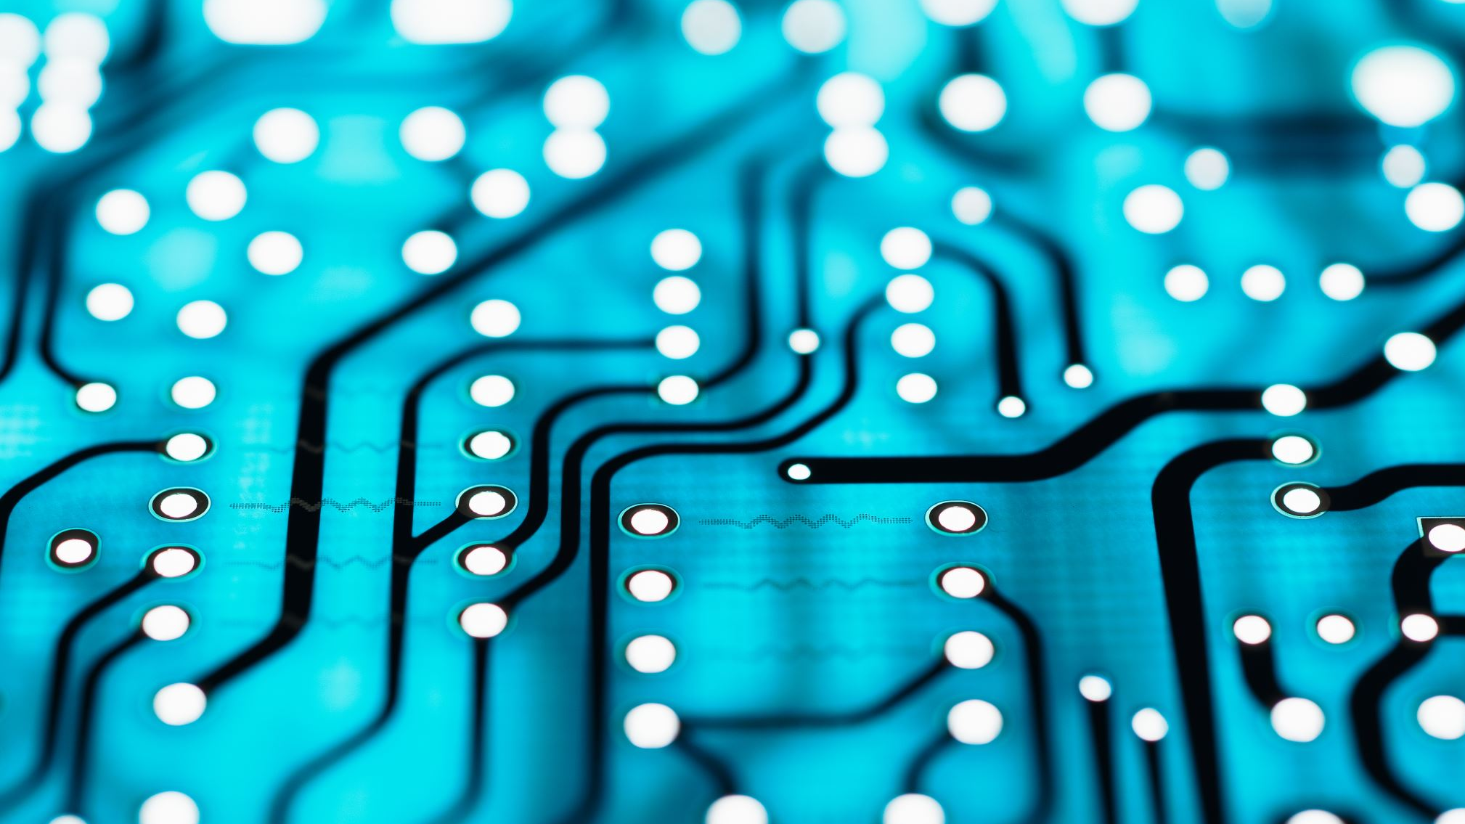


Distributed Quantum Error Mitigation Global and Local ZNE encodings
Maria Gragera Garces
Quantum Software Lab, University of Edinburgh
m.gragera.garces@ed.ac.uk
INFOCOM QuNAP 2026

Slide 2
Context

Slide 3
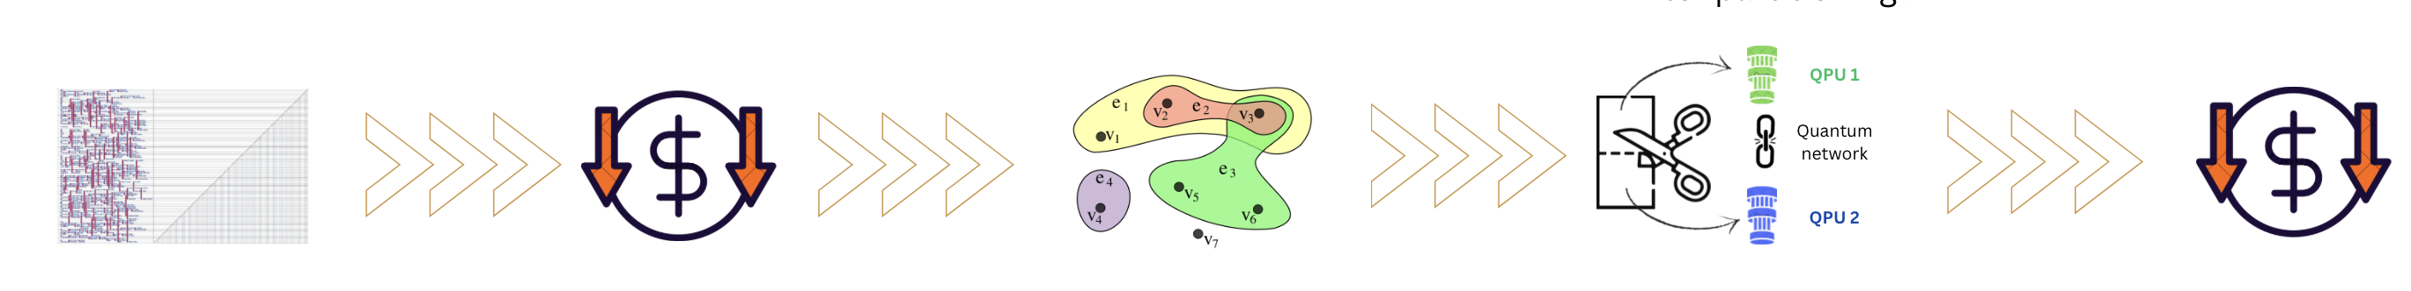
Distributed Quantum Computing (DQC)
Multiple quantum computers interconnected* to perform a joint computation larger than their individual capacities.
Large computation
Abstraction
Partition & Assignment
To QPUs in the network
*via a quantum network

Slide 4
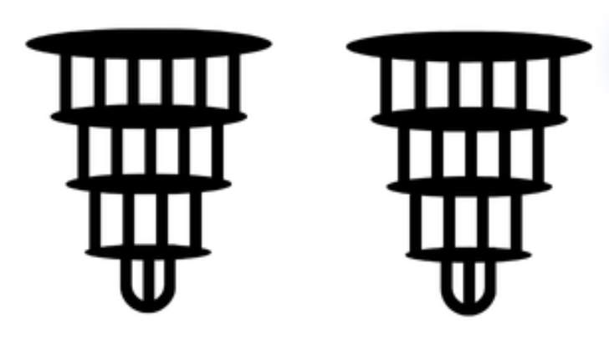
The noise problem
Quantum computation is fundamentally limited by noise. In a distributed setting, this challenge compounds.
More QPUs → more communication → more noise.
QPU noise
Network noise
QPU noise

Slide 5
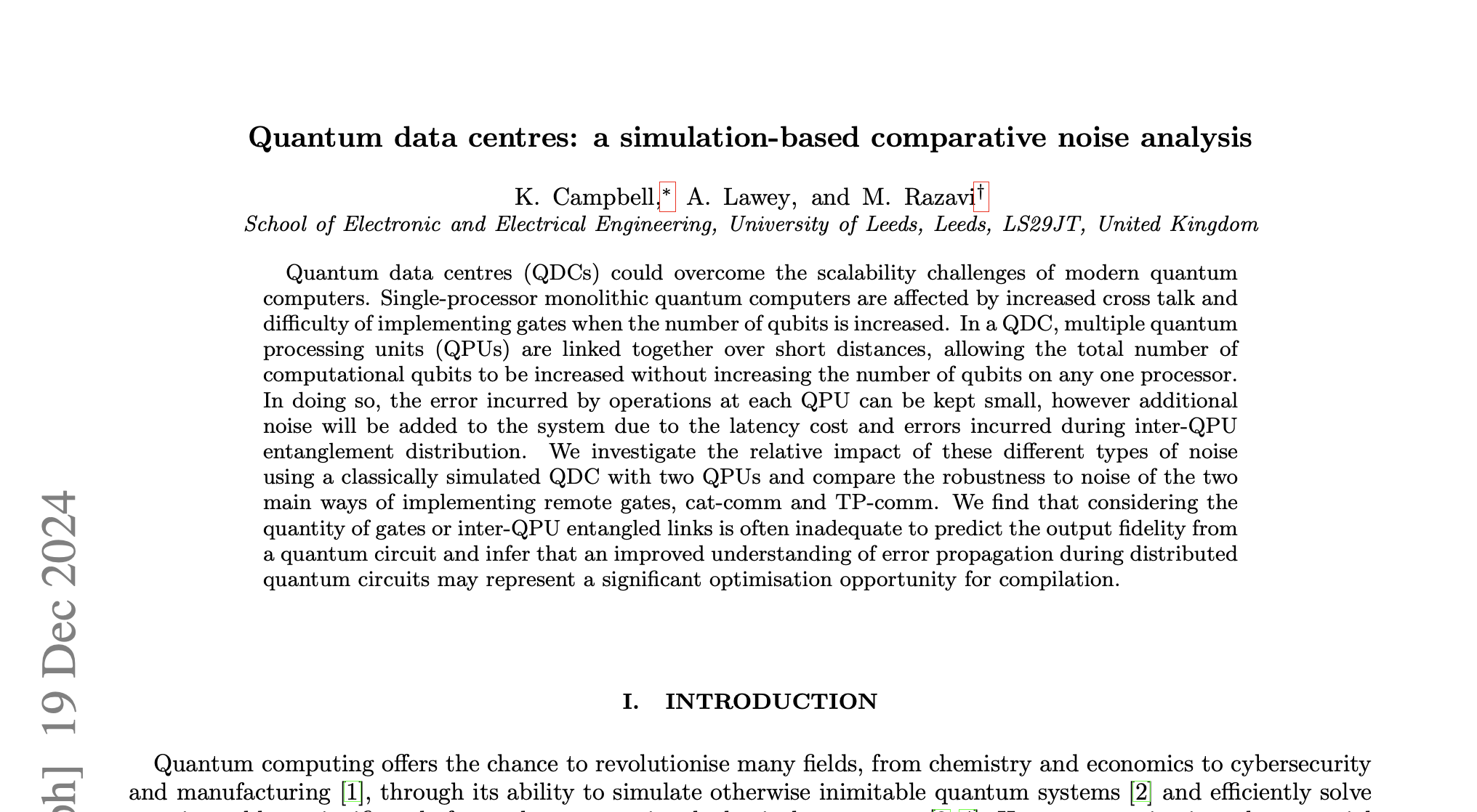
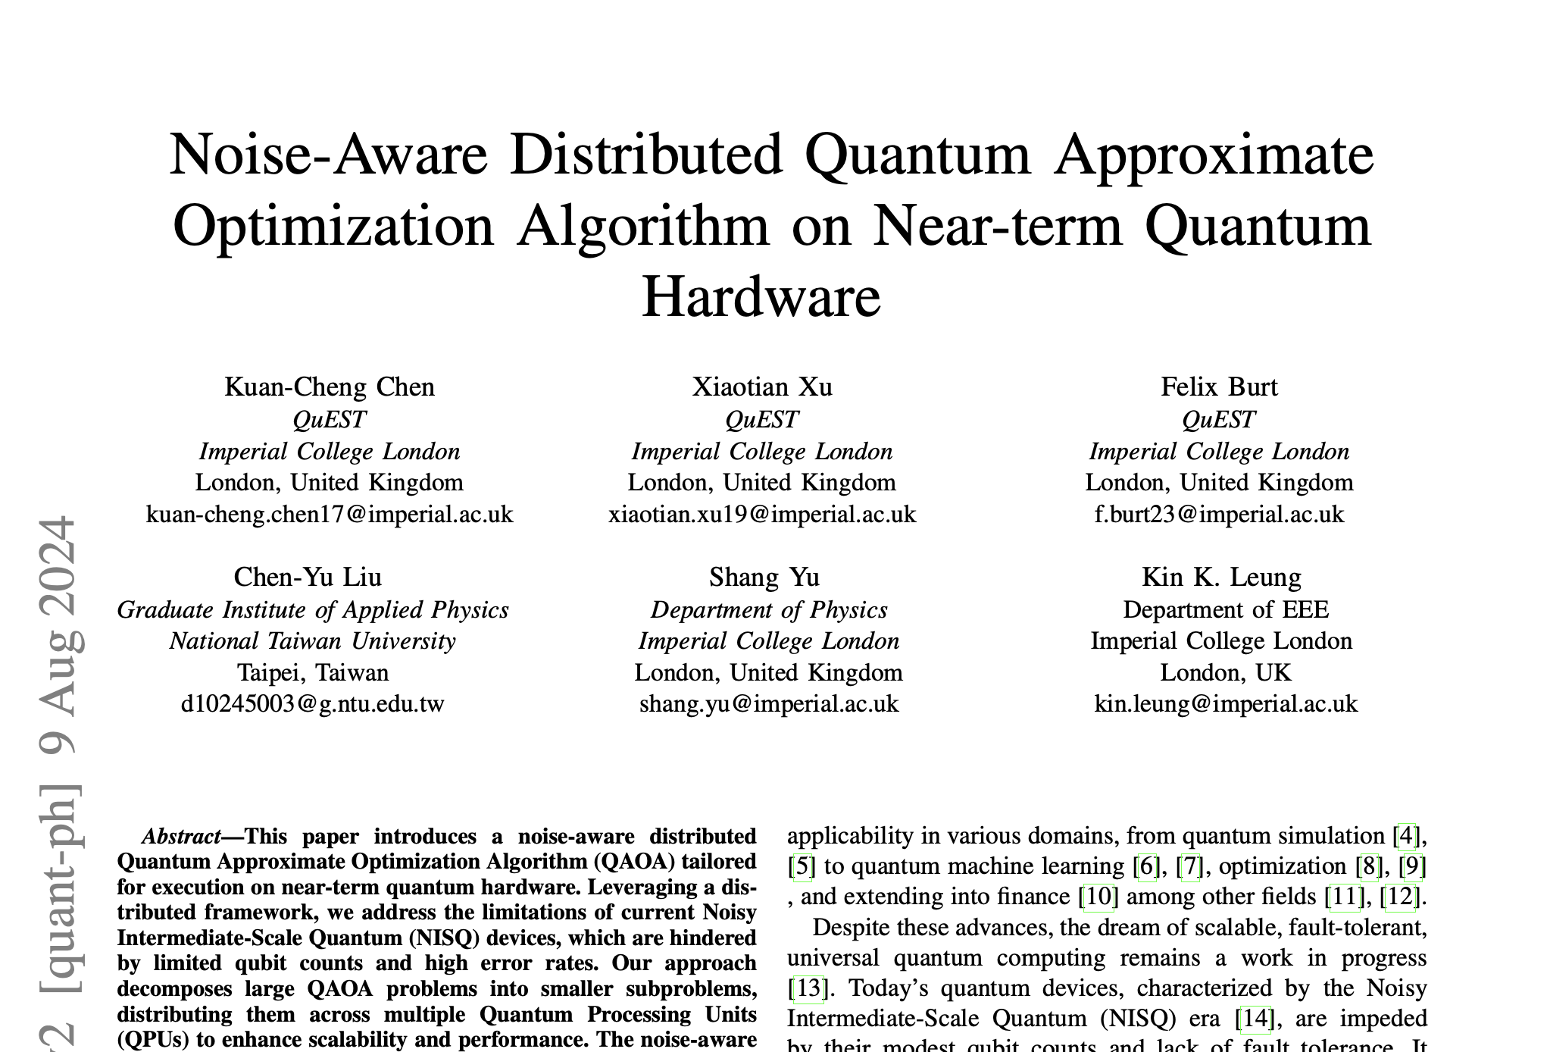
DQC & Noise: A Gap in the Literature
Field observation
Noise characterisation in distributed settings is sparse and nascent

Slide 6
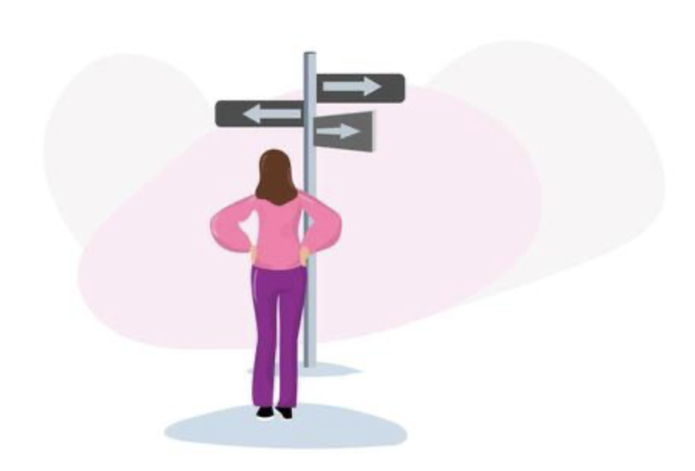
DQC & Noise: A Gap in the Literature
Field observation
Noise characterisation in distributed settings is sparse and nascent
Many error correction techniques have not yet been adapted to the distributed regime
Notes:
make bullet points appear as they come
paragraph above goes
make the bullet points shorter
ex. EC not yet adapter to DQC
we require cross-community collab
colour -> pop out what is important

Slide 7
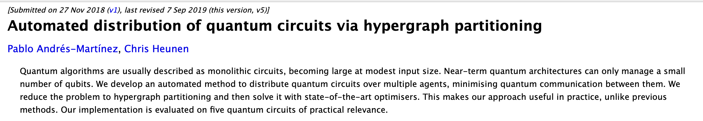
DQC & Noise: A Gap in the Literature
Field observation
Noise characterisation in distributed settings is sparse and nascent
Error correction techniques have not yet been adapted to the distributed regime
DQC itself is an emerging field, lacking the maturity of standalone quantum computing

Slide 8
DQC & Noise: A Gap in the Literature
Field observation
Noise characterisation in distributed settings is sparse and nascent
Error correction techniques have not yet been adapted to the distributed regime
DQC itself is an emerging field, lacking the maturity of standalone quantum computing
Progress requires cross-community collaboration between the error correction and networking communities (two groups with distinct toolkits and vocabularies)

Slide 9
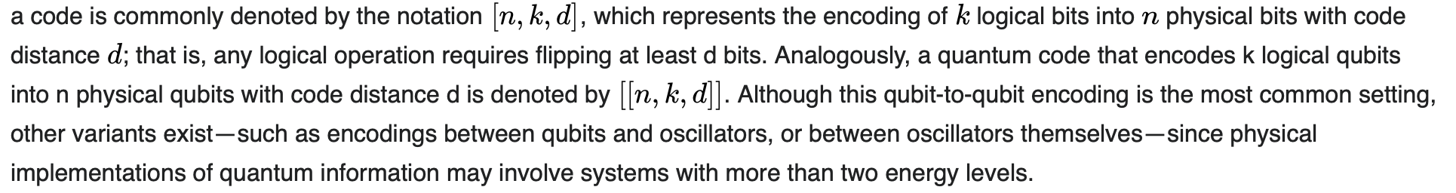
Distributed Quantum Error Mitigation Global and Local ZNE encodings
Taken from wikipedia.org/wiki/Quantum_error_correction
Maria Gragera Garces
Quantum Software Lab, University of Edinburgh

Slide 10
There is an alternative: Error mitigation
Cheaper
More implementable and arguably more advanced (in terms of what we can actually do with it)
A parallel* field to quantum error correction.
It does not ensure fault tolerance, but it enables noise reductions.
*hybrid mitigation-correction solutions are seriously considered:
Quantum Error Correction on Error-Mitigated Physical Qubits" (arxiv.org/abs/2601.18384, 2026)

Slide 11
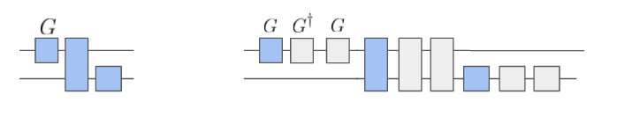

Zero Noise Extrapolation (ZNE)
A particular error mitigation strategy that is well studied and the object of this study is Zero Noise Extrapolation.
$$G⟼GG^{†}G$$
STEP 1
Intentionally scale noise
Image taken from mitiq.readthedocs. It depics a local folding (the strategy used in this work to implement unitary folding)
Expectation value
STEP 2
Extrapolate to the noiseless limit
Noise amplified values
Mitigated value
Un-mitigated value
Exact value
Noise amplification factor

Slide 12
Global vs Local encodings: a wider question
Where should error management techniques (such as circuit optimization, error mitigation or error correction) be implemented in the DQC pipeline?
Before partitioning?
After partitioning?
Global encoding
Local encoding
Optimisation/correction is performed on the entire computation prior to distribution.
Optimisation/correction is performed on the sub-computations post distribution.
Distributed Quantum Error Mitigation | Maria Gragera Garces

Slide 13
The experiment

Slide 14
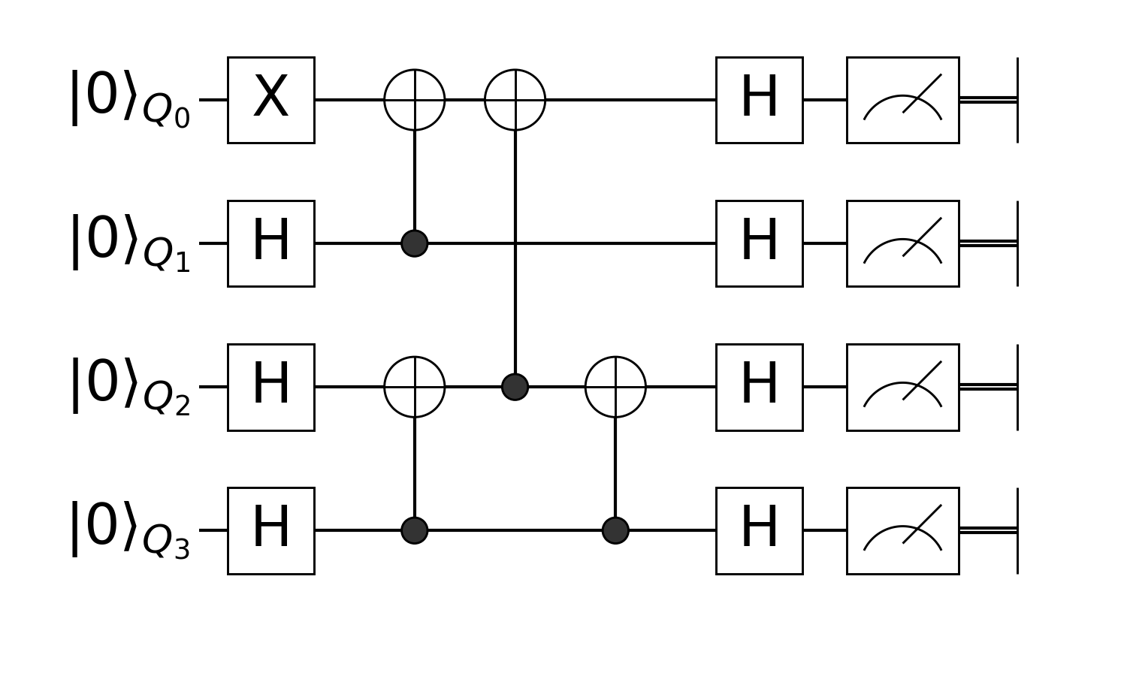
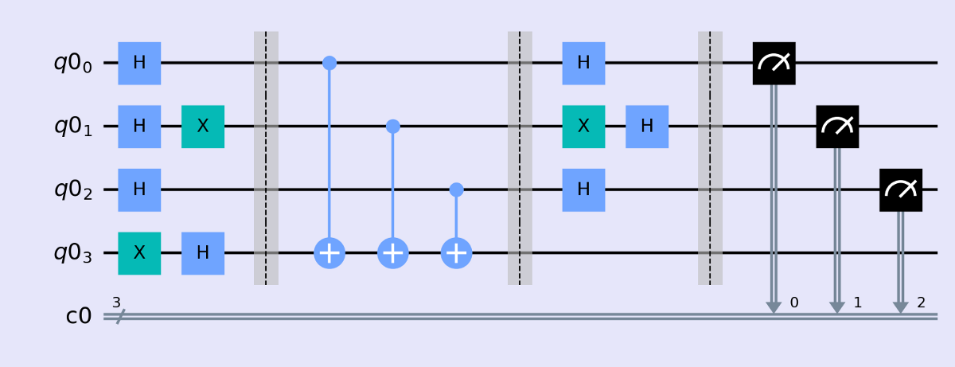
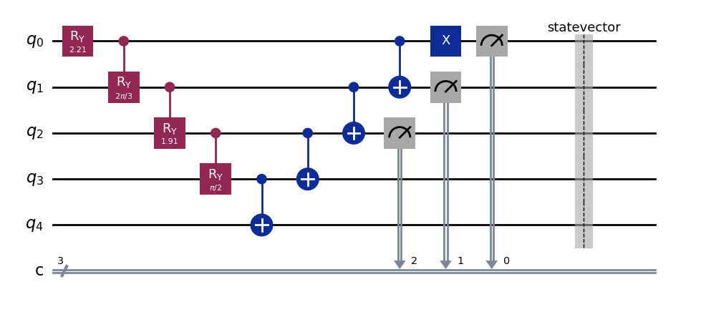
Experimental setup
3 Algorithms
Greenberger-Horne-Zeilinger (GHZ) state preparation
Deutsch-Jozsa (DJ)
W state preparation
GHZ
DJ
W prep

Slide 15
Experimental setup
3 Algorithms
Custom noise
Greenberger-Horne-Zeilinger (GHZ) state preparation
Deutsch-Jozsa (DJ)
W state preparation
Depolarizing noise with:
device noise ranging from 0.001% to 0.02%
Network noise being equal, or having an additional 10% and 20% error rate w.r.t device noise
1% -> 1/100 gates is faulty
(1/3) chance each of having a Pauli (X), (Y), or (Z) error applied)

Slide 16
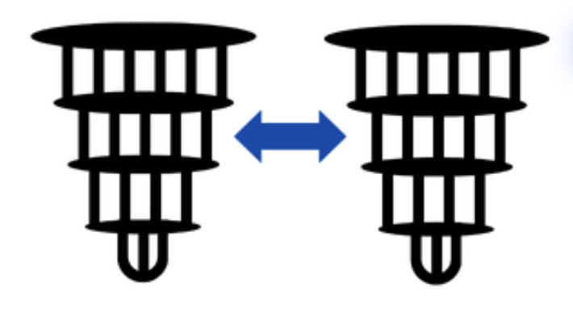
Experimental setup
3 Algorithms
Custom noise
2-6 partitions
Greenberger-Horne-Zeilinger (GHZ) state preparation
Deutsch-Jozsa (DJ)
W state preparation
Depolarizing noise with:
device noise ranging from 0.001% to 0.02%
Network noise being equal, or having an additional 10% and 20% error rate w.r.t device noise
…

Slide 17


Experimental setup
3 Algorithms
Custom noise
2-6 partitions
Standard Software
Greenberger-Horne-Zeilinger (GHZ) state preparation
Deutsch-Jozsa (DJ)
W state preparation
Depolarizing noise with:
device noise ranging from 0.001% to 0.02%
Network noise being equal, or having an additional 10% and 20% error rate w.r.t device noise
Qiskit Aer simulator
Mitiq
…

Slide 18
How we tested it

Slide 19
Evaluation metrics
ZNE error: Difference between measured and ideal expectation values.
Expected result
vs
Obtained with EM

Slide 20
Evaluation metrics
ZNE error: Difference between measured and ideal expectation values.
Error reduction: Fractional improvement in expectation value error when ZNE is applied
Expected result vs Obtained with EM
Given noise level

Slide 21
Evaluation metrics
ZNE error: Difference between measured and ideal expectation values.
Error reduction: Fractional improvement in expectation value error when ZNE is applied
Depth overhead: Ratio of the amplified circuit depth to the original circuit depth.
New circuit size

Slide 22
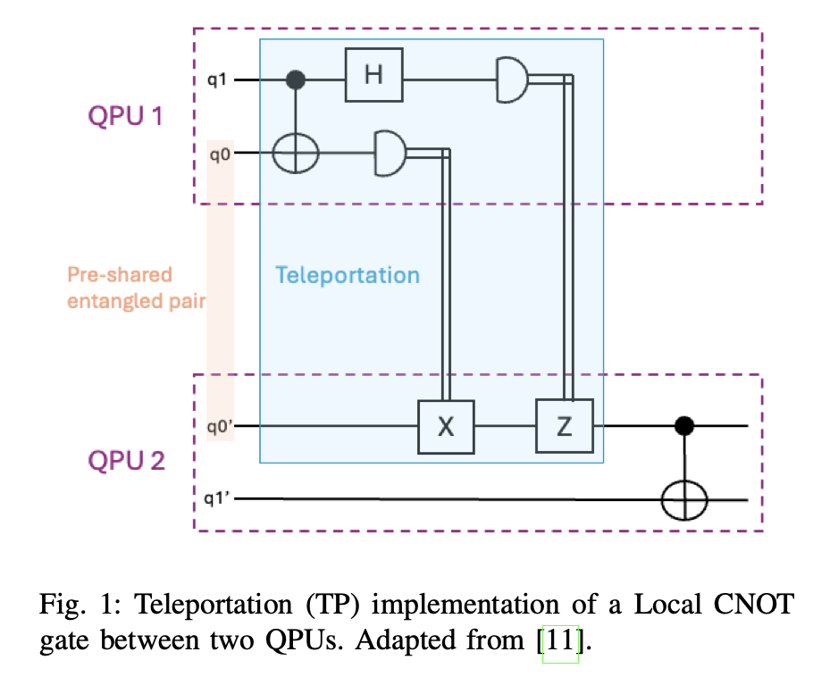

Performed partitioning
Computation -> Graph -> Greedy partitioning strategy -> Distributed Circuit
Greedy partitioning strategy:
Greedy cluster identification (dense inter-qubit connectivity)
Iterative cluster merging/splitting to match target partition
Partition assignments (network is fully interconnected)
Cross-partition operations: non-local multi-qubit gates

Slide 23
Findings

Slide 24
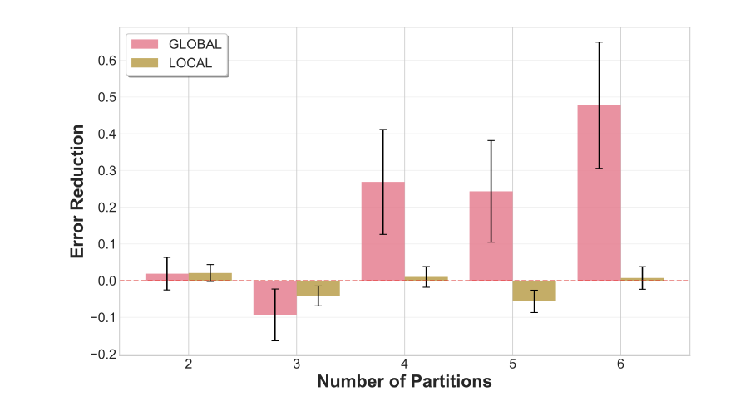
Global ZNE is the more effective and scalable strategy.

Slide 25
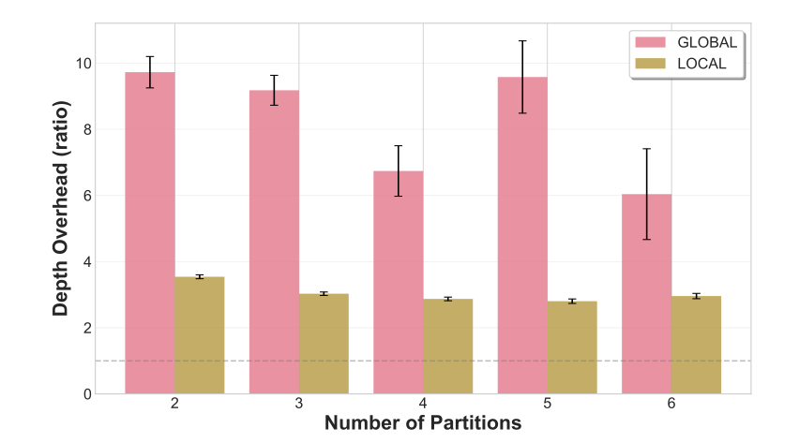
Global ZNE's performance advantage comes at a significant computational cost.

Slide 26
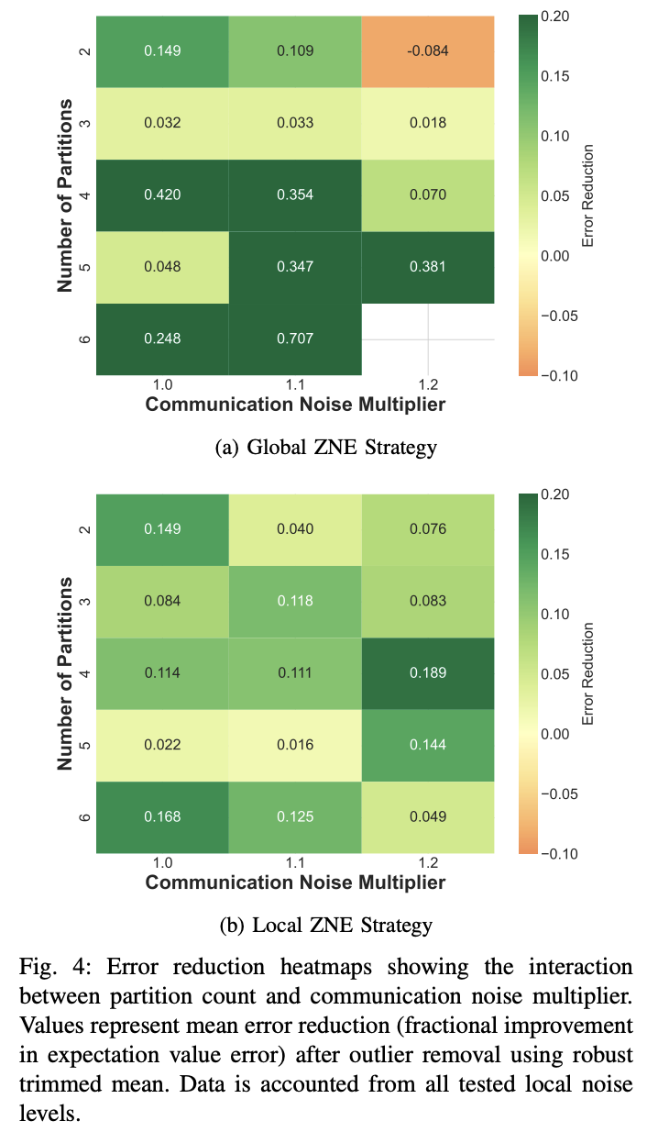
More QPUs can improve (not harm) mitigation effectiveness.

Slide 27
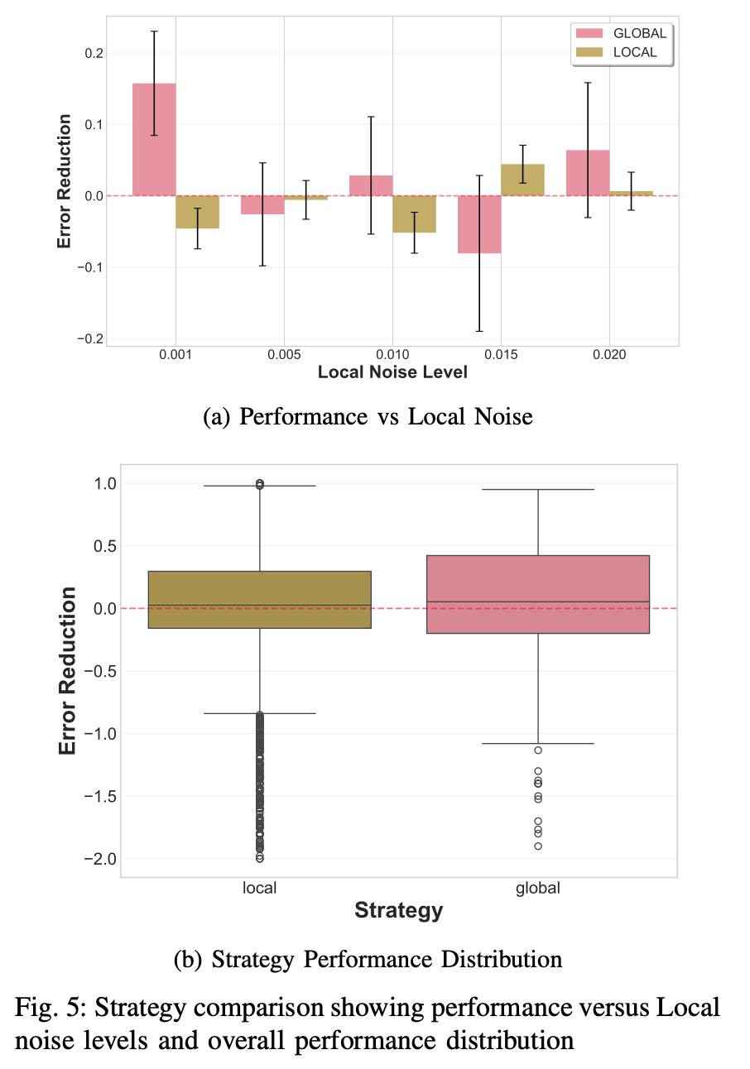
Global ZNE offers higher reward but less predictable behaviour; Local ZNE is “safer” but offers more modest gains.

Slide 28
Limitations

Slide 29
Limitations of results and research
Simulator fidelity: limitations of depolarizing noise models

Slide 30
Limitations of results and research
Simulator fidelity: limitations of depolarizing noise models
Algorithm coverage: 3 algorithms tested

Slide 31
Limitations of results and research
Simulator fidelity: limitations of depolarizing noise models
Algorithm coverage: 3 algorithms tested
Network realism: assumed full inter-connection (no multi-hop)

Slide 32
Limitations of results and research
Simulator fidelity: limitations of depolarizing noise models
Algorithm coverage: 3 algorithms tested
Network realism: assumed full inter-connection (no multi-hop)
Mitigation technique scope: one version of ZNE was tested, further exploration on ZNE variants + other EM methods

Slide 33
Conclusions

Slide 34
Global vs Local for Distributed ZNE
Global encodings seem to better capture error correlations across the entire computation leading to increased performance.
Nonetheless Local encodings do not significantly underperform and could be considered as a more stable and QPU aware alternative.
Global encodings are more effective,
but Local encodings show promise.

Slide 35
The Overhead-Resilience Trade-off
Global ZNE's 6–10× depth inflation risks negating the size-reduction benefits of distribution*.
However, at high partition counts, per-device depth approaches the original circuit depth.
The overhead cost diminishes at scale.
Reminder
*Multiple quantum computers interconnected to perform a joint computation larger than their individual capacities.
Notes:
pink = title
no reminder
scale - graphic
more depth = more noise
more partition = less depth

Slide 36
Challenging the expected noise hierarchy
More partitions and higher communication noise do not consistently degrade Global ZNE performance.
Noise in DQC does not behave monotonically.
Notes:
same previous

Slide 37
Thank you! Any Questions?
Takeaways
Global encodings are more effective, but Local encodings show promise.
The overhead cost diminishes at scale.
Noise in DQC does not behave monotonically.

