Slide 1
Instrumental Variables in action
Two Examples

Slide 2
Swanz Ganz Cathether
Swan-Ganz catheter, which is a device used by intensive care unit (ICU) doctors to guide therapy
A Swan-Ganz catheter is a long slender tube outfitted with sensors designed to measure hemodynamic pressures in the right side of the heart and in the pulmonary artery.

Slide 3
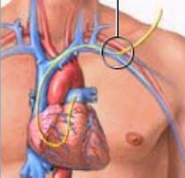
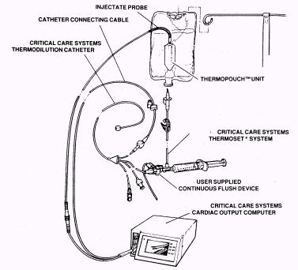
Swan Ganz Catheter
Under sterile conditions, an ICU doctor will typically insert the catheter into the left subclavian vein (underneath the clavicle)

Slide 4
Swan-Ganz catheter
A Swan-Ganz catheter is primarily used to measure pressure at different locations in the right side of the heart.
These pressure measurements can provide important diagnostic information, such as whether the patient’s heart valves are working, or whether the patient has pulmonary hypertension.
Information gleaned from Swan-Ganz measurements is often used by ICU doctors to make decisions about treatment, such as whether to give the patient medications that affect the functioning of the heart.

Slide 5
The procedure is done to evaluate how the blood moves (circulates) in people who have:
Abnormal pressures in the heart arteries
Burns
Congenital heart disease
Heart failure
Kidney disease
Leaky heart valves (valvular regurgitation)
Shock

Slide 6
Swan-Ganz catheterization can also be used to detect abnormal blood flow between two areas of the heart that are not normally connected.
Conditions that can also be diagnosed or evaluated with Swan-Ganz catheterization include:
Cardiac tamponade
Pulmonary hypertension
Restrictive cardiomyopathy

Slide 7
It may also be done to monitor for complications of heart attack and to see how well certain heart medicines are working.

Slide 8
Swan-Ganz Catheter & Econometrics
Connors et al. (1996), which examines the impact of Swan-Ganz catheterization on mortality outcomes among a population of patients admitted to the intensive care unit (ICU) at five prominent hospitals.
Connors et al. (1996) reach the controversial conclusion that patients who receive Swan-Ganz catheterization during their first day in the ICU are 1.27 times more likely to die within 180 days of their admission.

Slide 9
Before Connors et al. (1996), Gore et al. (1985) and Zion et al. (1990) also found found that catheterization increases mortality. Dalen (2001) criticized both studies because they did not control for clinically important differences between the patients who had catheters placed and those who did not.
The Connors et al. (1996) study was conceived in part as a response to this criticism.

Slide 10
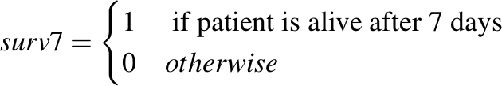
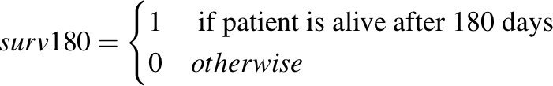
Dataset
The “outcome” variables are:
surv7
surv30
surv60
surv90
surv120
surv150
surv180

Slide 11
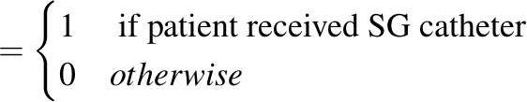
Dataset
The main regressor is
swang

Slide 12
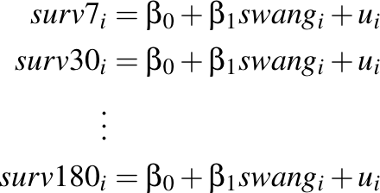
A first “stunning” regression
We run the following regressions:
What is the interpretation of in each model?

Slide 13
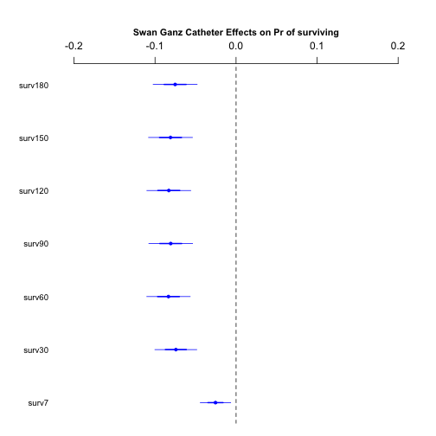
Estimated Effects of Catheterization

Slide 14
Results
Our simple analysis seems to confirm the results of the first generation studies
Catheterization increases the probability of death by 5%-8%, depending on the time span.
Catheterization also increases the probability of death at 7 days from admission...
There are however potential problems

Slide 15
Concerns
There is big concern:
Omitted variables………

Slide 16
Omitted Variable
Catheterization may depend on other personal characteristic that affect both catheterization decision and outcome
Sicker patients are probably catheterized more frequently than relatively healtier patients

Slide 17
Adding Regressors
We have a wealth of information about the patients:
Personal characteristic
age, sex, education, race, education, income, etc.
Categories of admission diagnosis
respiratory, cardiovascular, neurological, gastrointestinal, renal, metabolic, hematologic, etc.
Categories of comorbidities illness:
hearth failure, depression, cirrhosis, tumor, HIV, etc.
Other information
estimate of the prob. of surviving 2 months

Slide 18
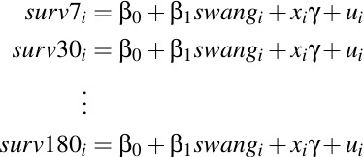
New Model
We estimate:

Slide 19
Additional Problem
Recall that the outcome variables are binary
surv7 is either 1 (patient is alive after 7 days) or 0
The linear probability model could not be appropriate
We should use Probit and Logit to verify the robustness of the results
In this case we have to be careful in interpreting the results…

Slide 20
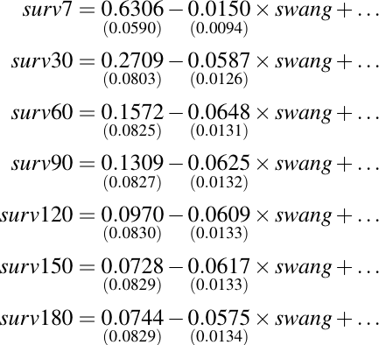
“Full” Linear Probability Model

Slide 21
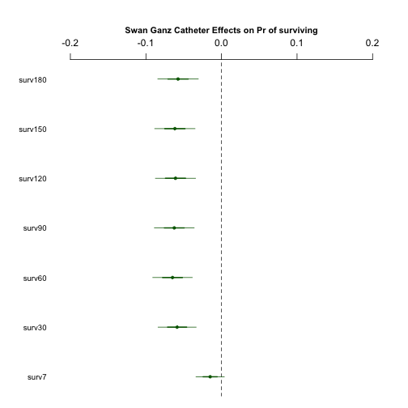
Comparison of the results
No controls
With controls

Slide 22
Comments
When we add controls the effects tend to become smaller in magnitude, but they are still negative
Except for surv7, they are still statistically different from 0
The effect of catheterization ranges from 5 to 6 percentage points

Slide 23
The unconditional probability of dying within 180 days from admission in ICU is
50.67%
With a Swang-Ganz catheter
56.42%
56.42/ 50.67 = 1.11 more likely to die

Slide 24
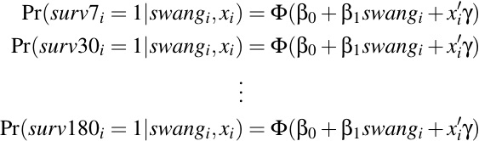
Probit and Logit
We estimate now the following model:
The interpretation of the coefficient is different..

Slide 25
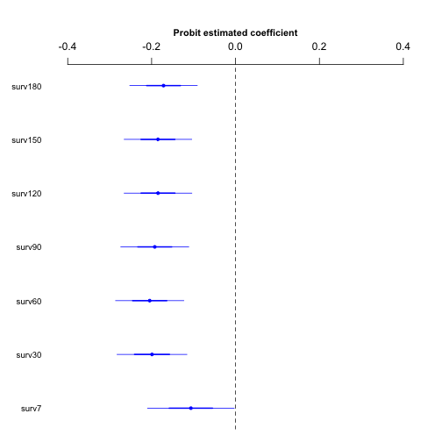
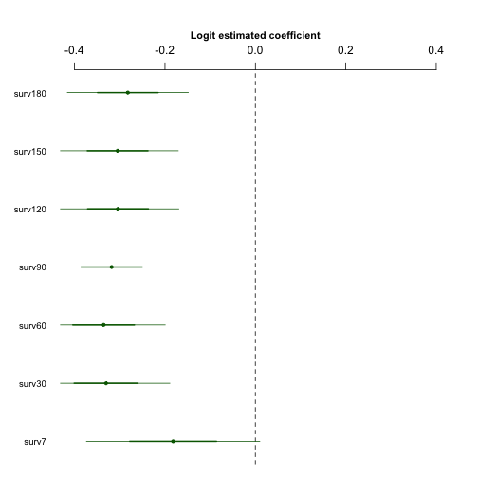
Probit/Logit Estimated Coefficients
Probit
Logit

Slide 26



Probit/Logit Effects
Probit - Effects
Logit - Effects
Estimate
Estimate
where

Slide 27
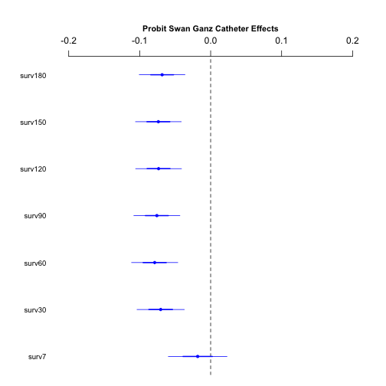
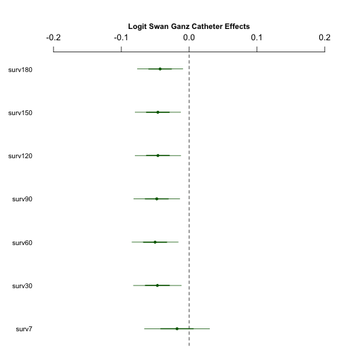
Probit/Logit Estimated Effects
Probit - Effects
Logit - Effects

Slide 28
Comments
Using Probit and Logit instead of the Linear
Probability model does not change the message:
Catheterization has a negative effect on the probability of surviving
The Probit effects are very close to the LPM effects
The Logit effects are somewhat smaller, yet still significantly different from 0

Slide 29
Unobserved Omitted Variable
A threat to the internal validity of the study is the possibility that doctors do have information on health status of the patient
This information may not be contained in the dataset
If it is so, there is an ‘unobserved’ omitted variable that might render the interpretation of the effects as casual invalid

Slide 30
Instrument
We could potentially solve the “endogeneity” caused by the unobserved omitted variable using instrumental variable technique.
How do we find a valid instrument for this study?
Think, think….

Slide 31
Two conditions for a valid instrument
For an instrumental variable (an “instrument”) Z to be valid, it must satisfy two conditions:
Instrument relevance
Instrument exogeneity

Slide 32
Instrumental Variable
An instrument is a random variable Z
E[Z’u]=0 (exogenous)
It enters the first stage regression (relevance)
.
endogenous
exogenouss
First Stage or Reduced Form
endogenous
exogenouss

Slide 33
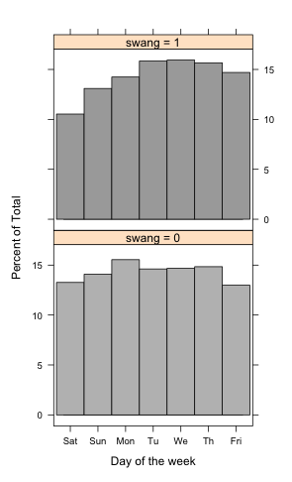
There are more catheterization on weekdays:
Tuesday, Wednesday, Thuersday, Friday

Slide 34

Instrument
We consider the following instrument
.
Two questions:
Is it exogenous?
Is it relevant?

Slide 35
Exogeneity of day of the week
Exogeneity means that the day of the week is uncorrelated with the unobserved health
There is not a priori reason to believe that the day of the week is correlated with unobserved health conditions
We cannot test this assumption since the model is exactly identified.

Slide 36
Relevance
The instrument must be correlated (in the first stage sense) with swang
The idea is that
On weekends there are fewer ICU doctors on the premises and the probability of being catheterized is much lower;
There is evidence that staffing affects treatment decisions

Slide 37



Testing relevance
First Stage
Testing
Simple regression:
First Stage
t-test:
Statistically ≠ 0 at 5%

Slide 38

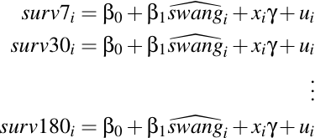
TSLS
Predict swang
Second Stage(s)

Slide 39
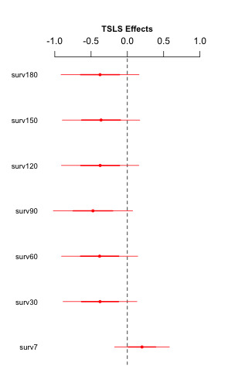
TSLS Results

Slide 40
Comments
TSLS:
The effects are estimated to be much (implausibly) larger
Catheterization seems to reduce mortality at shorter time horizon (7 days)
These effects are all statistically insignificant (not different from 0)

Slide 41
Caveats
The first stage involves a binary variables
The predictions
Can be outside the [0,1]
There are way to fix this problem by using a “probit instrumental variable” method.
Weak instruments…..

Slide 42
Weak instruments
The rule-of-thumb says that we should worry if the Wald-stat >10
What is the Wald-stat in our first stage?
Hint 1: there is only one endogenous regressor
Hint 2: for testing only one coefficient the Wald-test is numerically equivalent to ….

Slide 43
Effect of Education on Wages
The objective is to estimate the “causal” effect of education on individual wages
Very difficult to do with OLS because of omitted ability
This is usually addressed by Instrumental Variables techniques

Slide 44
Data
D. Card (1995), "Using Geographic Variation in College Proximity to Estimate the Return to Schooling," in Aspects of Labour Market Behavior: Essays in Honour of John Vanderkamp. Ed. L.N. Christophides, E.K. Grant, and R. Swidinsky, 201-222. Toronto: University of Toronto Press.

Slide 45
Data
Sample of 3009 workers from
National Longitudinal Survey
http://www.bls.gov/nls/
Variables:
Hourly wage (lwage), age (age), race (black),
experience (exper), geographic information (smsa),
family background (fatheduc, motheduc),
standardized test scores (IQ, KWWW).

Slide 46
Data
MSA – Metropolitan Statistical Area
In the United States, a metropolitan area refers to a geographical region with a relatively high population density at its core and close economic ties throughout the area.
KWW – Knowledge of the World of Work
A direct measure of “ability”
IQ
Measure of intelligence.

Slide 47
Omitted Variable Bias
log(wage) = β₀ + β₁ educ + u
“Ability Bias”
Suppose that some individuals have an an unobserved characteristic (“ability”) that enables them to earn higher wages at any level of education. If these individuals acquire higher than average schooling then the OLS estimate of β₁ will be upward-biased

Slide 48
Basic regression
> summary_rob(lm(lwage~educ, data=cd))
Dependent varaible: lwage
Coefficients:
Estimate Std. Error t value Pr(>|t|)
(Intercept) 5.57088 0.03914 142.4 <2e-16
educ 0.05209 0.00291 17.9 <2e-16
---
Heteroskadasticity robust standard errors used
Residual standard error: 0.4214 on 3008 degrees of freedom
Multiple R-squared: 0.09874, Adjusted R-squared: 0.09844
Wald-statistic: 320.5 on 1 and Inf DF, p-value: < 2.2e-16
Return to education are estimated at 5.2%

Slide 49
Regression with controls
Dependent varaible: lwage
Coefficients:
Estimate Std. Error t value Pr(>|t|)
(Intercept) 4.6252589 0.0833168 55.514 < 2e-16
educ 0.0733229 0.0045343 16.171 < 2e-16
black -0.1614265 0.0244866 -6.592 5.39e-11
south -0.1104188 0.0177876 -6.208 6.40e-10
smsa 0.1621471 0.0180048 9.006 < 2e-16
exper 0.0885766 0.0080561 10.995 < 2e-16
expersq -0.0023789 0.0003999 -5.949 3.13e-09
fatheduc -0.0007076 0.0031278 -0.226 0.821
motheduc 0.0078193 0.0037065 2.110 0.035
---
Heteroskadasticity robust standard errors used
Residual standard error: 0.3773 on 2211 degrees of freedom
(790 observations deleted due to missingness)
Multiple R-squared: 0.2663, Adjusted R-squared: 0.2636
Wald-statistic: 836.8 on 8 and Inf DF, p-value: < 2.2e-16
Return to education ≈ 7.3%

Slide 50
Ability
> summary_rob(lm(lwage~educ+black+south+smsa+exper+expersq+fatheduc+motheduc+IQ+KWW,data=cd))
Dependent varaible: lwage
Coefficients:
Estimate Std. Error t value Pr(>|t|)
(Intercept) 4.4909962 0.1266845 35.450 < 2e-16
educ 0.0628479 0.0066013 9.521 < 2e-16
black -0.0963360 0.0364614 -2.642 0.008319
south -0.0784613 0.0209866 -3.739 0.000192
smsa 0.1473359 0.0213596 6.898 7.59e-12
exper 0.0903101 0.0110791 8.151 7.21e-16
expersq -0.0026815 0.0005713 -4.693 2.92e-06
fatheduc -0.0046165 0.0037345 -1.236 0.216571
motheduc 0.0079514 0.0044815 1.774 0.076211
IQ 0.0018442 0.0008612 2.142 0.032384
KWW 0.0039044 0.0016718 2.335 0.019648
---
Heteroskadasticity robust standard errors used
Residual standard error: 0.3723 on 1593 degrees of freedom
(1406 observations deleted due to missingness)
Multiple R-squared: 0.2162, Adjusted R-squared: 0.2113
Wald-statistic: 472.1 on 10 and Inf DF, p-value: < 2.2e-16
Return to education ≈ 6.28%

Slide 51
Retrun to education
Returns to education are approximately 6%
Confidence interval is
[0.050, 0.076]

Slide 52
Instruments
nearc2 and nearc4 are indicator denoting whether the individual lives close to a 2 years and a 4 years college
Are nearc2 and nearc4 valid instruments?
Relevance
Exogeneity

Slide 53
Relevance – First Stage Regressions
> summary_rob(lm(educ~nearc2+nearc4+black+south+smsa+exper+expersq+fatheduc+motheduc+IQ+KWW, data=cd))
Dependent varaible: educ
Coefficients:
Estimate Std. Error t value Pr(>|t|)
(Intercept) 9.886683 0.429152 23.038 < 2e-16
nearc2 -0.007681 0.077462 -0.099 0.921020
nearc4 0.231521 0.087863 2.635 0.008495
black 0.681182 0.140342 4.854 1.33e-06
south 0.129108 0.081699 1.580 0.114239
smsa 0.005987 0.094456 0.063 0.949470
exper -0.553602 0.037193 -14.885 < 2e-16
expersq 0.012706 0.001953 6.504 1.04e-10
fatheduc 0.053552 0.014959 3.580 0.000354
motheduc 0.049008 0.017066 2.872 0.004137
IQ 0.022029 0.003291 6.694 3.01e-11
KWW 0.112311 0.005781 19.427 < 2e-16
---
Heteroskadasticity robust standard errors used
Residual standard error: 1.48 on 1592 degrees of freedom
(1406 observations deleted due to missingness)
Multiple R-squared: 0.5762, Adjusted R-squared: 0.5733
Wald-statistic: 3277 on 11 and Inf DF, p-value: < 2.2e-16
wtest(lm1, testcoef=c("nearc2", "nearc4"))
Wald test
Null hypothesis:
nearc2 = 0
nearc4 = 0
q W pvalue
2 7.037288 0.0296396
The null hypothesis that nearc2 and nearc4 do not enter the first stage regression is rejected at 5%

Slide 54
TSLS
coeftest(ivreg(lwage~educ+black+south+smsa+exper+expersq+fatheduc+motheduc+IQ+KWW|
.+nearc2+nearc4-educ , data=cd), vcov.=vcovHC)
Estimate Std. Error t value Pr(>|t|)
(Intercept) 4.6448384 0.9213975 5.0411 5.157e-07 ***
educ 0.0474293 0.0916678 0.5174 0.6049458
black -0.0857098 0.0741675 -1.1556 0.2480081
south -0.0770074 0.0227986 -3.3777 0.0007485 ***
smsa 0.1484669 0.0223741 6.6357 4.415e-11 ***
exper 0.0817947 0.0519974 1.5731 0.1159051
expersq -0.0024872 0.0013017 -1.9107 0.0562248 .
fatheduc -0.0037760 0.0062892 -0.6004 0.5483230
motheduc 0.0086968 0.0063199 1.3761 0.1689832
IQ 0.0021872 0.0021802 1.0032 0.3158995
KWW 0.0056362 0.0104880 0.5374 0.5910661
---

