Slide 1
Spatial Data
MSc Machine Learning & Data Science
Exploratory Data Analysis & Visualisation
Live Q&A – 12 February 2026
Niall Adams

Slide 2
Outline
MSc Machine Learning & Data Science
Exploratory Data Analysis & Visualisation
Dependence structures in time series & spatial data
Temporal autocorrelation
Spatial autocorrelation
The (semi)variogram
Guest Speaker: David Kenyon, Senior Manager, Advanced Analytics, CompareTheMarket

Slide 3
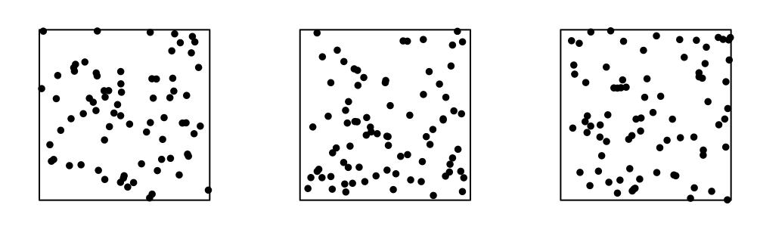
First, a question…
MSc Machine Learning & Data Science
Exploratory Data Analysis & Visualisation

Slide 4
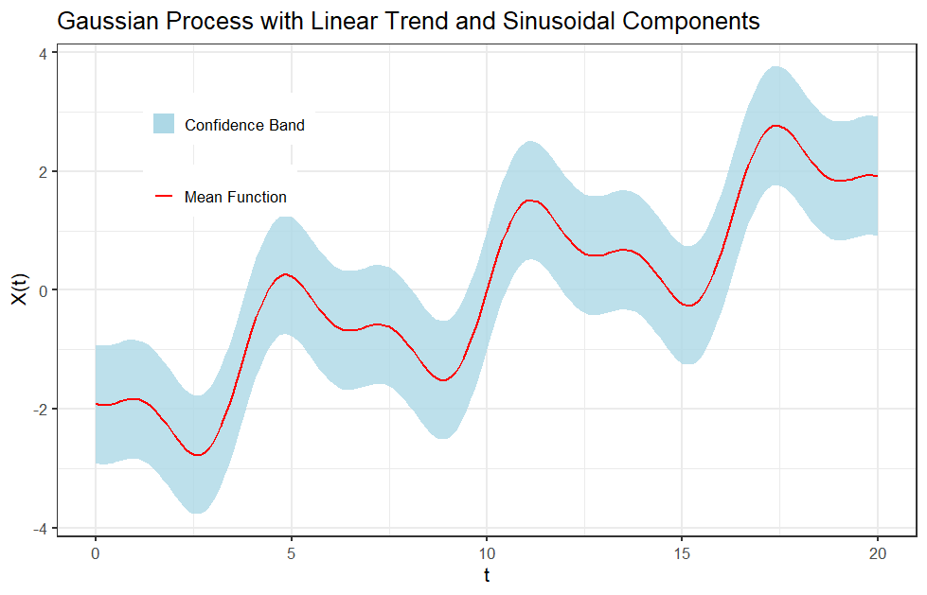

Temporal & Spatial Data – Observed Random Processes
MSc Machine Learning & Data Science
Exploratory Data Analysis & Visualisation
Time series:
$x_{1},…,x_{N}$ are observed values of ${\left\{X_{t}\right\}}_{t=1}^{N}$
Dependence: $\operatorname{Pr}\left(X_{t}\text{, }X_{t+τ}\right)≠\operatorname{Pr}\left(X_{t}\right)\operatorname{Pr}\left(X_{t+τ}\right)$

Slide 5
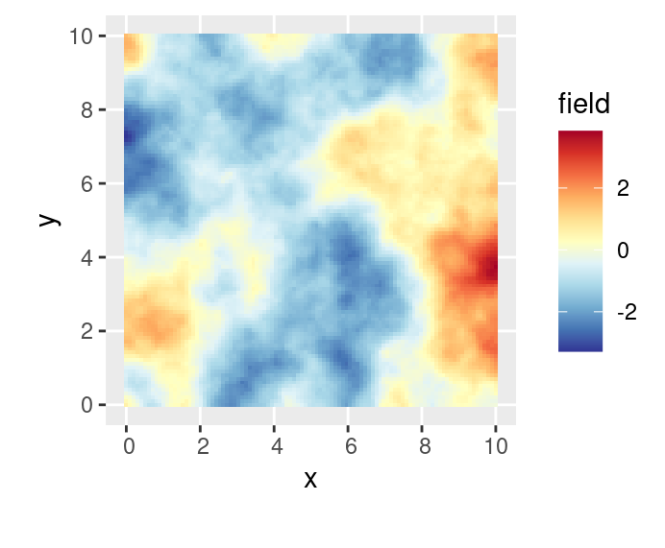


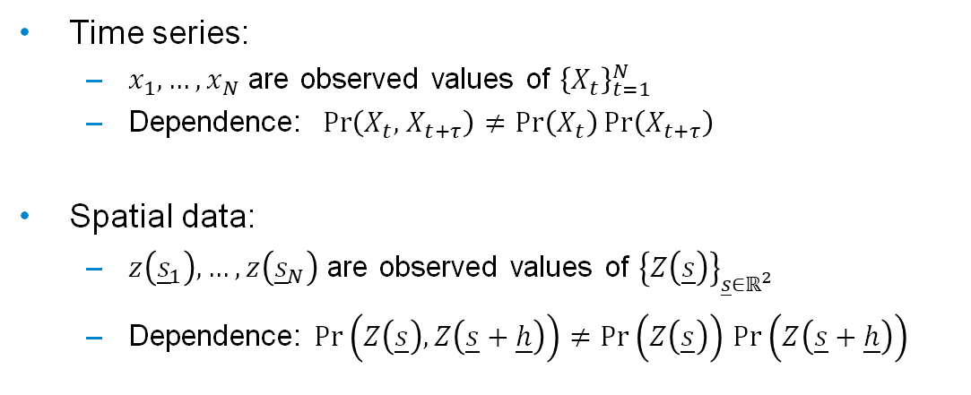
Temporal & Spatial Data – Observed Random Processes
MSc Machine Learning & Data Science
Exploratory Data Analysis & Visualisation
Time series:
$x_{1},…,x_{N}$ are observed values of ${\left\{X_{t}\right\}}_{t=1}^{N}$
Dependence: $\operatorname{Pr}\left(X_{t}\text{, }X_{t+τ}\right)≠\operatorname{Pr}\left(X_{t}\right)\operatorname{Pr}\left(X_{t+τ}\right)$
Spatial data:
$z\left({\underline{s}}_{1}\right),…,z\left({\underline{s}}_{N}\right)$ are observed values of ${\left\{Z\left(\underline{s}\right)\right\}}_{\underline{s}∈ℝ^{2}}$
Dependence: $\operatorname{Pr}\left(Z\left(\underline{s}\right),Z\left(\underline{s}+\underline{h}\right)\right)≠\operatorname{Pr}\left(Z\left(\underline{s}\right)\right)$ $\operatorname{Pr}\left(Z\left(\underline{s}+\underline{h}\right)\right)$
$$s_{2}$$
$$s_{1}$$

Slide 6
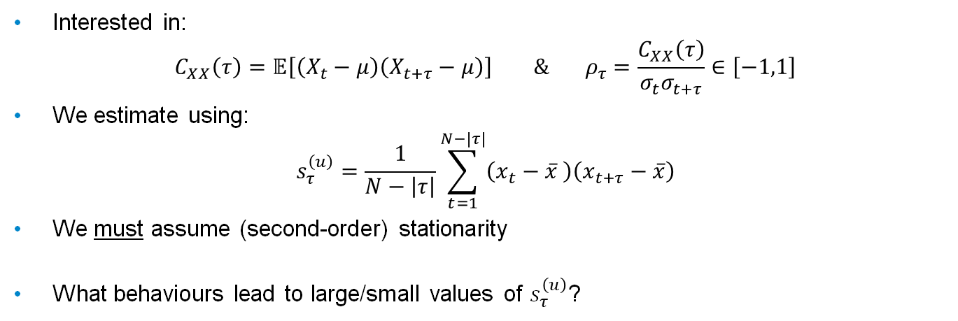
Autocovariance & Autocorrelation (Time Series)
MSc Machine Learning & Data Science
Exploratory Data Analysis & Visualisation
Interested in:
$$C_{XX}\left(τ\right)=𝔼\left[\left(X_{t}−μ\right)\left(X_{t+τ}−μ\right)\right] \& ρ_{τ}=\frac{C_{XX}\left(τ\right)}{σ_{t}σ_{t+τ}}∈\left[−1,1\right]$$
We estimate using:
$$s_{τ}^{\left(u\right)}=\frac{1}{N−\left|τ\right|}\sum_{t=1}^{N−|τ|}{\left(x_{t}−\overline{x} \right)\left(x_{t+τ}−\overline{x}\right)}$$
We must assume (second-order) stationarity
What behaviours lead to large/small values of $s_{τ}^{\left(u\right)}$?
Notes:
Again, comparing with time series….think back to the autocorrelation function. Or the standard deviation normalized version, the auto correlation
Here, we have the ACF at lag tau – an index.
We can estimate this from data; here is the unbiased sample estimate, sometimes call empirical autocovariance.
In both cases we have to assume second order stationary. Why? Well one way to see this is to examine an x-bar and mu -neither of these are indexed. They are constant overtime. This is one of the assumptions of stationarity if this is violated then these are more complicated and the calculation files.
Assuming we have satisfied, then we saw las week that the signs of ACF can indicate certain behaviours. There are limits to how far intuition can takes, but consider: to be positive, both factors (t, t+tau), need to be positive. To be large, in some sense, we need them to be high above the mean. This could look like trend, as you say in the lab, or it could look like a low order AR process.
A similar argument for the factors being having different signs, suggesting crossing the mean. This can signal periodicity.
Remember, the magnitude of the coefficient is critical – small values at all lags indicate white noise
Next slide

Slide 7
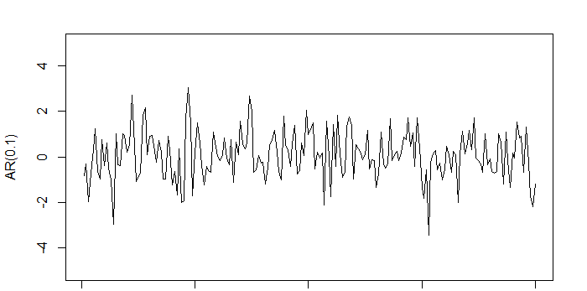
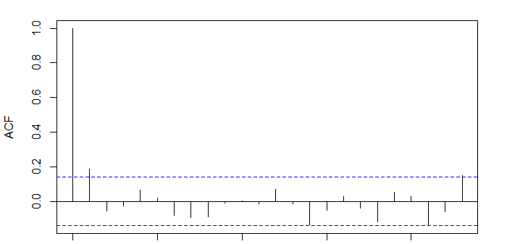
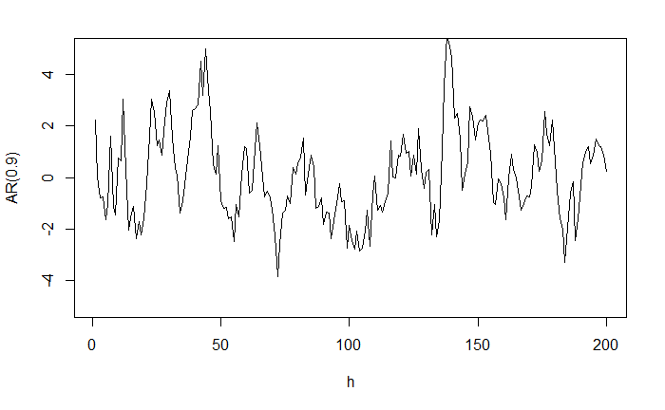
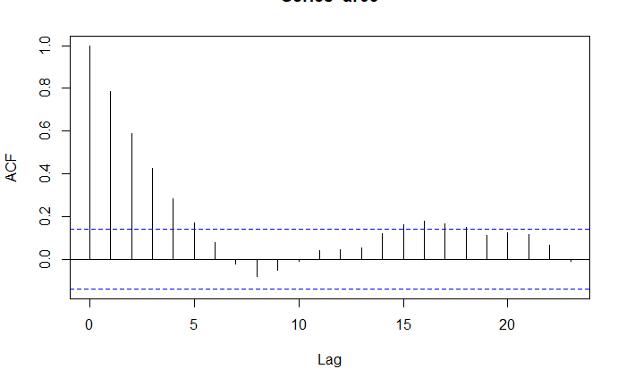
Autocovariance & Autocorrelation (Time Series)
MSc Machine Learning & Data Science
Exploratory Data Analysis & Visualisation

Slide 8
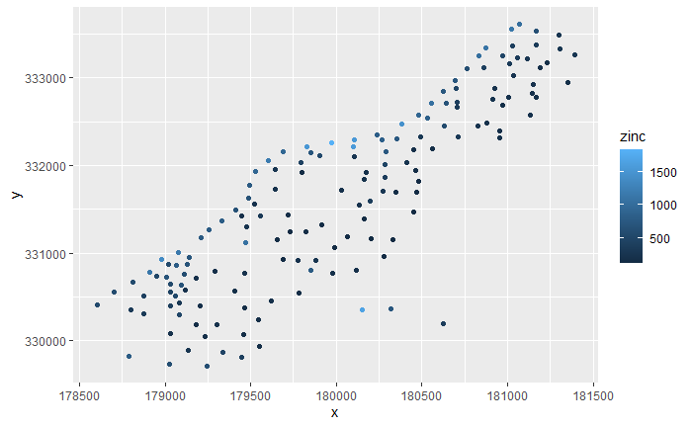
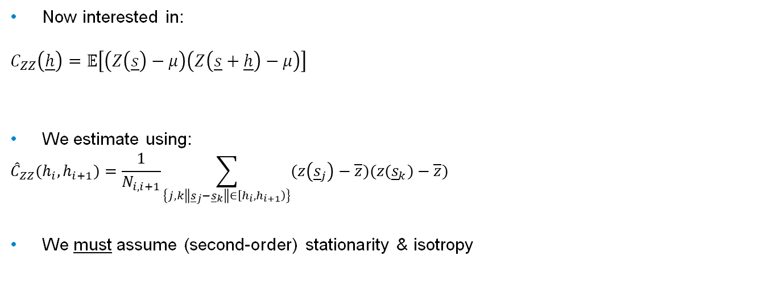
Spatial Autocovariance
MSc Machine Learning & Data Science
Exploratory Data Analysis & Visualisation
Now interested in:
$$C_{ZZ}\left(\underline{h}\right)=𝔼\left[\left(Z\left(\underline{s}\right)−μ\right)\left(Z\left(\underline{s}+\underline{h}\right)−μ\right)\right]$$
We estimate using:
$${\hat{C}}_{ZZ}(h_{i},h_{i+1})=\frac{1}{N_{i,i+1}}\sum_{\left\{j,k\left\|{\underline{s}}_{j}−{\underline{s}}_{k}\right\|∈\left[h_{i},h_{i+1}\right)\right\}}{(z\left({\underline{s}}_{j}\right)−\overline{z}})(z({\underline{s}}_{k})−\overline{z}) \sum_{\left\{j,k :\left\|{\underline{s}}_{k}−{\underline{s}}_{k}\right\|∈\left[h_{i},h_{i+1}\right) \right\}}{\left(z\left({\underline{s}}_{j}\right)−\overline{z}\right)\left(z\left({\underline{s}}_{k}\right)−\overline{z}\right)}$$
We must assume (second-order) stationarity & isotropy

Slide 9
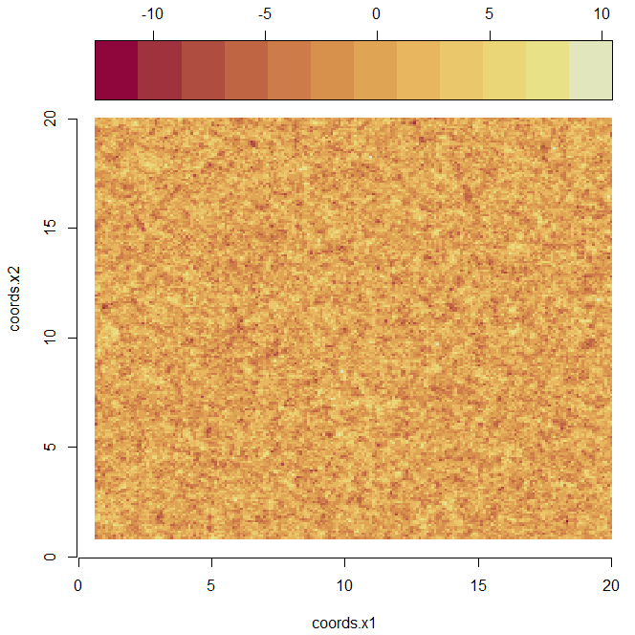
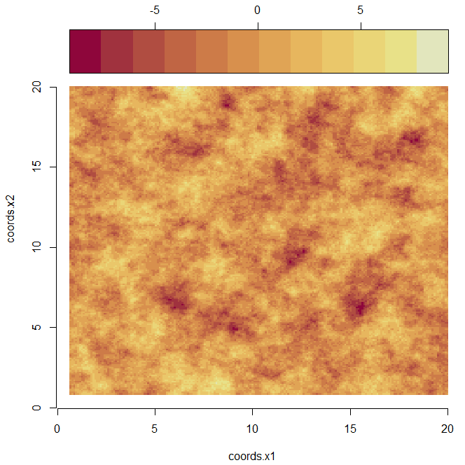
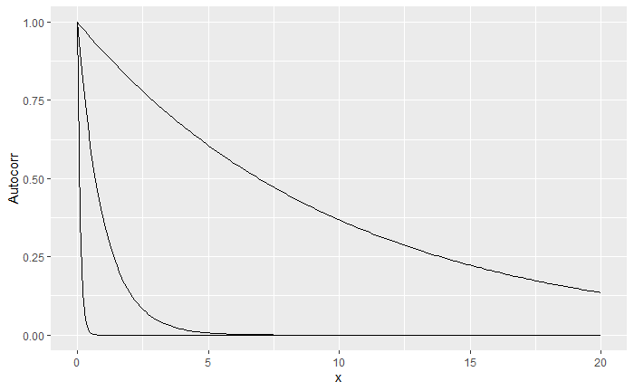
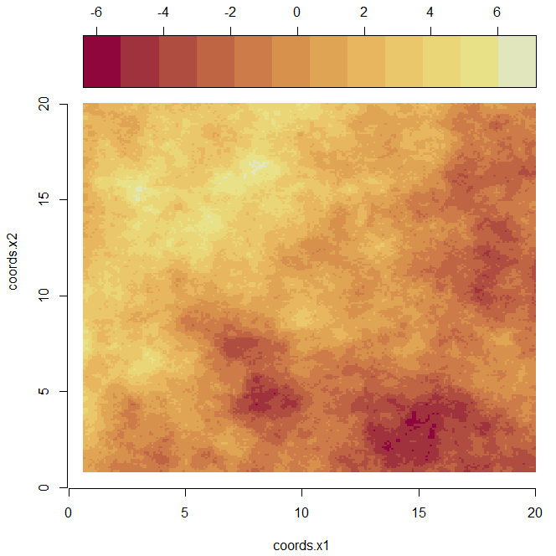
Spatial Autocovariance
MSc Machine Learning & Data Science
Exploratory Data Analysis & Visualisation

Slide 10
Any Questions?
MSc Machine Learning & Data Science
Exploratory Data Analysis & Visualisation

