Slide 1
Multivariate Data
MSc Machine Learning & Data Science
Exploratory Data Analysis & Visualisation
Live Q&A – 19th February 2026
Niall Adams

Slide 2
Overview
MSc Machine Learning & Data Science
Exploratory Data Analysis & Visualisation
MV time series
Diagnosing confounding variables
Notes:
Hello, and welcome back.
On the agenda today are two things: a little discussion about multivariate times series, and some discussion about confounding.
MV time series are a special area of focus for the stats section at imperial. This is particularly the case it we are interested in network structure; either manifest or latent. Indeed, if you look at the NEST project, a big EPSRC research activity, you will see it is lead from here– with much research effort going on.
A common (vulgar?) application of MV time series in is financial trading, where we have a portfolio of stocks (or whatever) we are tracking at some frequency. Now, we might be interested in forecasting – what will happen next? Or we might be interested in understanding lagged dependencies– does a change in one stock later indicate a later change in another. That would provide a leading indicator, against which we could potentially make trading decisions. Now, and econmetrician might be interested in more complex lagged and grouping behaviour – that is , the behaviour of groups. Now, we may know something about the stocks – what sector they are in, for example. So, we can link them into a simple ‘network’ - the relational data is manifest. On the other hand, even if they are in the the same sector, they may not exhibit dependence, in which case, we do not want to group them – we need to learn about the latent dependence behaviour. That is what the cross-correlation matrix in the reading is meant to support revealing.
Here is another example. In cyber security we are often interested in understanding normal behaviour and looking for departures from it. One way we can look at the behaviour of devices on the network is by looking at netflow data. this reports information about connections between devices. Now on the South Kensington campus, there are at least 40,000 devices. if we observe over time : a day, two days a week, whatever, each device is producing their (irregular) time series of interactions. Again, there now there is latent and manifest component to this. The manifest component is that we know something about the device that my computer is visiting, what building , what department. The thing we might be interested in instead is if groups of machines are exhibiting similar dependency, and what we might look at whether those dependencies change overtime in a way that might be suggestive of something undesirable. The reason this is interesting is that hackers are good at covering their tracks. But to cover a track that involves multiple devices means more intrusion which a hacker will be reluctant to do. This is slightly more complicated because we move into the world of discreet value time series but the core and is same A quick note about the reading and it’s a repetition of things I said before. You were asked to read about five pages. The description after giving some motivating examples was somewhat mathematically technical. If the material isn’t familiar that might have been intimidating. And I want you to learn to operate at masters level reading now so even if you do find intimidating that shouldn’t stop you. Clearly it can’t have been the intention for you to become expert in cross correlation matrices based on a few pages of technical but introductory reading. Another way to see that material is to ask what is going on: what’s similar to what I have seen before and what’s different. And if you look at it that way what you see is this is reusing the same ideas again again! we start with correlation and covariance then we moved to our time series and we get lag and ACF. Now we move to multiple time series and we get cross-correlation. The ideas become more complicated, the mathematical representation gets more complicated , but the core ideas are still the same for these approaches. Later in the reading there is some sense of how to put confidence thresholds on cross correlation functions based on White Noise. again the thing to see here is these are all ideas you seen before being recycled into a more complex situation! you don’t necessarily need to follow all the mathematical derivation unless you want to. Please keep this in mind. It’s the key to reading this type of material.

Slide 3
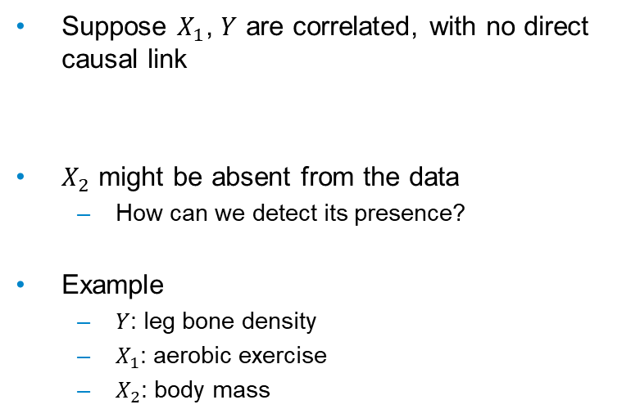
Diagnosing Confounders
MSc Machine Learning & Data Science
Exploratory Data Analysis & Visualisation
Suppose $X_{1}$, $Y$ are correlated, with no direct causal link
$X_{2}$ might be absent from the data
How can we detect its presence?
Example
$Y$: leg bone density
$X_{1}$: aerobic exercise
$X_{2}$: body mass
Notes:
Now, some highlights of the lab (all problem cases):
1_. Correlation NEQ causation, and examples.
2. Simpson’s paradox. Is it really a paradox? The picture in the lab is good – that is they way to remember. If you look overall, you got one slope, but the group slopes go the other way. It is not really a paradox, it is about what question you are asking (and the risk of asking the wrong question)
3. Data dredging, and p-hacking. This is a serious problem. When it is done willfully merely to find publishable results, we have an ethical concern. On the other hand, with large complex data sets, we will often create significant values anyway – we can detect minute effects. The effect size is important – we want substantive signficance. A problem I see in business is the ”quest for significance” with AB tests…
Last year lecturer, they tried to do some work with confounding and causality. Even after all the caveats in the lab!
I am not going to! except for some high level comments. The only place in the programme you will get close to causality is the learning agents module, where you will look at randomized designs. Or maybe your project.
There are two main schools of thought about causality (not competitors, they are doing different things):
Causal graphs – the Structural Causal Model approach: due to Judea Pearl. Based on DAGs, with variables as nodes, and CAUSAL relationships as arrows, data generating process as structural equations.
The potential outcomes framework, from Don Rubin (and others). Causality is defined as counterfactual outcomes. Each unit has a notional counterfactual (what wasn’t observed – the core problem),
Now, both of these approaches are complicated, and heavy on assumptions. They both help us make explicit all the assumptions we make, and can expose flaws in reasoning. SCM is more about identifiying causal relationships, potential outcomes are about estimating treating effects.
These are ALL contested, one way or another. This is an example where you need awareness, -- there are tools out there, and you need to know where to look if you need them. And of course, you need to be skeptical about the methods, and aware of the assumptions.
Anyway, back to this example. This was a case where a first study implicated aerobic exercise as causal for leg bone density, and a later study found that body mass was the driver, as in the DAG above. Now, this is used to illustrate a way that linear models MIGHT be able to suggest a MEANINGFUL variable is absent. This is based on an analysis of structure in residuals over different models – and it exploits something called the Frisch-Waugh-Lovell theorem, which is purely a properly of linear regression. I do not find these demonstrations compelling – and I feel they give false certainty. By all means read into this if you are interested – but I envourage you to read with caution and a degree of skepticism.
Dealing with causality seriously requires the involvement of subject matter specialists, a variety of tools, and a good amount of wariness.
QAPLA

Slide 4
Any Questions?
MSc Machine Learning & Data Science
Exploratory Data Analysis & Visualisation

