Slide 1
Multivariate Data Visualisation
MSc Machine Learning & Data Science
Exploratory Data Analysis & Visualisation
Live Q&A – 26 February 2026
Niall Adams

Slide 2
Overview
MSc Machine Learning & Data Science
Exploratory Data Analysis & Visualisation
Clarification of two points from the R lab
Faceting
Categorising multivariate data visualisations
Q&A

Slide 3
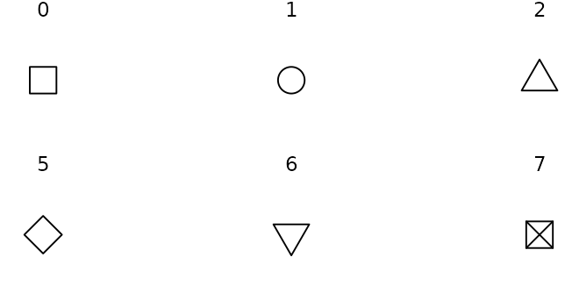
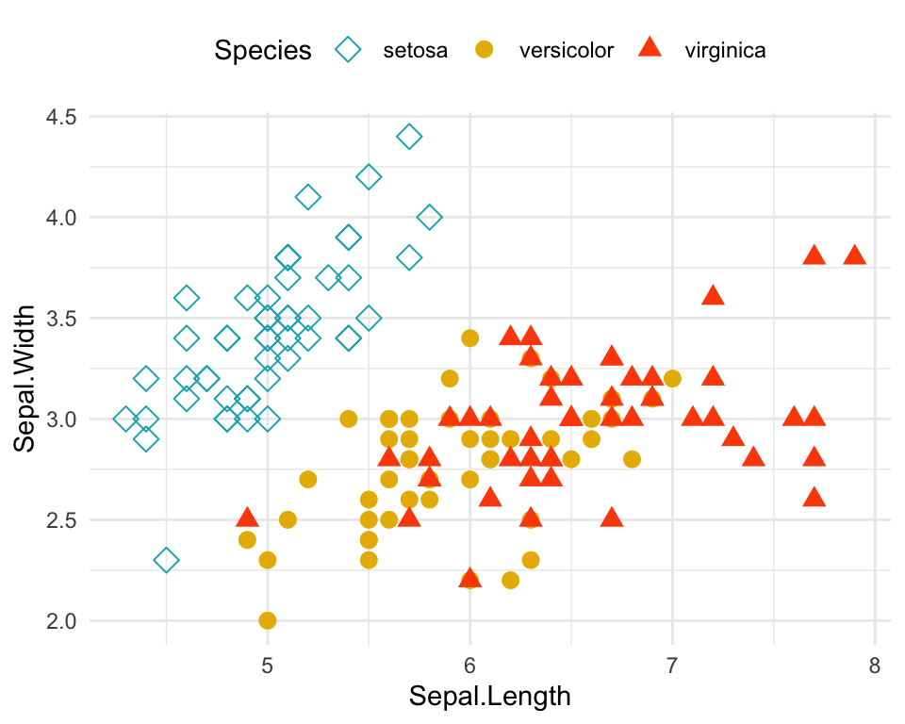
Clarification
MSc Machine Learning & Data Science
Exploratory Data Analysis & Visualisation
Exploratory Data Analysis & Visualisation
Clarification
What is a glyph?
What is a glyph?
+ geom_point(aes(shape = Species)))
+ scale_shape_manual(values = c(5, 16, 17))

Slide 4
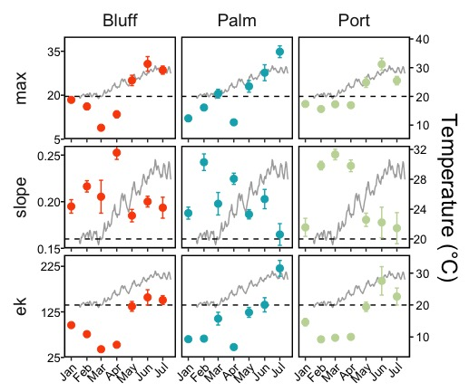
Faceting
MSc Machine Learning & Data Science
Exploratory Data Analysis & Visualisation
Plot 2D data across levels of a third (and fourth) variable
+ facet_grid(y~x)

Slide 5
Categorising Multivariate Data Visualisations
MSc Machine Learning & Data Science
Exploratory Data Analysis & Visualisation
Focus on three categories:
Geometric projections
Icon-based visualisations
Hierarchical visualisations

Slide 6
Categorising Multivariate Data Visualisations
MSc Machine Learning & Data Science
Exploratory Data Analysis & Visualisation
Focus on three categories:
Geometric projections
Icon-based visualisations
Hierarchical visualisations
(Pixel-oriented visualisations)
(Graph-based visualisations)
…

Slide 7
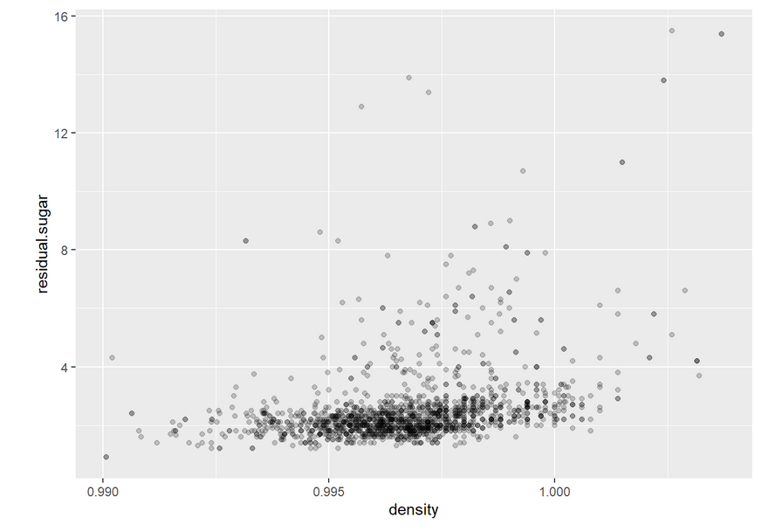
Geometric Projections
MSc Machine Learning & Data Science
Exploratory Data Analysis & Visualisation
Generally…
data is transformed and projected onto a set of geometric axes…
coordinates with respect to these axes represent different variables.

Slide 8
Geometric Projections
MSc Machine Learning & Data Science
Exploratory Data Analysis & Visualisation
Generally…
data is transformed and projected onto a set of geometric axes…
coordinates with respect to these axes represent different variables.
Allows for projection from higher dimensions (e.g. using PCA…)
Allows for alternative configurations of axes…

Slide 9
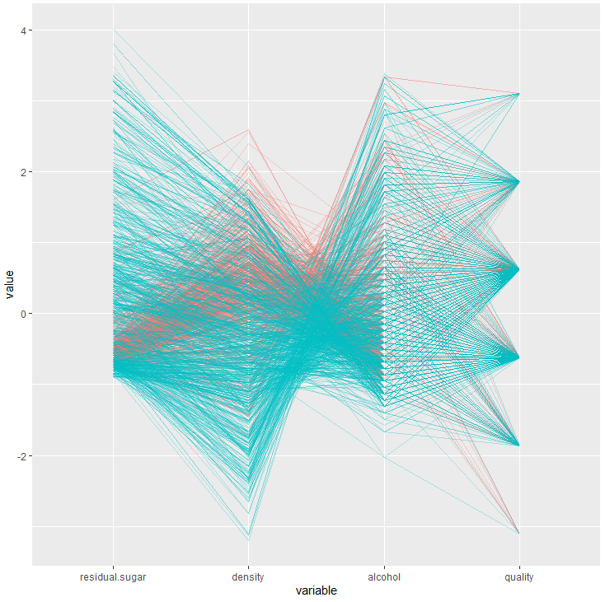
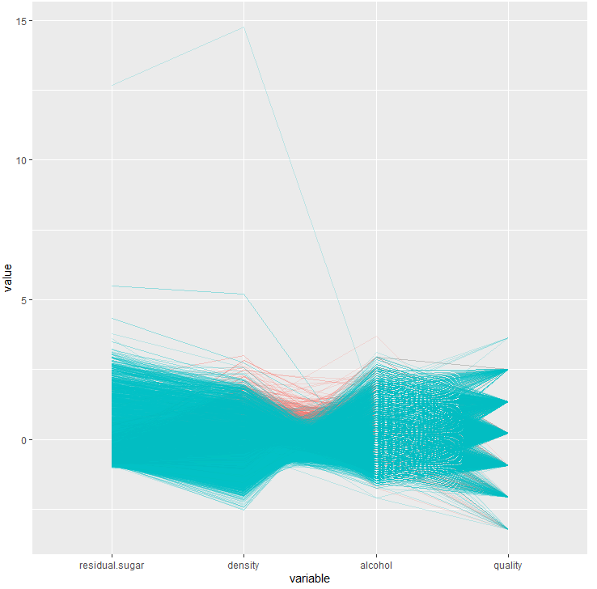
Geometric Projections
MSc Machine Learning & Data Science
Exploratory Data Analysis & Visualisation
Generally…
data is transformed and projected onto a set of geometric axes…
coordinates with respect to these axes represent different variables.
Allows for projection from higher dimensions (e.g. using PCA…)
Allows for alternative configurations of axes…

Slide 10
Geometric Projections
MSc Machine Learning & Data Science
Exploratory Data Analysis & Visualisation
Generally…
data is transformed and projected onto a set of geometric axes…
coordinates with respect to these axes represent different variables.
Allows for projection from higher dimensions (e.g. using PCA…)
Allows for alternative configurations of axes…
Advantages: good for finding outliers & correlations
Disadvantages: large datasets can lead to cluttered visualisations

Slide 11
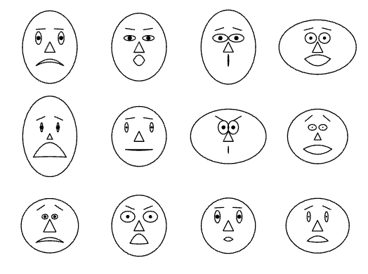
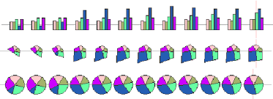
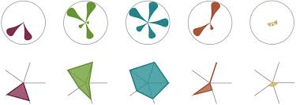
Icon-based Visualisation
MSc Machine Learning & Data Science
Exploratory Data Analysis & Visualisation
Using glyphs to represent multivariate observations
values of different variables control different glyph characteristics
Many weird and wonderful examples!
Can be v useful for visualisation for communication…
Well-chosen glyphs can be extremely interpretable
Less useful for exploratory data analysis

Slide 12
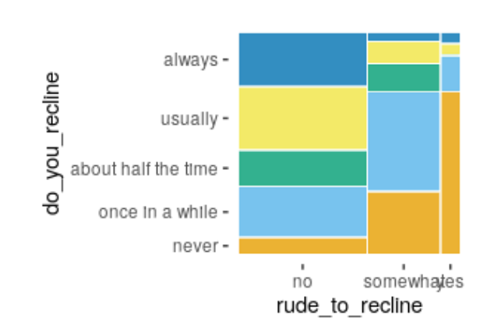
Hierarchical Visualisations
MSc Machine Learning & Data Science
Exploratory Data Analysis & Visualisation
(Categorical) variables given varying levels of prominence
Use one variable to divide the space into subregions
conditional distribution of remaining variables in each subregion
Iteration creates subregions within subregions
…creates a hierarchical structure

Slide 13
Any Questions?
MSc Machine Learning & Data Science
Exploratory Data Analysis & Visualisation

