Slide 1

Impacts of Simplifcation on Existing EM Build
Veeva Professional Services

Slide 2
Agenda fpr the Week
Examine areas of impact in the System for existing markets that do not cut-over to Simplified build

Slide 3
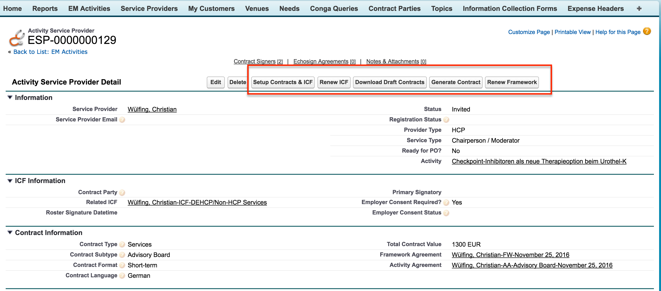
Existing Activity Service Provider Page

Slide 4
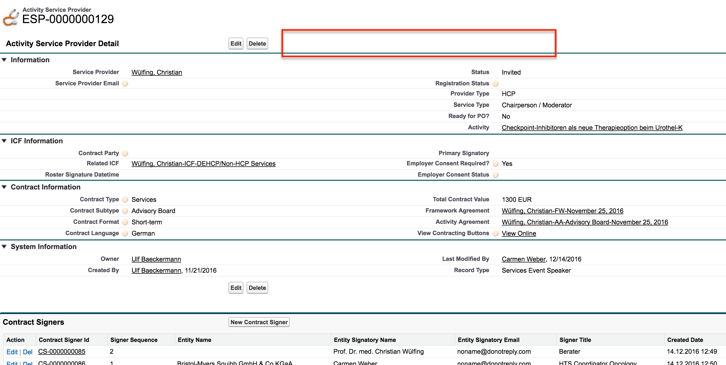
ASP Page after Simplification

Slide 5
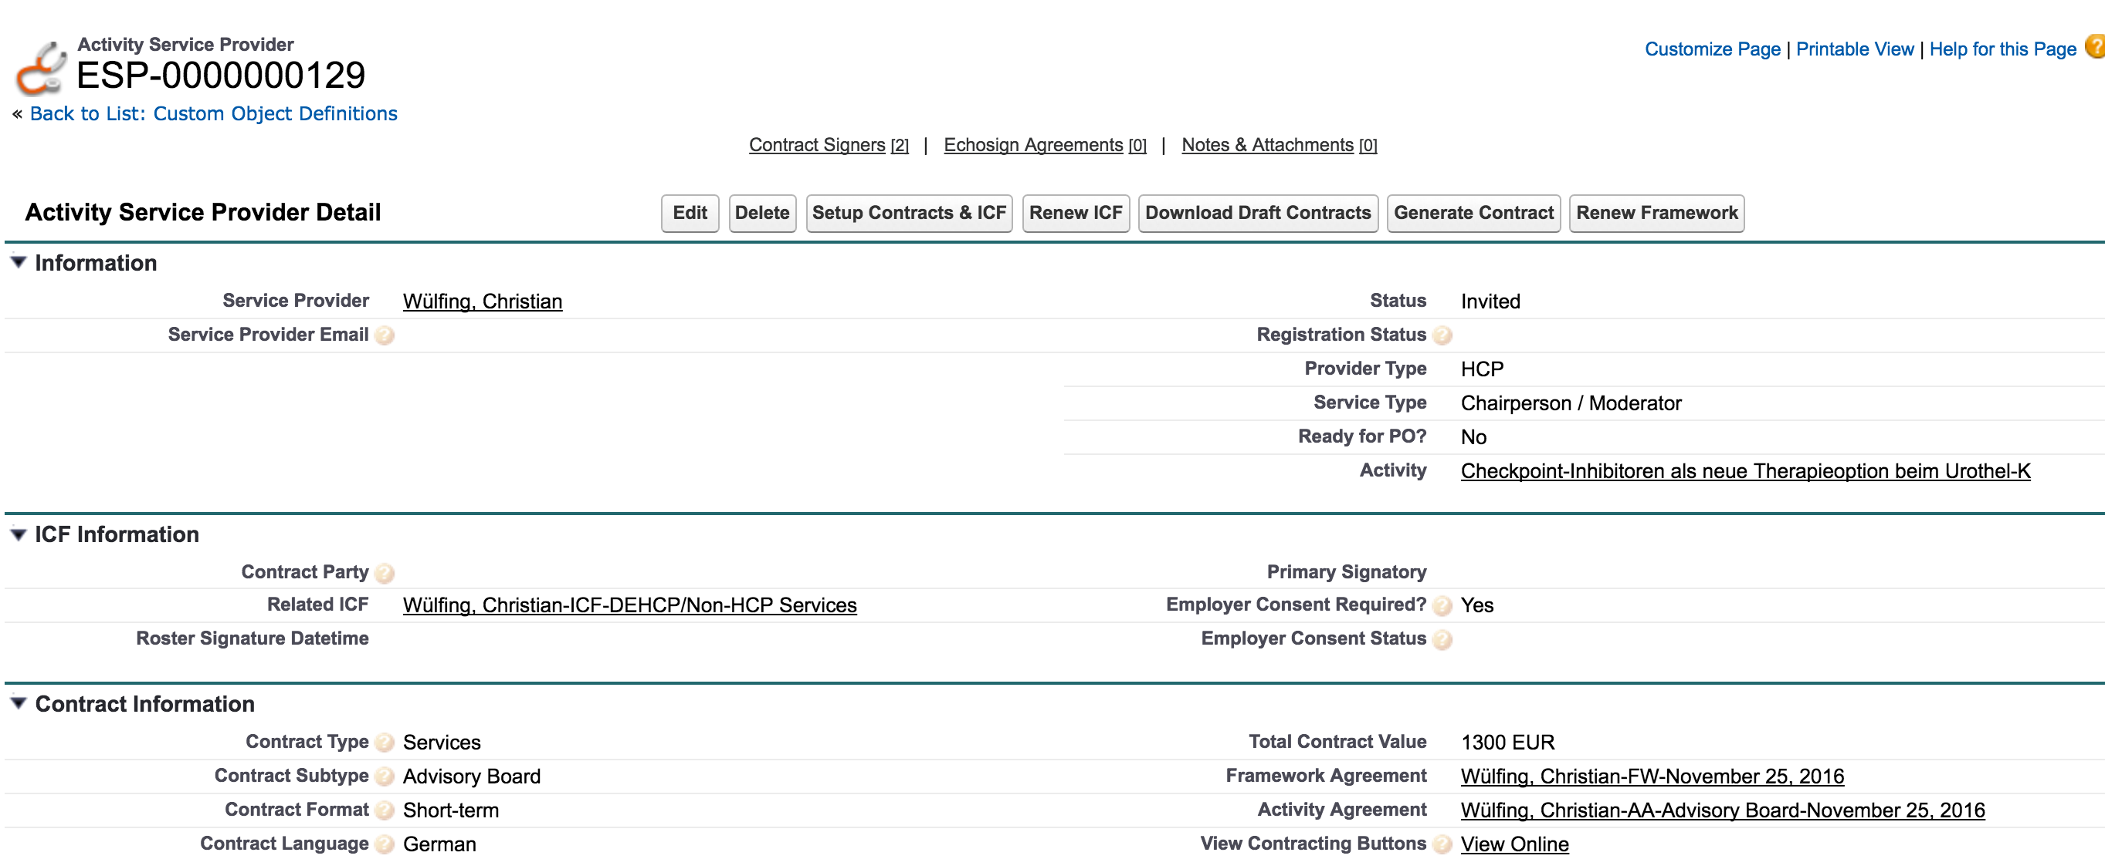
Workaround
New link – View Contracting Buttons
Clicking this link will show the Standard page with Contracting buttons

Slide 6
Technical Impacts to existing build
Update Page layouts to add the “View Contracting Buttons” link
Services
Events
Sponsorship
ADMIN
Update EM V3 Basic Perm set
Add VF page accesses for all overridden objects
Add Read Access to View Contracting Buttons field

Slide 7
Audience Page Impacts
Audience Page will also be impacted similar to Activity Service Provider page
Similar workaround should work for Audience as well
3 page layouts impacted – Sponsored Account, Sponsored Contact & Sponsored User
FIELD_USER Permsets will need to updated to reflect access to new VF pages and new field View Contracting Buttons

Slide 8
Other impacts on EM Activity Page
The following related record detail pages will display slightly differently (since they will now be overridden by Veeva Page l/o Engine)
Activity Team Member
Assigned Need
Activity Materials
Expense Estimate
Functionally no change to these sections on the EM Activity page
Is Germany impacted by PO integration?

Slide 9
Technical notes/impacts
VPROF_EMAttendeeBeforeInsert – Trigger update to exclude processing of Simple Events
VPROF_UpdateASPWithEmployerConsent – If Employer consent is updated on the Service Provider, then update all “Pre-Event” status Events with the change
VPROF_AutoAssignRecordTypeBeforeInsert – Support Simple activity rectype mapping
Update the existing EM_SUPER_USER perm set to only provide access to create Speaker_vod service providers
VPROF_ExpenseLine_BeforeInsert_BeforeUpdate – updated to match up Committed_vod with Committed_Amount_in_Requested_HCPTS__c on Expense Lines if Committed_Amount_in_Requested_HCPTS__c is empty or zero
How to get the Approver Id in a non-approval world for sap integration
Need to check Germany and LATAM builds reliance on English untranslated fields

Slide 10
Technical notes/impacts
Workflow field update that updates the NEED ID (Budget Identifier)
Much lesser page layouts
BMS_Simple_ApprovedPostEventBMS_Simple_Pending_ApprovalBMS_Simple_PrePostEventBMS_Simple_Read_OnlyBMS_Simple_Read_Only_RestrictedBMS_Simple_SysAdmin
This is an internal note for us for the future-- the custom setting that controls this will need to be done at the profile level during market rollout in order to not affect DE. They are currently using it to update other fields (employer consent, for example), so we can't just update the Org wide setting for simplification. Simplified should only see Status_vod__c
Profiles need to be updated to ensure visibility to Event Layout.Expense Estimate, Header, Line fields is taken away and assigned from Permission sets

Slide 11
Material Group Validation on EH - Trigger is updated to escape if Event rectype associated to Expense Header is a Simple Activity recordtype. Please test and confirm. Regression impact.
Approval Notifications for PO Approver - "You have been requested as Approver" notification for Simple Activities will not go out. Existing WF updated to do so. Regression Impact.
I have not disabled just the common Team member addition notification to PO Approver. We can remove it if they don't want to see it.

Slide 12
Currently, for Activities that do need Approval, following notification is automatically sent by SFDC to the Approver (since we enabled Approval via E-mail) -
"Murugesh Naidu has requested your approval for the following item:
To approve or reject this item, click this link https://cs82.salesforce.com/p/process/ProcessInstanceWorkitemWizardStageManager?id=04i3E000000FaKi or reply to this email with one of these words in the first line of the email message: APPROVE, APPROVED, YES, REJECT, REJECTED, NO
If replying via email, you can also add comments on the second line. Comments will be stored with the approval request in Salesforce CRM.
Thank you,
Salesforce"

Slide 13
Mkt Specific
Approvals
Sign in sheet template, print inv template
NEED TO THINK ABOUT MAKING TOPICS READ ONLY
Some more details on Account & User attendee fields
Sign in sheet & print sheet templates
SP Qual page layouts need to be straightened out – may need a profile specific page layout assignment for simplified group
Primary need error for Request Estimates on Activity

