Slide 1

Impacts of Simplification on Existing EM Build
Veeva Professional Services

Slide 2
Objective
Examine areas of impact in the System for existing markets that do not cut-over to Simplified build

Slide 3
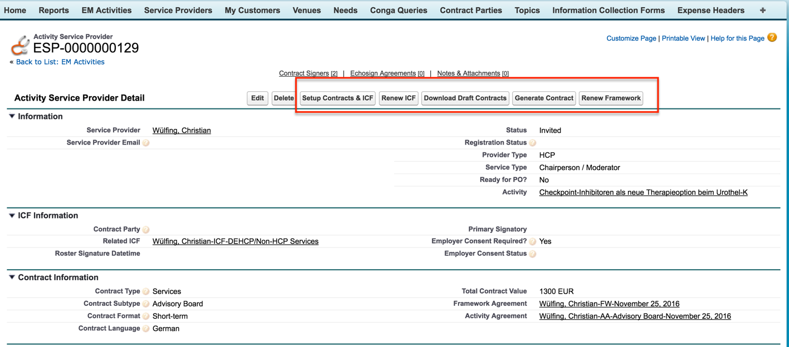
Existing Activity Service Provider Page

Slide 4
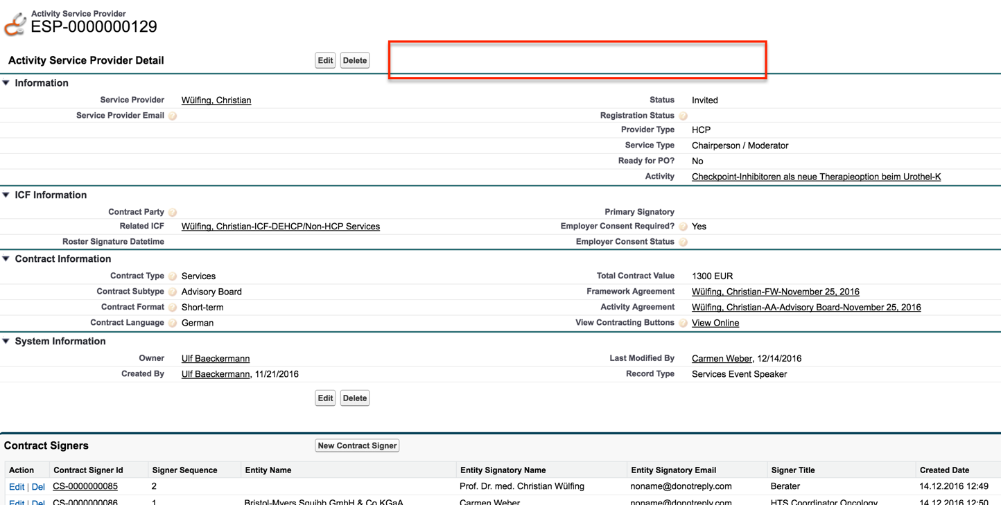
ASP Page for DE after Simplification
New Link

Slide 5
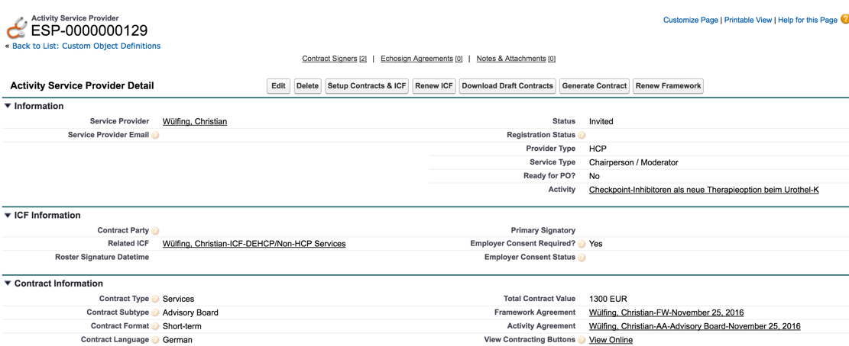
Workaround
New link – View Contracting Buttons
Clicking this link will show the Standard page with Contracting buttons
NOTE: Contract Signer Related list is sortable only in Standard View page

Slide 6
Audience Page Impacts
Audience Page will also be impacted similar to Activity Service Provider page
Similar workaround should work for Audience as well
3 page layouts impacted – Sponsored Account, Sponsored Contact & Sponsored User
FIELD_USER Permsets will need to updated to reflect access to new VF pages and new field View Contracting Buttons

Slide 7
Other impacts on EM Activity Page
The following related record detail pages will display slightly differently (since they will now be overridden by Veeva Page l/o Engine)
Activity Team Member
Assigned Need
Activity Materials
Expense Estimate
Functionally no change to these sections on the EM Activity page
Germany Impacts to PO Integration- still under review. New validation requirements to lock down need to be unit tested + Payment Request status added decision
Decision: Payment Status on Expenses- Moving forward?
Yes- add to Core for now

Slide 8
Impact of updated Labels
Several labels for Objects (for eg: Need to Budget) have been updated in Simplification build
No impact to German users that use German as their Locale & Language
Impacts about 27 German users that use English (US) as their language
Recommended to simply address the issue using translations
Technically, these impacted users could be moved to English (UK) to ensure status-quo is maintained
UK and US English translations will need to be matched/merged
Existing pre-simplification labels will need to be added as translated values in UK English
NOTE: Need to test this out in DEV to ensure we don’t run into unsupported items in translation workbench
NOTE: There are only about 5 active end users using UK English today

Slide 9
Technical Impacts to existing build
Update Page layouts to add the “View Contracting Buttons” link on ASP pages
Services
Events
Sponsorship
ADMIN
Update existing Field User Permission set
Add VF page accesses for all overridden objects
Add Read Access to View Contracting Buttons field

Slide 10
Technical notes/impacts - Triggers
VPROF_EMAttendeeBeforeInsert – Trigger update to exclude processing of Simple Events (drives Sponsorship Contracting on Audience today)
VPROF_UpdateASPWithEmployerConsent – If Employer consent is updated on the Service Provider, then update all statuses in [existing 1.0 RQ] Events with the change (Not applicable for Simplification; Only update the ASP the first time it is added to the Event).
VPROF_AutoAssignRecordTypeBeforeInsert – Support Simple activity rectype mapping on ASP
Update the existing EM_SUPER_USER perm set to only provide access to create Speaker_vod service providers (not Simple_Speaker_vod Record Type)
VPROF_ExpenseLine_BeforeInsert_BeforeUpdate – updated to match up Committed_vod with Committed_Amount_in_Requested_HCPTS__c on Expense Lines if Committed_Amount_in_Requested_HCPTS__c is empty or zero
MaterialGroupValidation – Trigger on Expense to validate Material Group on EH is applicable for the Contract Party- in simplification, we are removing this validation so this trigger needs to be updated to exclude Simplified Activities

Slide 11
Technical notes/impacts - Other
PO_Requested_Update VR on Expenses to exclude Simple Activities
Need_Vendor_to_Request_PO VR on Expenses to exclude Simple Activities
Workflow field update that updates the NEED ID (Budget Identifier) to exclude Simple Budget
Outstanding with Product: Mass Update fields on Manage Attendees- the custom setting that controls this will need to be enabled at the profile level during market rollout in order to not affect DE. They are currently using it to update other fields (employer consent, for example), so we can't just update the Org wide setting for simplification. Simplified should only see Status_vod__c. Currently, this causes an error and we are working with product to understand feasibility.
Notify Approver of Activity – Email notification to Approver is updated to exclude Simplified Activities
Activity_Team_Member_Template: Updated template to add Confirmed City, changed subject line to add Role. Added Dear Colleague to the body.
Contract Party/Payee SAP Vendor ID: New requirement- Validation rule that the ID must be 10 characters for integration purposes.
Notes:
Send_Email_Alert_To_Support_Member
Send_Email_Alert_To_Support_Member

Slide 12
Under Review- Impact TBD
Need to review Germany/Brazil Impacts on new Labels: Budget, WBS/CC, Payee, Expenses
SP Qual page layouts need to be straightened out – may need a profile specific page layout assignment for simplified group
Email Notifications- TBD in upcoming requirements review
Primary need error for Request Estimates on Activity- still under review
Notes:
Send_Email_Alert_To_Support_Member
Send_Email_Alert_To_Support_Member

Slide 13
Simplification Overview
Significant decrease in Event page layouts:
BMS_Simple_Approved,PostEvent,BMS_Simple_Pending_Approval,BMS_Simple_PrePostEvent,BMS_Simple_Read_Only,BMS_Simple_Read_Only_Restricted,BMS_Simple_SysAdmin
A new set of Simplified page layouts and record types for related objects.
Market Specific:
Approvals
Sign in sheet template, print invitation template, approved email Invitation templates
Need to analyze making Topics Read Only in Simplification
Some more details on Account & User attendee fields
Sign in sheet & print sheet templates

