Slide 1

Impacts of Simplification on Existing EM Build
Veeva Professional Services

Slide 2
Objective
Examine areas of impact in the System for existing markets that do not cut-over to Simplified build

Slide 3
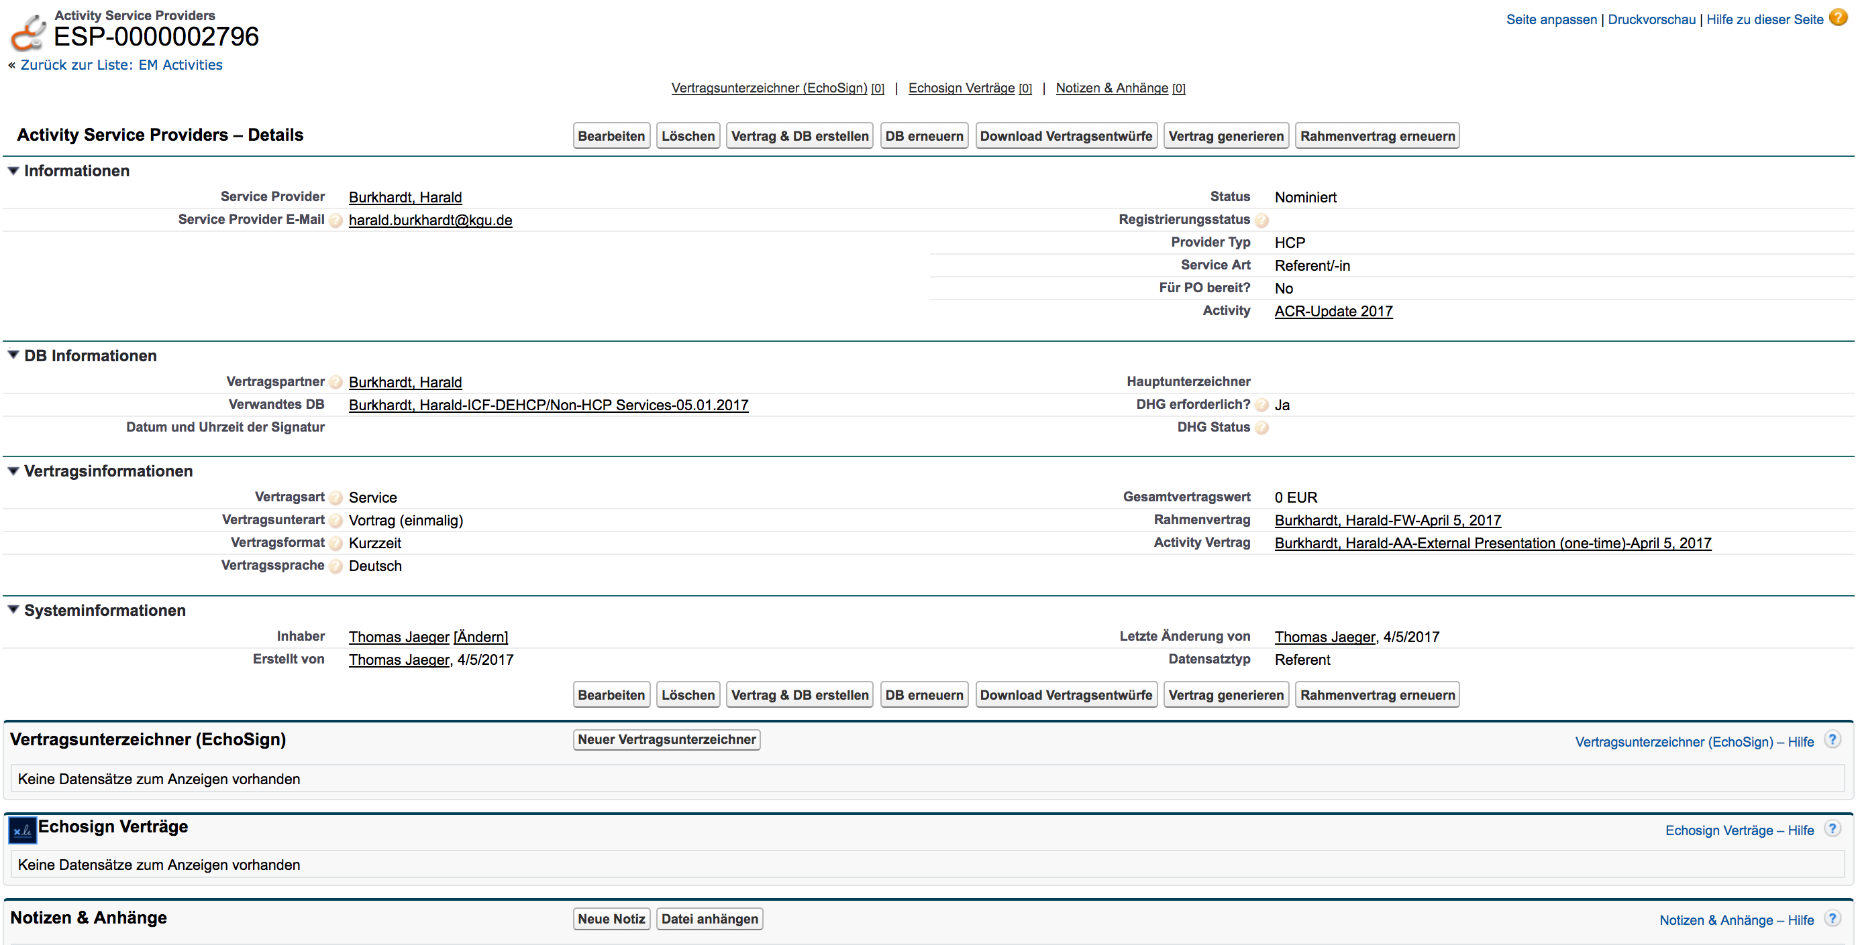
1.x DE Activity Service Provider (ASP) Detail Page

Slide 4
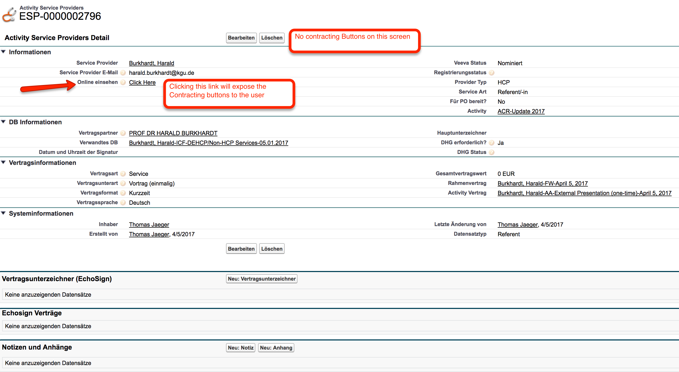
2.0 DE ASP Detail Page

Slide 5
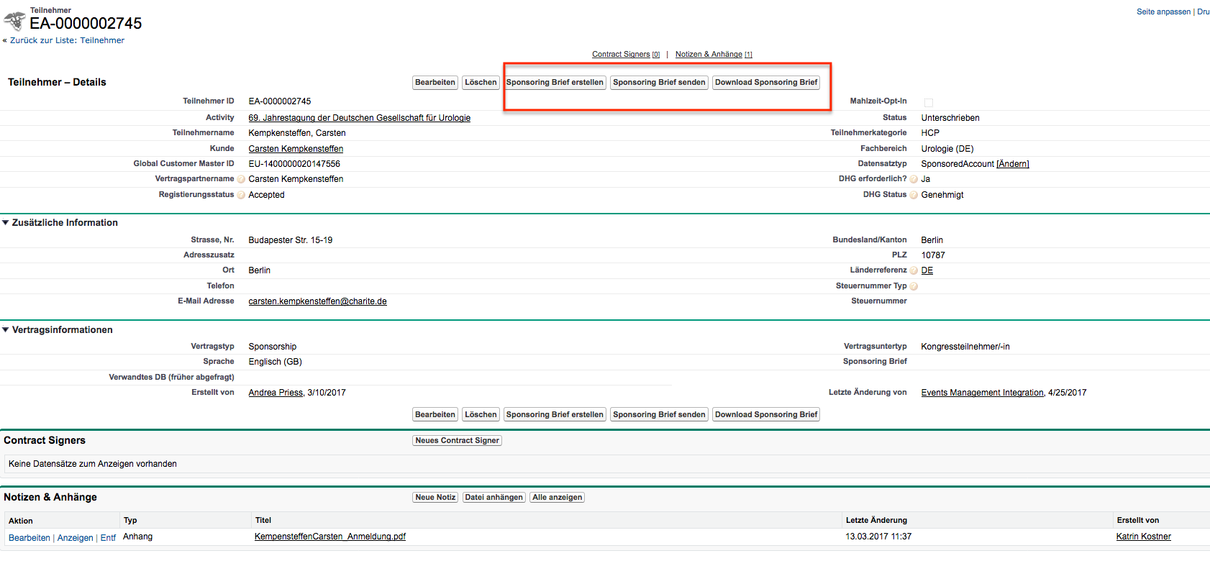
1.X DE Audience Detail Page (HCP Sponsorship)

Slide 6
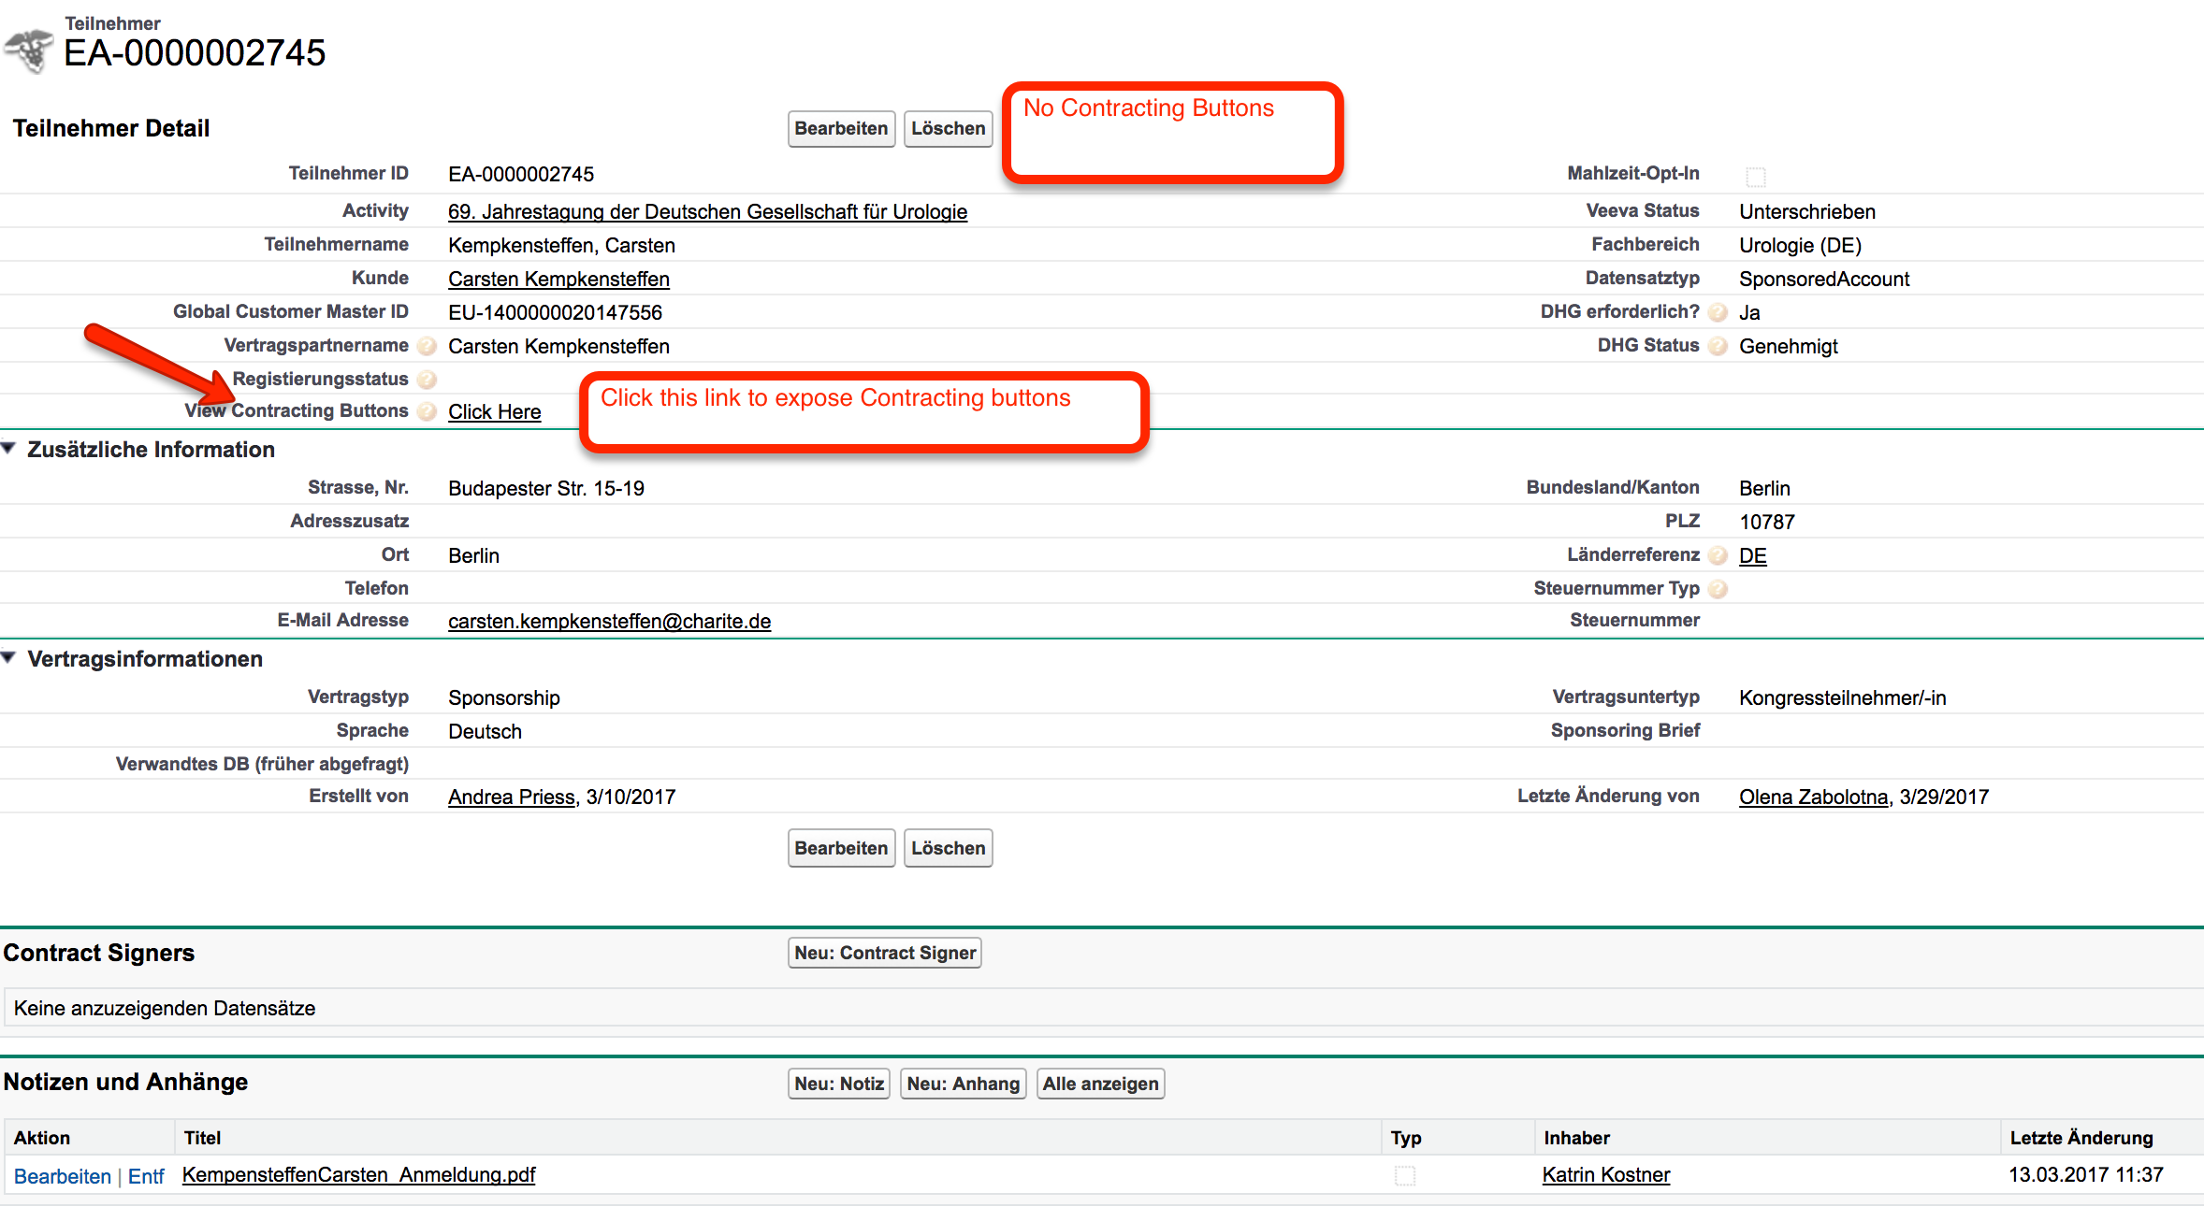
2.0 DE Audience Detail Page (HCP Sponsorship)

Slide 7
Other impacts on EM Activity Page
The following related record detail pages will display slightly differently
Activity Team Member
Assigned Need
Activity Materials
Expense Estimate
Functionally no change to these sections on the EM Activity page

Slide 8
Impact of updated Labels
Several labels for Objects (for eg: Need to Budget) have been updated in Simplification build
No impact to German users that use German as their Locale & Language
German users that use English as their Language will see updated labels for various objects
Needs ➔ EM Budgets
EM Activities ➔ EM Events
Any object or field or help text or message that addresses the word “Activity” will now say “Event”
Expense Headers ➔ Expenses
Expense Estimate Related List ➔ Budget Overview
Activity Budgets Related List ➔ WBS/CCs
Submit for Approval button ➔ Add PO Approver
Contract Party ➔ Payee

