Slide 1
Adding Attendees without a CM ID
May 1, 2017
Murugesh Naidu (Principal Architect, Professional Services)

Slide 2
Requirement Description
Business: Ability to add Attendees to Events that do not belong in Global Customer Master. These attendees are neither BMS Employees (User table) nor HCPs (Customer table)
Business: Ability for the EMCoE team to control and manage the list of such attendees and
Business: Ability for EMCoE to share the Attendee List with the field users
Business: Ability to reuse such attendees across multiple Events
Business: Ability to report on such Attendees
IT Governance: All Accounts and Contacts in Interact must have a Global Customer Master ID
Notes:
Breaking out the Requirements into pieces to evaluate the options based on how many we can meet. Also creating a distinction between Business and IT requirements

Slide 3
Problem Statement & Agenda
BMS IT Policy strongly prefers and advocates all Customer records must have a BMS Global Customer Master ID for data governance and compliance
While Veeva could technically meet the requirements, it would in all but one option require storing data that does not have a Customer Master ID in Account or Contact table
This deck will go over technical options available to meet all these requirements and discuss trade-offs if any
The options are presented in order of Veeva recommendation

Slide 4
Option 1 - Recommended
Use the Walk-in feature in Events Management to add such attendees
Walk-ins can be added in 2 ways
By clicking the Attendee Reconciliation button and selecting New Walk-in
Attendee does not need to Sign, supported on iRep and online
This option is only available before “Complete Reconciliation” is clicked. If Reconciliation is completed, it must be opened to add a New Walk-in
Via the Register feature on the Digital Sign-in Sheet
Attendee must Sign, supported on iRep only

Slide 5
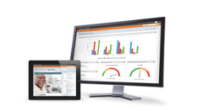
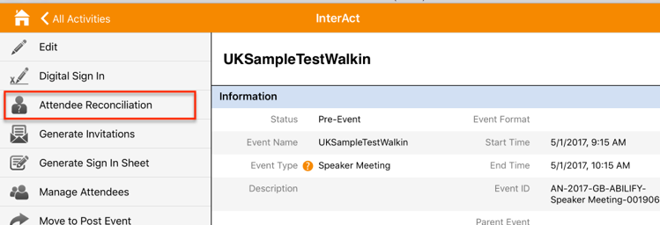
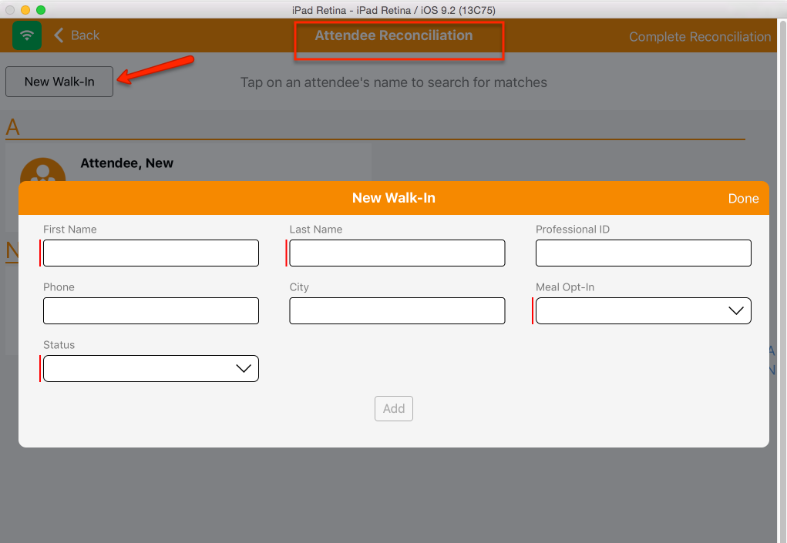
Option 1 a – Attendee Reconciliation
iPad + Browser

Slide 6

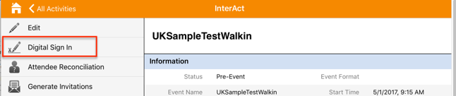
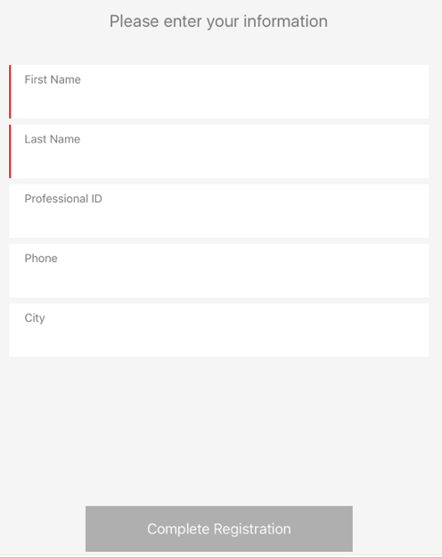
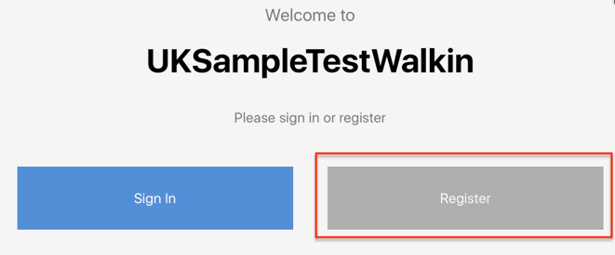
Option 1 b) – Register via Digital Sign-in
iPad Only

Slide 7
Option 1 Trade-off Matrix
Requirement | Meets?
#1 Business | ✔
#2 Business | ❌
#3 Business | ❌
#4 Business | ❌
#5 Business | ✔
#6 IT Gov | ✔
Business: Ability add Attendees to Events that do not belong in Global Customer Master. These attendees are neither BMS Employees (User table) nor HCPs (Customer table)
Business: Ability for the EMCoE team to control and manage the list of such attendees and
Business: Ability for EMCoE to share the Attendee List with the field users
Business: Ability to reuse such attendees across multiple Events
Business: Ability to report on such Attendees
IT: All Accounts and Contacts in Interact must have a Global Customer Master ID
Reasons for Recommendation:
Meets the immediate needs of the business without any additional effort
Depending on volume of such requests, support for #2, #3 and #4 can be added in subsequent releases
Available for June 2017 Release
Notes:
Recommended because

Slide 8
Option 2 – Use Contacts List Privately
Use Contacts list in Veeva EM
Contacts are special records in Orgs with PersonAccount enabled since each PersonAccount has a Contact record behind the scenes
As such, Contact visibility and access is dependent/controlled via Account visibility/access
There is no way to independently control Contact access/visibility in Veeva
Since Accounts are Private, Contacts are also Private
Users can create Contacts if enabled, but they will remain Private to them; the only way to “Share” them or extend their Visibility is by associating them to an Account and extending the visibility of the Account
Please note that users can add new Contacts Online only via the EM Contacts tab (unless the Account add DCR process is amended to accommodate such requests)

Slide 9
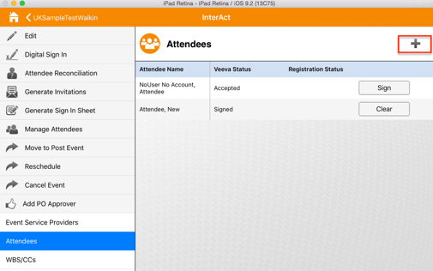
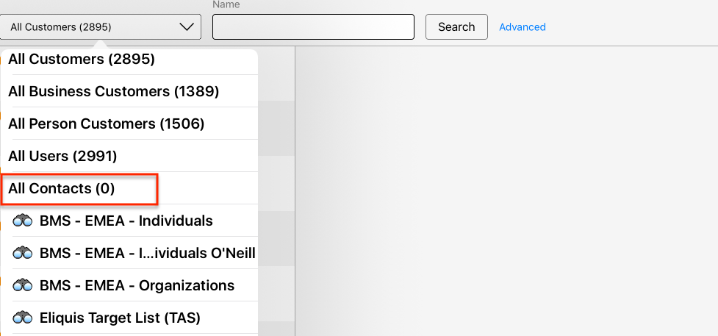
Option 2 – Use Contacts List
iPad + Browser

Slide 10
Option 2 Trade-off Matrix
Requirement | Meets?
#1 Business | ✔
#2 Business | ❌
#3 Business | ❌
#4 Business | ✔*
#5 Business | ✔
#6 IT Gov | ✔
Business: Ability add Attendees to Events that do not belong in Global Customer Master. These attendees are neither BMS Employees (User table) nor HCPs (Customer table)
Business: Ability for the EMCoE team to control and manage the list of such attendees and
Business: Ability for EMCoE to share the Attendee List with the field users
Business: Ability to reuse such attendees across multiple Events
Business: Ability to report on such Attendees
IT: All Accounts and Contacts in Interact must have a Global Customer Master ID
* - Users can reuse the Contacts that they own
Reasons for Recommendation:
Meets most of the key Business needs & IT Governance needs are met (by storing these records in the Contact table and not the Account table)
Can be made available for June 2017 release
Considerations:
Does not support Attendee Reconciliation in case of Walk-ins
Notes:
Recommended because

Slide 11
Option 3 – Use Contacts List Publicly
Use Contacts list in Veeva EM (option 2) w/ a technical workaround
Create a SINGLE Master Account (preferably Business and maybe a new Recordtype for differentiation) per Market and share it with the market using Sharing rule in a Read Only manner (preferably)
Associate ALL EM Contacts as children to this SINGLE Business Account
Set Master Accounts Do Not Call? Field to true
NOTE: The Master account will download to iRep and will be visible for use on an Event; Users must be trained to not use this Account in Events

Slide 12
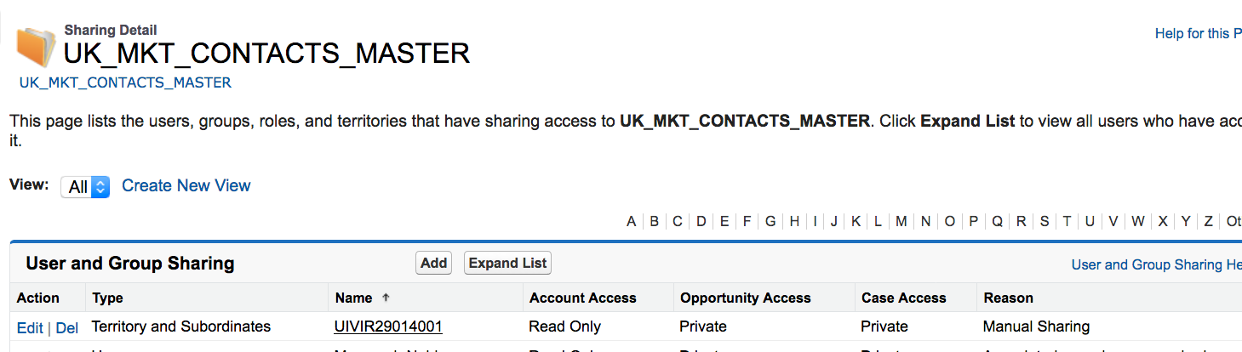
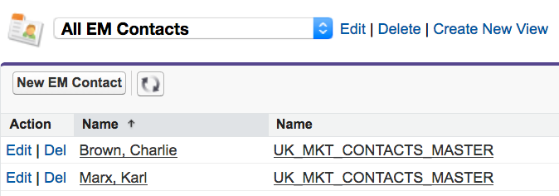
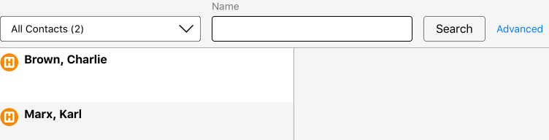
Option 3 – Contacts List w/ Workaround
iPad + Browser

Slide 13
Option 3 Trade-off Matrix
Requirement | Meets?
#1 Business | ✔
#2 Business | ✔
#3 Business | ✔
#4 Business | ✔
#5 Business | ✔
#6 IT Gov | ✔*
Business: Ability add Attendees to Events that do not belong in Global Customer Master. These attendees are neither BMS Employees (User table) nor HCPs (Customer table)
Business: Ability for the EMCoE team to control and manage the list of such attendees and
Business: Ability for EMCoE to share the Attendee List with the field users
Business: Ability to reuse such attendees across multiple Events
Business: Ability to report on such Attendees
IT: All Accounts and Contacts in Interact must have a Global Customer Master ID
* - Very limited Accounts (Master) without CM IDs; Contacts never had CM IDs anyways
Reasons for Recommendation:
Meets all the requirements including IT Governance requirement
Considerations:
Needs to use workaround
Needs communication and training
Needs additional Config and Testing
May be tough to meet June 2017 date
Notes:
Recommended because

Slide 14
Last Option – New Account Rectype
Add new Account Recordtype that does not require BMS Global Customer Master ID
EMCoE can create List(s) by Market and maintain
This will need several IT updates
Provide Access to this Account Recordtype to the EMCoE team to create and manage
Setup Market specific Sharing rules to share Accounts appropriately with the market
Setup rules in alignment system to not align these to any field users
Update GAS filters to prevent self-alignments
Using this option (over using Contacts) will allow users to also be able to Reconcile Walk-ins to these Accounts, which is not available in Contacts, and thereby ensure greater data integrity
Adding Account Add DCRs is available today to users; DCR process could be updated to handle adds of such Accounts as well

Slide 15
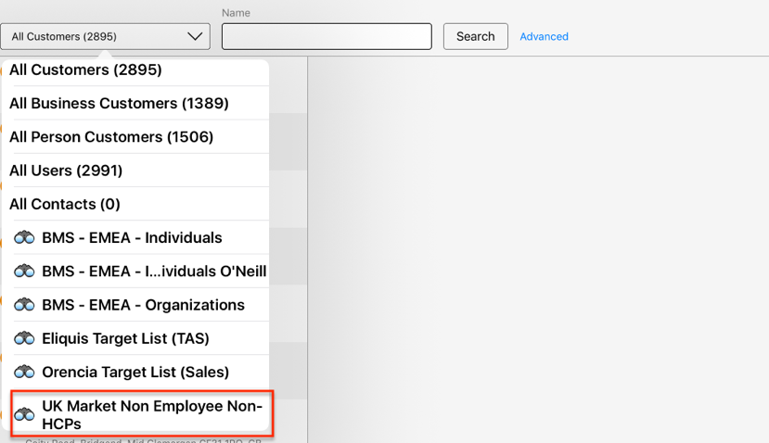
Last Option – New Account Rectype
iPad + Browser

Slide 16
Last Option Trade-off Matrix
Requirement | Meets?
#1 Business | ✔
#2 Business | ✔
#3 Business | ✔
#4 Business | ✔
#5 Business | ✔
#6 IT Gov | ❌
Business: Ability add Attendees to Events that do not belong in Global Customer Master. These attendees are neither BMS Employees (User table) nor HCPs (Customer table)
Business: Ability for the EMCoE team to control and manage the list of such attendees and
Business: Ability for EMCoE to share the Attendee List with the field users
Business: Ability to reuse such attendees across multiple Events
Business: Ability to report on such Attendees
IT: All Accounts and Contacts in Interact must have a Global Customer Master ID
Reasons for Recommendation:
Meets the all the needs of the business
Supports Attendee Reconciliation for Walk-ins
Considerations:
Additional Development and Testing Required by IT (Sumit’s team)
Does not seem plausible for June release
Notes:
Recommended because

