Slide 1
E-mail Alerts Discussion
Feb 6th, 2017

Slide 2
Goals & Agenda
Examine existing system E-mail Alerts
Decide on Simplified E-mail Alerts

Slide 3
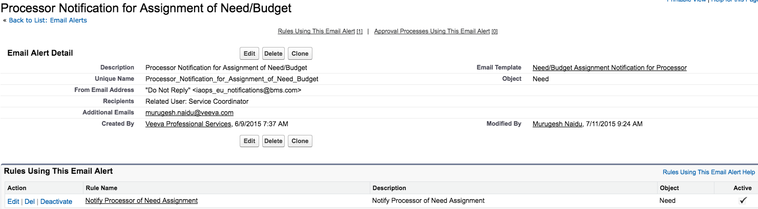
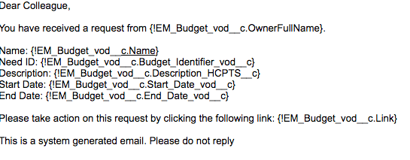
Notes:
This is N/A for Simple Build – Need will be shared out automatically with the Service Coordinators at a minimum. Need to discuss further granular sharing rules. No e-mail necessary

Slide 4
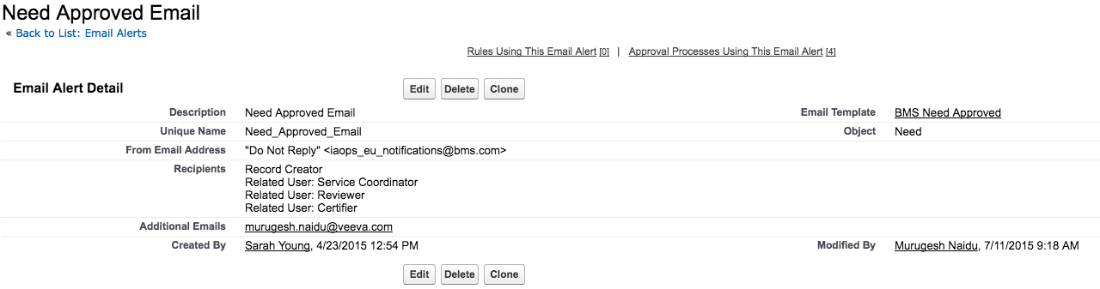
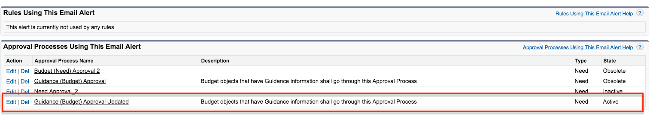
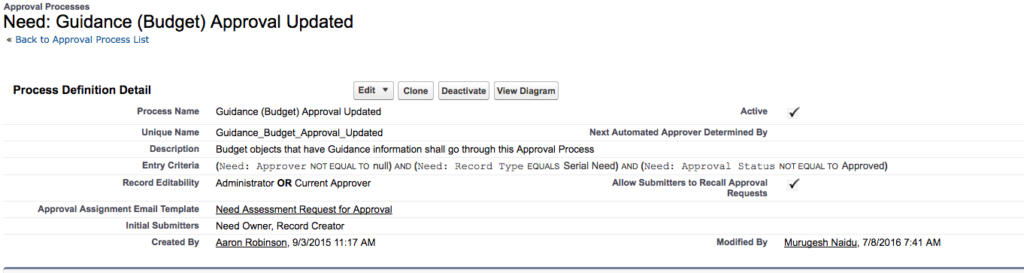
Notes:
N/a for Simplified world since we don’t Need Approvals…France may need discussion

Slide 5
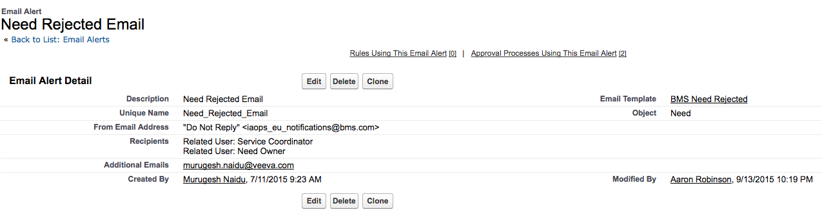
Notes:
N/a for Simplified world since we don’t Need Approvals…France may need discussion

Slide 6
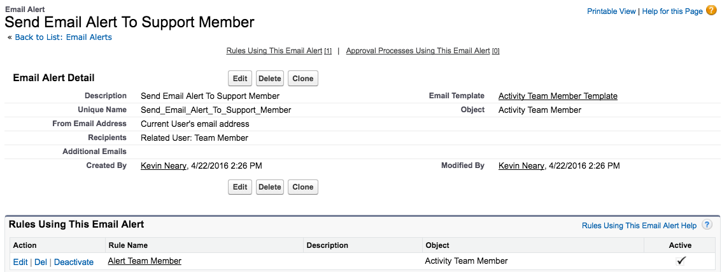
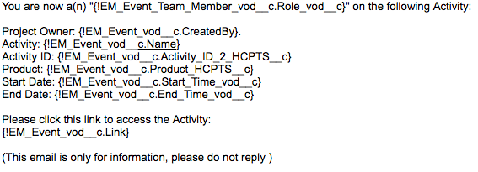
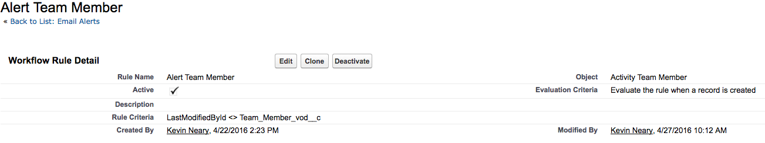
Notes:
Keep this Notification – Add the City_vod as well to the E-mail Template- This needs to be kept in the Simple Build.

Slide 7
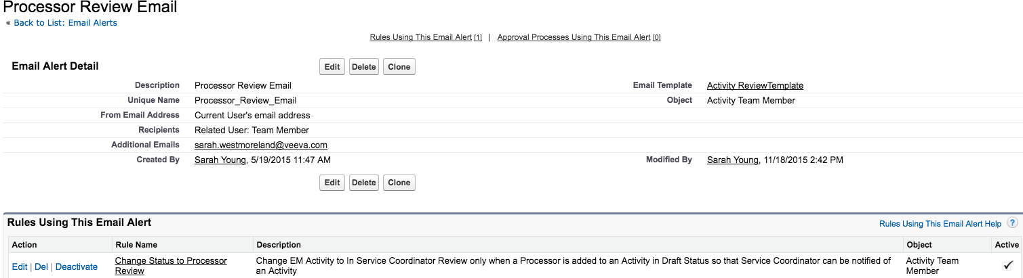
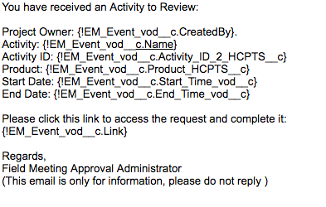
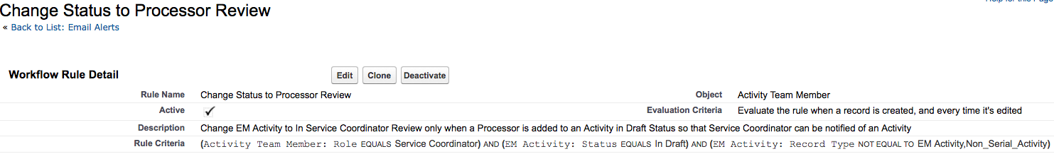
Notes:
This is N/A for Simplified EM Activity. Might want to look at changing the wording in PROD – look into adding the City.

Slide 8
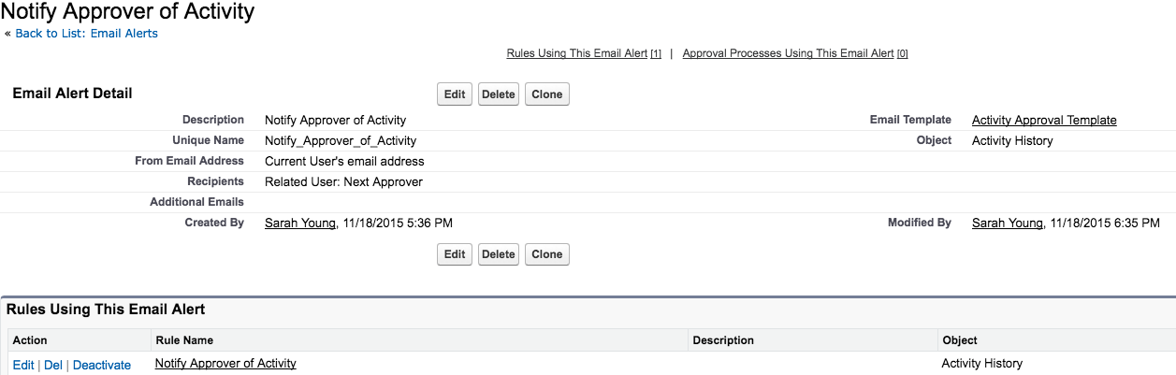
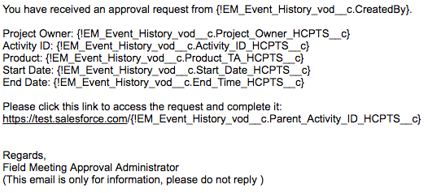
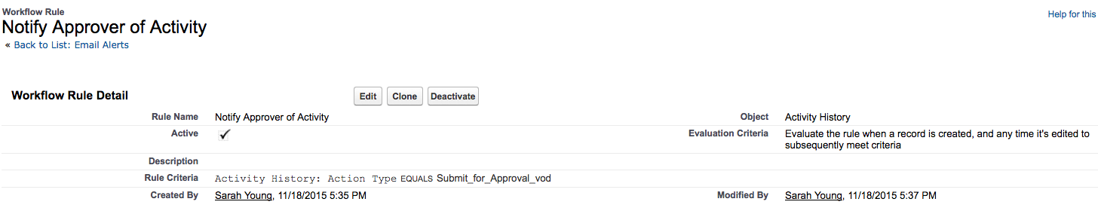
Notes:
Update this e-mail template to match the new Simplified Approval process. Also, ability to approve/reject using e-mails needs to be available. However, Activity History record creation may need customization which needs to be looked at at some point. Email template should also include Activity City.

Slide 9
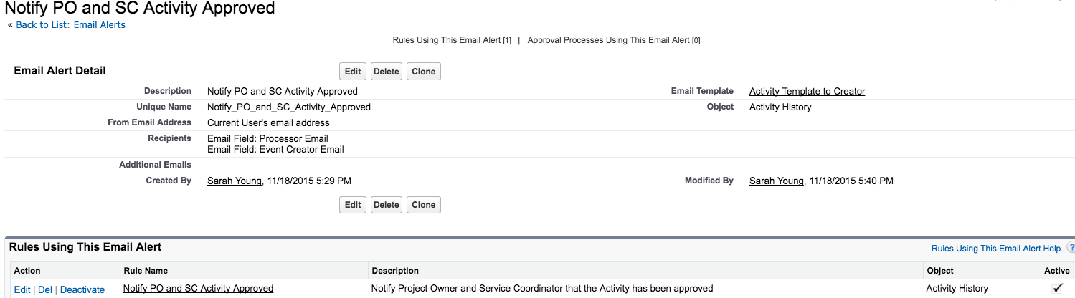
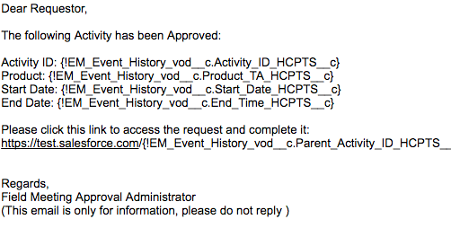
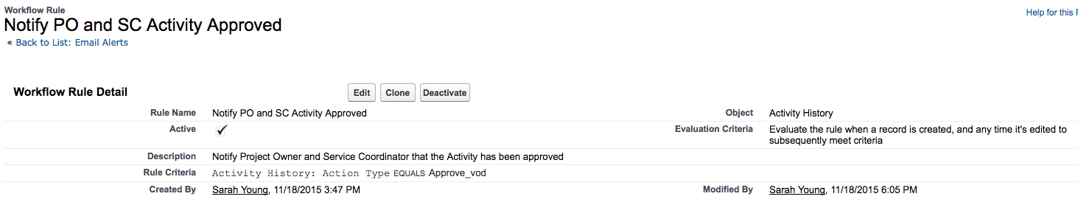
Notes:
Keep this for Simplified build. Also add Activity Name, City to ALL Simple Email templates

Slide 10
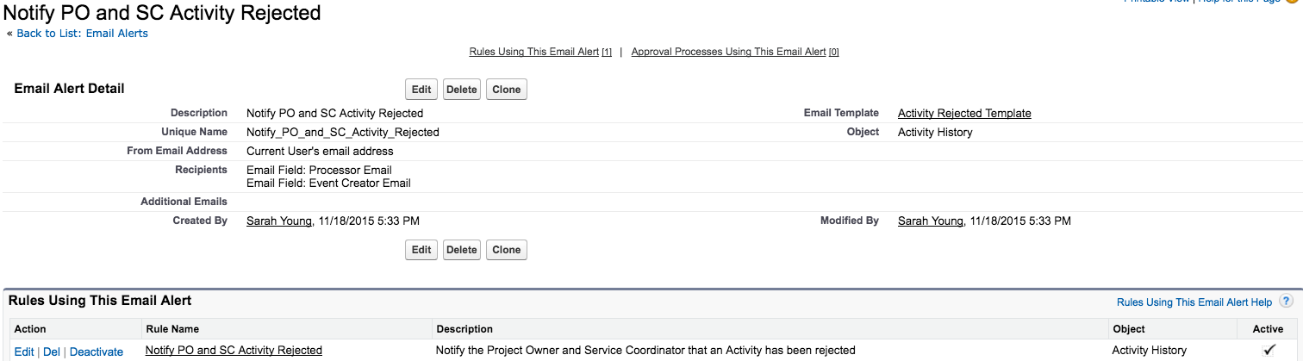
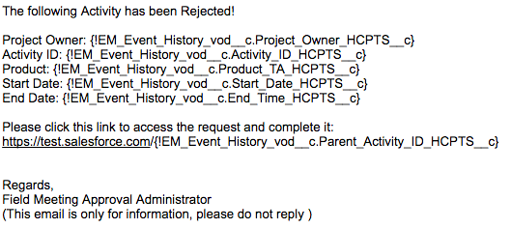
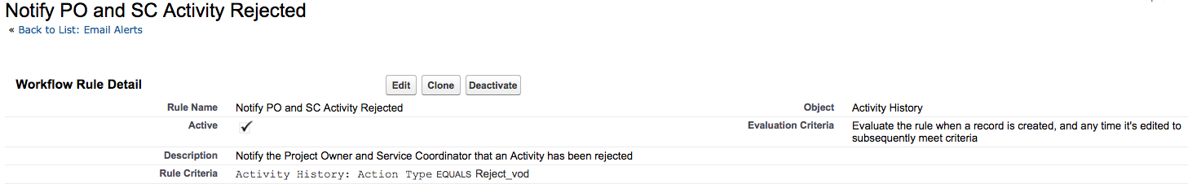
Notes:
Keep this for Simplified build. Also add Activity Name, City to ALL Simple Email templates. See if the Comments can be added to this e-mail template.

Slide 11
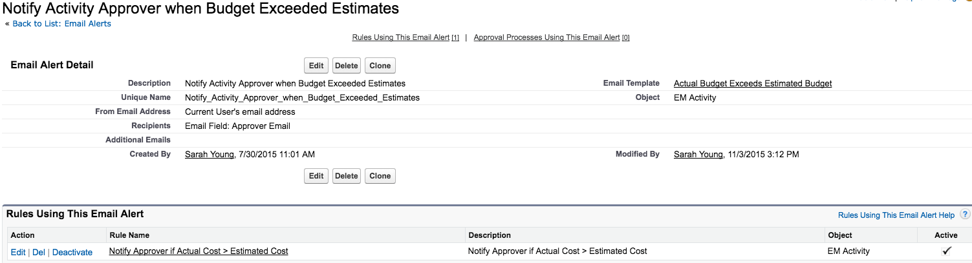
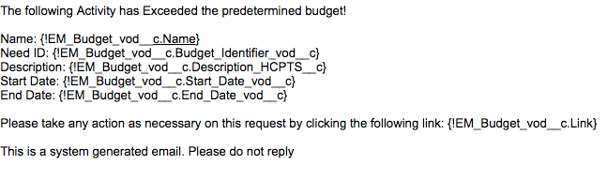
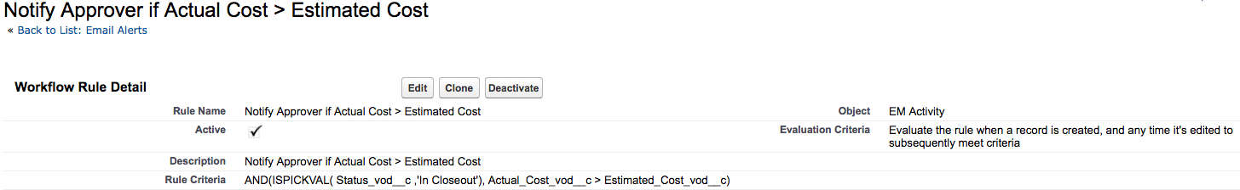
Notes:
N/A for Simplified Core Build.

Slide 12
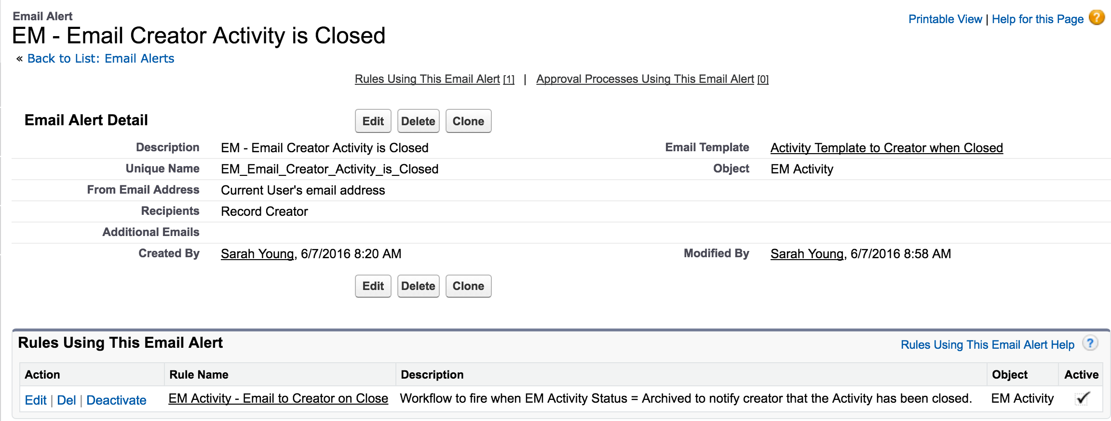
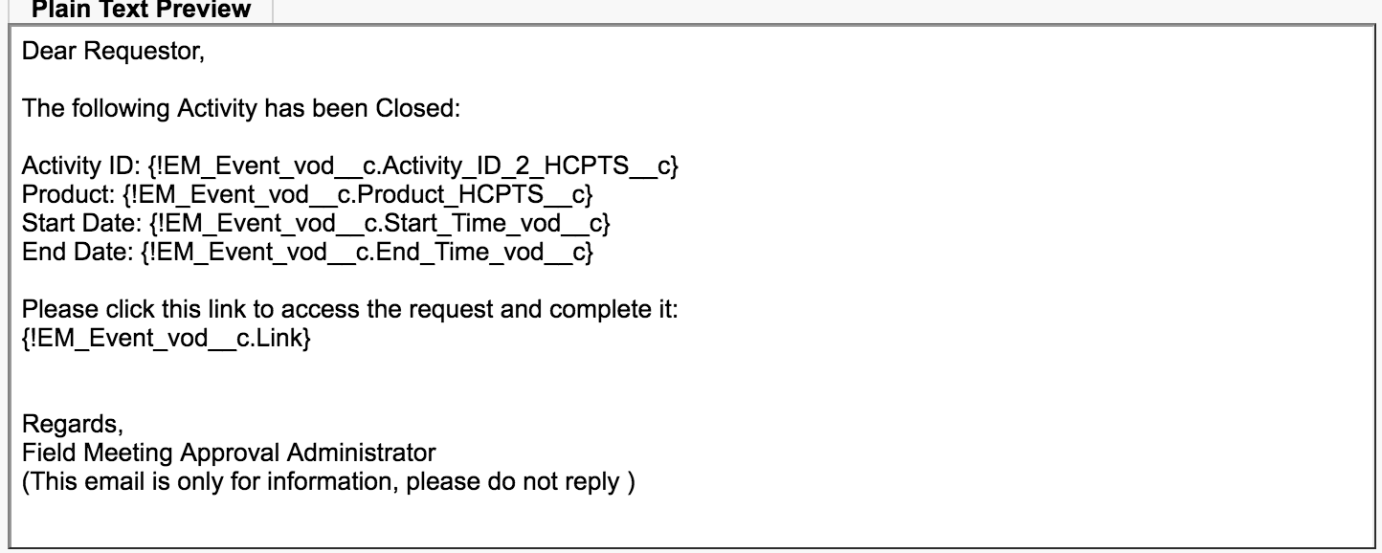
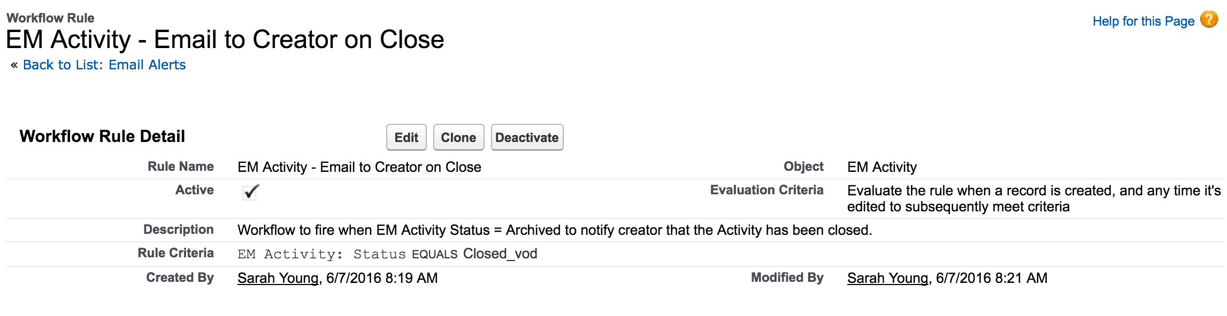
Notes:
Keep this in Simplified Build.Add city and event name to this template.

Slide 13
New Simple Emails
When a Task has been assigned, E-mail should be sent out- Org Specific
E-mail to be sent out as a reminder after n # of days of Post-Event Status
Pre, Post, Archived//Pre, Pending Approval, Approved, Post-Event, Archived
SC needs to be able to create Activities on behalf of another user
ONLY SCs can update Team Member roles
As an AO – you can add Team Members and choose a role – cannot edit but can add and delete Team Members

Slide 14
Created but Not used currently (redundant)–
Certifier Activity Email Notification
EM Approver Notification
EM Activity Approval Notification Email
Activity- Approve or Reject Email – inactive ef - Send Email to Business Approver
Activity Email Activity Creator – inactive wf - Approval Notification
Activity Rejected by Approver - EM Activity Rejection Email
EM Activity Rejected Email
ICF has been Signed
Need (Guidance Budget) Submitted for Approval

