Slide 1

EM 2.0 – Opening Event Access
March 2017

Slide 2
Requirement
Ability for the user to see all events where the HCP was an Attendee or Service Provider when selecting that HCP for an Event.
Product Enhancement
Revised requirements:
Ability for the user to see all events where the HCP was an Attendee when selecting that HCP as an Attendee for an Event.
Ability for the user to see all events where the HCP was a Service Provider when selecting that HCP as a Service Provider for an Event.
Ability for users to see all events where the HCP was an Attendee or Service Provider for an Event on the Customer Profile and timeline view (InterAct CR to update the Account page layout, not in scope for EM 2.0)
The events for these 3 requirements should be limited to Events within the user’s Country

Slide 3
Veeva Recommendations
Product Enhancement for the original Requirement
Configuration option
Sharing rule to share out all Events within the Company level of the country
There are existing sharing rules (see appendix) that we can leverage to minimize re-work for Wave 1
A WF or a Trigger to reuse these FFM Sharing rules OR Brand new set of sharing rules for countries that do not have existing sharing rules that meet this requirement
All non-team members (including Service Coordinators) will get the restricted access page layout
Only Defined team members will see the full details of the Event based on if their role is Activity Owner, Editor, Read Only or Service Coordinator
If a Service Coordinator is not added as a team member, but needs access to the Event, the new business process should be that they reach out to the owner or SC and ask the owner to add the Service Coordinator to add them
Defined Profiles may get extended view with more details; for eg Sys Admin
Requires updates to current page layouts; documentation to the RS, Access Grid and FD; and re-unit testing

Slide 4
Potential Future Updates
There are ways to enhance this access in a future release, but in the effort to meet this requirement in the deadlines provided, these should be considered for future.
Re-open access to all Service Coordinators
All Service Coordinators would need to be added to their own unique profile(s)
If this is considered while FFM meetings are still in progress, a full analysis would need to be done to ensure existing Service Coordinators continue to have access to close out FFM Meetings
Consider adding the Team Member and Tasks to the restricted page layout
This would allow users to see who the team members are and send a task to that team member to grant access or obtain other information

Slide 5
Testing
Change in 2.0 testing strategy to ensure:
If two users within the same Country who share the same HCP in their territory can see all Events that HCPs attended within their country regardless of Role, BU, Sales, Medical, etc…
Unless the user is a team member, they only see the restricted page layout
Change in CRM & EM 1.0 Regression Testing
Ensure no impact to CRM FFM Meeting access
Ensure no impact to EM 1.0 Event access in Germany

Slide 6
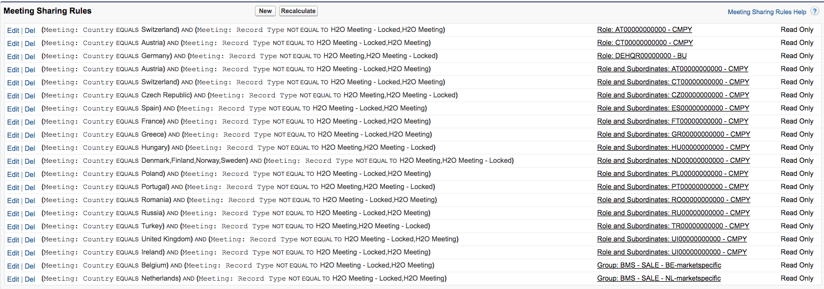
Appendix: Existing Meeting Sharing Rules

