Slide 1

_{Using EM Queues}
Veeva Professional Services

Slide 2
Objective
Enable using Groups/Queues for Event Team Members in Veeva EM
Formulate a process that BMS can use based on initial discussions with Business on what they required

Slide 3
Business Process
Event Creation
PO Creates a new Event
QM Assignment
PO adds a Market Specific QM
QM Triage
QM Monitors queue showing unassigned Events
QM Picks an Event and assigns to a Service Coordinator
Process Completion
QM releases the record from the Queue

Slide 4

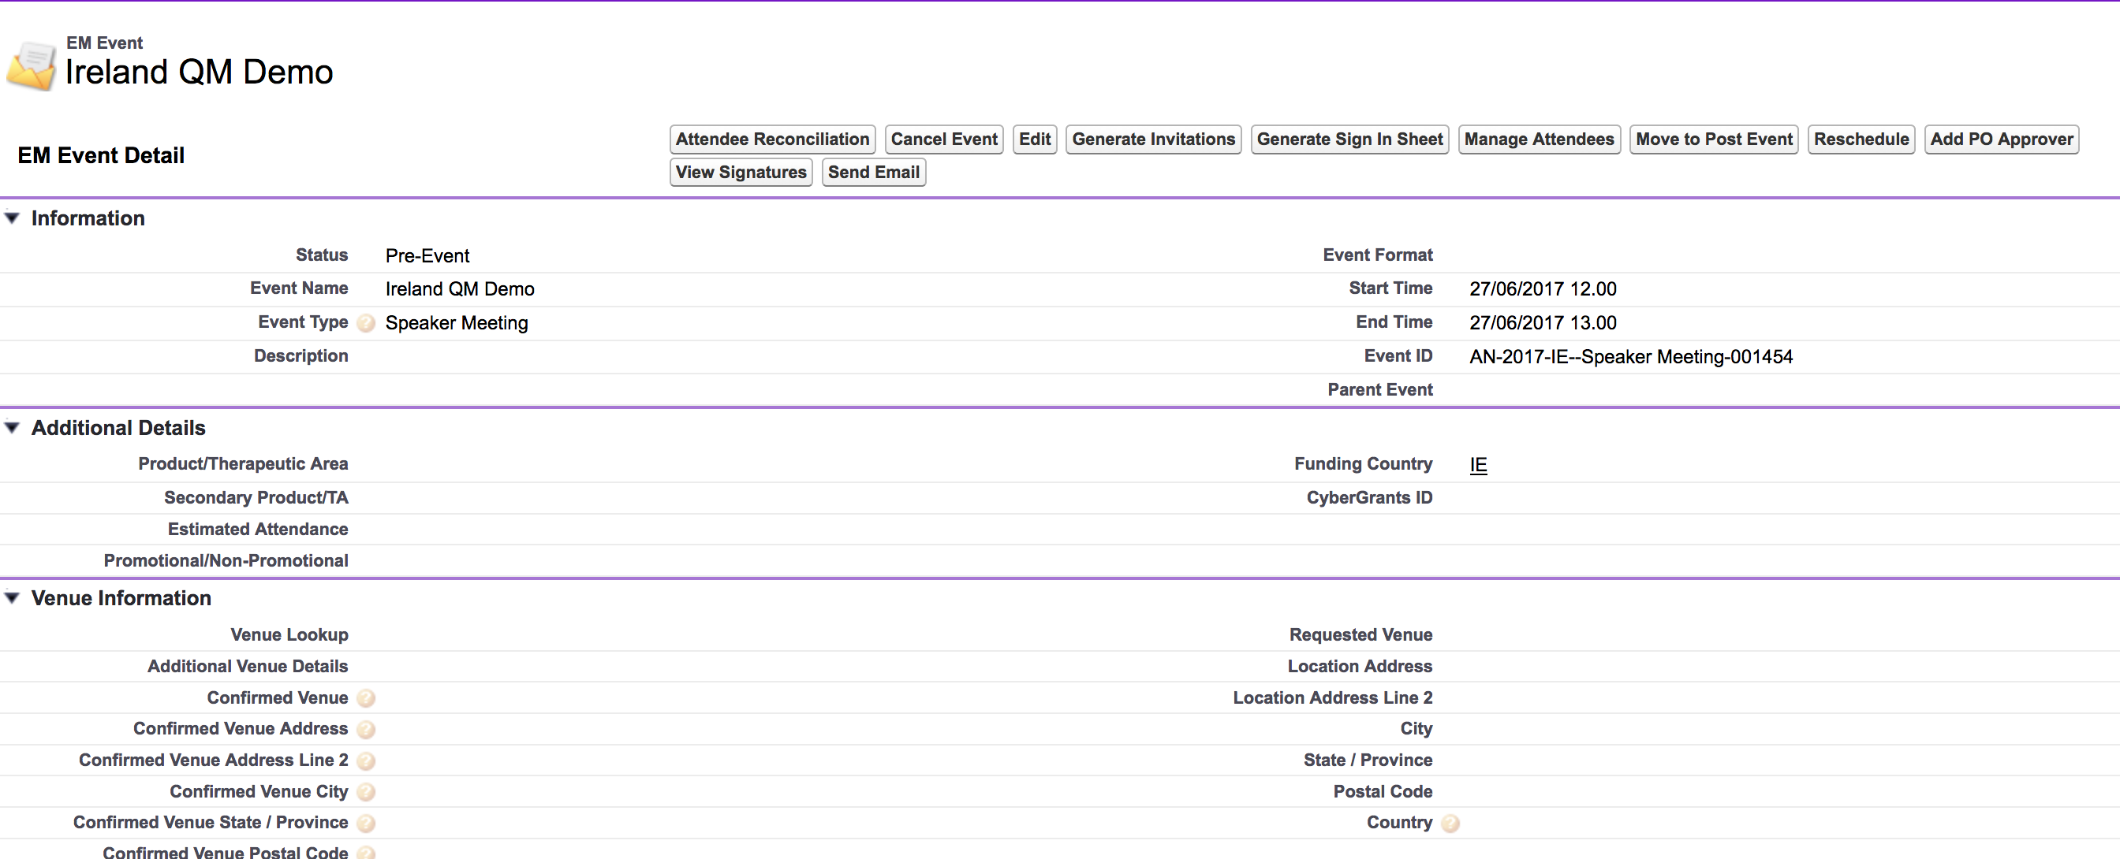
Event Creation

Slide 5

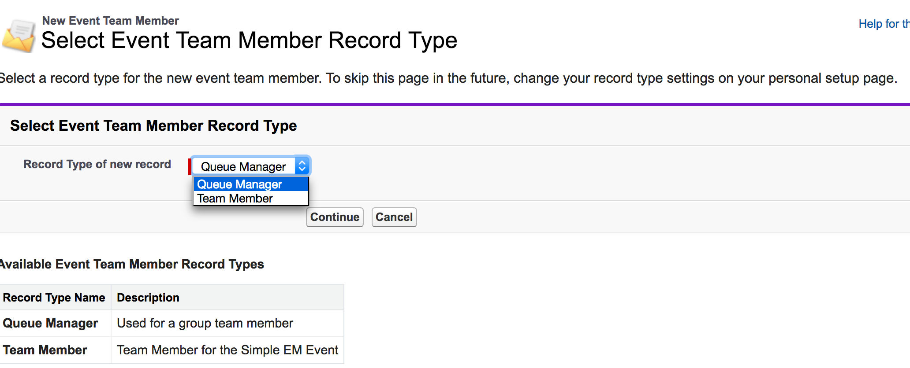
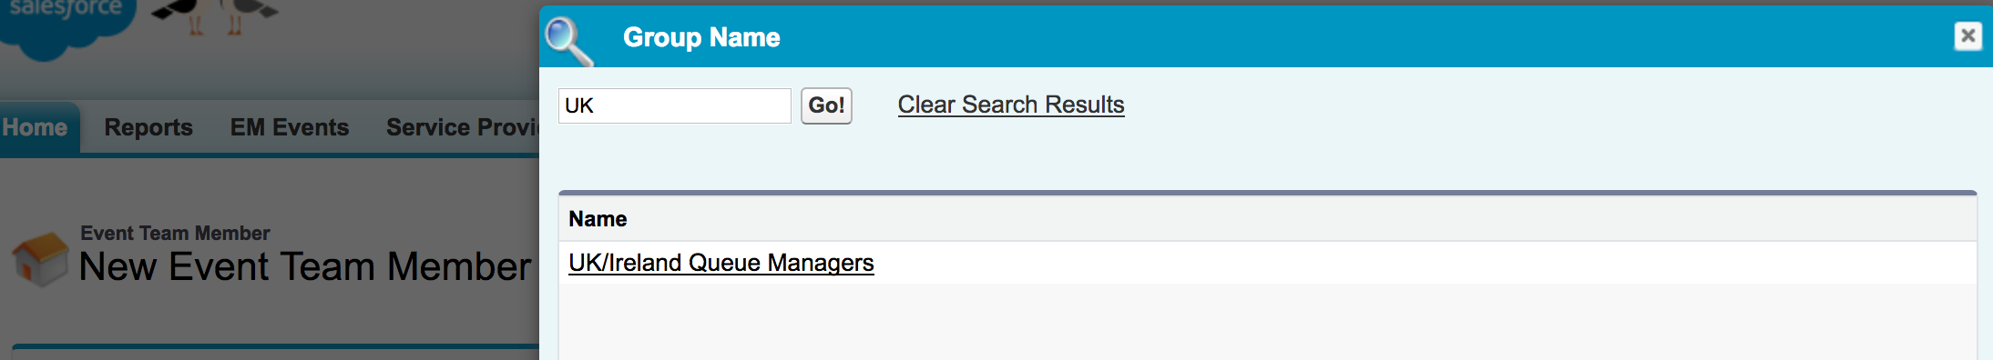
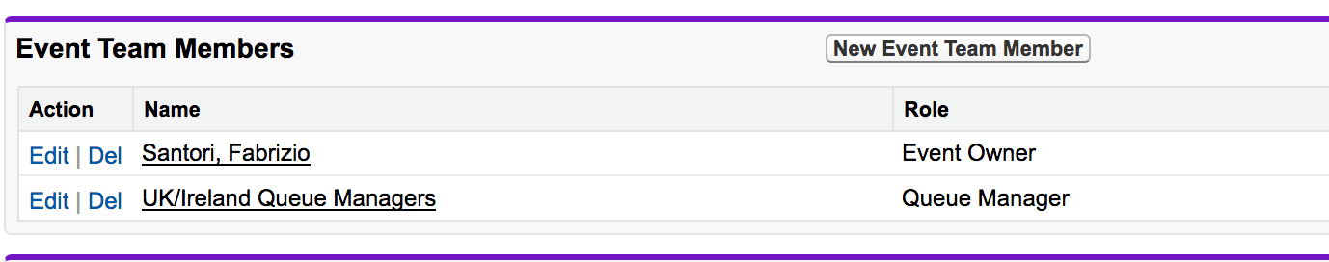
Queue Manager Assignment

Slide 6

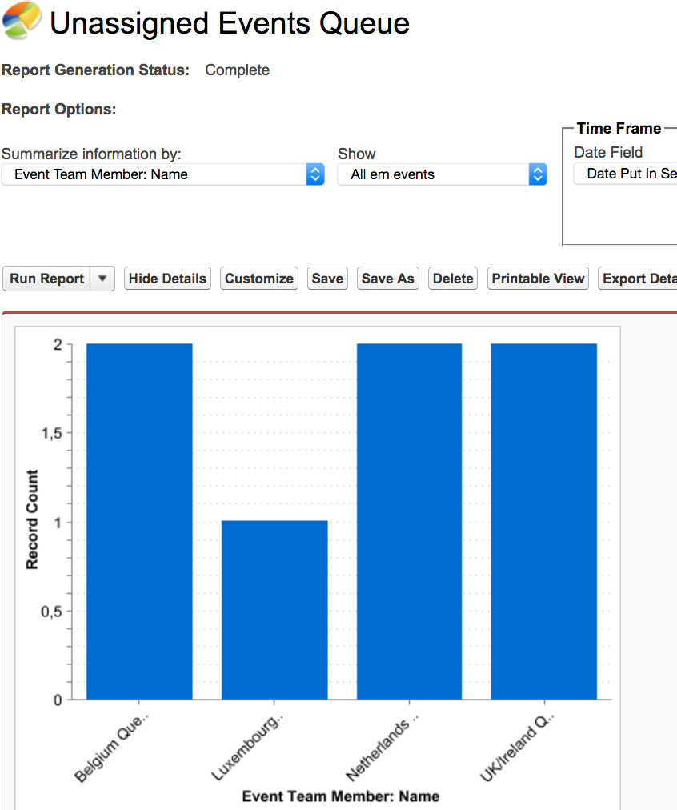
Queue Manager Triage
QMs run a report/Dashboard to see their Market’s Events that are not yet assigned to a Service Coordinator

Slide 7

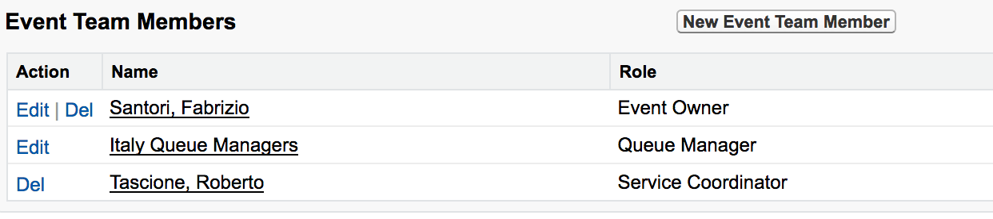
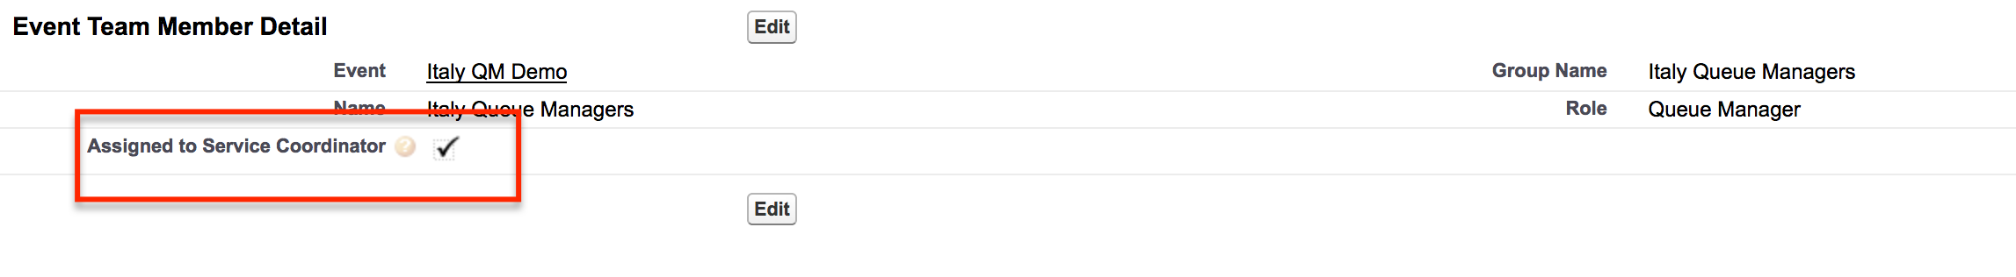
Queue Delegation Process Completion
QM Assigns a real single user/person as a Service Coordinator
QM then checks a box on the Queue Member team member record to indicate SC has been assigned
This will take him out of the queue report

