Slide 1

_{Using EM Queues}
Veeva Professional Services

Slide 2
Agenda for today
Queue Manager assignment/triage Requirement overview
Veeva’s recommended approach walk-through
System demo of Veeva’s prototype in EMSIM
Business Feedback!

Slide 3
Business Objective
High Level Requirement: Ability for Events Management to support a Work-Queue for effective delegation & delivery of responsibilities
Granular Requirements:
Ability for the system to define a group of users as an EMCoE Team for their Market
Ability for Field Users to delegate Service Coordinator assignment process to their EMCoE Team
Ability for EMCoE team to be able to track a dynamic queue of Events that need attention (for Service Coordinator assignment)
By Market (?)
By BU (?)
Ability for EMCoE team members to assign Service Coordinators to Events in their Queue

Slide 4
High Level flow in Veeva EM
Event Creation
PO Creates a new Event
QM Assignment
PO adds a Market/BU Specific Queue Manager (QM)
QM Triage
QMs monitor queue showing unassigned Events
A QM Picks an Event and assigns to a Service Coordinator
Process Completion
QM releases the record from the Queue manually OR
System releases it automatically when SC is added

Slide 5

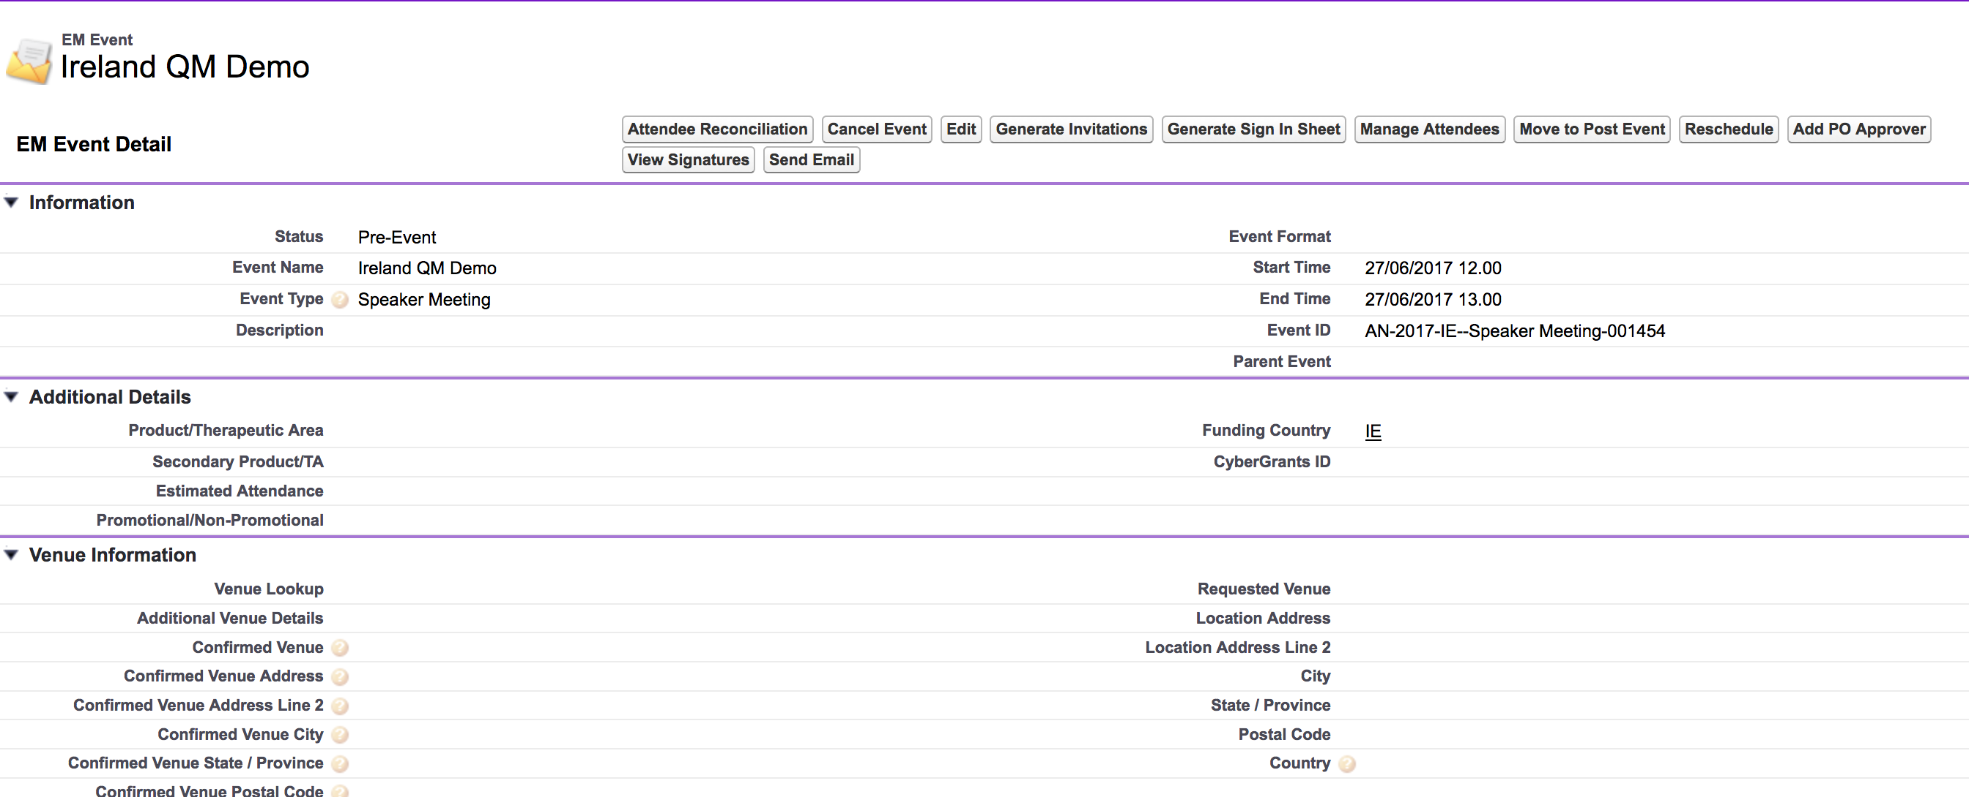
Event Creation

Slide 6

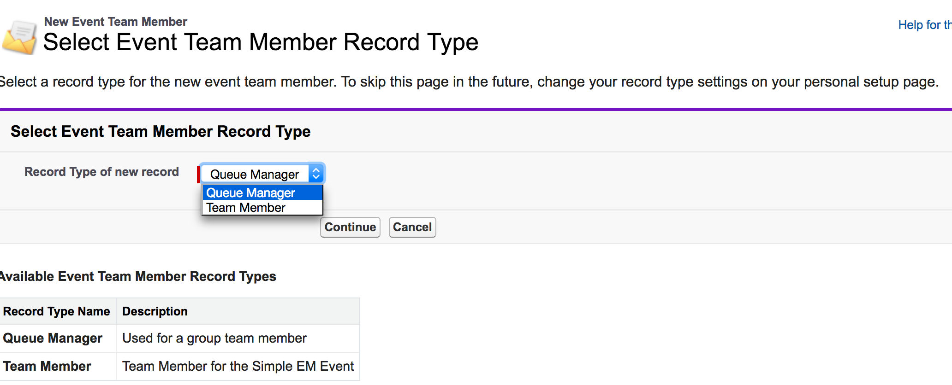
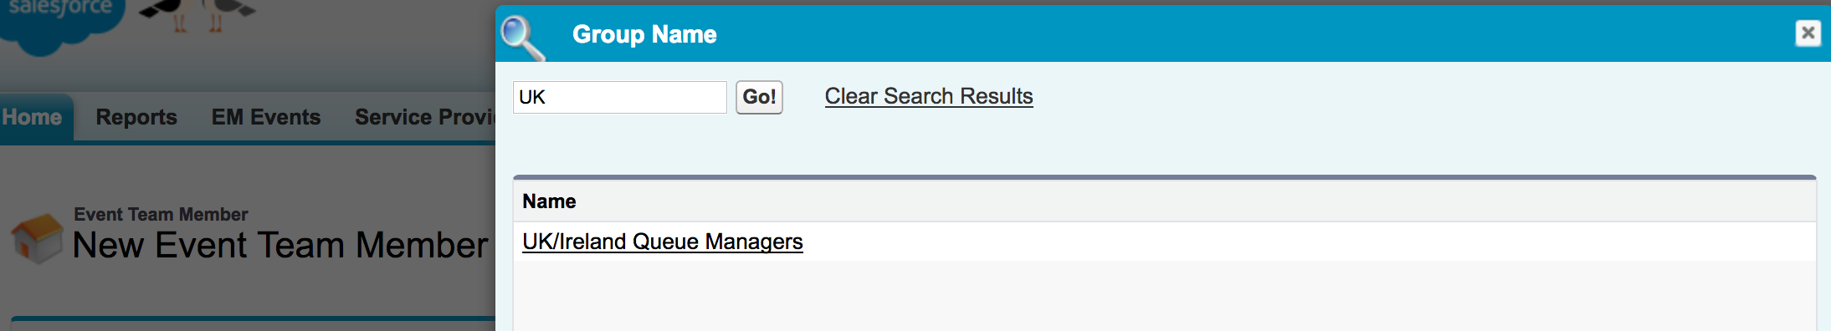
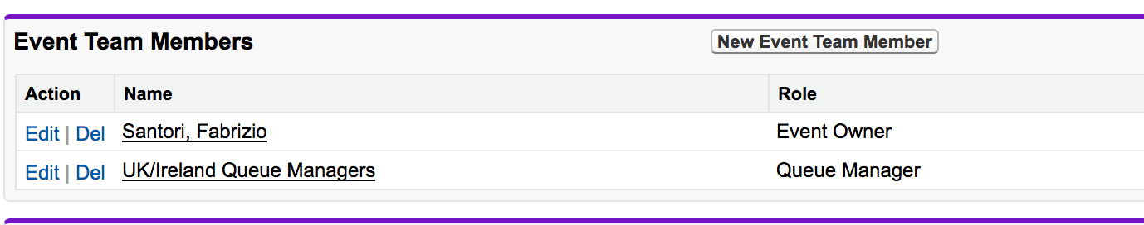
Queue Manager Assignment

Slide 7

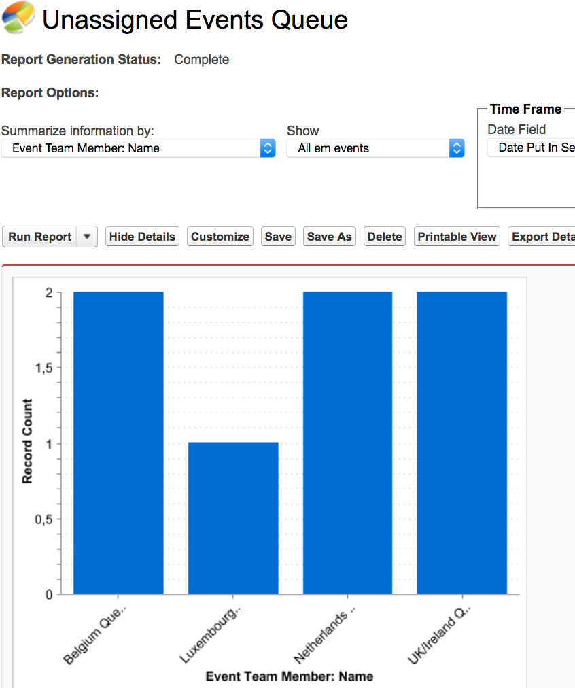
Queue Manager Triage
QMs run a report/Dashboard to see their Market’s Events that are not yet assigned to a Service Coordinator

Slide 8

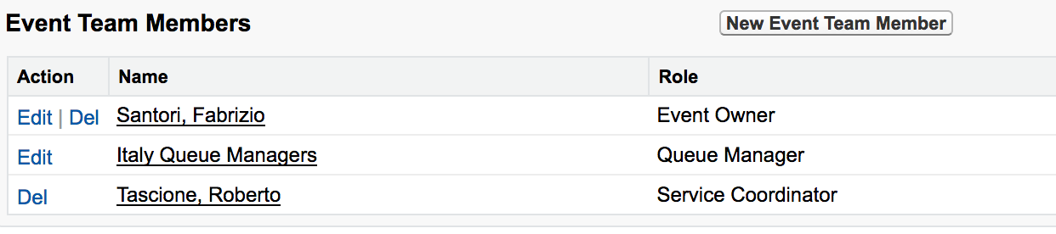
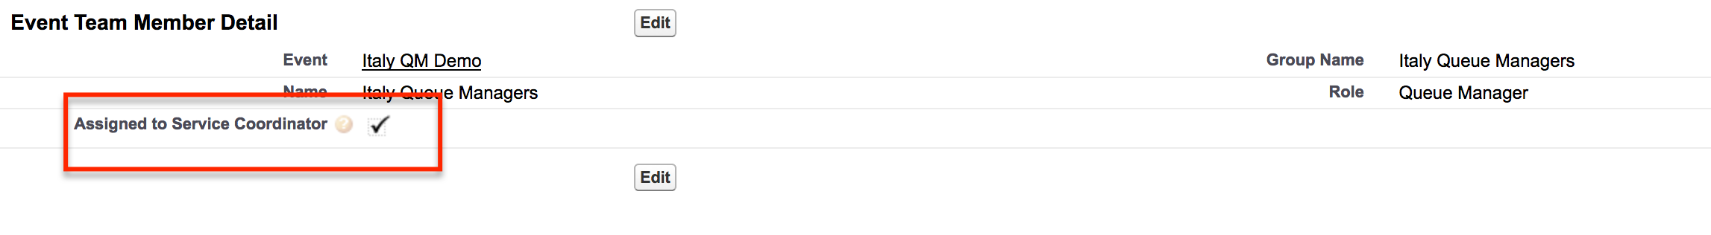
Queue Delegation Process Completion
QM Assigns a real single user/person as a Service Coordinator
"Question – Should the existence of a valid Service Coordinator on the Event indicate QM intervention is no longer required and hence the Event should not show in the Report OR Should the QM specifically mark SC Assignment to be complete?"

