Slide 1
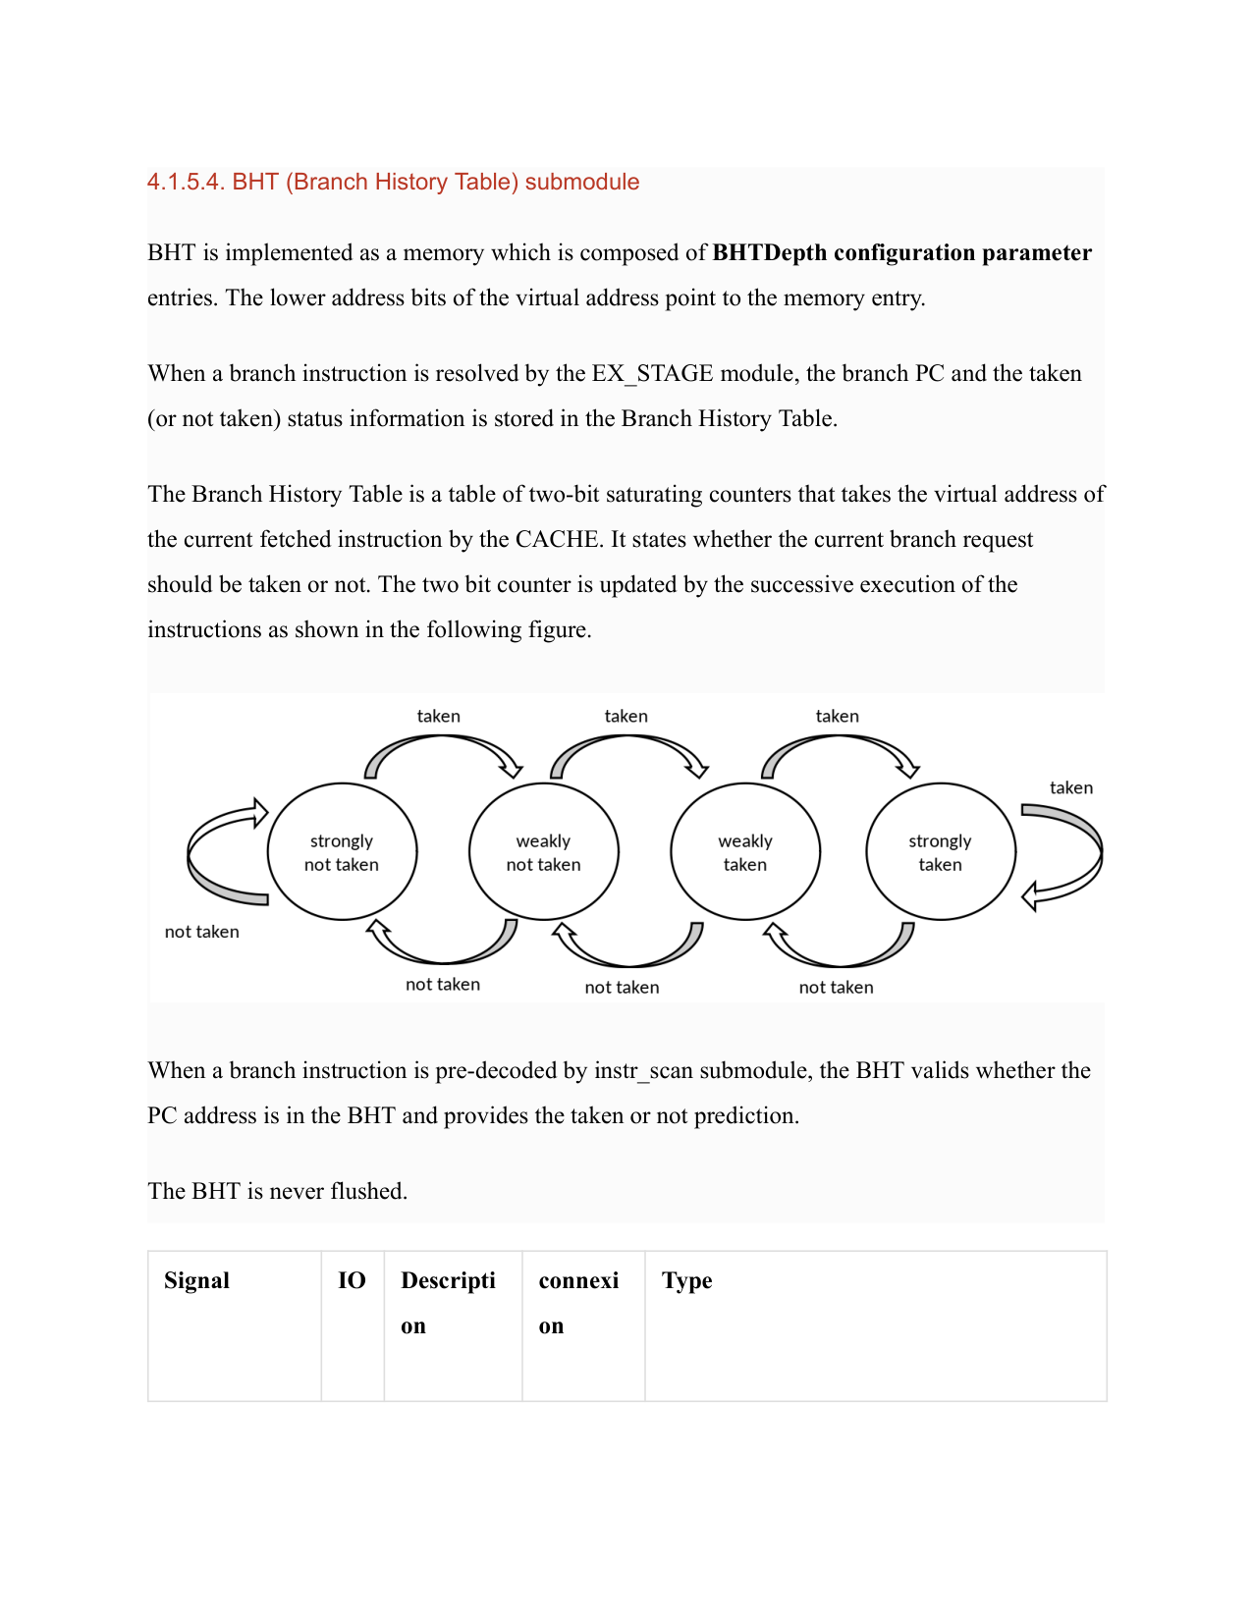
label
pdf
data
Section header
Text block
Figure
Text block
Table
["Signal", "IO", "Description", "Connection", "Type"]

Slide 2
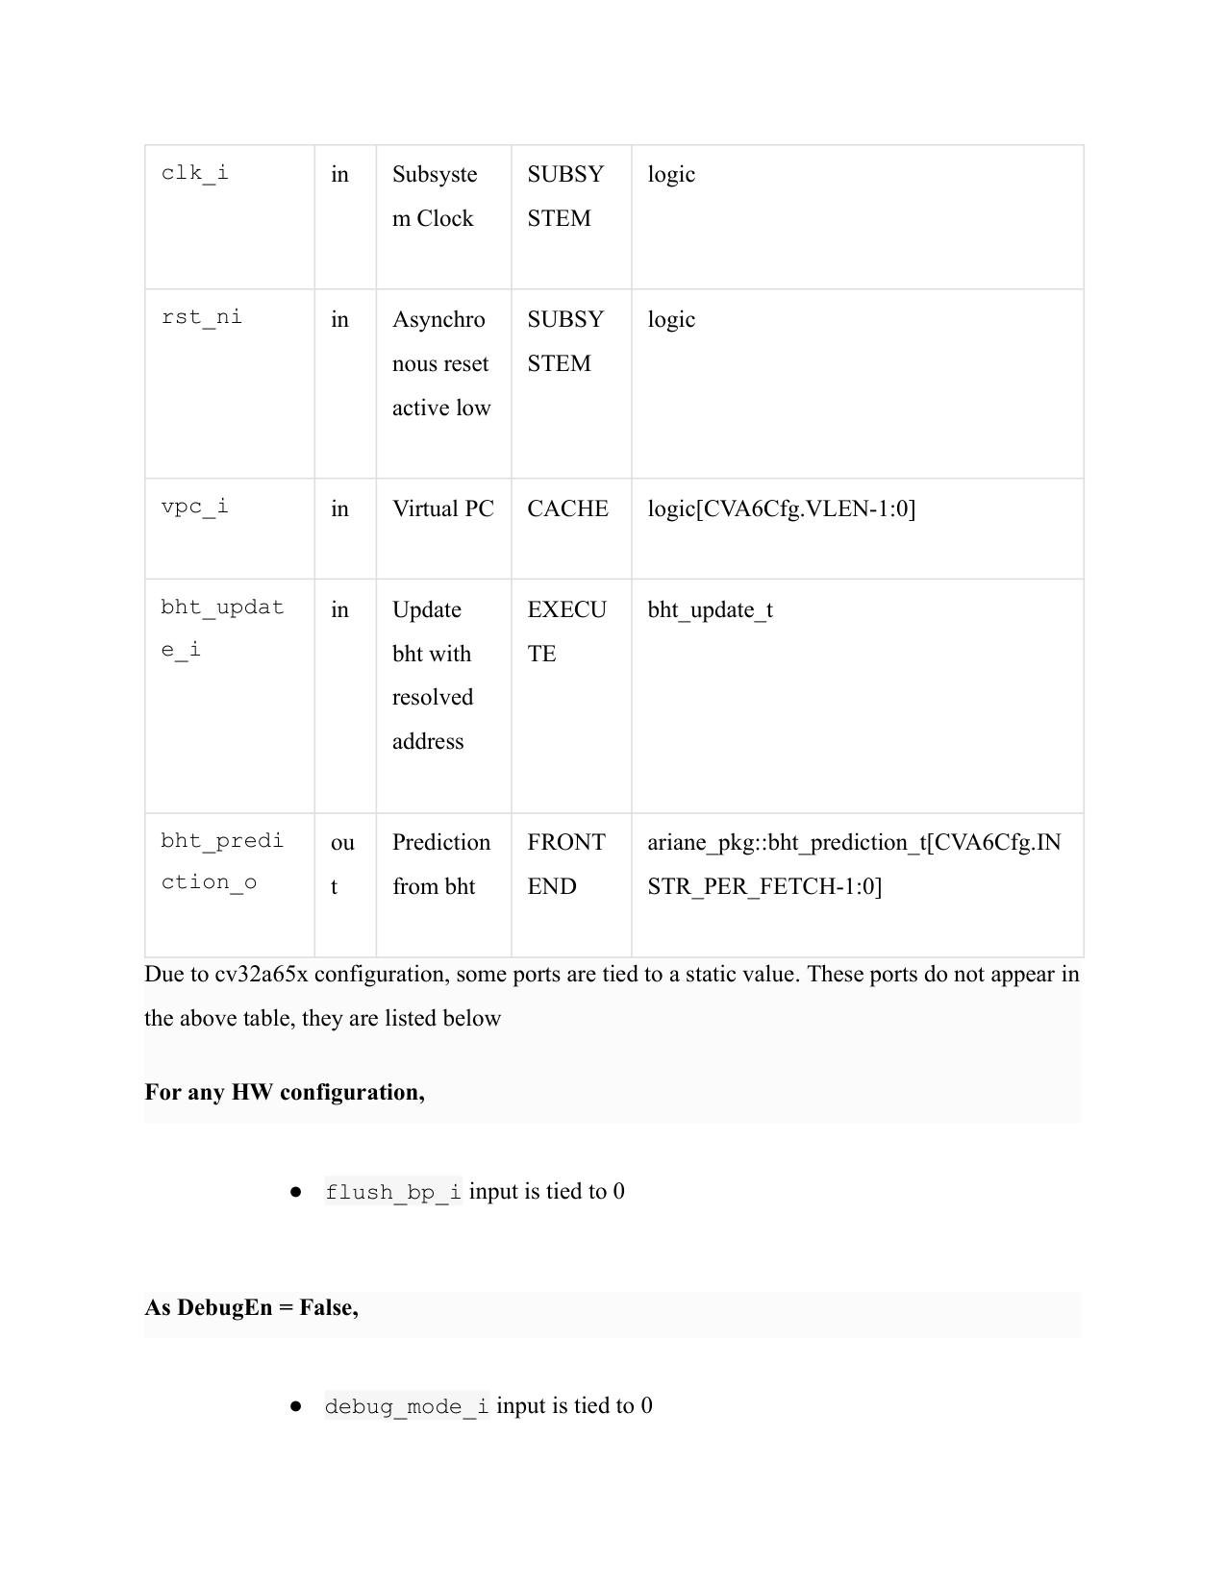
label
pdf
data
Table
[
{
"signal": "clk_i",
"direction": "in",
"description": "Subsystem Clock",
"unit": "SUBSYSTEM",
"type": "logic"
},
{
"signal": "rst_ni",
"direction": "in",
"description": "Asynchronous reset active low",
"unit": "SUBSYSTEM",
"type": "logic"
},
{
"signal": "vpc_i",
"direction": "in",
"description": "Virtual PC",
"unit": "CACHE",
"type": "logic[CVA6Cfg.VLEN-1:0]"
},
{
"signal": "bht_update_i",
"direction": "in",
"description": "Update bht with resolved address",
"unit": "EXECUTE",
"type": "bht_update_t"
},
{
"signal": "bht_prediction_o",
"direction": "out",
"description": "Prediction from bht",
"unit": "FRONT END",
"type": "ariane_pkg::bht_prediction_t[CVA6Cfg.INSTR_PER_FETCH-1:0]"
}
]
Text block

Slide 3
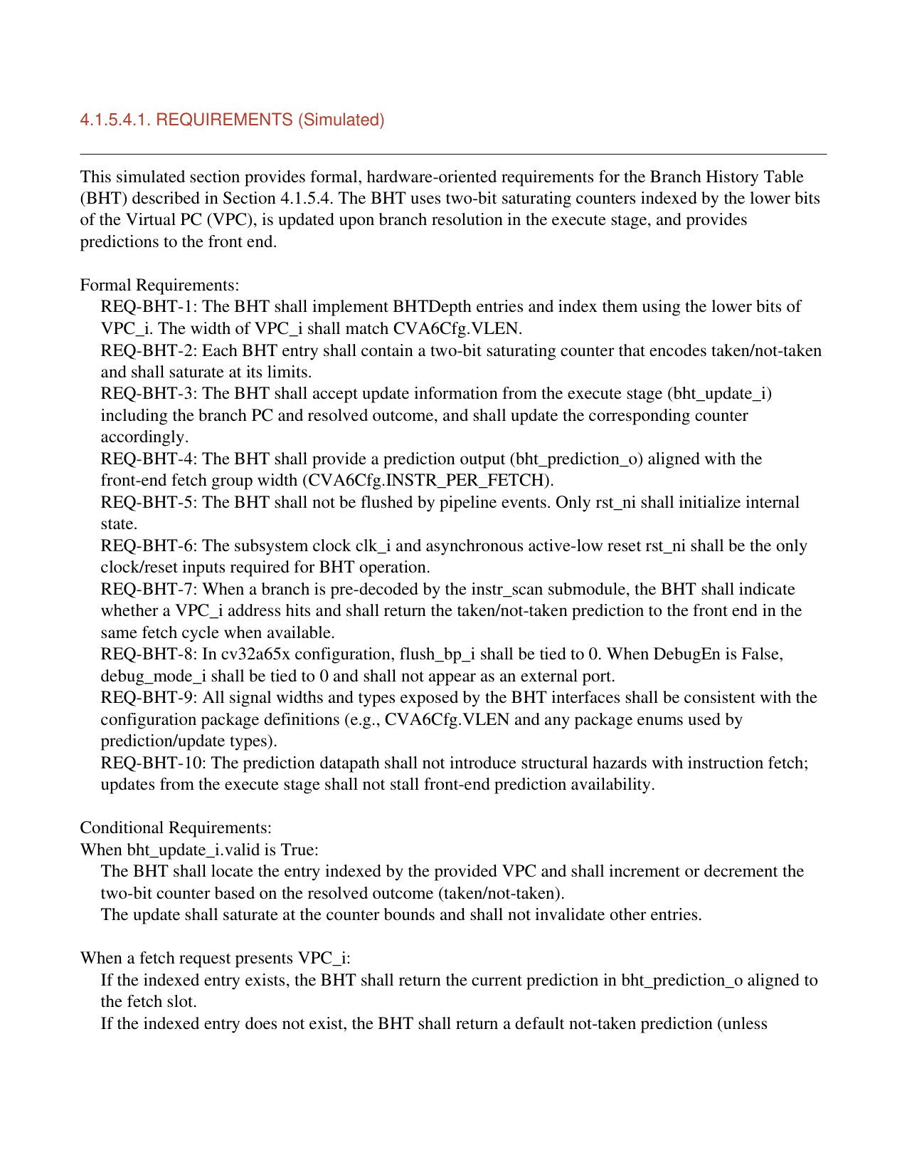
label
pdf
Section header
Text block
Requirement
Requirement
Requirement
Requirement
Requirement
Requirement
Requirement
Requirement
Requirement
Requirement
Text block
Requirement
Requirement

Slide 4
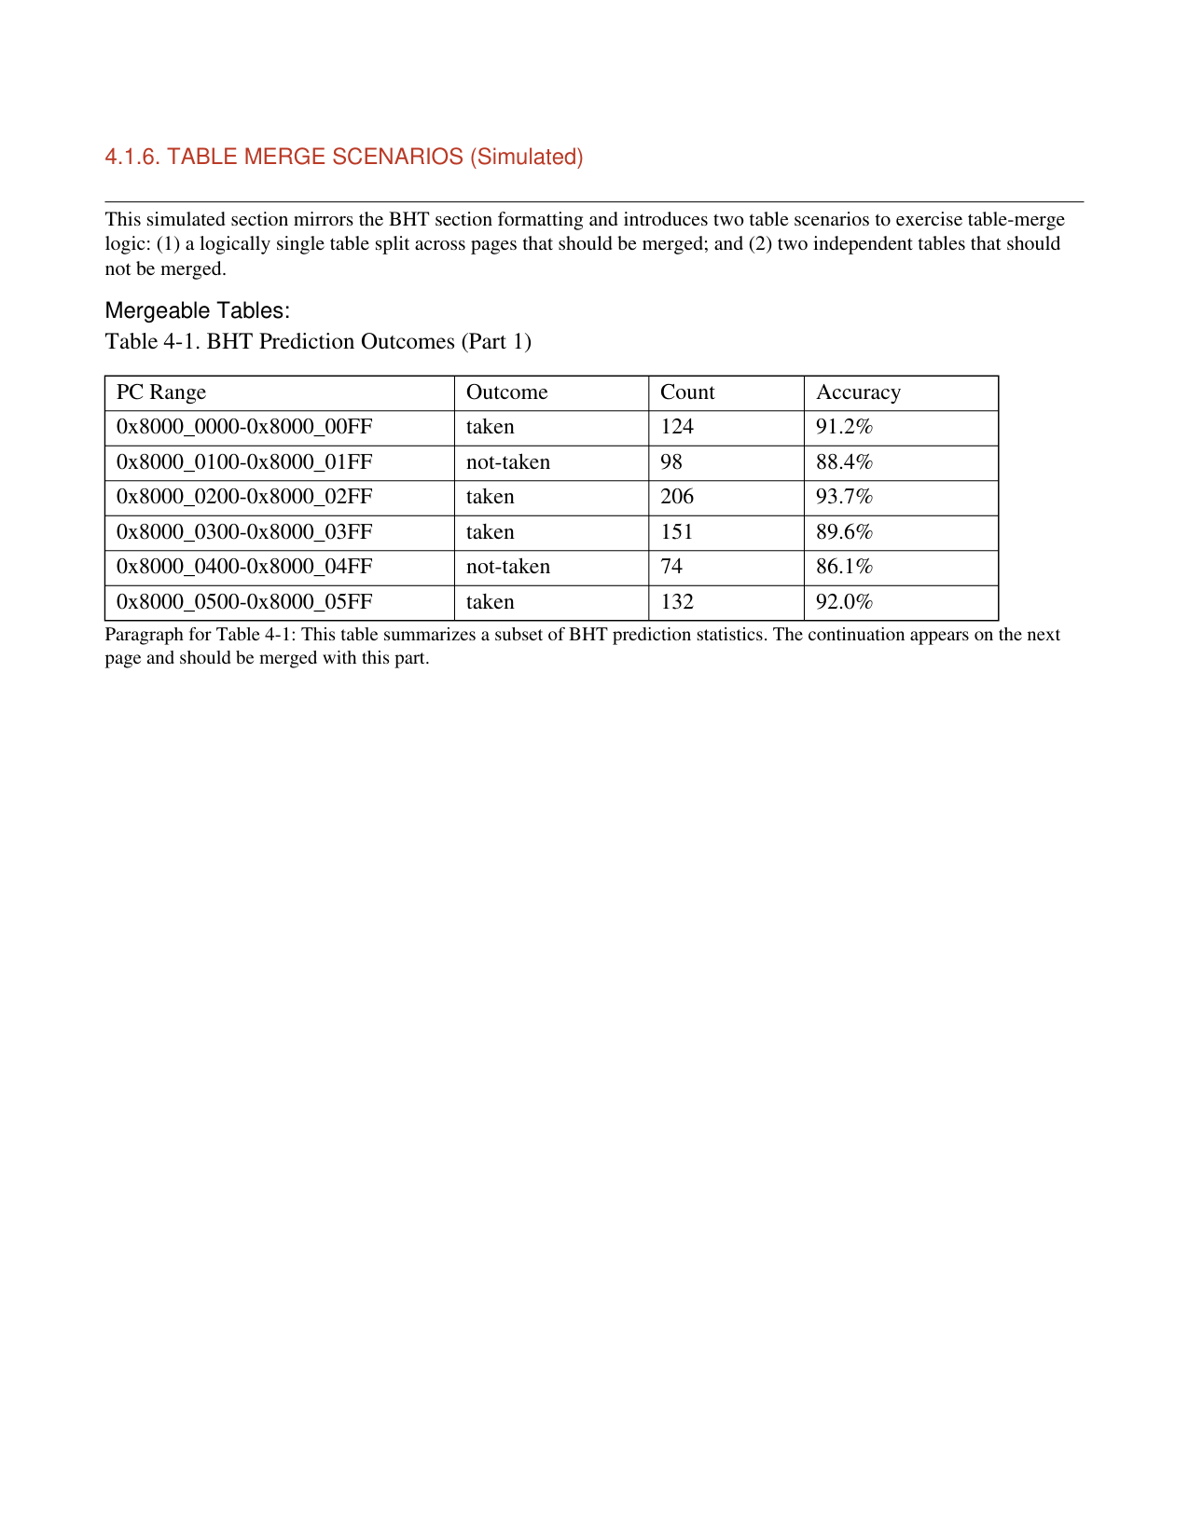
label
pdf
data
Section header
[
{
"PC Range": "0x8000_0000-0x8000_00FF",
"Outcome": "taken",
"Count": 124,
"Accuracy": "91.2%"
},
{
"PC Range": "0x8000_0100-0x8000_01FF",
"Outcome": "not-taken",
"Count": 98,
"Accuracy": "88.4%"
},
{
"PC Range": "0x8000_0200-0x8000_02FF",
"Outcome": "taken",
"Count": 206,
"Accuracy": "93.7%"
},
{
"PC Range": "0x8000_0300-0x8000_03FF",
"Outcome": "taken",
"Count": 151,
"Accuracy": "89.6%"
},
{
"PC Range": "0x8000_0400-0x8000_04FF",
"Outcome": "not-taken",
"Count": 74,
"Accuracy": "86.1%"
},
{
"PC Range": "0x8000_0500-0x8000_05FF",
"Outcome": "taken",
"Count": 132,
"Accuracy": "92.0%"
}
]
Text block
Table
Text block

Slide 5
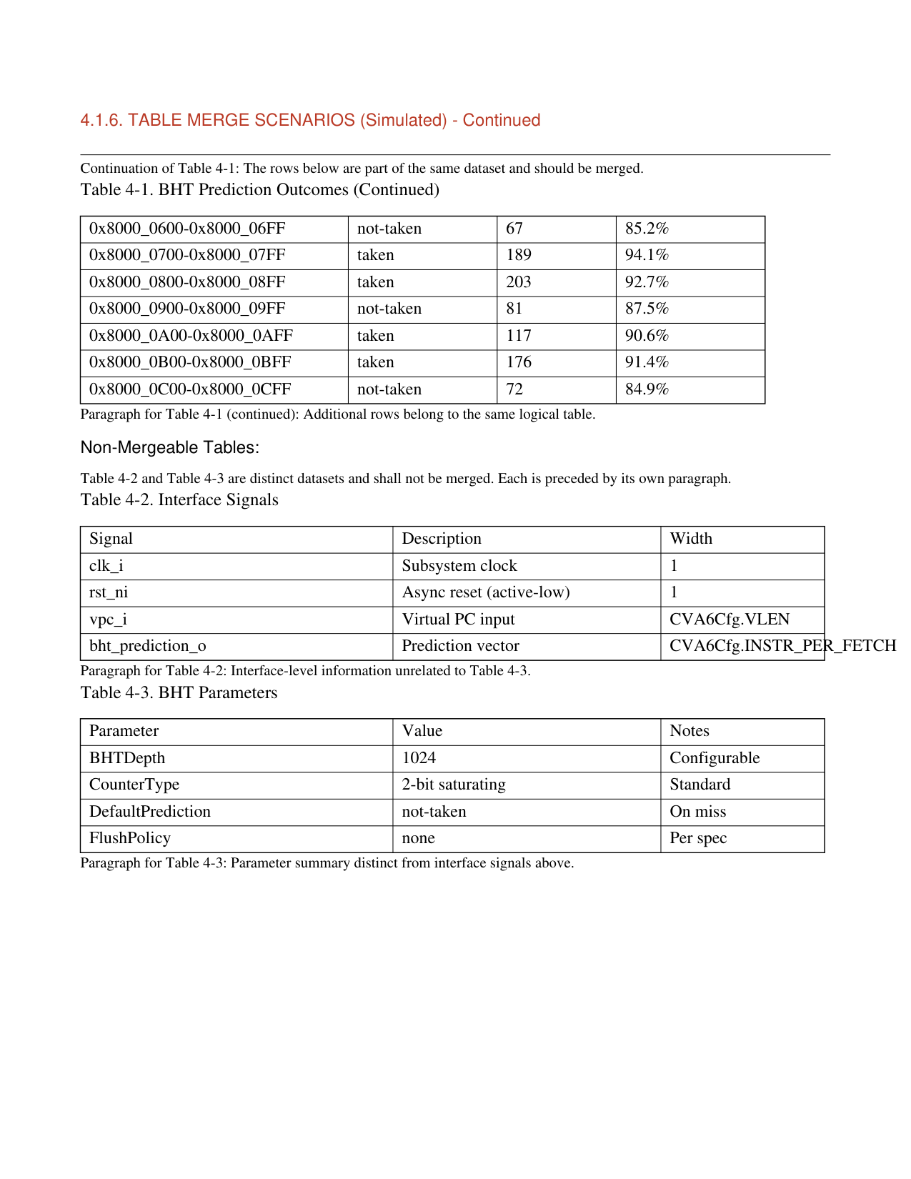
Text block
Table
Section header
Text block
Table
Text block
Table
Text block

