Slide 1
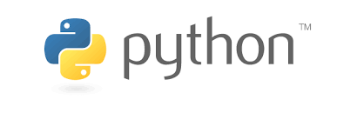
python training Schedule
Have you…
Heard about Python and want to see what all the talk is about?
Explored Python previously and want a refresher?
Ever thought “I bet this could be automated”?
Spent too much time working with dirty data?
Python Training is scheduled for September 18th, 20th, and 22nd in the Board Room. Lunch will be provided!
Day 1: Intro to Python | Day 2: Python for Analytics | Day 3: APIs, Review, Live Coding
Course Roadmap Explore the Spyder IDE Python Fundamentals Syntax Variable Assignment Viewing Variables Data Structures Intro to Object Oriented Programming Functions Classes, Attributes, Methods Errors, Exceptions, and Debugging Common errors/exceptions Debugging approaches Example Scripts | Control Flow Try/Except/Finally If/elif/then Loops Standard Python Modules Package Review: Numpy Ndarray Array-based computations Package Review: Pandas Series DataFrames DataFrame Operations Package Review: SciKit Learn Machine Learning Review website Example Scripts | Popular Python APIs Helpful Python Modules Look at resources for exploring what’s available Review Days 1 + 2 Quick overview followed by time for Q & A Live Coding Exercise Attendees given the task of programming a small workflow Practice/reinforce the concepts learned, foster discussion and P2P help Example Scripts (if time permits)
Calendar invitations, RSVP confirmation, and dietary restrictions (for lunch orders) to follow

