Slide 1




Generating Phases of Play in Rugby Union using Recurrent Neural Networks
Thomas Edley
Graham Davies
Supervised by Neil Watson

Slide 2
Background
Rugby Union is based on sequences of play called phases.
Recurrent Neural Networks (RNNs) are capable of modelling and predicting outcomes of sequences.
Common Uses: Natural language processing and image recognition
RNNs have been found to be effective in sport analysis.
Sequential nature of sport is often overlooked.

Slide 3
Recurrent Neural Networks in Sport
A Sure Bet: Predicting Outcomes of Football Matches (Goddijn et al., 2018).
Predicting the winner of NFL-games using Machine and Deep Learning (Bosch and Bhulai, 2018).
Integrating machine learning and decision support in tactical decision-making in rugby union (Watson et al., 2020).

Slide 4
Aim:
Primary Objective: Determine whether one can use RNN’s to simulate a game of rugby union.
Secondary Objective: Test for significant different in the phases of play between winning and losing teams.

Slide 5
Recurrent Neural Networks
Used to model sequential data.
Similar to standard feed-forward neural networks.
Output influenced internal memory.
Standard RNNs do not have a long memory.

Slide 6
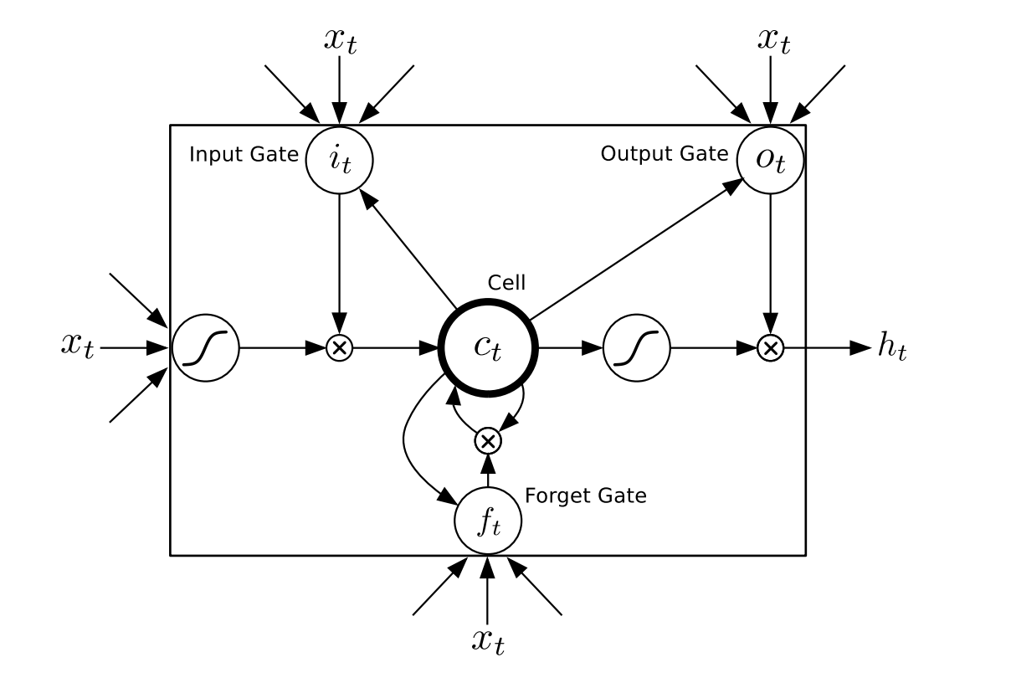
Long Short-Term Memory Networks
Long short-term memory networks (LSTM) have a longer memory than standard RNNs.
Input(i), output(o) and forget(f) gate.
Cell state(c) has information added to it by various operations of the cell.
LSTM Cell from Graves, 2014

Slide 7
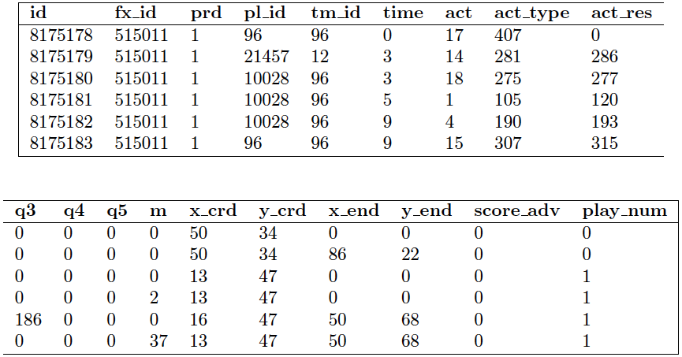
Data
Data sheets for five competitions between 2013 -2015
Extensive
Spatiotemporal

Slide 8
In summary
Underexplored element of Rugby Statistics
Primary objective is to generate phases of play
Potential for secondary objectives.
LSTMs are the best RNNs to perform the task due to the storage of long-term memory.
Data is suitable for our project

