Slide 1

DYNAMIC COLLISION AVOIDANCE
Ryan Baker
Garrett Chinsomboon
Graham Fletcher
George Yuchi
31 October 2011
Notes:
Our project encompasses a system of algorithms, sensors and computer vision which measure driving conditions and the distance to the leading car. The system alerts end users when collision is imminent.

Slide 2

Project Overview
  System that detects impending collisions
  Designed for highways
  Determines reaction time
  Weather detection
  Real-time time headway display
  Issues warnings
2
Notes:
The motivation for our project is to prevent rear-end collisions. At this point, rear-end accidents account for a fourth of all collisions on the road. Apart from the fatalities that arise, these accidents cause hundreds of millions of hours of delay every year in America. It is also determined that most of these kinds of accidents arise from inattentive drivers. Therefore, we want to develop a system that warns the drivers of impending collisions. It is designed mainly for highway for use with vehicles moving at high speeds and will take into account each individual driver's reaction time by implementing a self-learning system that will determine constant values to be used in our generic model. Special aspect of the system is taking weather conditions into account, detect outside environment by a series of temperature/humidity sensors and a rain tracker device. If weather conditions are determined to be hazardous, the alert will be issued sooner to leave more time for the driver to react. Also will be committed to display a real-time headway reading for the driver. Using this value, the system will issue a visual and auditory warning to the driver accordingly. Our system is design to be a built-in product rather than an off-the-shelve product. We want our systems to be built-in to the vehicles before they are shipped to the drivers. Therefore, car manufacturers are our target customers but car buyers are our target users.

Slide 3
Technical Objectives
  Method of predicting impending collisions
  Auditory/visual warnings
  Weather/environmental factors
  Weatherproof enclosure to protect external parts
  Estimated cost of $1760
3
Notes:
So in general, the project has four major objectives:
-Defines method of predicting impending collisions using sensors and algorithms
-Issues alerts to the driver or user
-takes into consideration the weather and its effect on road conditions, which impact stopping distance
-fully integrateable into virtually any modern vehicle
mention weatherproofing enclosure as part of the integration
With the current bill of parts, we estimate this system to be readily deployed in industry for about $1760

Slide 4
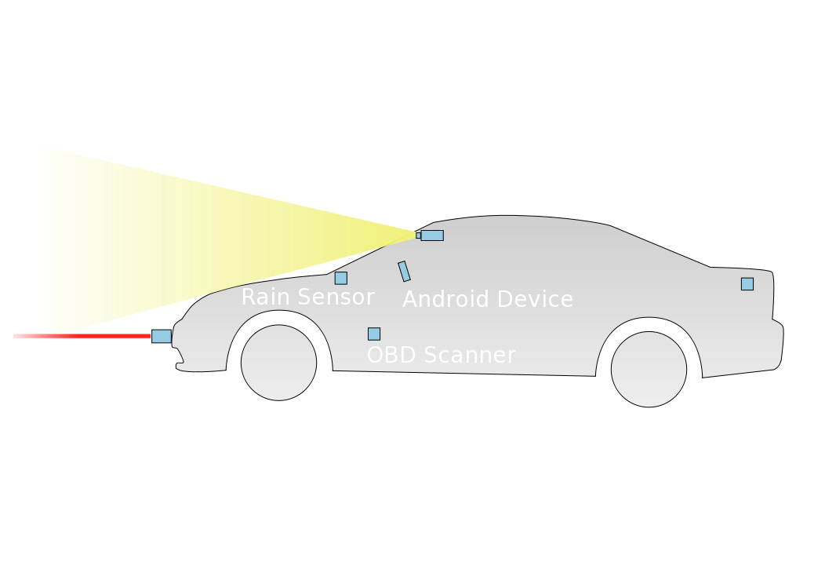
System Overview Diagram
4
Notes:
Our system has five primary sources of data input: a LASER RANGEFINDER, which measures the distance to a lead vehicle; a RAIN SENSOR, which detects precipitation on the windshield; an OBD SCANNER, which measures the instantaneous velocity of the vehicle; a TEMPERATURE SENSOR, which detects potentially icy conditions; and a CAMERA that detects and tracks lead vehicles.
The primary interface for the driver is an ANDROID MOBILE DEVICE, which displays the instantaneous time headway to a lead vehicle and issues auditory alerts through the vehicle's speaker system.

Slide 5

Component Interaction
5
Notes:
The OBD SCANNER and CAMERA are both connected to the CONTROLLING LAPTOP COMPUTER via USB.
The RANGEFINDER, TEMPERATURE SENSOR and RAIN SENSOR are each connected to the ARDUINO microcontroller.
The ARDUINO sends information from the RANGEFINDER, TEMPERATURE SENSOR and RAIN SENSOR to the LAPTOP COMPUTER over a USB connection.
The LAPTOP COMPUTER then takes the information from the FIVE INPUT SOURCES, calculates the the current time headway, compares it with a safe time headway, and sends the results to the ANDROID MOBILE DEVICE to be displayed to the driver.

Slide 6
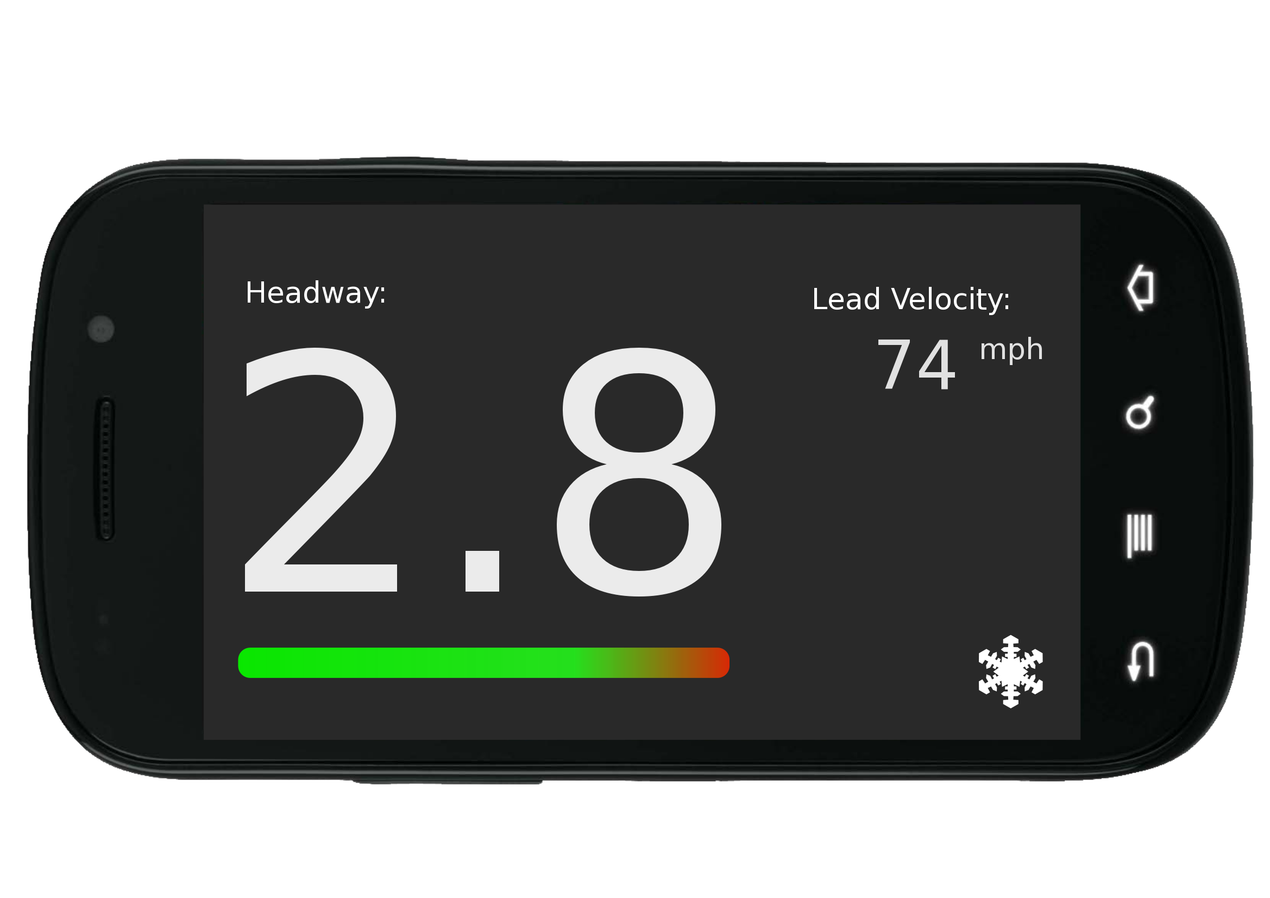
User Interaction
6
Notes:
What you see here is what the driver would see when looking at the android device. The main purpose of this device is to issue auditory warnings to the driver when the system has determined that a collision may happen.
The secondary function of the device is to present information to the driver about their driving conditions.
The headway value shows how much time it takes to reach the lead vehicle at current speeds and conditions. The bar graph changes to indicate whether or not the headway value is safe.
The icon that'll be displayed here indicates inclement weather conditions that may affect when warnings are issued. In this case, the slowflake would indicate icy road conditions.
The lead velocity is a placeholder for more pertinent information that we may choose to display instead

Slide 7
Problems and Limitations
  Vehicle recognition algorithm
  Android GUI development
  Occasional false readings for black-colored vehicles
7
Notes:
Vehicle Recognition Algorithm - The computer vision part of the system uses an algorithm that'll recognize things as vehicles. What's holding us back with this algorithm is that it may take up to a week for the algorithm to be trained off the data we've collected to detect vehicles
GUI development - When we were developing the android GUI, we had what we thought was a problem with reading from the sensor to the android. But what had really happened was that the connections to the sensors were too sensitive resulting in faulty readings. Eventually we fixed the connections but the sensors had such an accuracy problem that we decided to replace them all together.
False readings - Another problem is that we get occasional false distance readings from the laser range finder when it hits a black vehicle because of how the color affects reflectivity. We can deal with this by using kalman filter. What the filter does is it estimates the location of vehicles based off of previous valid data.

Slide 8
Project Schedule
  Android/Arduino interfaced - 28 Sept
  Temp, Humidity Sensors Online - 11 Oct
  Laser Range Finder Operational - 13 Oct
  OBD\Laptop Interfaced - 20 Oct
  Android GUI complete - 26 Oct
8
Notes:
So at this point in the prototyping process, our project is on schedule or ahead of schedule
Fully interfaced with all sensors and hardware
The first step in doing so was to get the Arduino online. So far, we have successfully gotten the Android mobile device to communicate with the Arduino ADK. The ADK board is a special Arduino that interfaces nicely with the recently released USB Accessory Mode set of API's included in Android 2.3.4 AKA Gingerbread
Due to shipping delays, the laser rangefinder was the last hardware component to go online. However, all sensors were fully operational by mid October.
Recently, we achieved communication via serial interface to the OBD port for velocity readings, and the visual alert interface written in java for Android is now complete.
We anticipate a fully functional prototype by mid-November.

Slide 9
Budget
Prototype Parts
Unit Cost
Arduino Mega ADK
$85
Laser Rangefinder
$320
Rain Sensor
$90
Total
$495
Delivery Status: Arrived
9
Notes:
This table shows the price of the hardware that was ordered using the senior design budget. so we have the arduino, the laser rangefinder and the rain sensor here. The laser range finder was bought at a discounted price, $100 off the original price tag. The engineer at Opti-logic also made modifications to their product to fit our needs. He increased the rep rate to 400 Hz, and tested it to make sure that it is still safe for the eye.
Other components such as the OBD cable, laptop computer, temperature/humidity sensor, webcam. we are able to either obtain it from the senior design lab or one of the team members donated it for the sake of completing this project
so far, all the hardware components have arrived and we are working hard to interface them together.

Slide 10
Current Status
  Laser Rangefinder
    Completed
  Android Phone
    GUI completed
    Receives data from Arduino
  OBD Scanner
    Vehicle speed obtainable
  Temperature Sensor
    Measurements can be obtained
  Computer vision
    Crude lane detection algorithm completed
    Training data for vehicle detection gathered
10
Notes:
The LASER RANGEFINDER is completely finished. We are able to parse all of the data output from the device's RS232 interface and filter the data to obtain reliable distance measurements.
The ANDROID MOBILE DEVICE has a fully-functional GUI and is able to recieve data from the Arduino.
We are currently able to obtain the vehicle's velocity in real-time from the OBD SCANNER and are in the process of combining this data with the LASER RANGEFINDER data to calculate the instantaneous time headway.
We are able to obtain real-time information from the TEMPERATURE SENSOR, but we still need to implement a filter to remove invalid data.
The COMPUTER VISION portion of our project is the furthest from completion, but so far, we are able to detect lanes in real time and we have gathered all of the training data necessary for completing the vehicle detection algorithm.

Slide 11
Future Work
Task
Date
Implementation of auditory alerts
5 Nov
Mounting of rangefinder on vehicle
5 Nov
Interpretation of temperature, humidity and precipitation data
10 Nov
System Logic for calculating headway and giving warning
14 Nov
Interfacing with rain sensor
20 Nov
Vehicle Detection and tracking algorithms
25 Nov
11

Slide 12
Questions
  26.5% of all motor accidents are front-to-rear crashes
  Such accidents accounts for 4.3% of traffic-related fatalities
  Accounts for 1/3 of all crash-caused delays
  Results in 157 million vehicle-hours of delay annually
  64% of such crashes are a result of driver inattention
12

