Slide 1

EARLY DYNAMIC COLLISION AVOIDANCE SYSTEM
Ryan Baker
Garrett Chinsomboon
Graham Fletcher
George Yuchi
12/14/2011
Notes:
George

Slide 2

Project Overview
  System that detects impending collisions
  Determines reaction time
  Weather detection
  Warns driver of impending collisions
  Designed for highway conditions
  Real-time headway time display
  Final cost of $1760
2
Notes:
Ryan
So in general, we created a system that engages during interstate travel and detects impending collisions. Our project uses several subsystems to achieve this goal. we developed a learning algorithm to evaluate the user's reaction time. This requires "training" the system for each specific user.
The system evaluates weather conditions and any impact on stopping distance. The system then measures distance using a laser and determines if the current following distance and speed will result in a collision.
Alerts are then sent to an Android mobile device which is mounted inside the interior of the vehicle. It issues an auditory alert via the car speakers and displays a visual warning on the phone's screen.
Final cost for our project was a total of $1760.00.

Slide 3
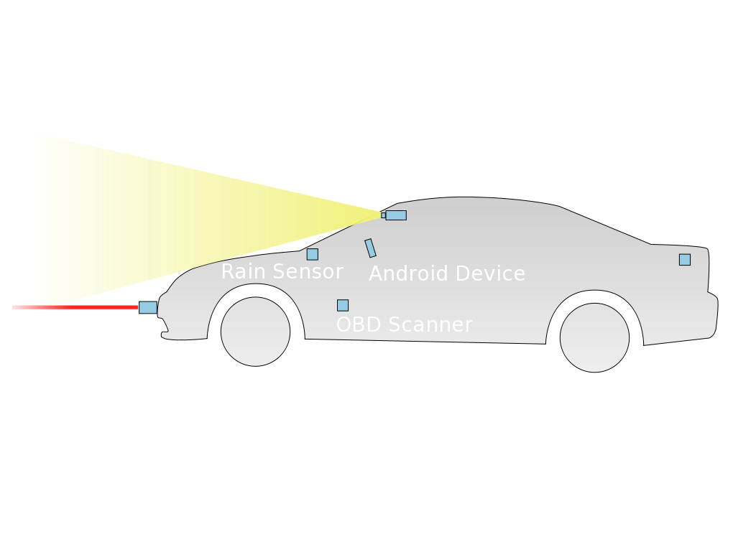
System Overview Diagram
3
Notes:
Ryan
Here we have a visual breakdown of the various components and where they are located on or in the vehicle.
There is a laser rangefinder mounted to the front bumper and in planar alignment with the ground.
The rain sensor which bounces light on the windshield and measures changes in refractivity is mounted inside on the front windshield.
The system camera is mounted on the reverse of the rearview mirror.
Our onboard diagnostics scanner is plugged into the OBD port by the driver
The android mobile device is mounted on the dash facing the driver.
And the temperature and humidity sensors are mounted in the trunk, exposed to the elements but beneath the chassis' metal exterior.

Slide 4

Block Diagram
4
Notes:
George

Slide 5
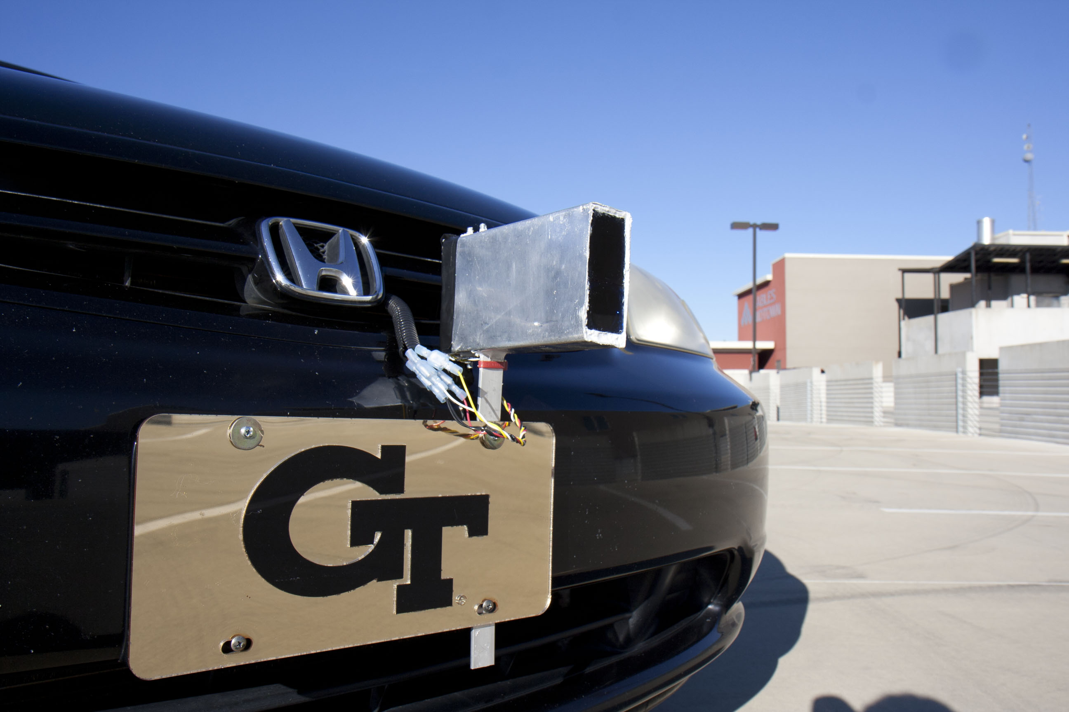
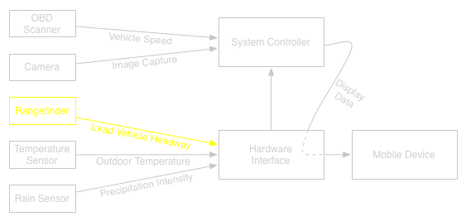
Final Product: Laser Rangefinder
Laser Rangefinder RS-100 by Opti-Logic
  Opti-Logic RS-100 with increased rep rate
  19200 baud serial connection to laptop
  Custom weather-proof enclosure
5

Slide 6
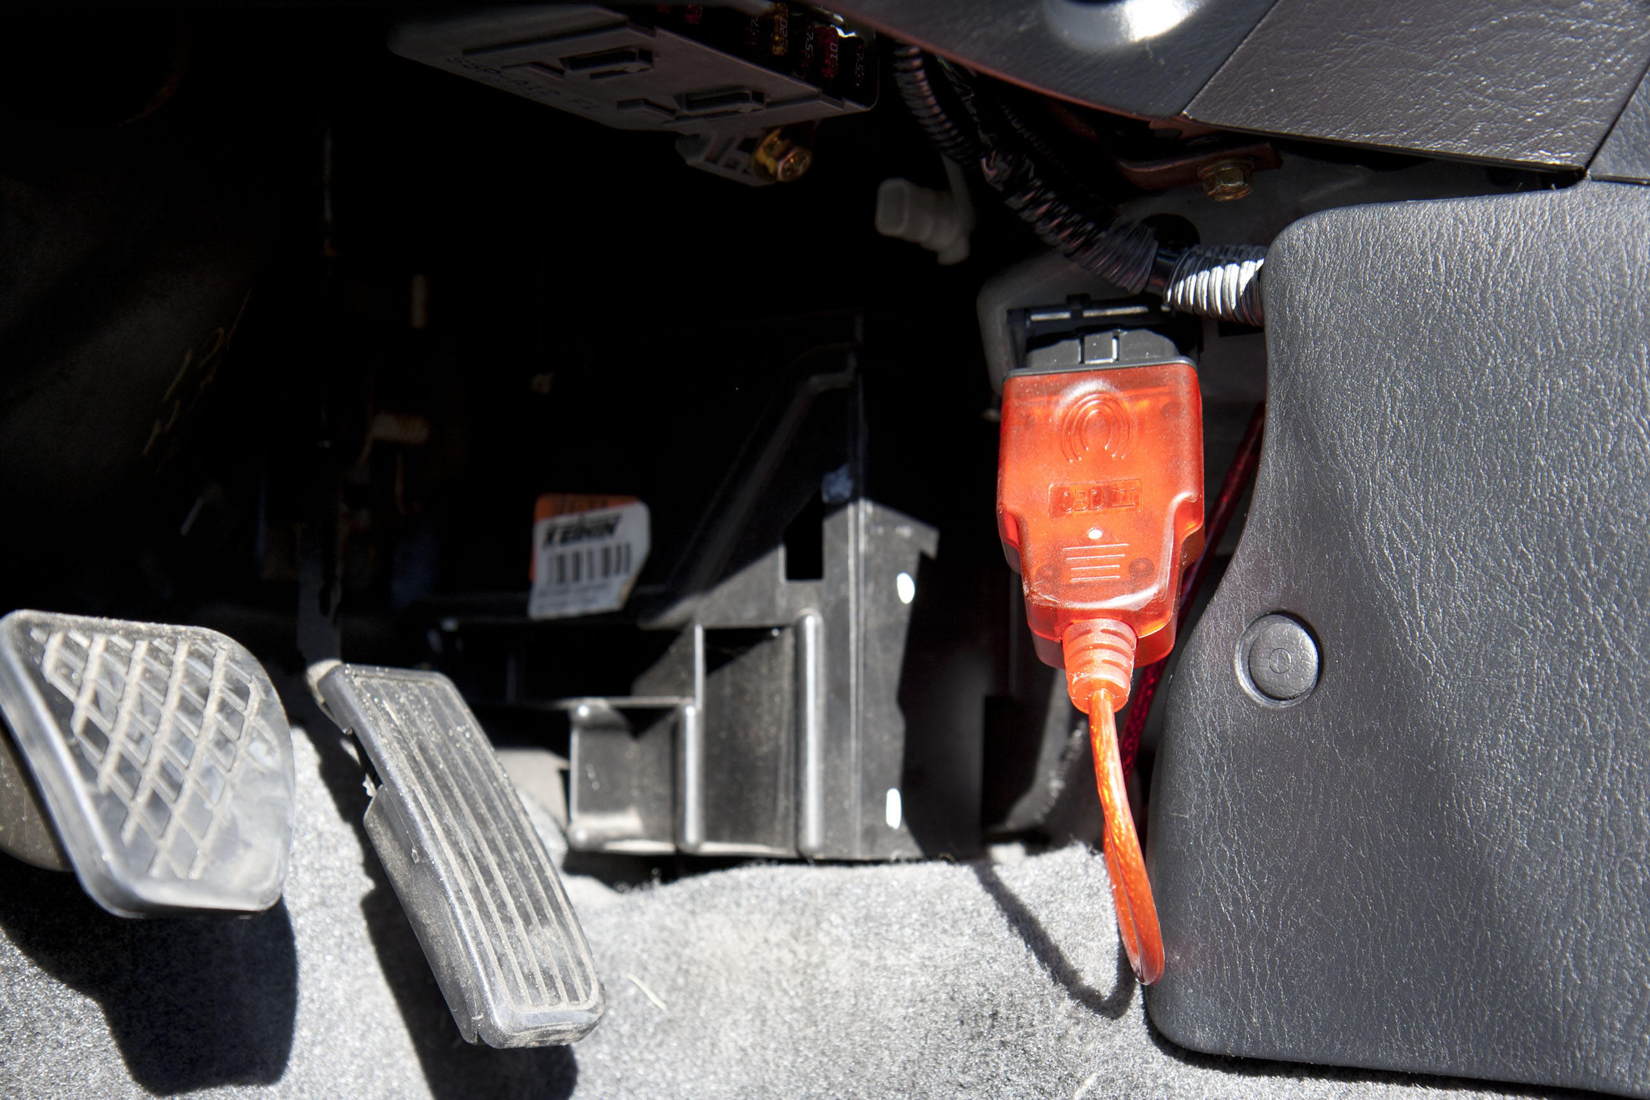
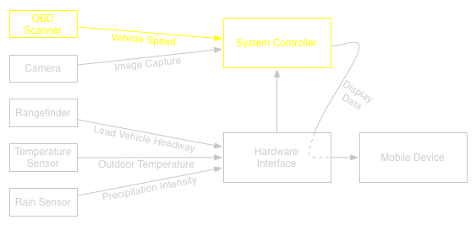
Final Product: OBD Scanner
OBD II Scanner
  Capable of querying any parameter provided by ECU
  115200 baud serial connection to laptop
6
Notes:
Graham

Slide 7
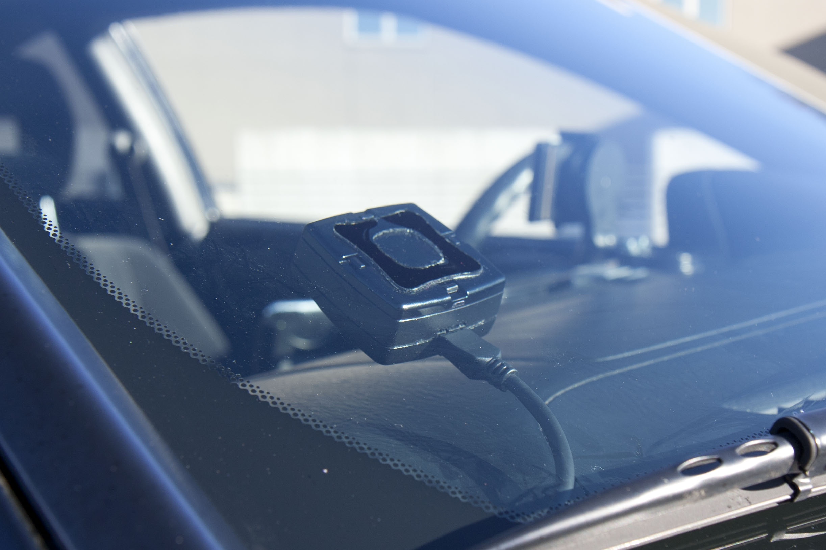
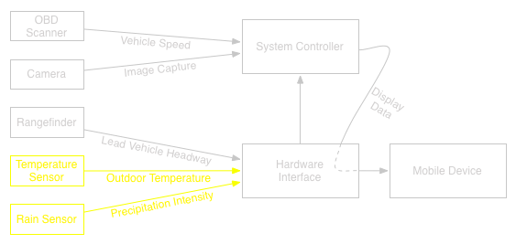
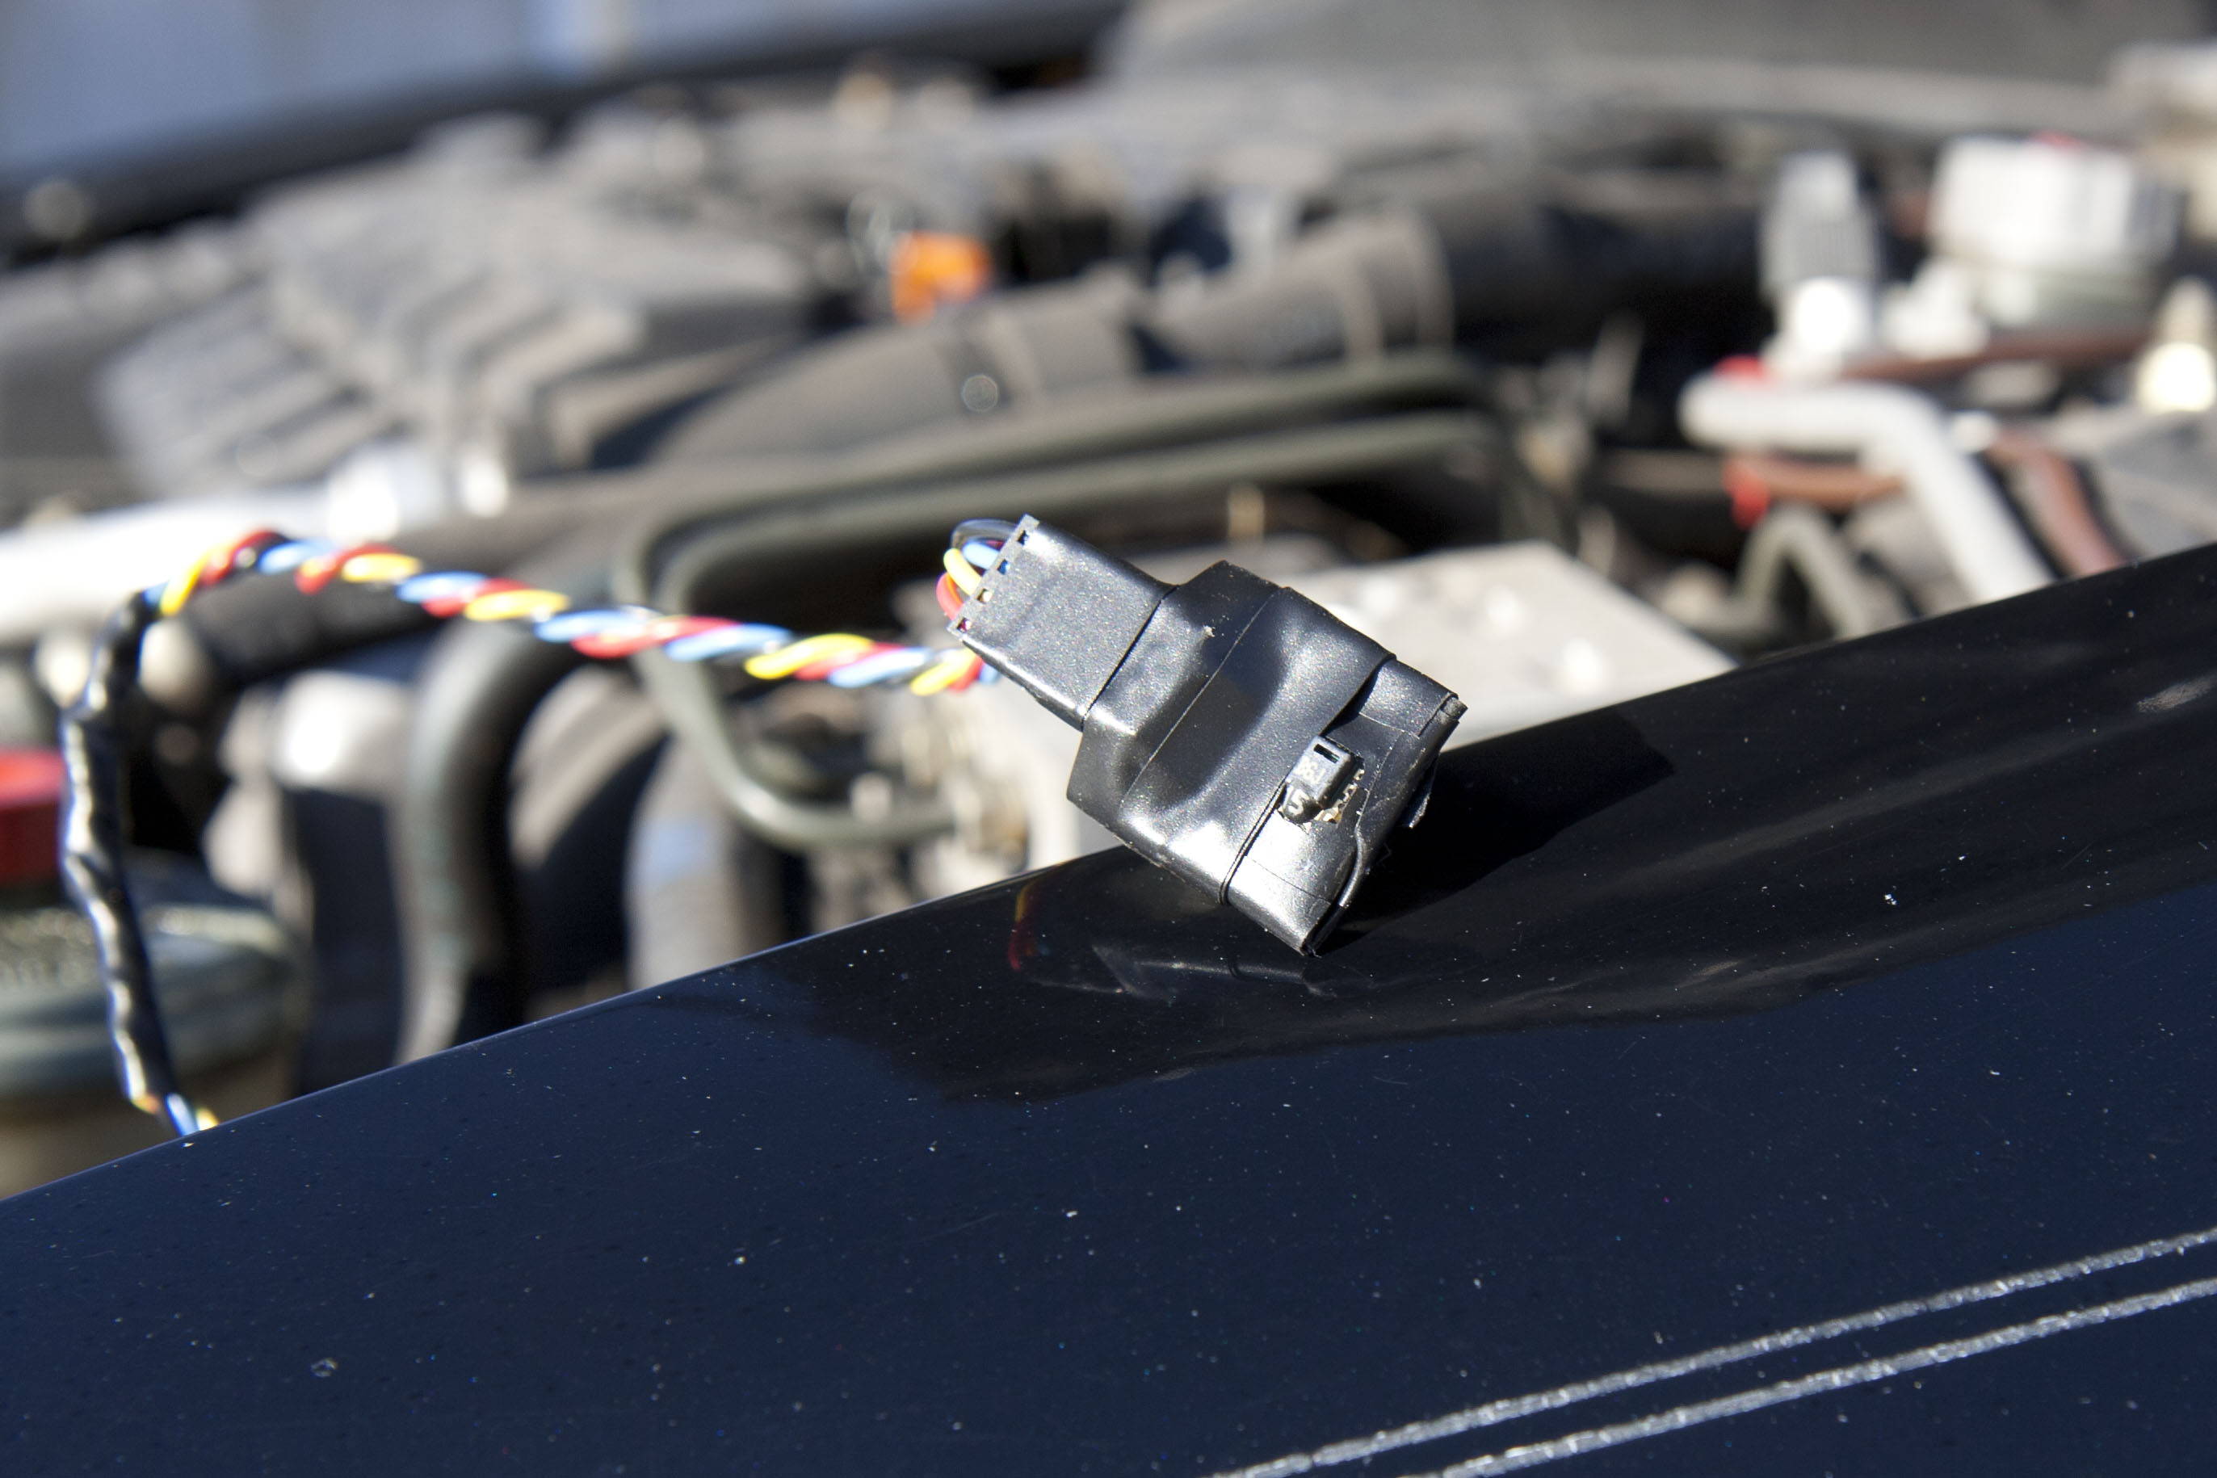
Final Product: Environmental Sensors
Hydreon RT-50A Rain
Tracker
  Infrared detection of rain
  5V Analog Output
  10-bit accuracy
Sensirion SHT_15 Temperature/humidity sensor
  Digital 2 Wire interface/I²C
  Response time < 1 sec
  Mounted inside chassis
7
Notes:
Ryan
An integral part of our system is the weather detection subsystem.
Handling communication for the sensors is the hardware microcontroller. We selected the arduino ADK embed, which implements a 10-bit a/d converter and a serial communication protocol.
The Hydreon rain tracker was purchased to detect whether or not the operator was driving in rainy conditions. It uses a beam of IR light that bounces off the windshield to a detector. If rain is present, the refractive index of the light path changes and the output voltage fluctuates accordingly.
Detecting icy conditions proved more difficult, as no "ice sensors" for cars presently exist. We infer from temp and humidity readings whether or not it is likely that there could be ice on the roads.
We selected the sensirion combination sensor, which implements serial communication to relay data to the arduino.

Slide 8
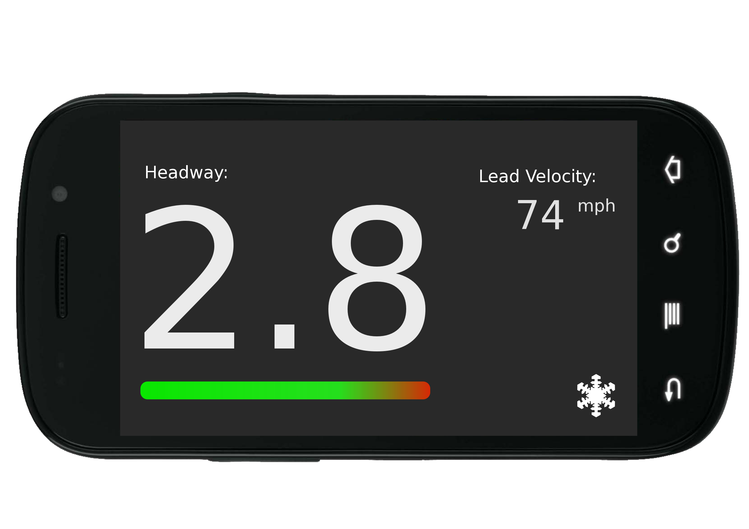
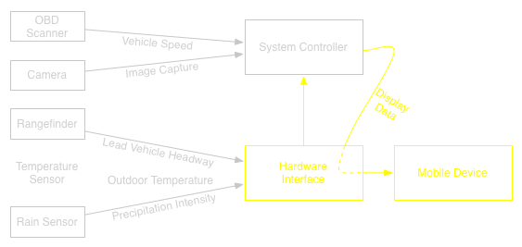
Final Product: Interface and Mobile Device
Android GUI and Alert
  Android Open Accessory Development Kit
  Interpretation of data from Arduino
Arduino Mega ADK
  Sensor data collection and dissemination to Android
  Serial communication with computer
8
Notes:
George

Slide 9
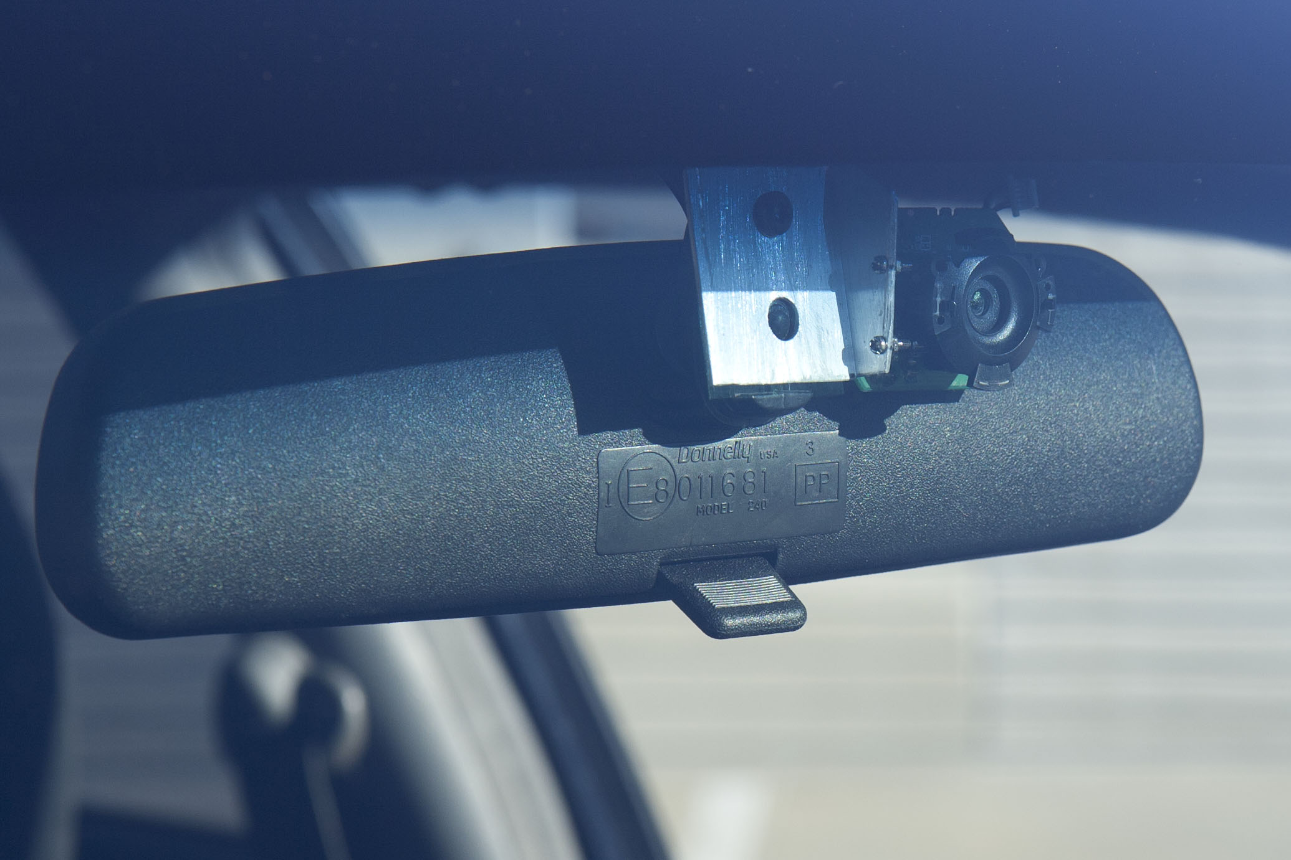
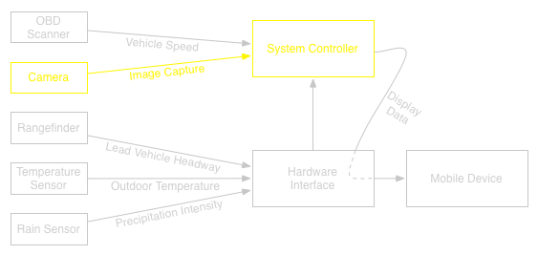
Final Product: Computer Vision
  Logitech C-600 Webcam
  Detects presence and position of lead vehicles
  Provides context for distance readings
9
Notes:
Graham
The sole purpose of the computer vision component is to detect situations in which the laser rangefinder is returning data, but the reading is not a distance to a lead vehicle in the same lane. An example might be a distance to a vehicle in an adjacent lane when driving around a curve. The system should be smart enough to recognize that low distance readings in such an instance don't constitute a dangerous situation.

Slide 10





Asynchronous Fused Kalman Filter
Time update equations:
Measurement update equations:
States:
Transition Matrix:
10
Notes:
Graham
In order to accurately track our system's critical measurements, the distance to the lead vehicle and the following vehicle's velocity, our team designed and implemented a Kalman filter.
The Kalman filter serves several functions:
- First, it provides more reliable measurements with time, as it promotes sensor readings with the lowest covariance over more noisy readings
- Second, it provides a mechanism through which we can predict future values of sensors given past values. This is critical in situations in which a lead vehicle is present, as confirmed through computer vision, but not aligned with the laser rangefinder. Such a scenario might occur along a curve in the road.
The states we chose to track are the range to the lead vehicle and the velocity of the following vehicle. Two additional states were added to specifically track changes in the first two states, allowing us to also perform derivations of the values.
With these four states, we are able to directly calculate the
- time headway
- distance headway
- lead vehicle velocity
- following vehicle velocity
- following vehicle acceleration

Slide 11

Asynchronous Fused Kalman Filter
General Kalman filter update procedure:
11
Notes:
Graham
A general Kalman filter would be implemented as shown in the diagram. Given the last state of the system, the next value is predicted using the transition matrix specified in the previous slide. After the new state has been estimated, it is corrected given incoming sensor readings, and the resulting state is a weighted sum of the prediction and correction.
However, there is an underlying assumption that all sensor readings are available at the same time for the correction step. Given that each sensor in our system operates independently and asynchronously, the general Kalman filter isn't sufficient for our application, especially given the scenario in which the velocity of the following vehicle is readily available to update the Kalman filter, but the distance to the lead vehicle is not known, perhaps when driving around a curve.

Slide 12

Asynchronous Fused Kalman Filter
Asynchronous Kalman filter update procedure:
12
Notes:
Graham
Our solution is to modify the parameters of the Kalman filter in real time, based on the available readings.
This diagram shows a possible scenario in which the Kalman filter is updated with an available reading from the rangefinder, and then updated again when the speed reading becomes available.
In order to make this actually work, we have to modify the matrix relating the sensor readings to the state space and the variance of the sensor providing the update. As long as these two parameters are changed to the correct values before the update procedure, the Kalman filter functions as if it is receiving synchronous updates.

Slide 13
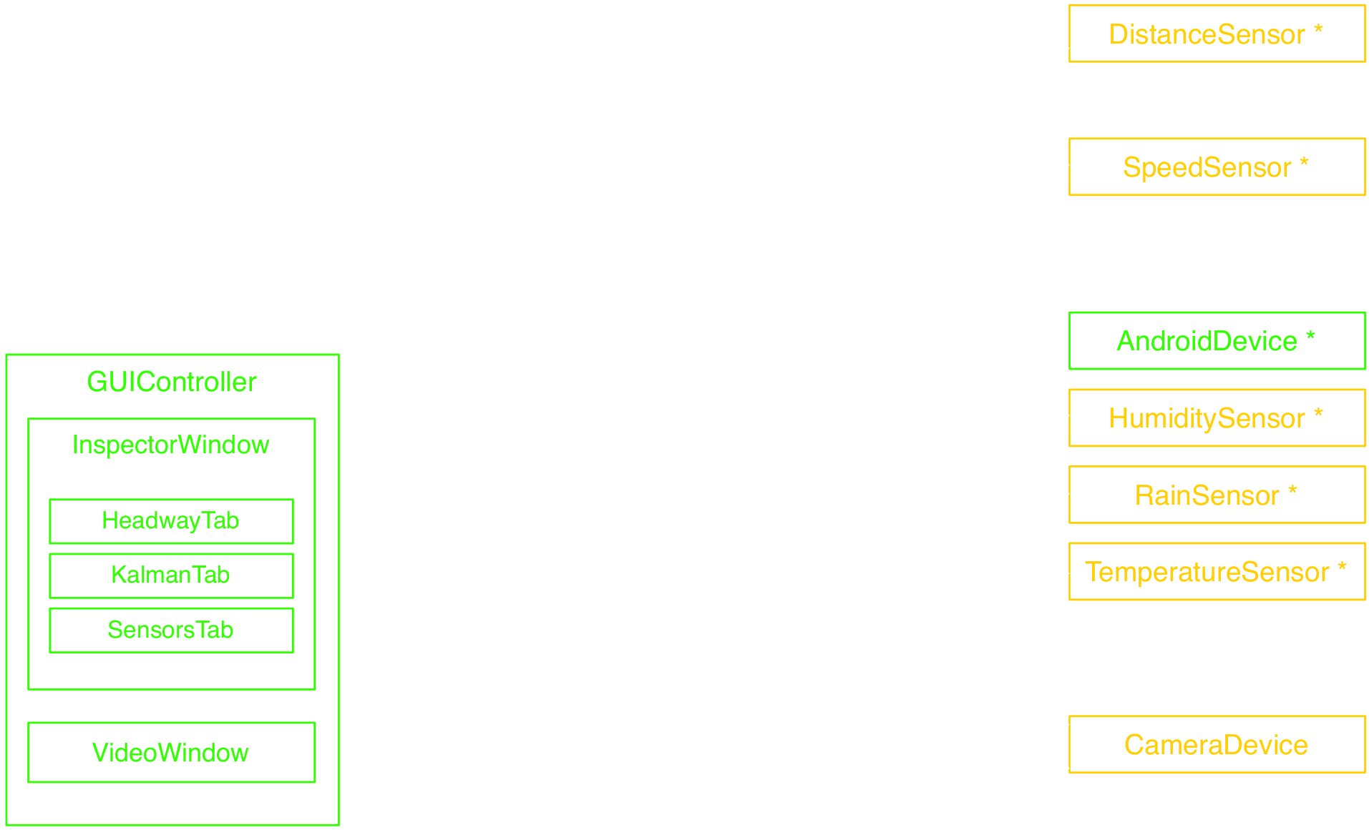
Software Overview
13
Notes:
Graham
The following diagram provides a very simplified overview of the major software components of our system.
The green components are system outputs, and the yellow components are system inputs.
The goal was to organize the software in a way that would minimize any blocking operations and allow each sensor to update at it's maximum rate.
Part of the solution was to divide up the operations among different threads. Each object with an asterisk has it's own runloop which lives in a thread independent of the others. When a result becomes available, it is passed only to the objects which are interested in it using Qt's signals and slots mechanism.
Several classes were created specifically to safeguard data in the multi-threaded environment. For example, the purpose of the ArduinoDevice is to make sure that only one object on one thread is allowed to communicate with the Arduino at any given instant. Without this protection, objects on different threads could try to communicate with the Arduino at the same time, which would fail.

Slide 14
Original Objectives
Method of predicting impending collisions
Auditory/visual warnings
Weather/environmental factors
Weather-proof enclosure to protect external parts
14
Notes:
Garrett

Slide 15
Completed Objectives
Method of predicting impending collisions ✓
  Mathematical algorithms
Auditory/visual warnings ✓
  Android displays pertinent data and emits alerts
Weather/environmental factors ✓
  Implementation of environmental sensors
  Role of environmental sensor data in reaction time calculations
Weather-proof enclosure to protect external parts ✓
  Sensors physically insulated
  Laser insulated with weather proof materials
15
Notes:
Garrett

Slide 16
Final Cost
Previous Expenses
Cost
Senior Design Budget Total
$495
Parts contributed by members
$1250
Additional Expenses
Cost
Wires, Misc. Cables and Connectors
$14
USB Hub
$24
Waterproofing Materials
$10
Phone Mount
$15
Final Project Total
$1808
16
Notes:
Garrett

Slide 17
Future Work
Adaptive cruise control abilities
  Engage the car system to automatically brake
  Regulate vehicle velocity
Servo installation
  Adjust the laser based on computer vision
Radar rangefinder application
  Wider field of view for vehicle detection
Accurate road condition detection
  Real-time ice detection using radar
17
Notes:
Garrett

