Slide 1
CRYPTOGRAPHY
Jackson Russett, Danial Hasan, Graham Hoyes, Andrew Wang

Slide 2
Parallel
Design
Process.

Slide 3
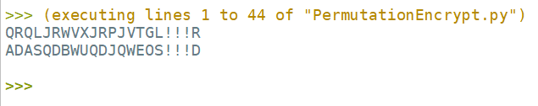

Slide 4
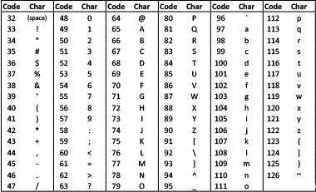
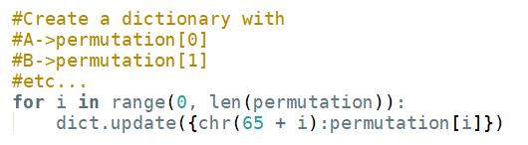
Encryption and Decryption
Simple Step - O(n)
Block Step - O(n)
Permutation - O(n)

Slide 5
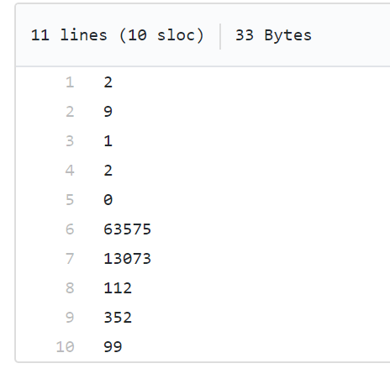
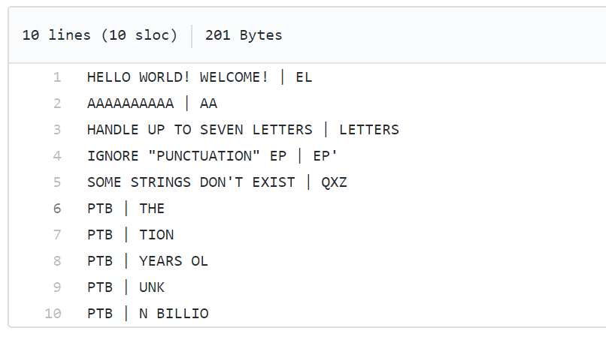


Training
Counting
Modelling

Slide 6
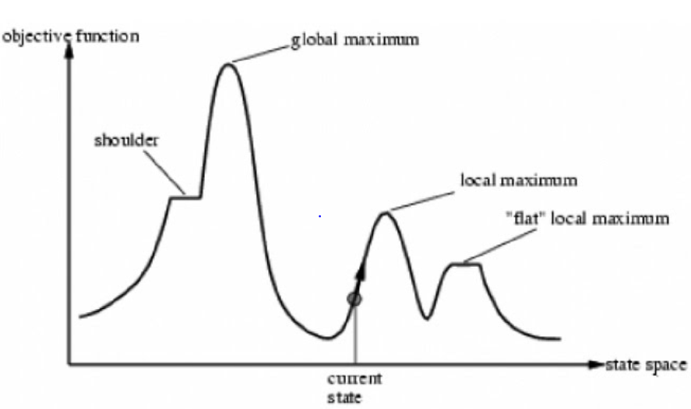
Cracking
Bruteforce Simple Step Crack
Hill-Climb Iteration Block Crack - (100000)
Hill-Climb Iteration Permutation Crack - (100000)

