Slide 1

P
y
1
Zappos
Analytics Challenge
Las Vegas, Nevada
Thousands of Happy Customers
Powered by Service, Driven by Data
insights & findings

Slide 2

Bookings Made
D
M
v
l
y
Raw Data
Exploration
Visualizations
Insight
Happy Customers!
Analytics Work Flow

Slide 3
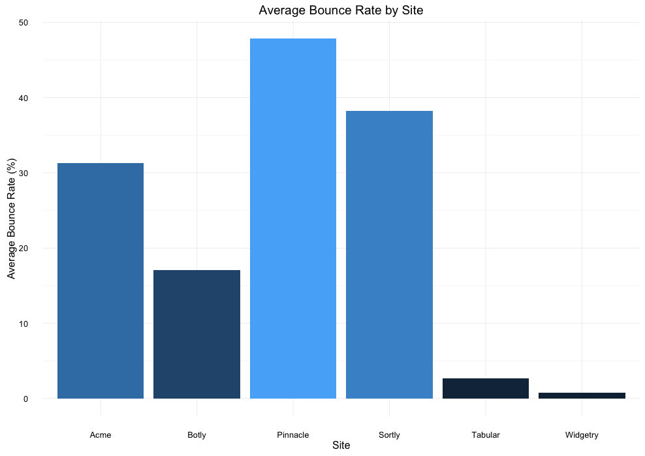
Average
Bounce Rate
Aggregated bounce rate data reveals that Pinnacle is by far our lowest-performing site, followed by Sortly and Acme
Tabular and Widgetry are stellar performers, while Botly has modest performance

Slide 4
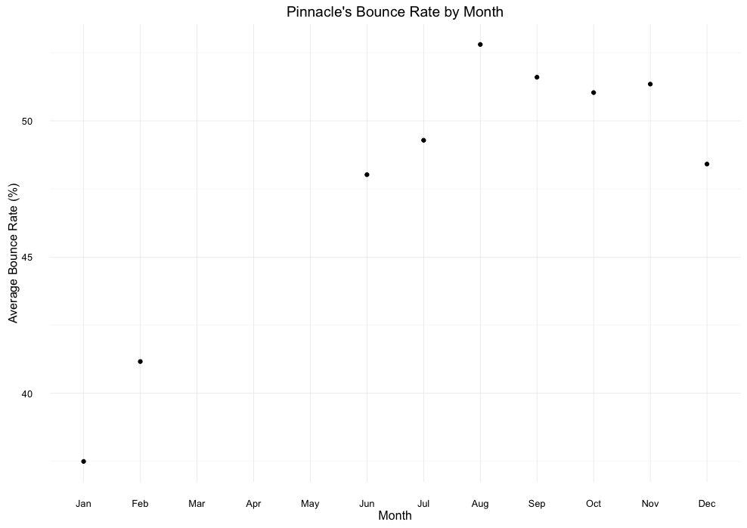
SEASONALITY OF BOUNCE
How can we decrease Pinnacle’s Bounce Rate?
Pinnacle has the lowest bounce at the start of the year
As the year goes own, its performance worsens
Peak bounce rate happens in Q3
Let’s look at what content differences exist on the site between Q1 and Q3
What new-year initiatives did we launch that we could mimic in Q3?
(Pinnacle has no bounce rate data available for Mar-May)

Slide 5
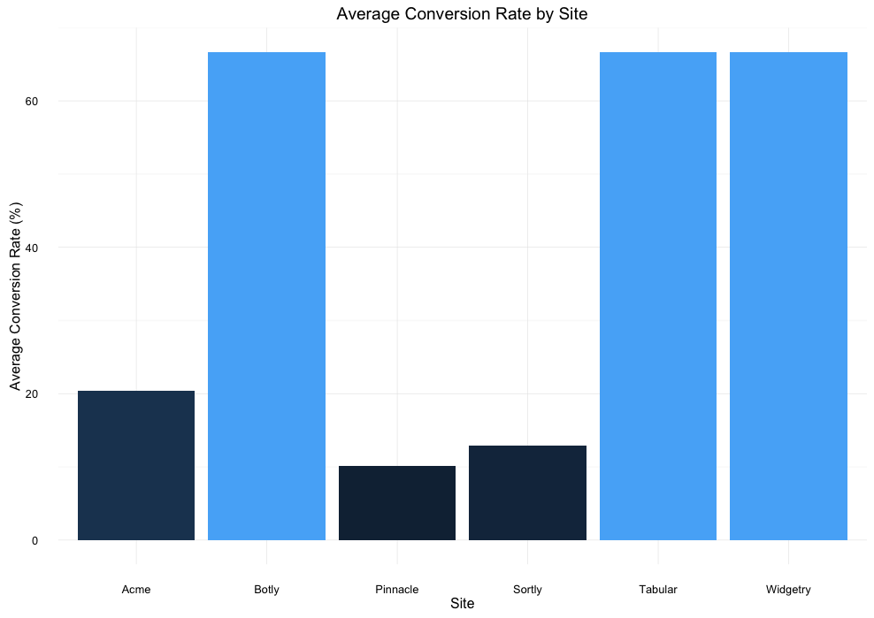
Average
Conversion Rate
Average
Conversion Rate
Aggregated bounce rate data reveals that Pinnacle is by far our lowest-performing site, followed by Sortly and Acme
Aggregated conversion rate data reveals that Acme, Pinnacle, and Sortly have the lowest conversion rates
Tabular and Widgetry are stellar performers, while Botly has modest performance
Botly converts as well as Tabular and Widgetry, even though it had a far inferior bounce rate

Slide 6
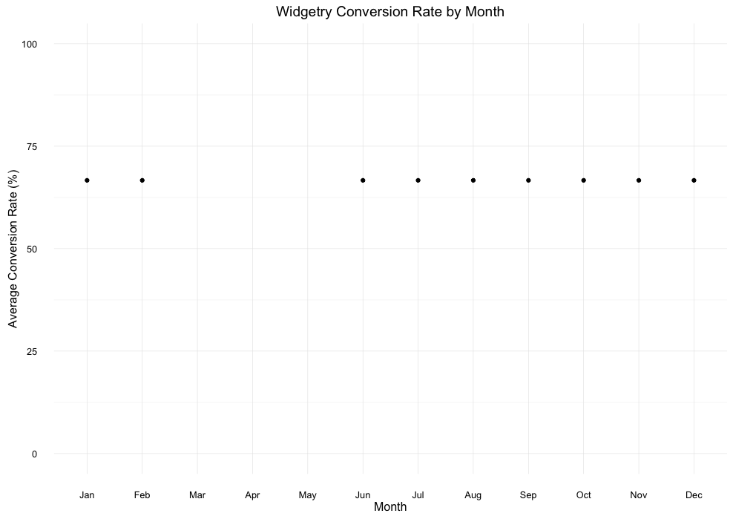
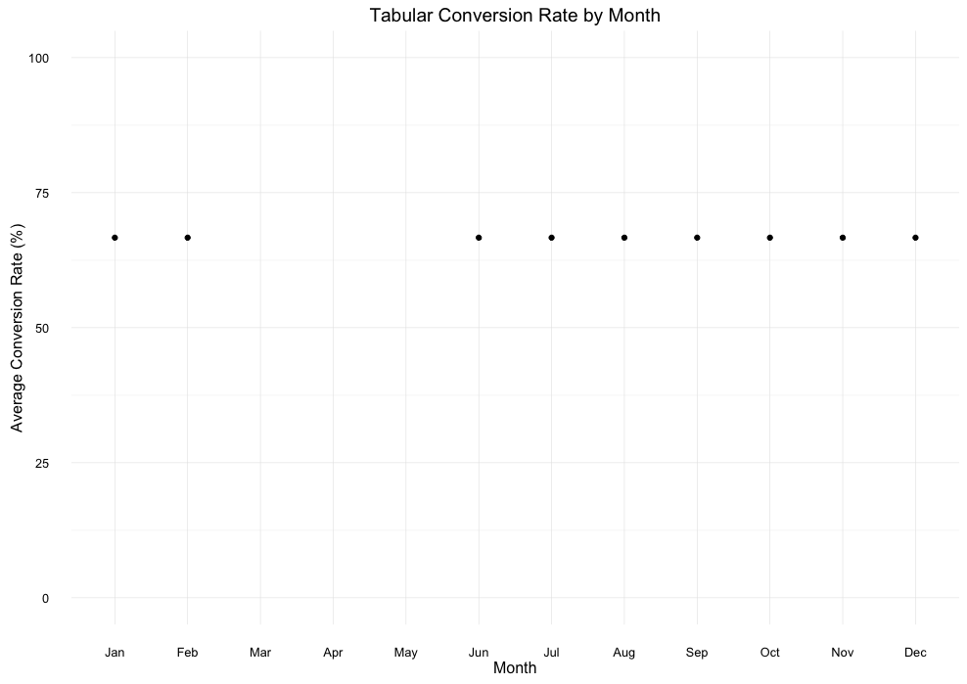
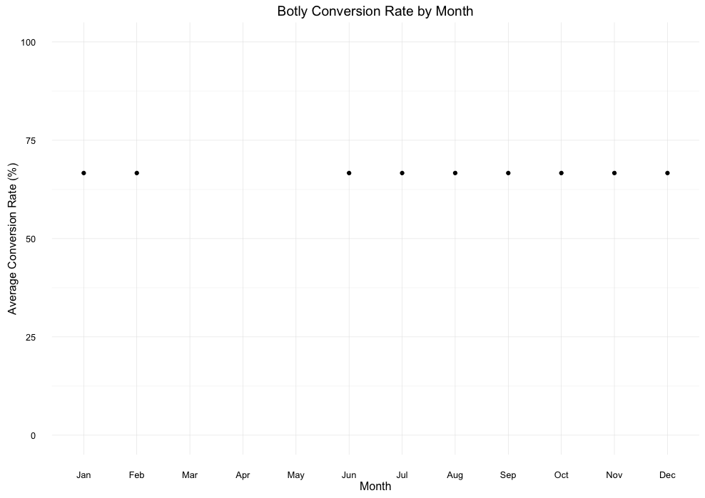
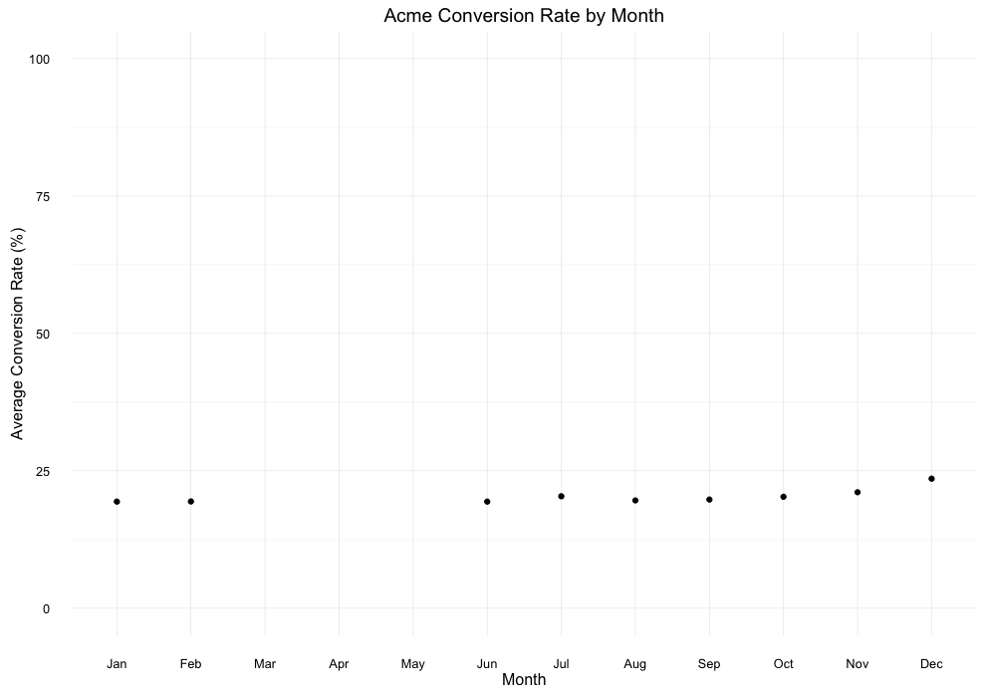
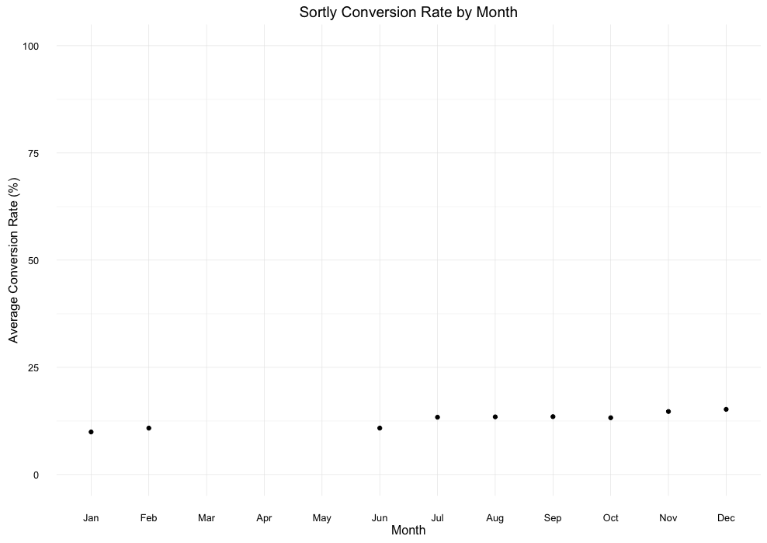

SEASONALITY OF CONVERSION
How does our Conversion Rate vary over the year ?
There is essentially no change in conversion rate over the year for any site
These plots reveal that Widgetry, Tabular, and Botly have identical conversion rates.
This is good; any changes our company implements to boost conversion rates should result in an increase in conversion across the entire year

Slide 7
iOS/iPhone make up the vast majority of all sites’ Orders, Sales, and Visits.
Our company needs to bring our mobile experience on platforms other than iOS up to par. With more than double the amount of android users globally (1 billion vs 470 million), this is a huge untapped market for our company.
If we improve our mobile experience on Android, Orders, Sales, and Visits will skyrocket.

Slide 8
Zappos
Analytics Challenge
Graham Place
insights & findings

