Slide 1
Microsimulation Work With Government At the University of Northumbria

Slide 2
The CommonSense Group
A new policy and modelling group at the University of Northumbria
Multi-disciplinary: contributions from
  Psychologists
  Epidemiologists
  Qualitative Social Researchers
Innovative Statistical Methods:
  Conjoint analysis - how people value components of policy
  Focus groups (Jarrow experience) – people’s lived experience of the benefit system;
  Latent variable modelling
  Our Own Surveys: public opinion on reforms to transport, education, the welfare system
Agile development
  Custom models built quickly using notebooks as front-ends and ‘test first’ development.
Microsimulation in teaching
  Tax Benefit models integrated into PostDoc level course
Over 50 Publications in 2 years

Slide 3
Who We Are
Core members are:​
Chair: Matthew Johnson, Professor of Public Policy, Northumbria University​
Public Affairs & Impact Lead: Elliott Johnson, Vice Chancellor's Fellow in Public Policy, Northumbria University​
Behavioural Science Lead: Daniel Nettle, Professor of Community Wellbeing, Northumbria University, and Directeur de reserche, Institut Jean Nicod, CNRS, Paris​
Epidemiology Lead: Kate Pickett, Professor of Epidemiology, University of York, and Academic Co-Director, Health Equity North​
Economics Lead: Howard Reed, Professor (Practice) in Public Policy, Northumbria University, and Director, Landman Economics​
Innovation Lead: Graham Stark, Senior Research Fellow in Public Policy, Northumbria University, and Director, Virtual Worlds​
Communications Officer: Anna Thew, Senior Research Assistant, Northumbria University​

Slide 4
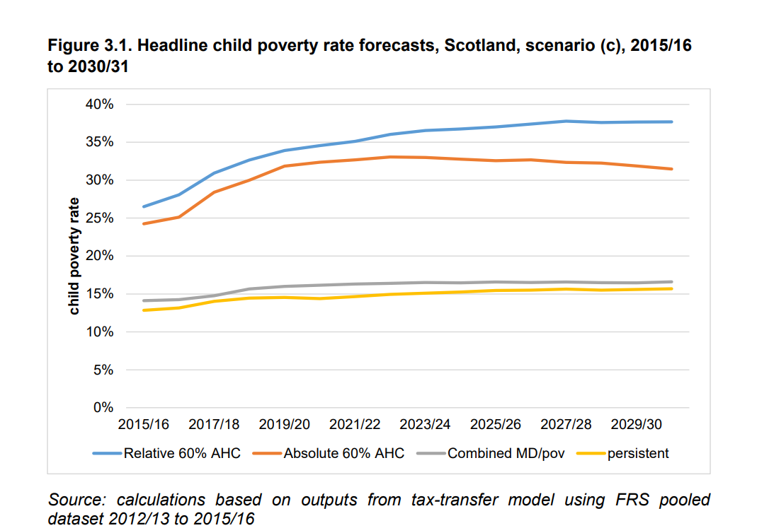
Common Sense Working With Government: Forecasting Scottish Child Poverty
Uses the Landman model, augmented with forecasting components later used in Scotben, to project the level of child poverty in Scotland 2015-2030. Formed an important part of the Scottish Government’s poverty reduction strategy.

Slide 5
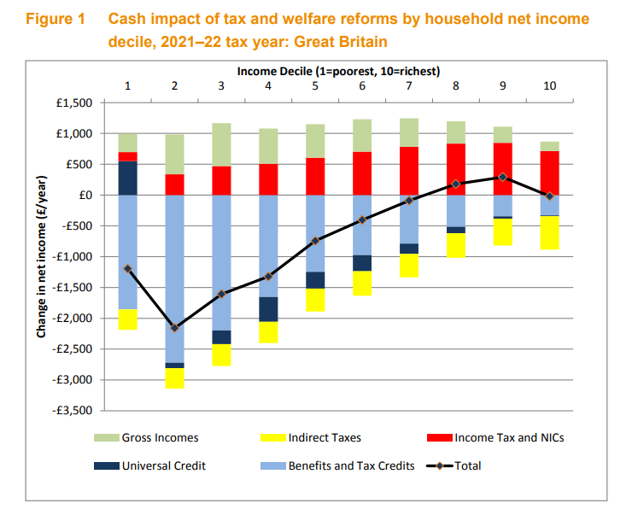
Common Sense I Working With Government: Equality and Human Rights Commission (EHRC)
A cumulative impact assessment of the changes to the tax and welfare over the period 2010-2018.
A companion report models the effects on household of public spending cuts over the same period.
Uses the Landman model.

Slide 6
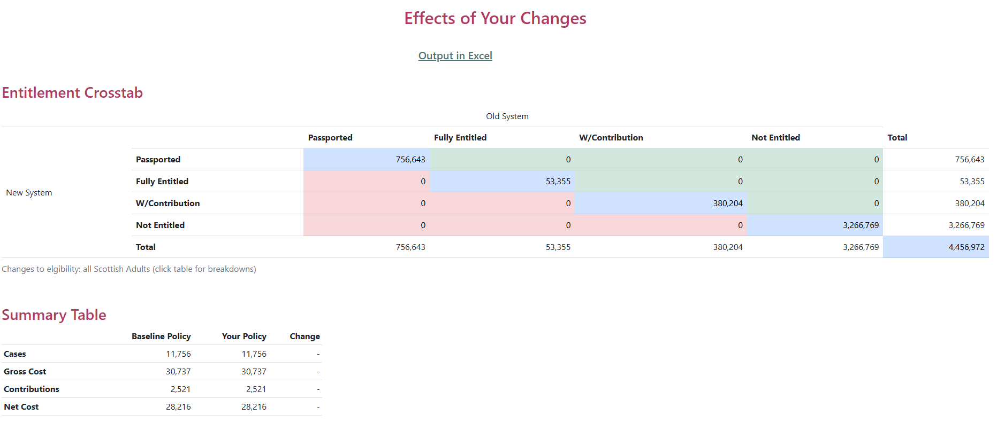
Common Sense Working With Government: Scottish Legal Aid Board
Modelling changes to Legal Aid entitlement for Scottish Legal Aid Board (SLAB). Informing two Scottish Parliament enquiries.
Using a modified version of Scotben augmented with SLAB administrative data.
Has an easy to use web front-end.

Slide 7
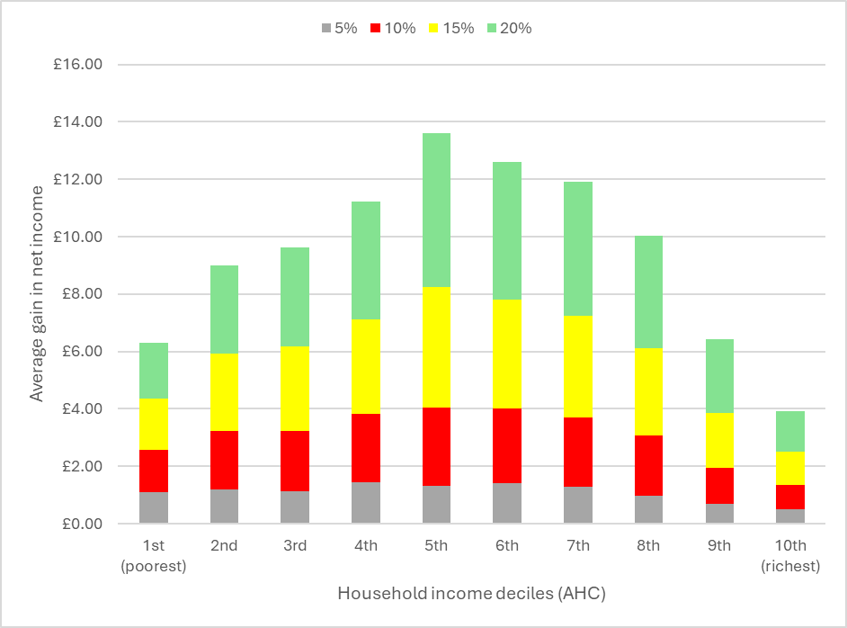
Common Sense Working With Government:
The Low Pay Commission
Modelling the distributional effects of possible increase to the minimum wage.
Work in progress, using the Landman model

Slide 8
Current Modelling Capacity
Landman Model
TriplePC
ScotBen

Slide 9
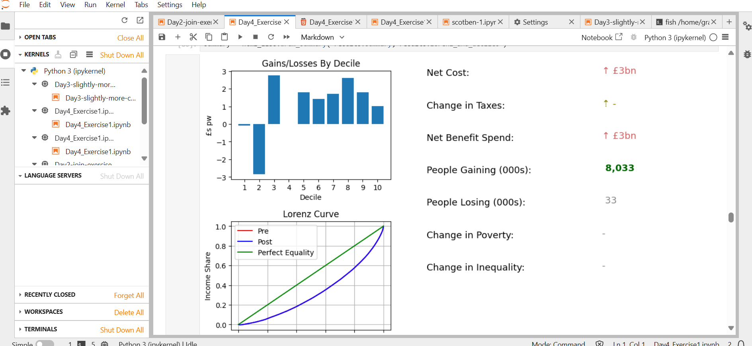
Common Sense Microsimulation Capacity: The Landman Tax-Transfer Model
Microsimulation model of the UK, derived from the IPPR and IFS tax and benefit models.
Written in Python.
Uses WAS and LCF data.
Figure shows Landman running in a Juypter notebook, as part of a new postdoc level tax-benefit policy course.

Slide 10
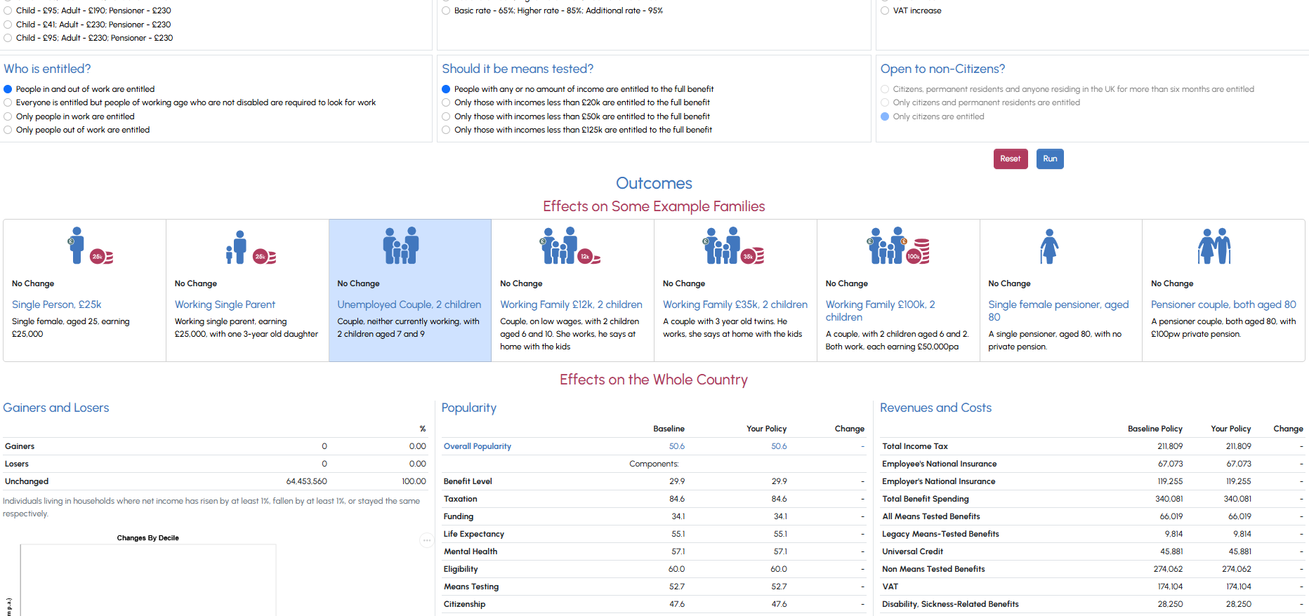
Common Sense Microsimulation Capacity: TriplePC
TriplePC is a conventional tax-benefit model, written in Julia and using Family Resources Survey (FRS) data, but with two novel outcomes:
Public opinion derived from Conjoint Analysis – is your policy mix political suicide?
health outcomes derived from observational data – what do your changes mean for mental health and life expectancy?
Uses an adapted version of ScotBen, Publicly available with a Web front end (https://triplepc.northumbria.ac.uk)

Slide 11
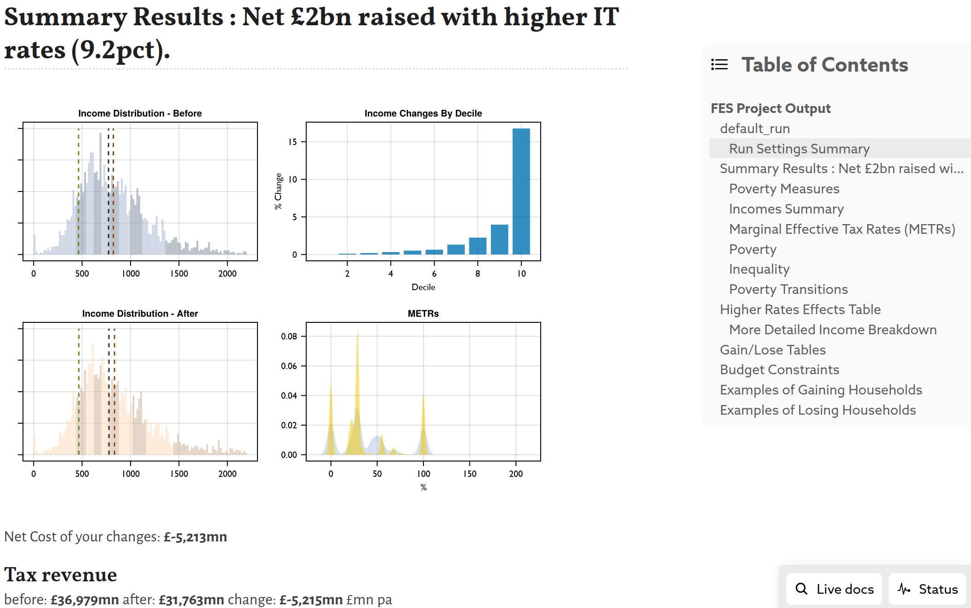
Common Sense Microsimulation Capacity: ScotBen
Scotben is a new Microsimulation model of Scotland, written in the Julia programming language and using matched FRS, LCF, WAS and Scottish Household Survey Data.
The picture shows ScotBen running inside an Interactive Pluto notebook.
Features include:
Built-in reweighting and datamatching
Precise budget constraints
Extensive test-suite

