Slide 1
Virtual Worlds
Modelling A Local Authority Using the FRS

Slide 2
Why?
Localism agenda: Benefits increasingly devolved to local authorities;
Social Care;
Born of failure: we were asked to bid for a project to do this – we didn't get it!

Slide 3
How?
The FRSs we have don't include LA identifiers
In any case, samples would be small, and sample is stratified.
Instead: find weights so the sample looks like the council

Slide 4
How?
Technique is an extension of the method used to create the basic FRS weights included in the dataset
Council populations differ in (e.g)
  Proportions employed and unemployed
  Racial composition
  Age Structure
  Numbers on Benefits
And many others

Slide 5
How?
Get Data on these things broken down by council from Nomis, HMRC, DWP...
Make a dataset with the same variables from FRS
Find a set of weights such that the FRS data sums to the council totals
Infinitely many sets of weights are possible
Pick the set that minimises the distance (in some sense) between the final weights and some initial (usually uniform) set of weights.
Problem is then a constrained minimisation problem familiar in economics

Slide 6
How: Choosing Weights?
A variety of distance measures are possible
See Creedy (2003) and Deville and Sarndal (1992) (Atkinson (1989) for a discussion;
Obvious one: sum of squared deviations ('Chi-square') – doesn't work because weights can be negative
Various 'entropy' measures proposed, but these can be unstable
'Constrained chi' works well, usually – minimise sum of squared deviations between uniform and new weights but place constraints on how far new weights can deviate from initial weights - e.g. must be positive.

Slide 7
Limitations
Can only fix composition differences – distributions of (e.g.) wages, housing costs will be corrected only to the extent that they are due to differences in composition (a council has disproportionate number of professionals, large houses, etc.);
Composition variables not in the targets set may be made worse by the new weights;
Program doesn't always converge

Slide 8
Implementation
Written in Ada
Data in relational database
Council target data assembled from
  Nomis Census Data
  HMRC Tax Credit Data
  Benefit Receipts from DWP and Nomis
FRS data from 2009/10 and 2010/11 (other datasets possible)
Getting NOMIS and FRS consistent is fiddly
Minimisation code based on Creedy
Generates Household-Level weights
Has (very ugly) web interface http://projectsvr.virtual-worlds-research.com/la/
All downloadable from http://virtual-worlds-research.com/downloads/

Slide 9
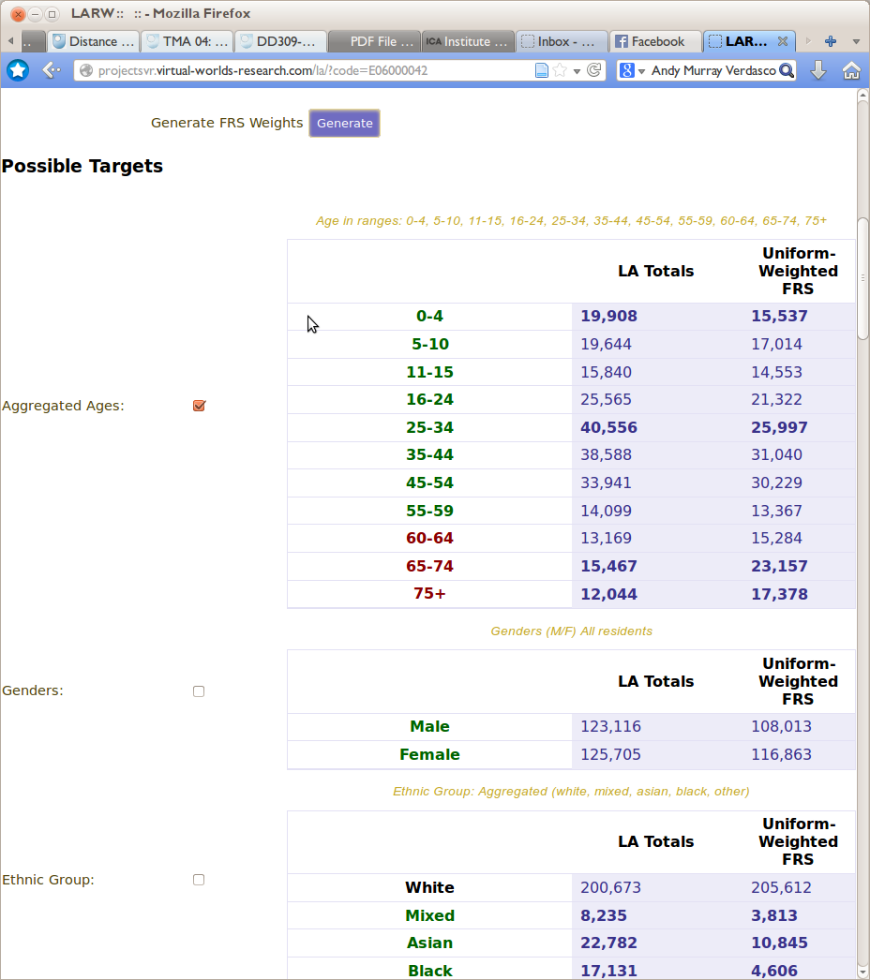
(Ugly!) User Interface

Slide 10

(Ugly!) User Interface

Slide 11
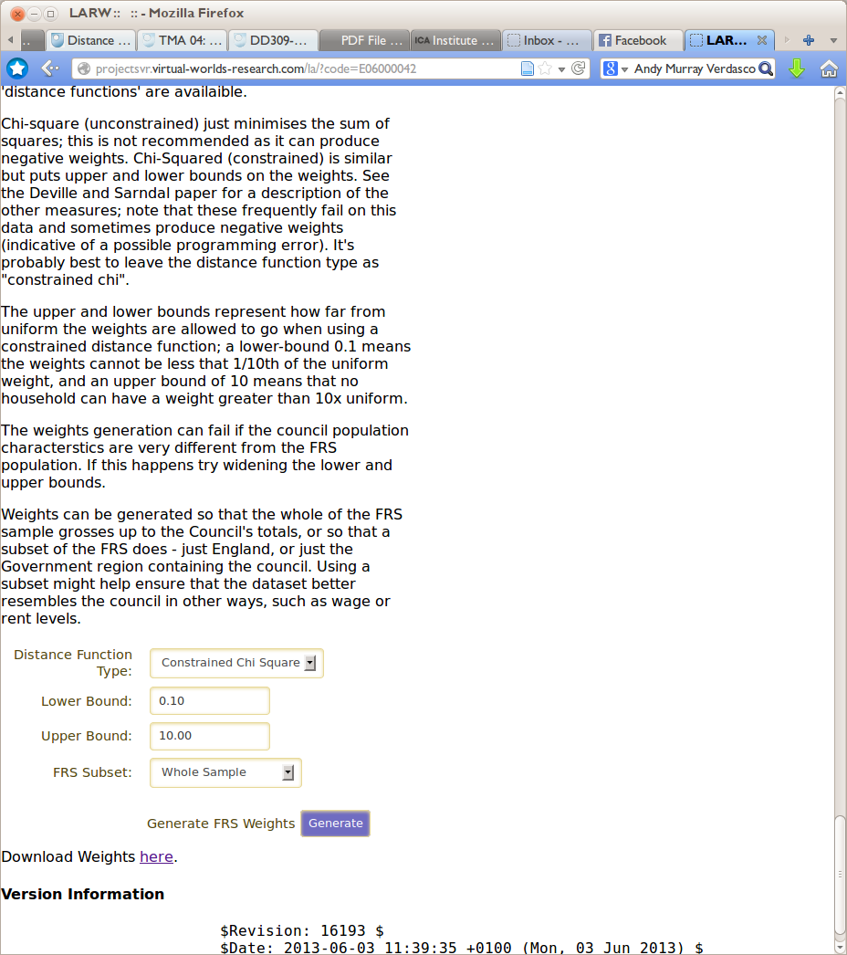
(Ugly!) User Interface

Slide 12
Example Output

Slide 13
Do do
Add code to correct wages, housing costs, other incomes, given composition:
  Quite good disaggregated data on wages from LFS
  Housing costs data seems less good (regional only?)
  Haven't investigated other incomes
  Probably never be able to capture some councils properly (Westminster)
Support other datasets;
Wider range of targets;
Different aggregations (regions, police authorities, metropolitan areas..);
Build directly into tax-benefit model;
Nicer interface.

Slide 14
Run the program:http://projectsvr.virtual-worlds-research.com/la/
Download the code:http://virtual-worlds-research.com/downloads/
Further Reading:
Creedy (2003) “Survey Reweighting for Tax Microsimulation Modelling”
Deville, J.-F. and Sarndal, C.-E. (1992) Calibration estimators in survey sampling. Journal of the American Statistical Association 87

