Slide 1
Virtual Worlds
Modelling Entitlement to Legal Aid Using The FRS

Slide 2
The Legal Aid System
3 Main Types:
  Civil Legal Aid
  Criminal Legal Aid – partly at discretion of trial judge
  Advice and Assistance aka “Green Form” - for short consultations
We're mainly concerned with Civil Legal Aid
Systems different in Scotland (http://www.slab.org.uk), England & Wales (http://www.legalservices.gov.uk/), Northern Ireland (http://www.nilsc.org.uk/)
England and Wales system reformed significantly during 2002-2004
Costs:
  England and Wales: £2bn, of which ~55% criminal, ~25% civil and 15% Advice and Assistance
  Scotland: £155Mn
  Northern Ireland: £65Mn

Slide 3
Civil Legal Aid Means Tests
Broadly similar structure in all 3 jurisdictions
Merits tests (is claim likely to succeed?) as well as means test
Means Tests have income and capital components
Recipients of Income Support and its equivalents are 'passported' (qualified automatically with no further means test).
Income:
  Some measure of typical or expected income
  minus allowances for partner, children
  minus allowances for housing costs, work expenses, various other expenses
  Gives disposable income
  Disposable compared to upper and lower income limits
  Disposable < lower Limit? All Legal Expenses Paid
  Disposable < upper limit? Expenses paid, but claimant makes contribution of proportion of excess over lower limit
  Disposable > upper limit? Disqualified
Limits and Allowances loosely aligned with Income Support levels

Slide 4
Problems With The Means Tests
Complex, difficult to administer;
High allowances for (e.g.) housing can produce appearance of unfairness: e.g. the Maxwell brothers;
Incentive problems with lawyers: possibly no incentive to cut costs for a client on legal aid.

Slide 5
English Reforms
Replace allowances for work expenses, etc. with fixed amounts;
Introduce further gross income cap – disqualified if income is above this, no matter what other allowances you have;
Modelled using an earlier version of model described here

Slide 6
Modelling Legal Aid
Virtual World's clients: Scottish Legal Aid Board (2007 - ); Northern Irish Legal Legal Services Commission (2006/7)
Eligibility (the means test) can be modelled using FRS;
To estimate costs you need to know how many of those eligible would claim: FRS doesn't contain suitable information for this (legal need or usage). So supplementary data needed.

Slide 7
Modelling Eligibility - Problems
Main problem: nothing to verify results against:
  No recorded individual receipts as with (e.g.) income tax, income support;
  Likewise no aggregate figures possible for eligibility (as opposed to claims and costs)
Modelling capital is always difficult, of course
Constructing forward-looking income measure is awkward

Slide 8
Modelling Costs: Scottish Case
Disaggregated cost and payment data for all Civil Legal Aid Cases from 2005/6 was made available to us;
Matched against baseline estimated entitlement figures by age group and gender;
Allows us to model effects of changing contribution rates on costs and claims: the higher a family's contributions, the more cases there are where contributions would exceed the likely costs, making claiming legal aid uneconomic.

Slide 9
The Model
Conventional Tax-Benefit model structure
Uses recorded benefit receipts and tax payments, so not (yet) a full tax benefit model;
Separate versions for Ireland and Scotland
Written in Ada: high – level language similar to Pascal, developed for US Government (http://www.adacore.com);
Developed using a “test first” methodology: write unit tests describing everything the model should do, write enough code to pass the tests, then stop;
Has a web based front-end: allows all researchers (and also clients) to share access to the same version of the model, protected;
Model Size:
  Approx 1,500 lines of specific legal aid code;
  Approx 10,000 general-purpose lines (I/O handling, tabulators, general calculators, etc.);
Interface to FRS data: automatically generated using scripts to parse the FRS documentation. (Scrips written in Ruby http://www.ruby-lang.org/en/)
Code is downloadable: http://virtual-worlds.biz/downloads/tb_components.tgz (GPL Licence)

Slide 10
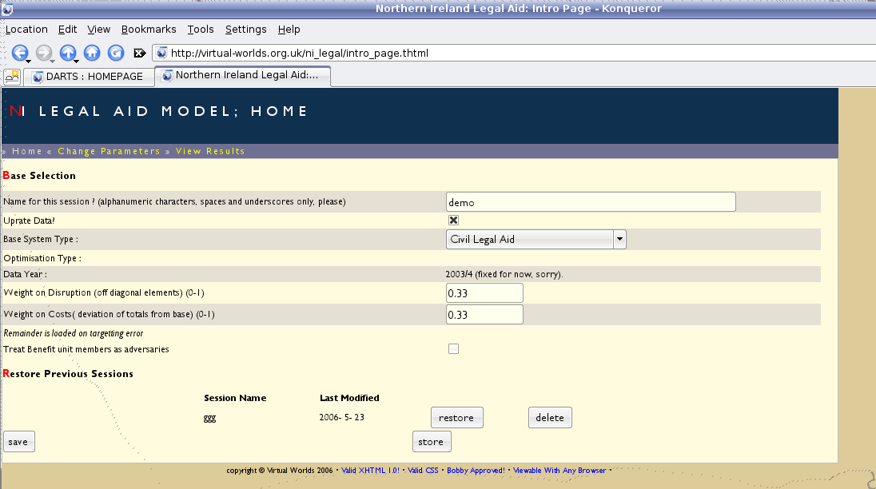
Irish Model: Home Page

Slide 11
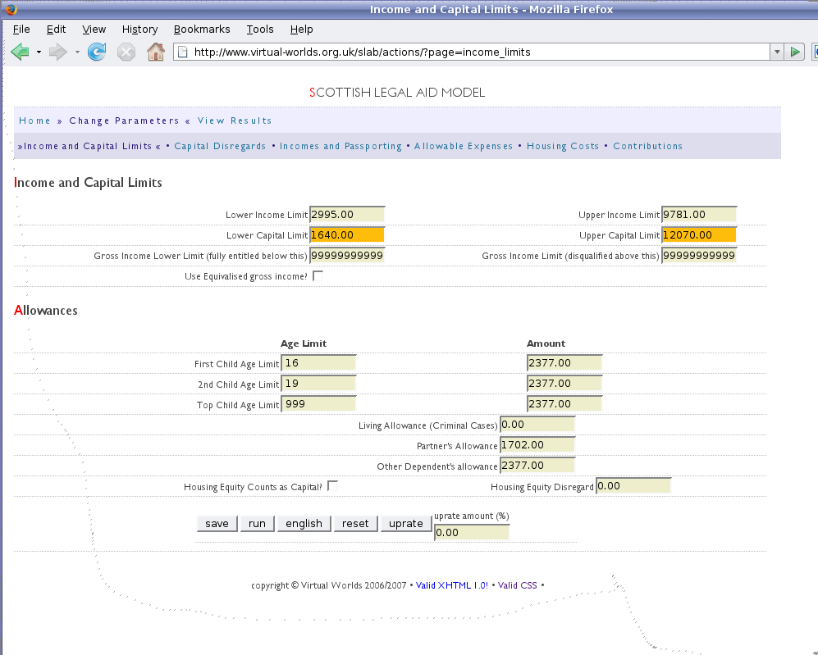
Scottish Model: Changing Allowances

Slide 12
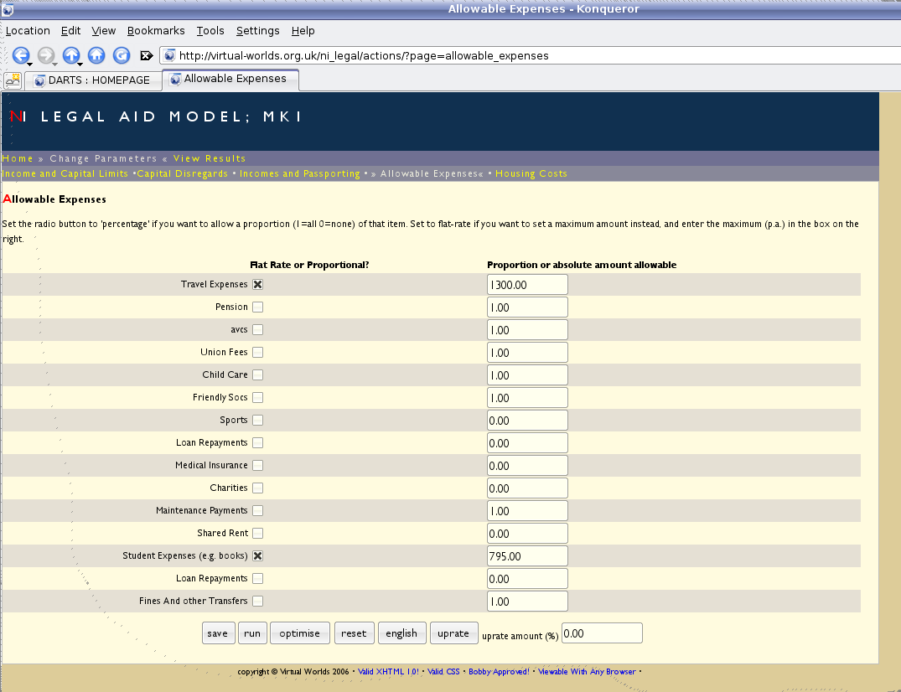
Irish Model: Swapping Allowances for flat-rate alternatives

Slide 13
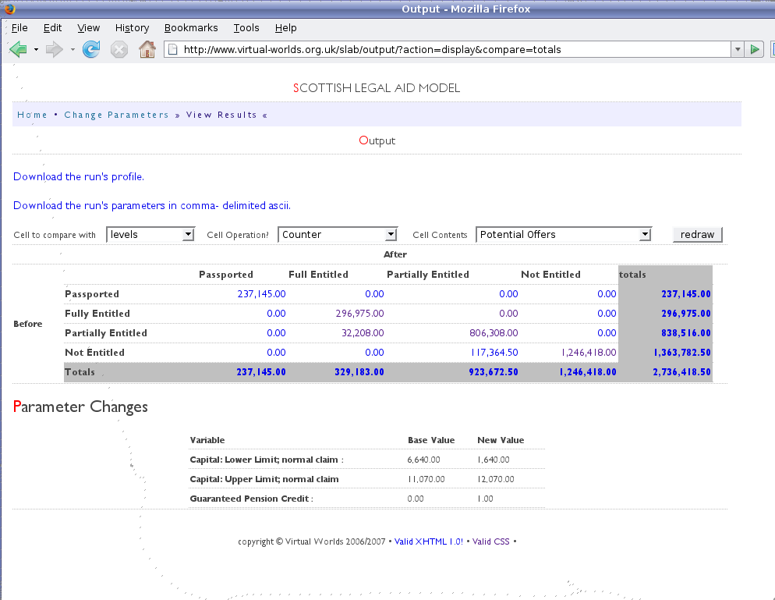
Scottish Model: Example Output
This shows eligibility both before and after some reform, as across-tabulation of counts of benefit units. Pre- reform is in the rows and post- in the columns

Slide 14
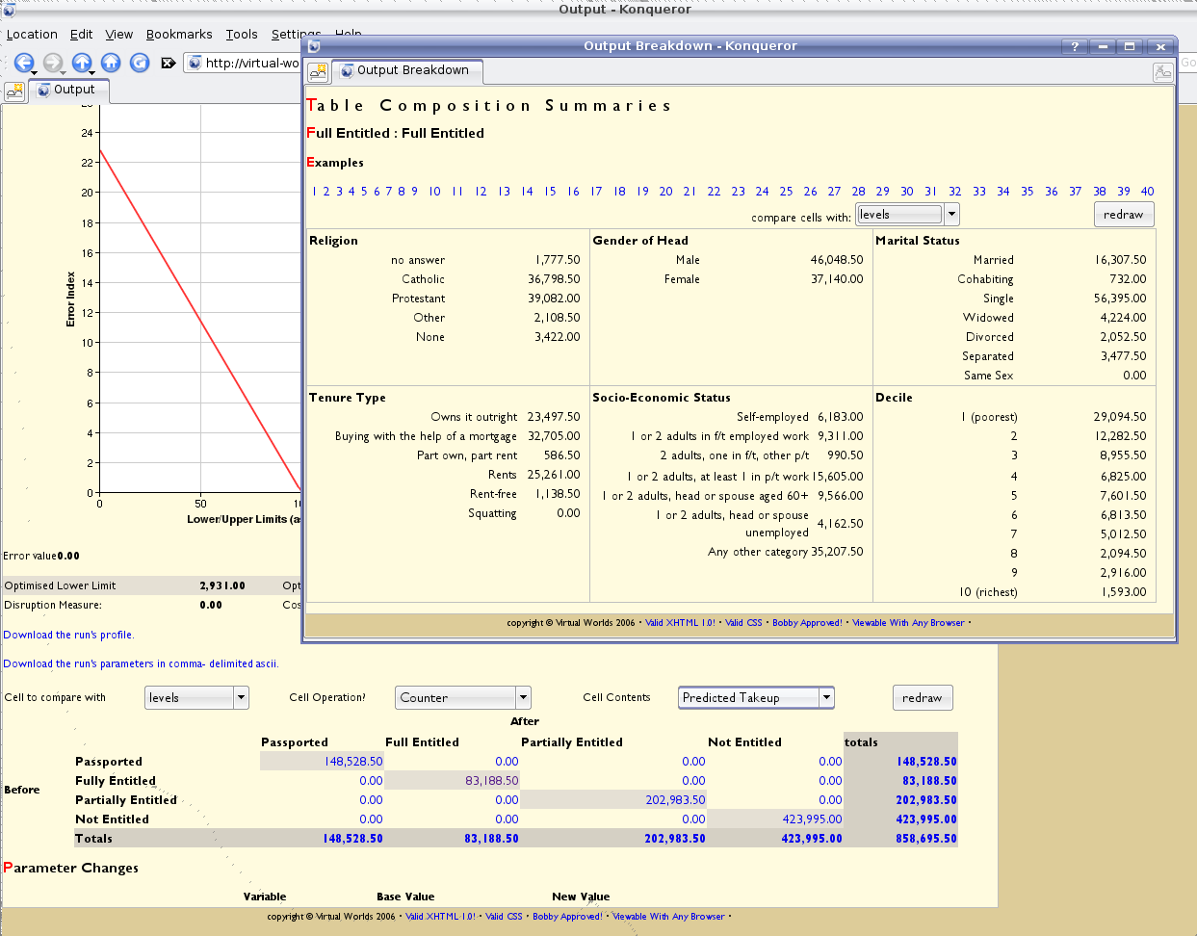
Irish Model: Drill-Down Output
All the cells in the the output tables are selectable by the investigator. This brings up a window showing the composition of the cell (proportion of owner-occupiers, for example).

Slide 15
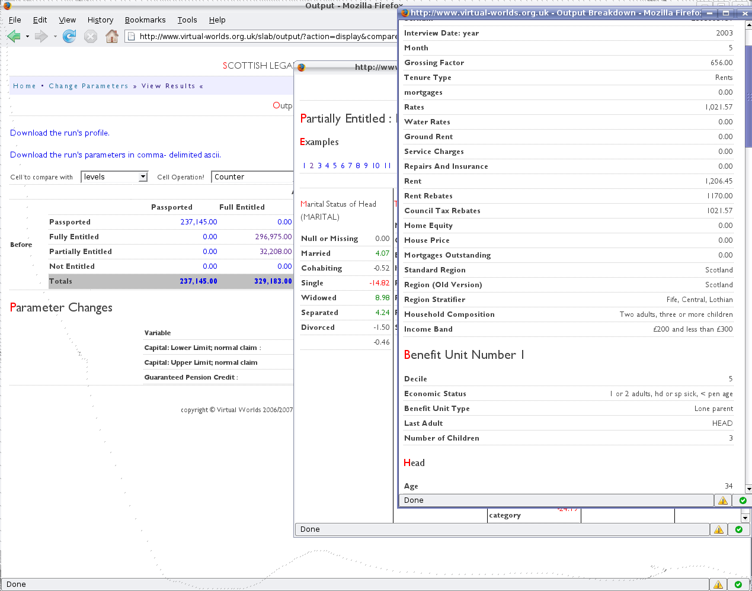
Scottish Model: Example Household
The investigator can go further and display individual households that have been affected in some way.

Slide 16
Some Applications: simplification
(Ireland/England & Wales): if you replace allowances for housing, work, etc. expenses with flat rate amounts, to what would you have to change the main allowances to maintain the same level of eligibility?
Solution: the model can find this automatically using an optimisation routine which uses a summary value from a model run as the minimand

Slide 17
Some Applications: reforming contributions in Scotland
Increases in the contribution rate for those partially entitled reduce the net cost of the scheme. For a given budget, therefore, an increase in contributions allows the upper limit to be extended, so more families are eligible. But, as contribution rates rise, contributions will be more than the cost of many cases, making legal aid uneconomic for them. So, for a given net cost, what contribution structure puts the most cases in scope?
We used a brute force search. We ran the model 70,000 times on a 'server farm', each with a different contribution rate and income limit. To find the optimal combination we searched through all those which had the desired net cost, and from those Iso-Cost sets, selected the one with the largest number of viable cases.

