Slide 1
Wall’s Finance Project – Designing Website
Rajat sharma
Rohit Jagota
Omanpreet Singh

Slide 2
Introduction
Web development for Stock Market Option Chain
Development required for Website, Database, Graphs
The website refreshes the options data
The website refreshes the graph based on options data

Slide 3
Website Functions
Data is received from Google API
Following tables added on the screen:
Puts
Calls
Tables are refreshed from Google API
Graphs are recreated in R Shiny
Graphs are reloaded on the website

Slide 4



Development Tools

Slide 5
Google API
Following Google Finance API used for receiving data:
http://www.google.com/finance/option_chain?q=AAPL&output=json
Finance APIs are no more supported by Google
The API had output format errors in JSON
Regular Expression used to correct JSON output

Slide 6
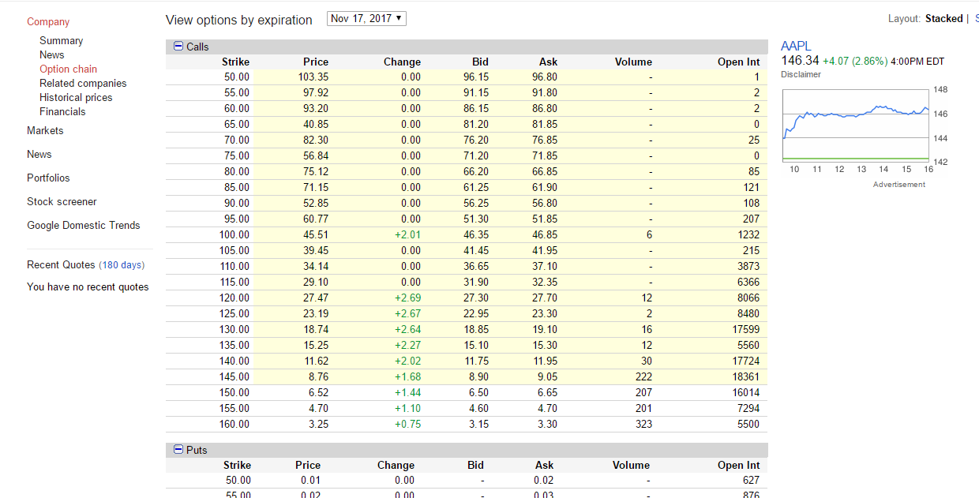
Apple Inc.

Slide 7
Web Development
Word press was used for Web Development
Database created for word press
Two tables – one each for Puts and Calls created
The web page refreshed at every set interval of time
Data refreshed in tables at each API call
This makes the table refresh on the page

Slide 8
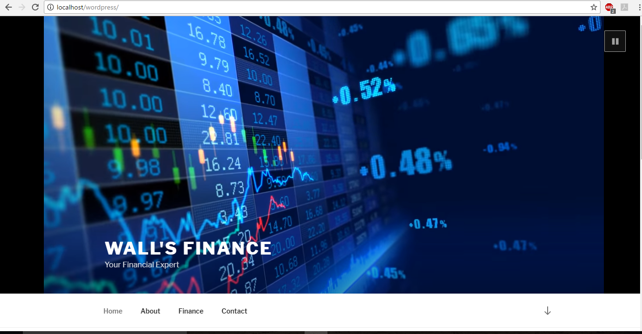
Homepage

Slide 9
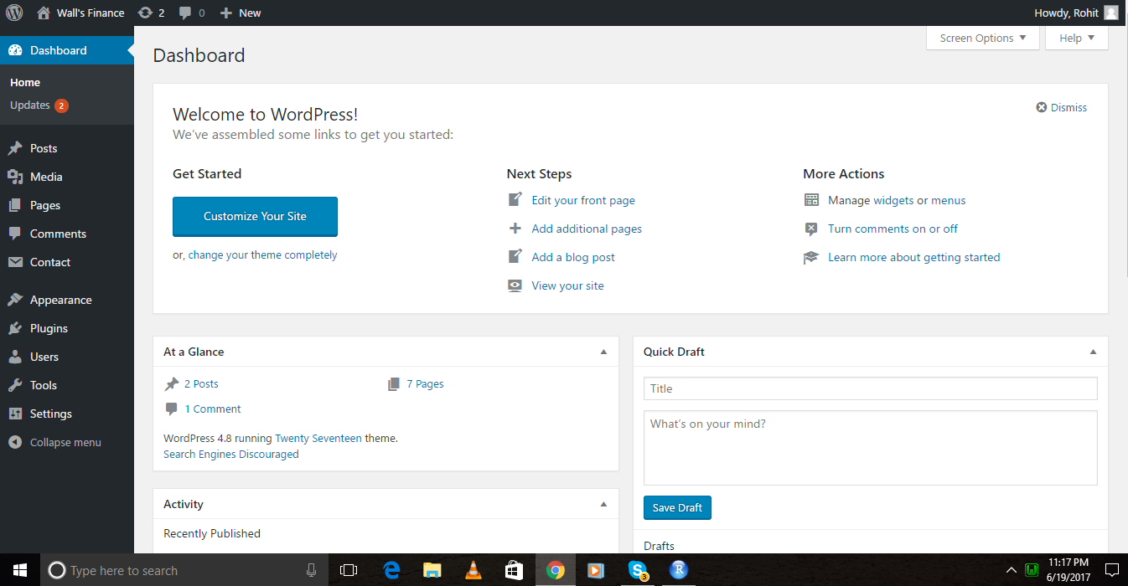
Dashboard:

Slide 10
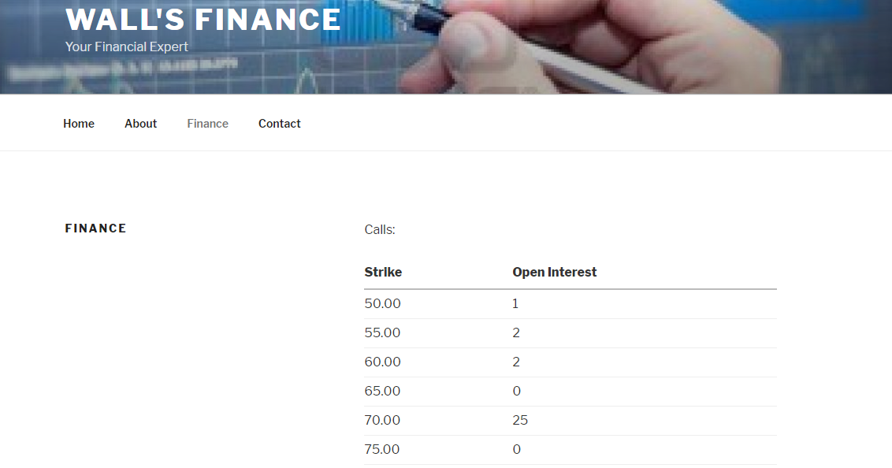
Table Calls:

Slide 11
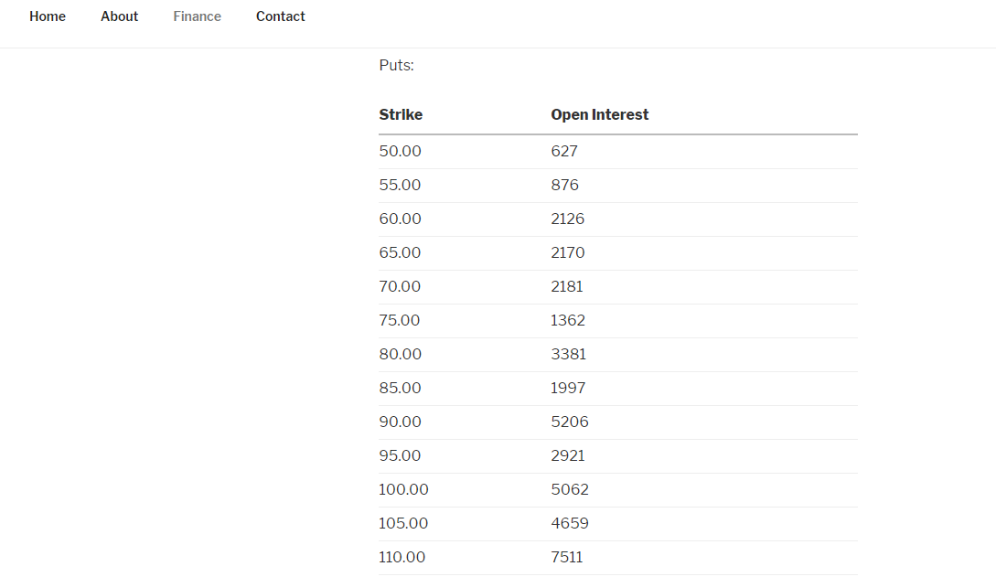
Table Puts:

Slide 12
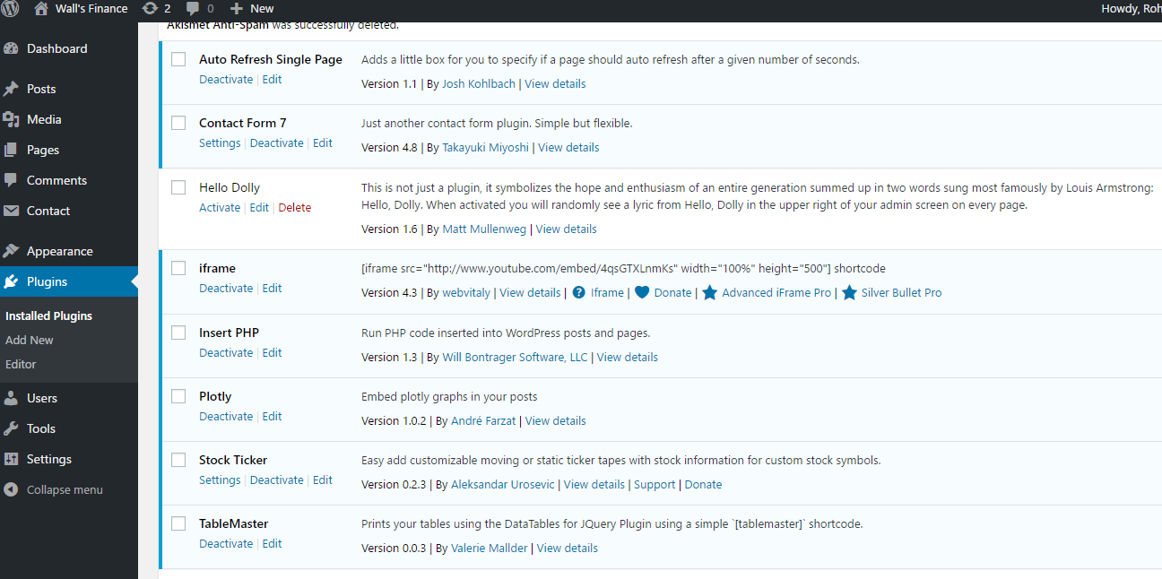
Plugins:

Slide 13
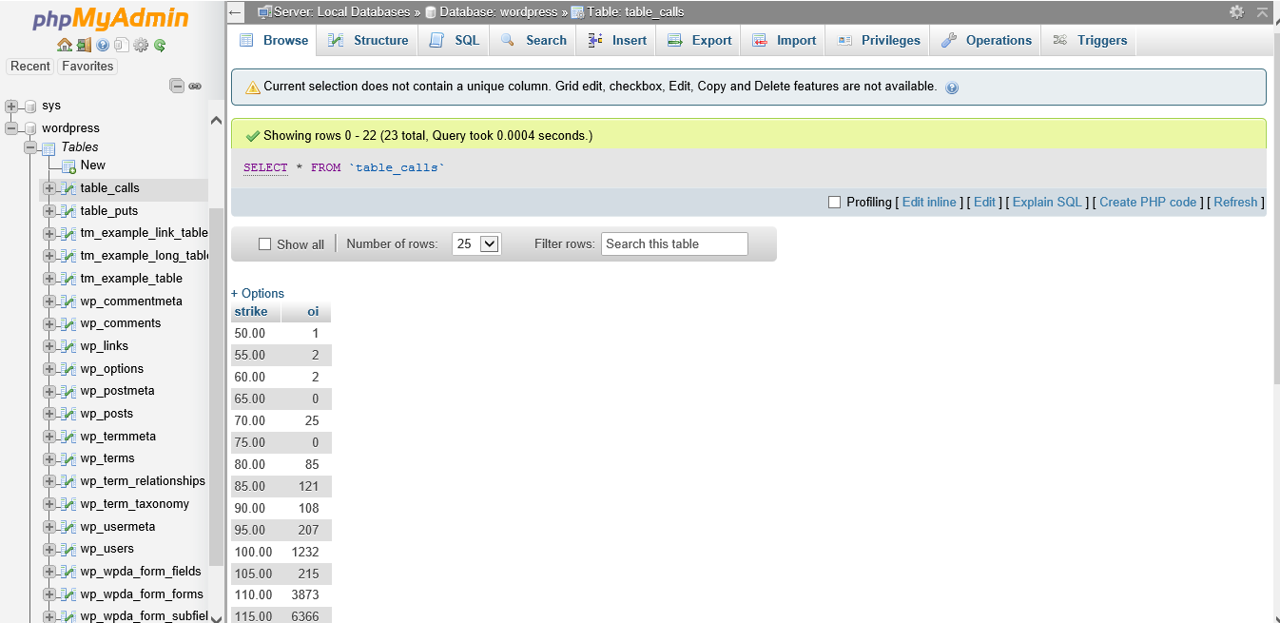
Php-Myadmin:
We use Php-myadmin as our Database which includes table calls and table puts to show data on website.

Slide 14
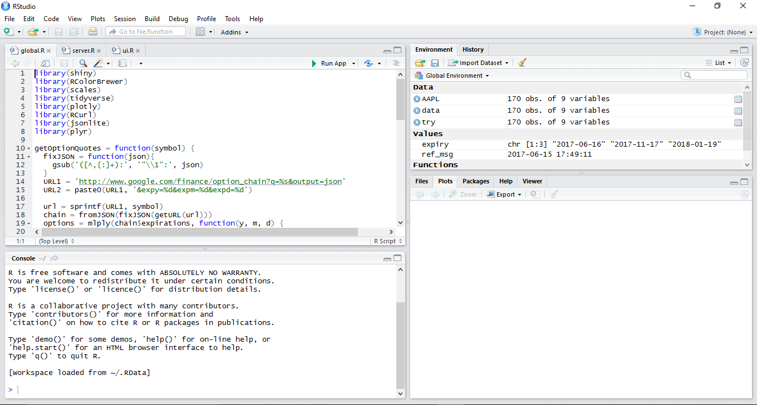
Integration Of Graphs:

Slide 15
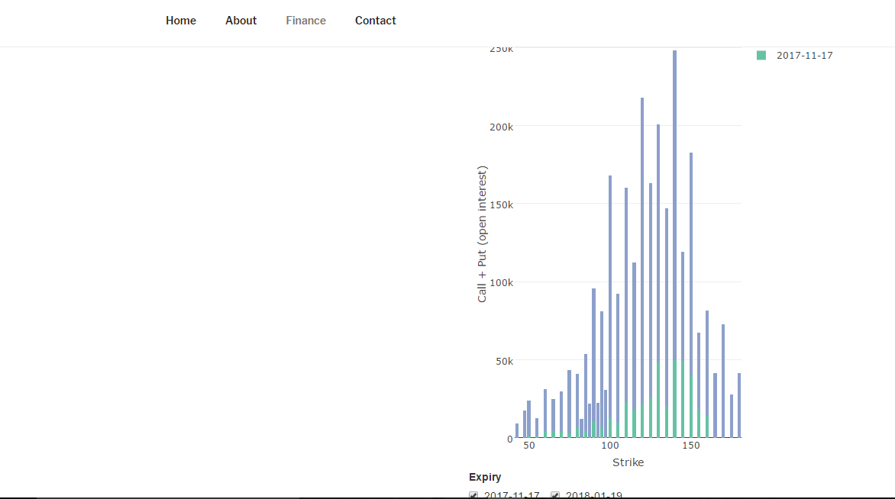
Graph in Webpage:

Slide 16
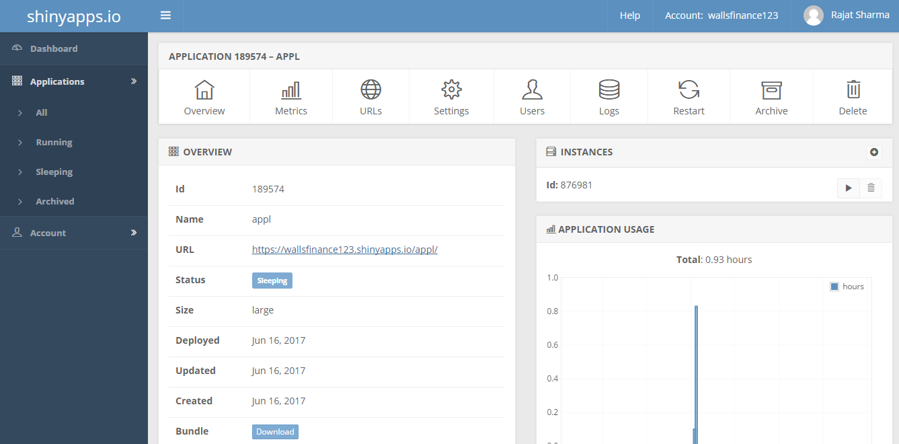
Integration On Cloud Server:

Slide 17
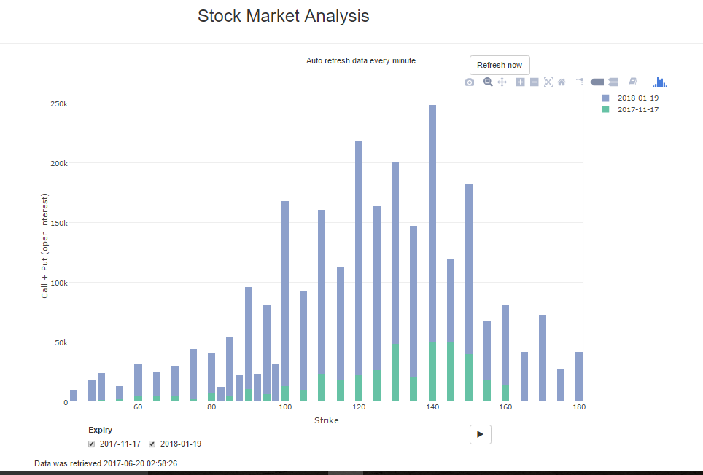
Graph

Slide 18
Thank You

