Slide 1
Docker Engine
Container
workload
9pfs
Container
workload
containerd
Container
workload
VM
containerd-shim
cc-proxy
hyperstart
I/O
cc-shim
cc-shim
CTL
containerd-shim
cc-oci-runtime
cc-oci-runtime
Socket pair (unnamed AF_UNIX)
AF_UNIX socket

Slide 2
Docker Engine
9pfs
Container
workload
containerd
VM
containerd-shim
cc-proxy
hyperstart
I/O
cc-shim
CTL
cc-oci-runtime
Socket pair (unnamed AF_UNIX)
AF_UNIX socket

Slide 3
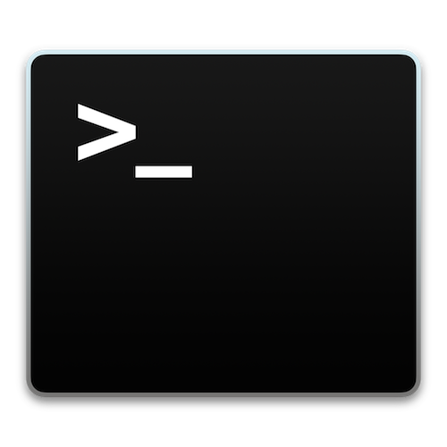
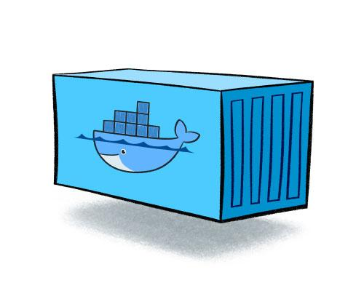
Docker and runc
Docker and Clear Containers
Docker Engine
Docker Engine
containerd
containerd
shim
shim
shim
shim
shim
shim
runc
runc
runc
cc-oci-runtime
cc-oci-runtime
cc-oci-runtime

Slide 4
1
namespaces
VM
cc-oci-runtime
5
3+4
hyperstart
6
2
7
10
8
cc-proxy
cc-shim

Slide 5
Host networking namespace
Container networking namespace
QEMU
Pod
Docker
Bridge
veth pair
Clear Containers
Bridge
workload
TAP
VM

Slide 6
VMX Root
VMX Non-Root
Virtio services
Container workload
hyperstart
QEMU
VM
VM Exit
Linux Kernel
Virtio services
KVM
vhost

Slide 7
stdout
Sequence
Number (8 bytes)
Packet Length
(4 bytes)
payload
stdin
Hyperstart packets
# pwd
/tmp
hyperstart
VM
containerd-shim
# pwd
/tmp
8888
16
“/tmp”
pwd
cc-shim
8888
16
“/tmp”
/tmp
8888
17
“# pwd”
cc-proxy
Container process
stdin/stdout: 8888
stderr: 8889

Slide 8
Kubernetes Node
Kubelet
Virtual Machine
kuberuntime
Ctr 1
Ctr 2
Ctr 3
Kubernetes Master
Pod
CRI-O/ocid
hyperstart
cc-oci-runtime

Slide 9
Docker Engine
Container
workload
9pfs
Container
workload
containerd
Container
workload
VM
containerd-shim
cc-proxy
cc-agent
I/O
cc-shim
CTL
cc-shim
containerd-shim
cc-oci-runtime
cc-oci-runtime
TCP socket
AF_UNIX socket

Slide 10
Guest
VM
Host
User
Kernel
Kernel
User
nvdimm
rootfs
shmem
DAX
mount

Slide 11
Docker
CRI-O
OCI
json
proxy
shim
VM kernel
cc-runtime
VM FS
agent
virtcontainers
pod
container
helpers
OCI
CNI
CNM
QEMU

