Slide 1



Car Sales Dashboard
View in Power BI
Last data refresh:
19-10-2024 16:46:26 UTC
Downloaded at:
19-10-2024 21:56:32 UTC

Slide 2
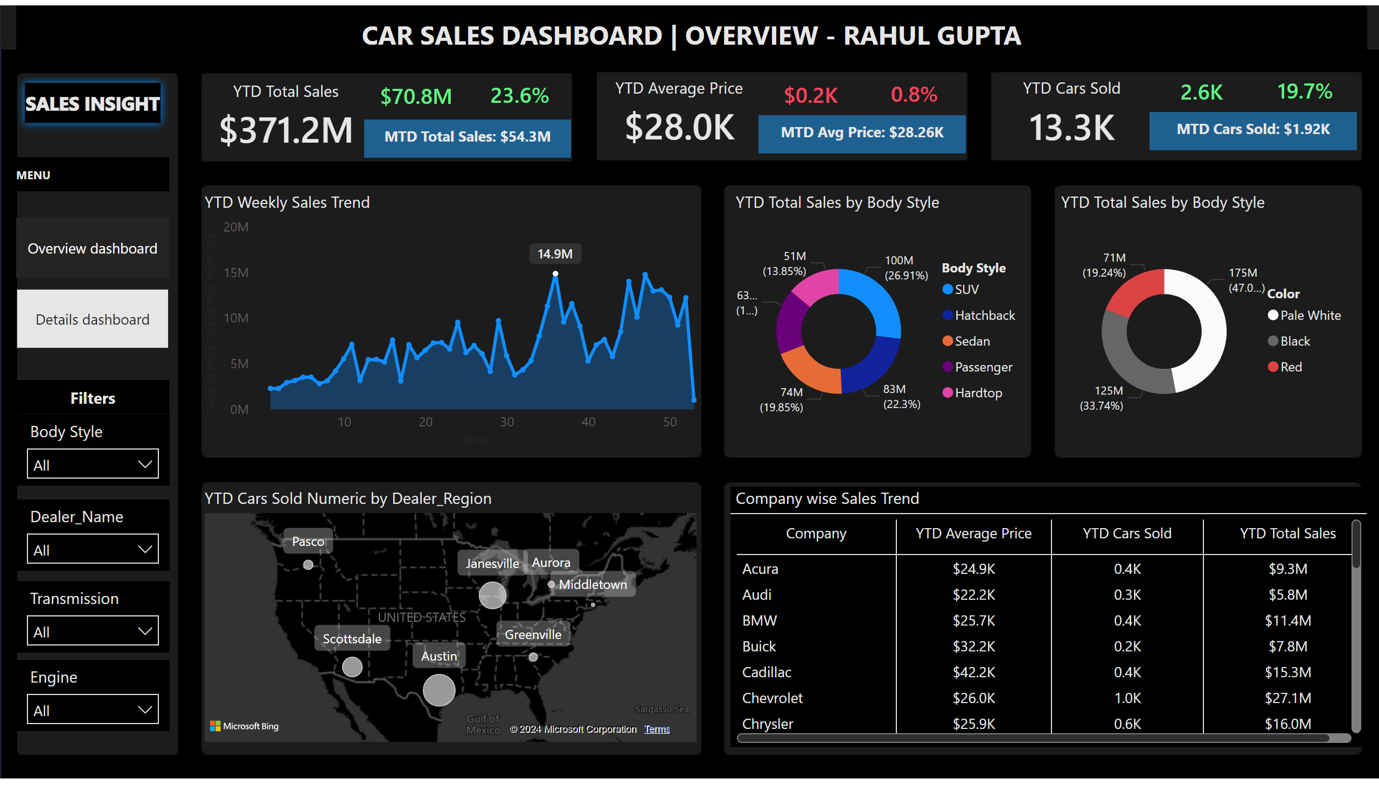
Overview dashboard
Notes:
YTD Total Sales
No alt text provided
card
No alt text provided
card
No alt text provided
MTD Total Sales
No alt text provided
YTD Weekly Sales Trend
No alt text provided
MTD Total Sales
No alt text provided
card
No alt text provided
card
No alt text provided
YTD Cars Sold
No alt text provided
MTD Total Sales
No alt text provided
card
No alt text provided
card
No alt text provided
YTD Average Price
No alt text provided
YTD Total Sales by Body Style
No alt text provided
YTD Total Sales by Body Style
No alt text provided
Company wise Sales Trend
No alt text provided
map
No alt text provided
shape
No alt text provided
shape
No alt text provided
pageNavigator
No alt text provided
shape
No alt text provided
slicer
No alt text provided
slicer
No alt text provided
slicer
No alt text provided
slicer
No alt text provided
shape
No alt text provided

Slide 3
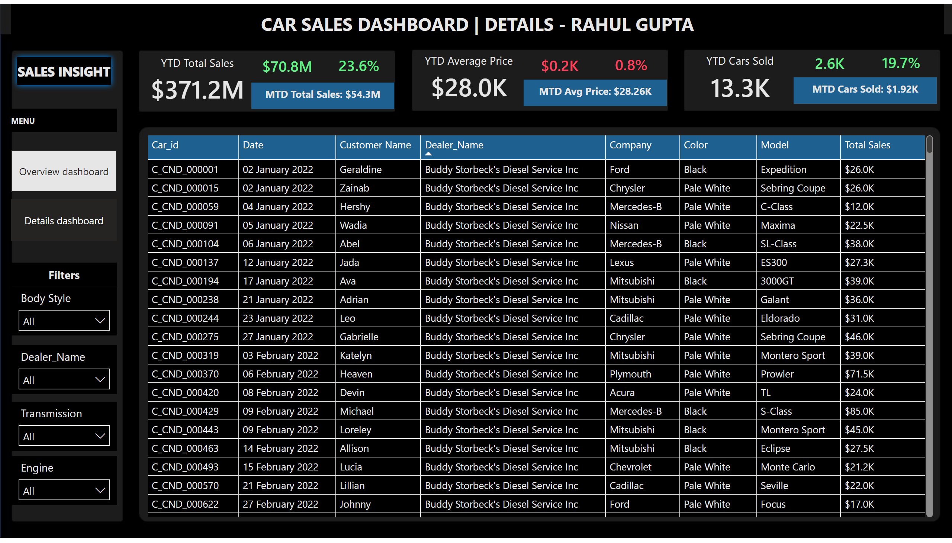
Details dashboard
Notes:
pageNavigator
No alt text provided
shape
No alt text provided
shape
No alt text provided
tableEx
No alt text provided
shape
No alt text provided
slicer
No alt text provided
slicer
No alt text provided
slicer
No alt text provided
slicer
No alt text provided
shape
No alt text provided
YTD Average Price
No alt text provided
card
No alt text provided
card
No alt text provided
MTD Total Sales
No alt text provided
YTD Cars Sold
No alt text provided
card
No alt text provided
card
No alt text provided
MTD Total Sales
No alt text provided
MTD Total Sales
No alt text provided
card
No alt text provided
card
No alt text provided
YTD Total Sales
No alt text provided

