Slide 1


A Denoising Diffusion-Based Evolutionary Algorithm Framework Demonstrated on the Maximum Independent Set Problem
Joan Salvà Soler Günther Raidl

Slide 2
ML for Combinatorial Optimization (CO)
CO -> find an optimal solution from a discrete set (e.g., routes, schedules, assignments)
Solution methods
  Exact -> Mathematical Programming, Constraint Programming
  Heuristic -> Greedy Heuristics, Local Search procedures
  Metaheuristic -> e.g. Evolutionary Algorithms (EA)
  Machine Learning
    Supervised, Unsupervised, Reinforcement Learning approaches
    End-to-end learning, Learning configurations, ML for algorithmic decision-making…

Slide 3
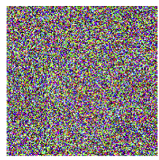
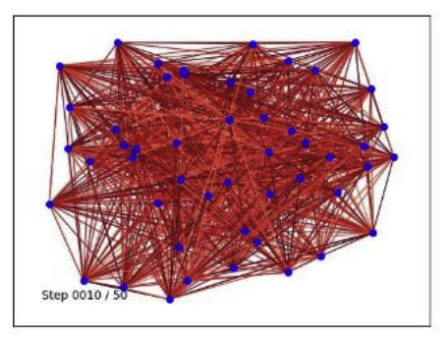
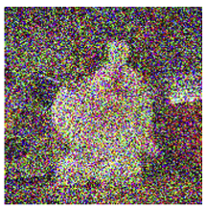
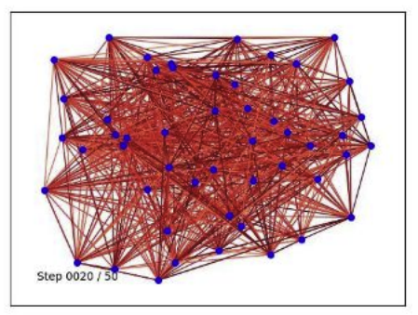
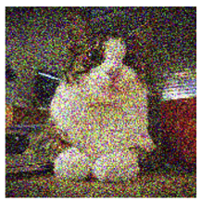
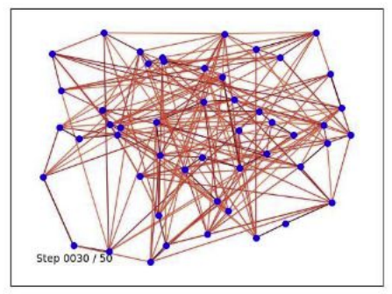
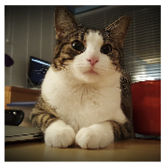
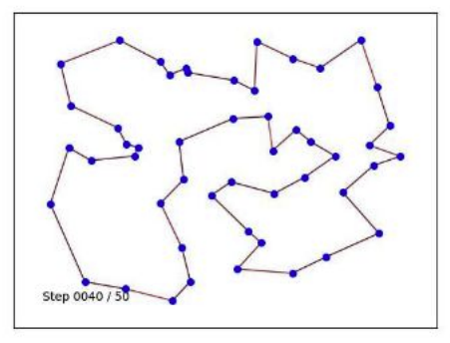
Denoising Diffusion Models for Combinatorial Optimization (CO)
Denoising Diffusion Models, a new generative modeling appraoch for CO
DIFUSCO^{[a]}:
  Use a Denoising Diffusion Model (GNN backbone) to denoise a random graph into a solution
  Multi-modality -> multi-sampling leads to distinct solutions
  Train in supervised manner using solver-generated labels
  Parallel generation of solutions thanks to GPU acceleration
[a] Sun, Z., & Yang, Y. (2023), NeurIPS, https://arxiv.org/abs/2302.08224

Slide 4
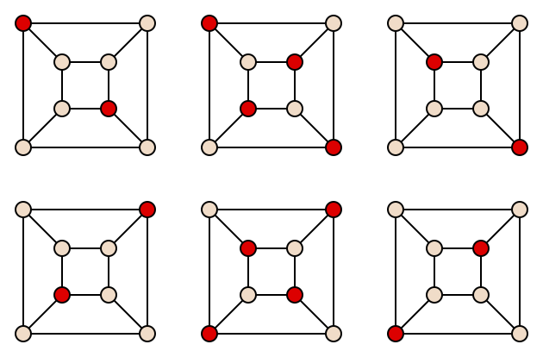
Focus Problem: Maximum Independent Set (MISP)
Definition: Find a largest set of non-adjacent nodes in a graph
A good benchmark:
  Common in ML for CO literature
  Simple definition, but NP-hard
KaMIS^{[b]} is the state of the art solver:
  C++
  Combines exact methods with heuristics, no ML
[b] Lamm et al. (2017), J. Heuristics, https://doi.org/10.1007/s10732-017-9337-x

Slide 5
Beyond DIFUSCO: Hybrid Diffusion–Evolution Approach
Limitations of DIFUSCO:
  Need post-processing heuristics for feasibility / quality (often problem-dependent)
Goal
  Combine strong multi-modal generative power of Diffusion Models
  With methods that effectively explore the solution space (Evolutionary Algorithms)
  Leverage GPU acceleration for parallelization of population operators
Focus Problem: Maximum Independent Set

Slide 6
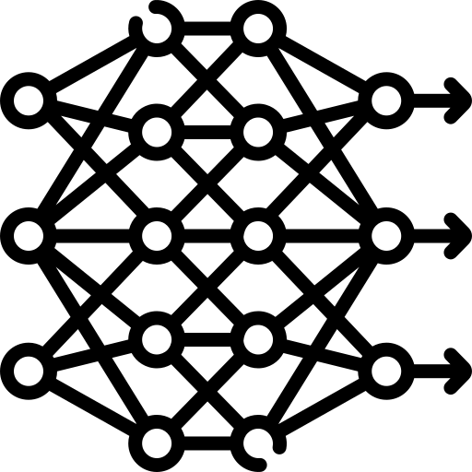
Methodology: Denoising Diffusion-Based EA (DDEA)
Diffusion-Based Initialization
Problem instance
Problem instance
Denoising Diffusion
Trained on high-quality solutions
. . .
Diffusion-Based
Initialization
Problem instance
Initialize
Diverse population of solutions
Repeat N generations
Repeat N generations
Crossover
Diffusion-Based
Crossover
Diffusion-Based Recombination
Select
Select
Replace
Replace
Mutate
Mutate
Problem instance
+
Denoising Diffusion
+ Conditioning
Trained on “optimal recombinations”
High-quality recombined solutions
Two solutions to combine
Solution
Solution
Evolutionary Algorithm
DDEA

Slide 7
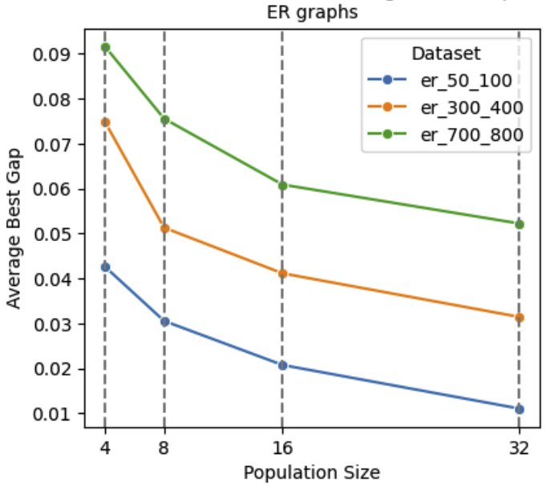
Diffusion-Based Initialization
Sample a population of initial solutions from a pre-trained DIFUSCO model
Multi-modal property ensures diversity
Decode node probabilities into feasible solutions using a probability-biased greedy decoding
  Sort by highest probability, and sequentially add to the IS respecting feasibility
  Simple and the only problem-dependent component
Multi-modal property of DIFUSCO in action

Slide 8
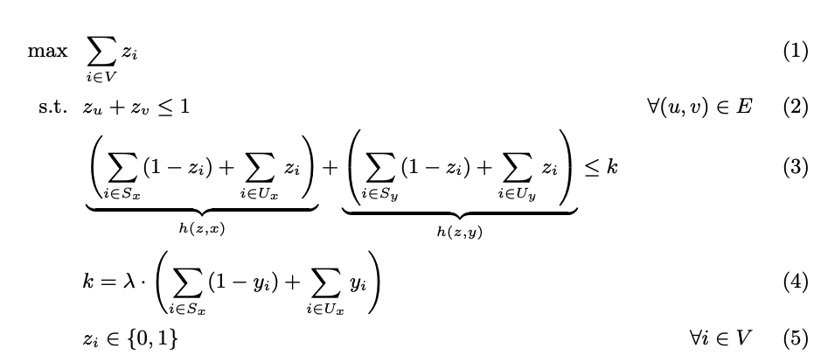
Diffusion-Based Recombination
Train with Imitation Learning from Expert Demonstrator
  Use Integer Linear Program to generate offspring combining qualities from both parents
  Slow but high quality
We modify the DIFUSCO architecture to accept conditioning features
Train on in-distribution examples: real EA trajectiories with the optimized recombination
ILP for the expert demonstrator

Slide 9
Experimental Setup
MISP on Erdős-Rényi (ER) graphs:
  50 – 100 nodes (375 – 1500 edges)
  300 – 400 nodes (13500 – 24000 edges)
  700 – 800 nodes (73500 – 96000 edges)
Hardware:
  DDM training and inference on NVIDIA A100 80GB GPU
  Intel(R) Xeon(R) E5-2640 v4 CPU at 2.40GHz and 160GB RAM on Ubuntu 18.04.6 LTS
Metrics:
  Optimality gap to KaMIS^{[b]} solution = 1 – ( {KaMIS solution} / {best solution found} )
  Cost = size of the independent set
[b] Lamm et al. (2017), J. Heuristics, https://doi.org/10.1007/s10732-017-9337-x

Slide 10
Baselines
DIFUSCO (multi-shot x16, timed to avg time of DDEA)
KaMIS (60s time limit)
Gurobi (timed to avg time of DDEA) solving a standard MIS model
Ablation variants:
  Randomized Greedy Initialization (RG Init) – replacing DIFUSCO initialization
  Consensus-Divergence Crossover (CDX) – replacing diffusion recombination

Slide 11
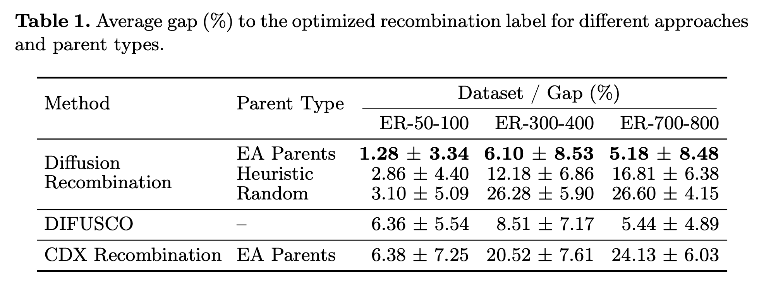
Diffusion Recombination Evaluation
  Diffusion Recombination effectively approximates the expert operator
  Clearly outperforms baseline recombination
  Cost monotonicity -> better conditioning solutions increases offspring quality

Slide 12
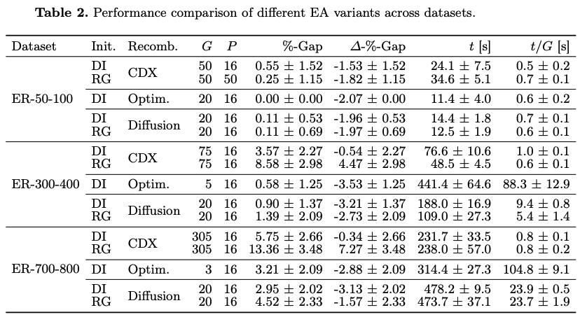
DDEA Ablation Studies
Full DDEA achieves performance comparable to the EA with expert optimized recombination, reducing runtime per generation drastically
Full DDEA clearly outperforms the ablations -> both diffusion operators are critical
Diffusion Recombination seems particularly important

Slide 13
DDEA Ablation Studies
Full DDEA achieves performance comparable to the EA with expert optimized recombination, reducing runtime per generation drastically
Full DDEA clearly outperforms the ablations -> both diffusion operators are critical
Diffusion Recombination seems particularly important

Slide 14
DDEA Ablation Studies
Full DDEA achieves performance comparable to the EA with expert optimized recombination, reducing runtime per generation drastically
Full DDEA clearly outperforms the ablations -> both diffusion operators are critical
Diffusion Recombination seems particularly important

Slide 15
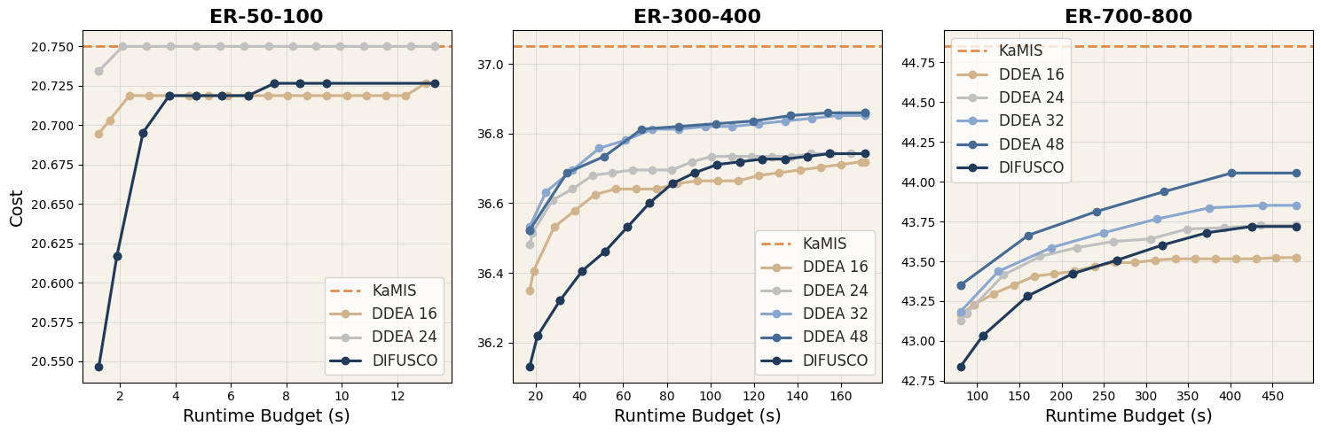
DDEA vs DIFUSCO Under Different Time Budgets
  DDEA demonstrates superior performance compared to DIFUSCO independently of the time budget provided
  Optimal population size dependant on the instance sizes -> 24, 32, or 48

Slide 16
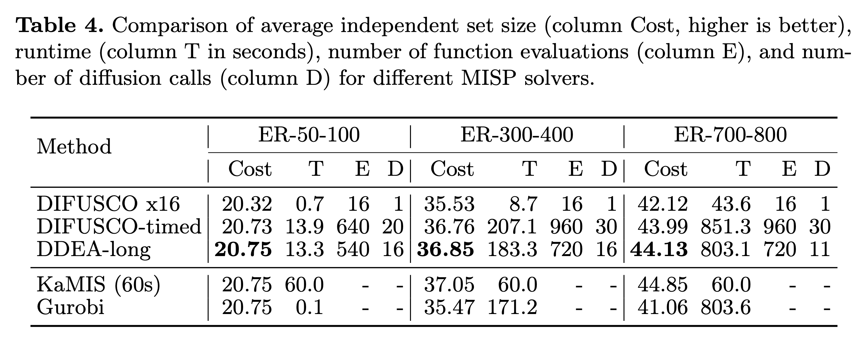
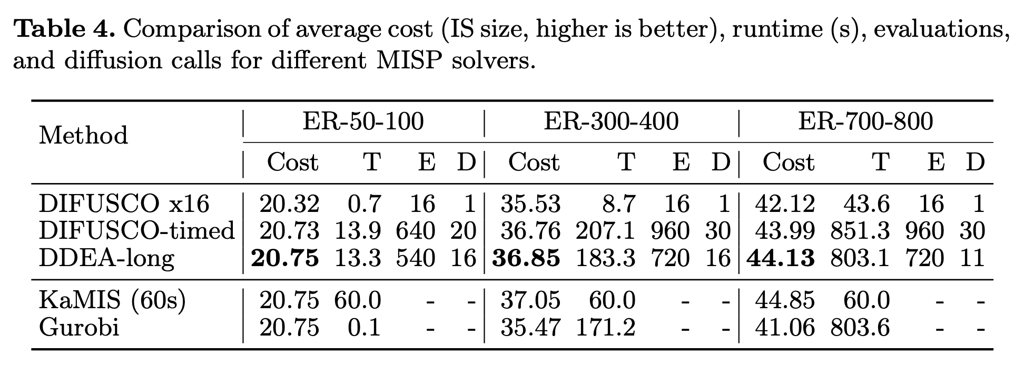
DDEA vs Other Solvers
  DDEA outperforms Gurobi’s OptiMods MISP model under same time budget
  DDEA does not outperform KaMIS, which is the ground truth solver

Slide 17
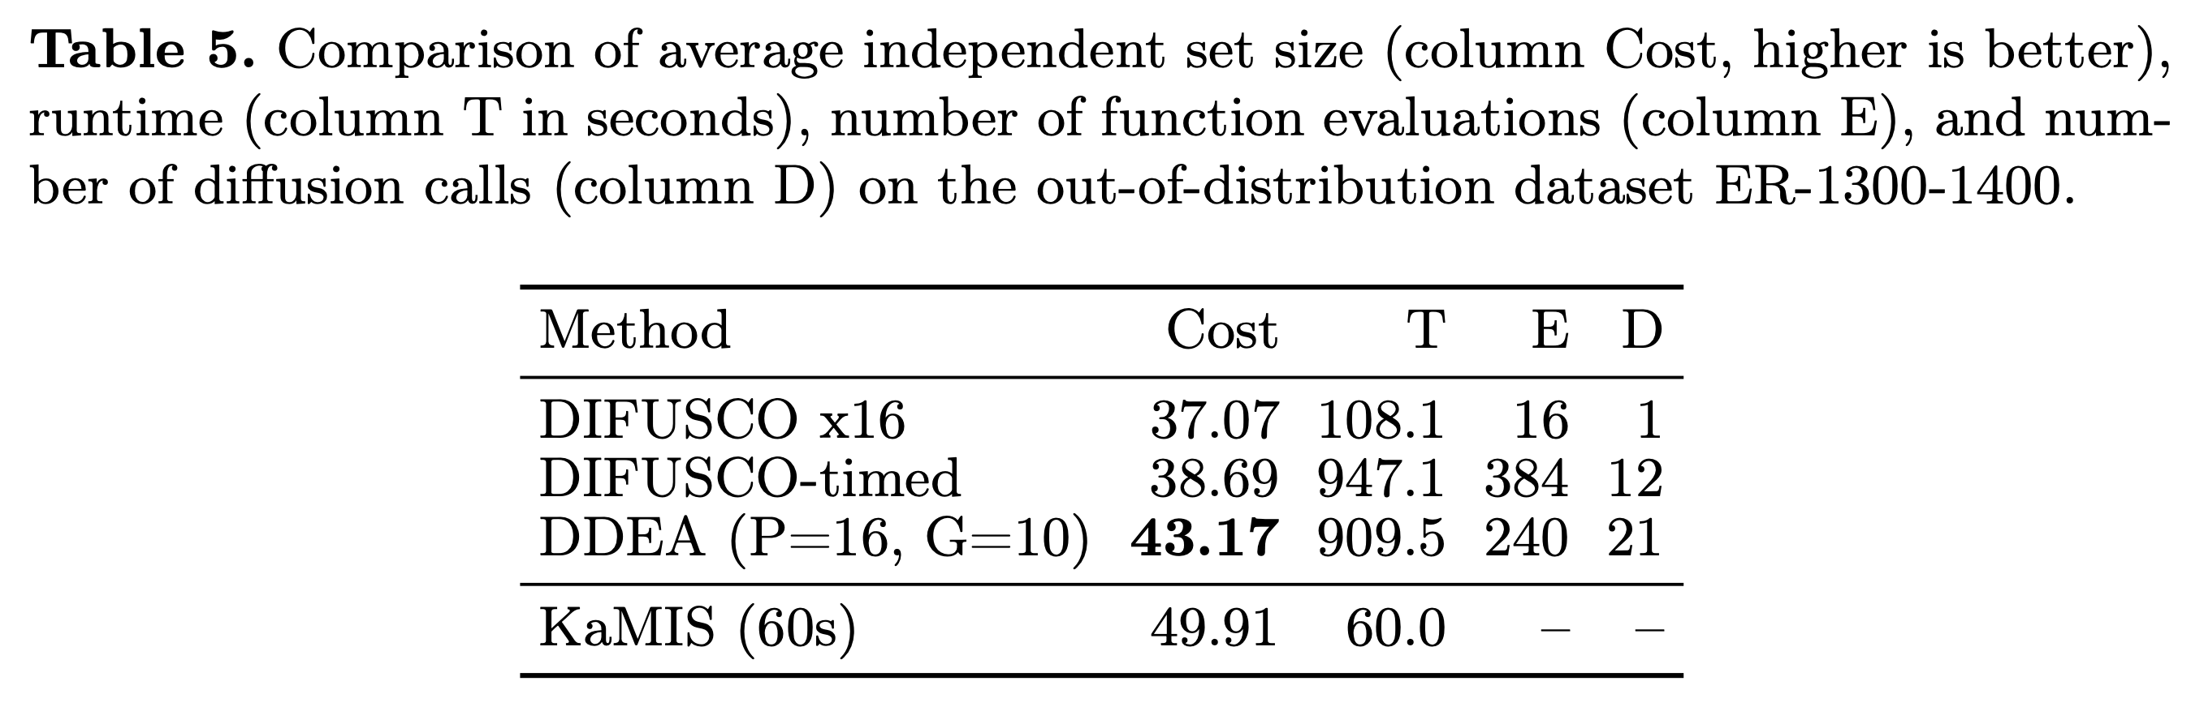
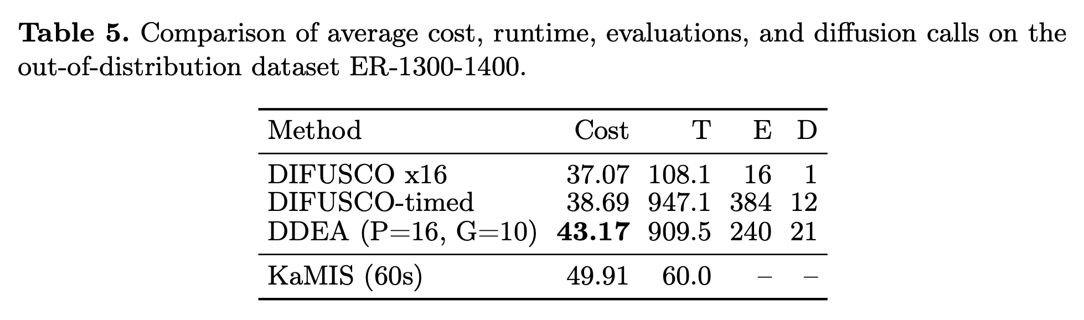
DDEA Out of Distribution
  DDEA is superior to DIFUSCO under same time budged due to evolutionary search mechanisms

Slide 18
Summary and Conclusion
Introduced DDEA: a Hybrid DDM + EA framework
  Key components: Diffusion Initialization and Diffusion Recombination
Results
  DDEA superior to DIFUSCO independently of the time budged
  DDEA superior to MISP Gurobi model on large datasets when given same time budget
  DDEA performs worse than specialized classical solvers (KaMIS)

Slide 19
Limitations and Future Work
Limitations:
  Runtime (dominated by diffusion inference). GPU parallelization benefits still to exploit.
  Expensive Diffusion Recombination training data generation
Improvements:
  Cheaper training data generation pipeline
  GPU parallelization optimization
  Expanded problem domains
  Advanced Diffusion-CO architectures (T2T, DISCO)

Slide 20
Questions?

Slide 21
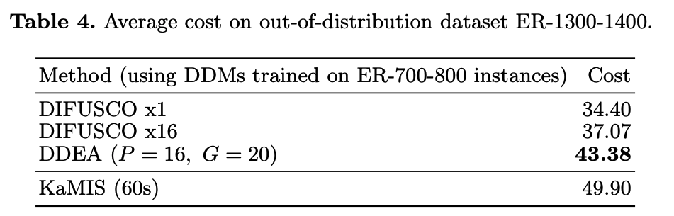
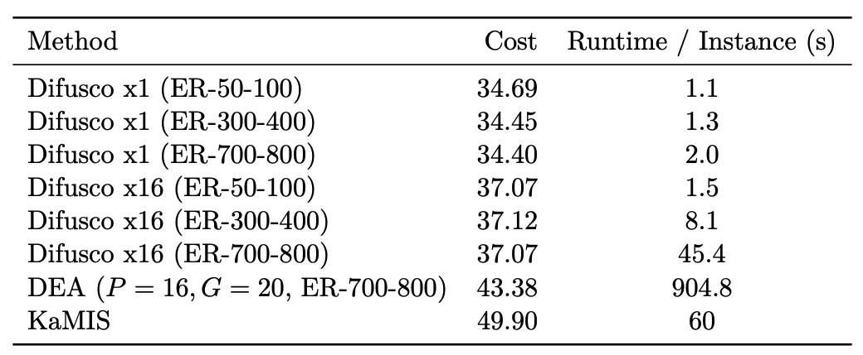
Out-of-Distribution Generalization
DIFUSCO struggles, multi-shot provides little improvement
Full DDEA generalizes much better
However, gap to KaMIS is much bigger compared to in-distribution evaluation

Slide 22
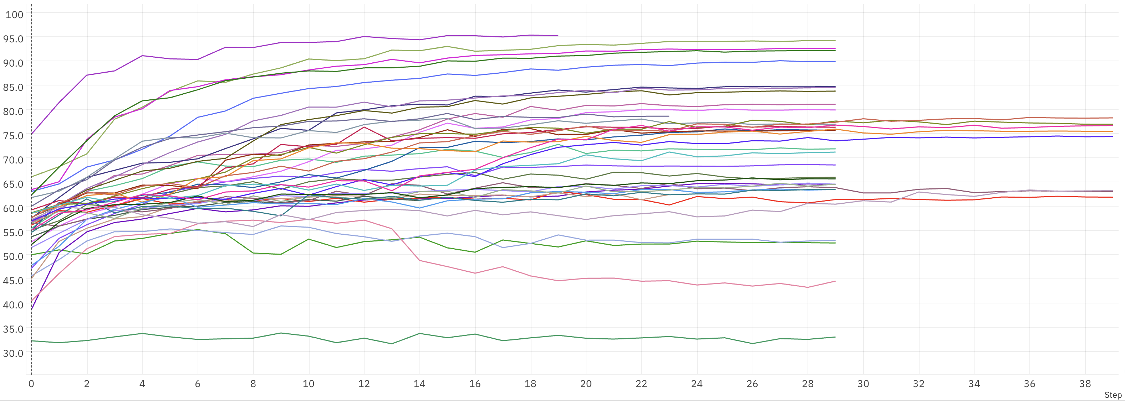
Validation Accuracy

