Slide 1
isyBlocks
A modern attempt to solve the issue of housing
Idea Made by Islam, Sachit and Yeni

Slide 2
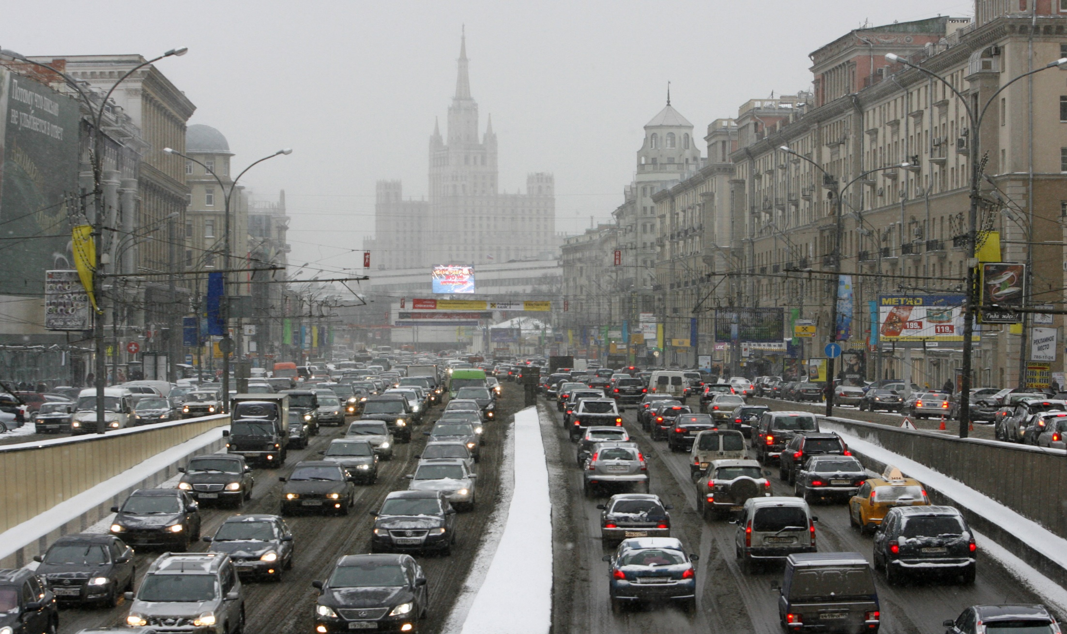
Image Of A Congested City

Slide 3
Problems with modern housing
Homes that all look the same.
Streets that discourage walking and cycling.
Neglected communal gardens.
On-street car parking.
Soulless streets without trees or flowers.

Slide 4
How are we going to fix housing?
Have a lot of open space.
Have the streets be “living” with plants and animals.
No cars allowed on streets in the block.
Have all the necessities have a close proximity to each other to promote walking.

Slide 5
Sustainable Houses
Incorporating bamboo in housing by replacing the steel rebar in houses.
Bamboo is also going to be used for flooring as carpet production releases chemicals in the sky.
Ashcrete will be used to replace cement.

Slide 6
Facts on the materials
Bamboo has greater tensile strength (or resistance to being pulled apart) than steel, and it withstands compression better than concrete.
Bamboo is is 2-3 times harder than most hardwoods, including oak!
Carpet is primarily made up of petroleum products, such as nylon, vinyl and PVC.
About 93% of Ashcrete is made of recycled material, making it immediately more environmentally viable than concrete.

Slide 7
Comparing To Normal Houses (Co2 Emissions in tons)
Normal Steel house
ISYblock house
Co2 from Steel | 9578
Co2 from Wood | 377
Co2 from Concrete | 6313
Extra Co2 from Calcinating Concrete Adjusted Total Co2 = 18500 | 2232
Co2 from steel 168
Co2 from wood 156
Co2 from concrete 442
Adjusted Total Co2 = 766

Slide 8

The Human (POV)
Meet Rylie, she will explain her opinions on IsyBlocks.

Slide 9
Rylie’s opinion
IsyBlocks are great, all the wildlife that surrounds you is so beautiful and it is a very tranquil place. The security is great and everything is so close I Don't need a car, it even saves on the bills!

Slide 10
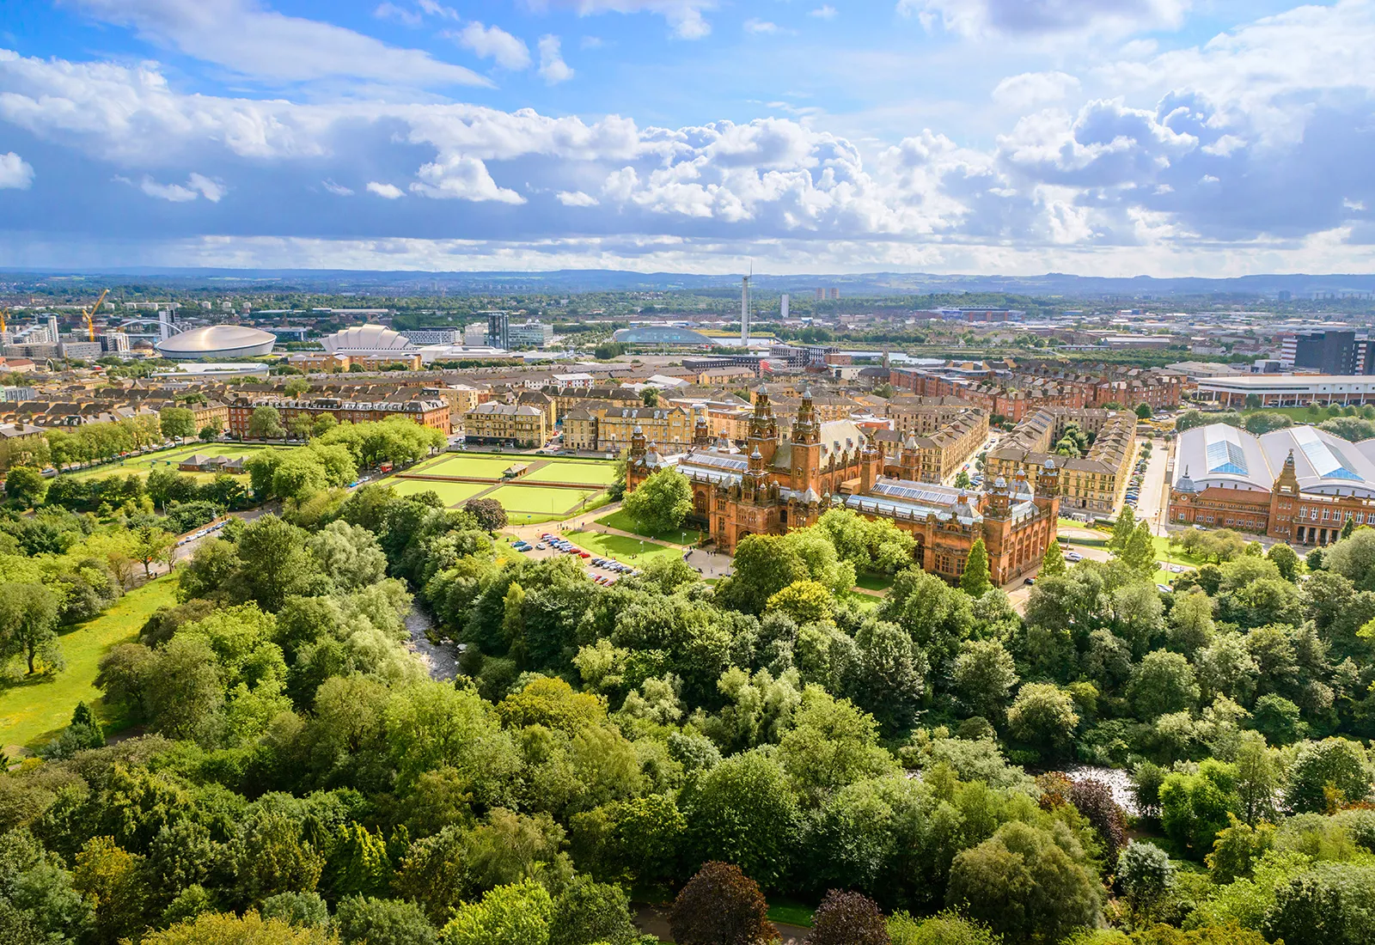
Taking Inspiration From Other GREEN Cities

Slide 11
Sachit – Slide show Islam – CAD design Yeni – Model Alex – Minor Tweaks
Credits

Slide 12
Sources
Slide 2: https://www.weforum.org/agenda/2021/01/covid-19-10-most-congested-world-cities-congestion-traffic/
Slide 3: https://www.theguardian.com/housing-network/gallery/2014/dec/17/new-housing-development-problems-pictures
Slide 6:
https://www.newsweek.com/stronger-steel-85533
https://sustainablebuild.co.uk/eco-friendly-alternatives-to-carpets/
https://www.ambientbp.com/blog/is-bamboo-stronger-than-hardwood
https://www.re-thinkingthefuture.com/materials-construction/a4497-alternative-material-ashcrete/#:~:text=Ashcrete%20is%20a%20mixture%20of,is%20produced%20by%20power%20plants
Slide 7: http://www.greenrationbook.org.uk/resources/footprints-building-construction/
Slide 8: Rylie, unfortunately doesn’t have the same appearance as the picture.

