Slide 1
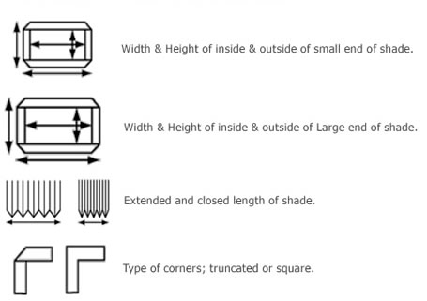
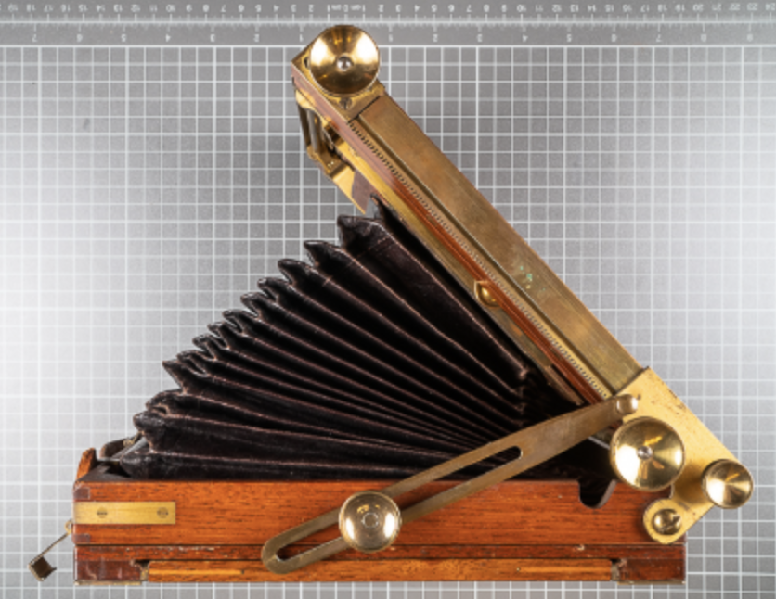


Inside: width=89, height=89 [mm] Outside: width=105, height=105 [mm]
Inside: width=171, height=171 [mm] Outside: width=195, height=195 [mm]
Extended: 360 [mm] Closed: 14 [mm]
15 [mm]
Element count=15
…
Requirement: - flexible enough to be folded

