Slide 1
MicroServices
CPD Team
Notes:
Ron

Slide 2
Agenda
What are micro services
Building
Deploying

Slide 3
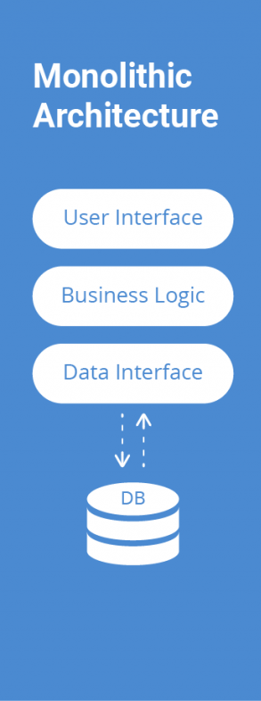
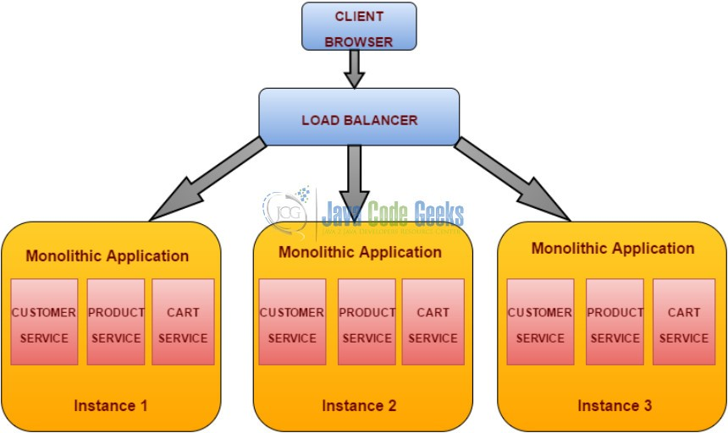
Monolithic Application

Slide 4
Disadvantages of Monolithic Large and complex Slowdown the development Unscalable Unreliable Blocks the continuous development Inflexible

Slide 5
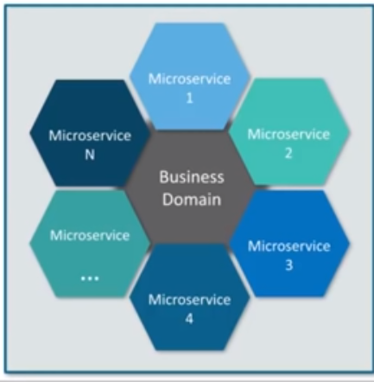
Microservices Microservice is an architecture style that structures an application as a collection of small autonomous services , moduled around a business Domain , each service is self-contained and implements a single business capability

Slide 6
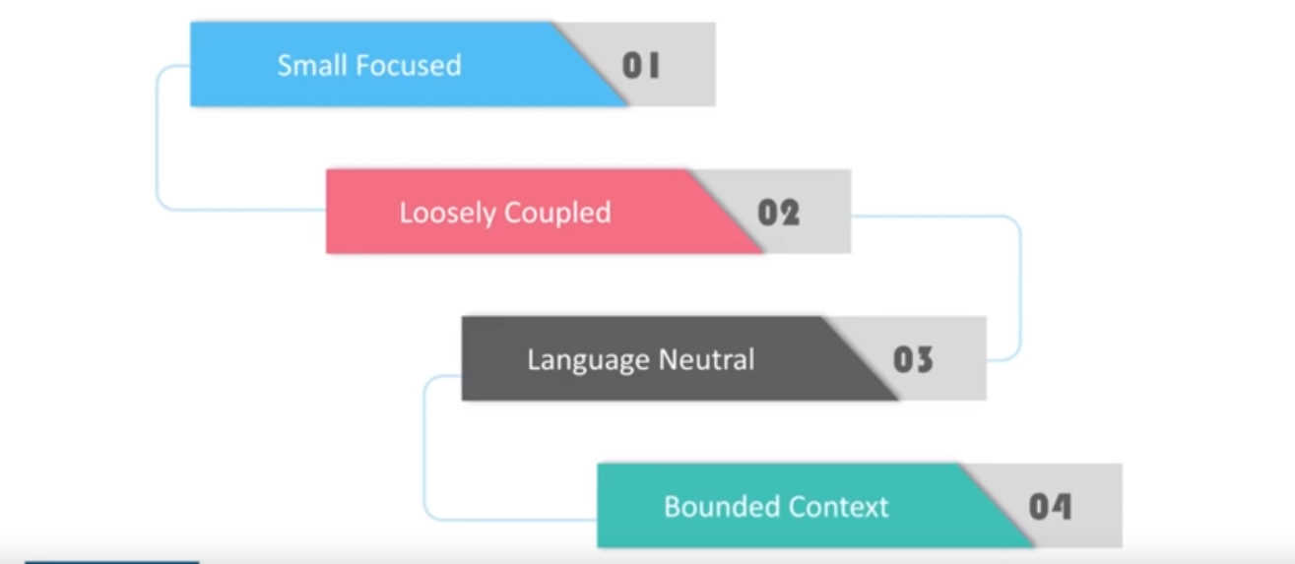
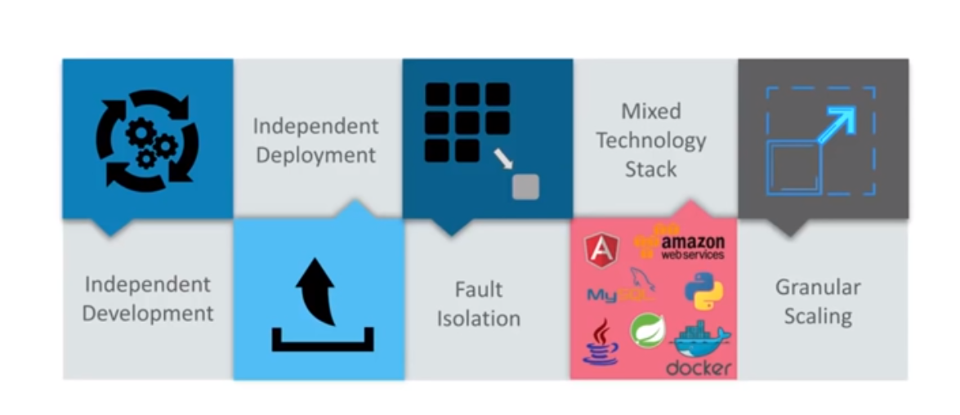
Advantages
Features

Slide 7
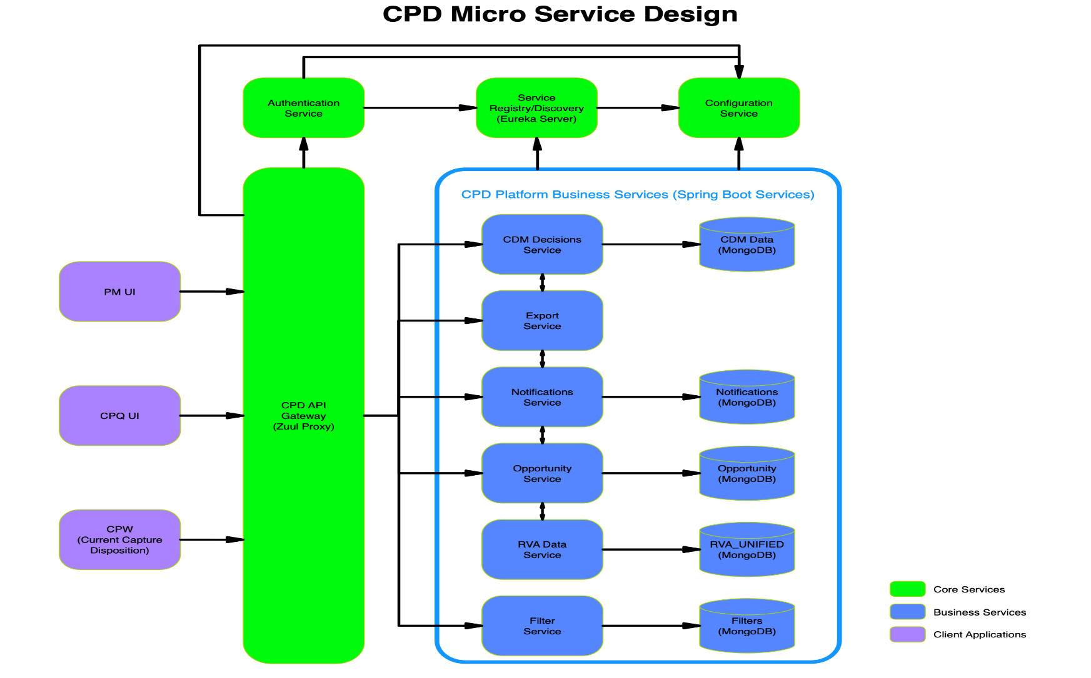
Microservice Arch

Slide 8
Spring Cloud
Implementing a microservice architecture is difficult. There are many concerns microservice architecture needs to address. Netflix developed a microservice framework to support their internal applications, and then open-sourced many portions of that framework. Many of these tools have been popularized via the Spring Framework – they have been re-implemented as Spring-based tools under the umbrella of the Spring Cloud project.
Spring Boot
Spring Boot is an open source Java-based framework used to create a micro Service, is used to build stand-alone and production ready spring applications.

Slide 9
Configuration management: configuration for a microservice application needs to be externalized from the code and be retrievable via a simple service call. | Spring Config Server
Service discovery: maintain a list of service instances that are available for work within a microservice domain. | Spring Cloud Eureka allows clients to register to it, maintains a heartbeat with registered clients, and maps service names to hostnames for clients that look up services by service name.
Load balancing: The key to scaling a distributed system is being able to run more than one instance of a component. Load has to be then distributed across those instances via a load balancer. | Spring Cloud Ribbon provides the ability for service clients to load balance across instances of the service.
API gateway: The granularity of APIs provided by microservices is often different than what a service client needs. API Gateways implement facades and provide additional services like proxying, and protocol translation, and other management functions. | Spring Cloud Zuul provides configuration-based API facades
Resilience and fault tolerance: Distributed systems must be capable of auto-routing around failures, and be capable of routing requests to the service instance that will provide an optimum response. | Spring Hystrix,& Ribbon

Slide 10
API GATEWAYS
Authentication, authorization and security
Rate Limits
Fault Tolerance
Service Aggregation

Slide 11
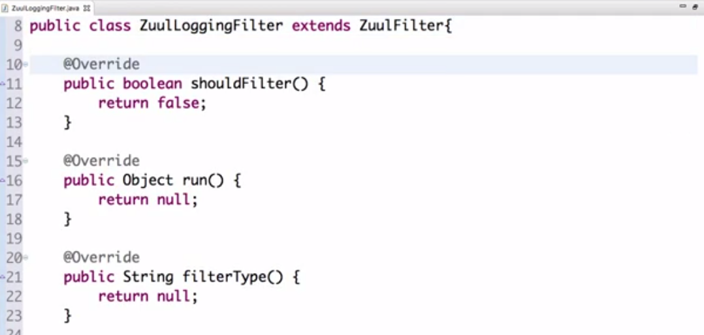
Zuul Filter

Slide 12
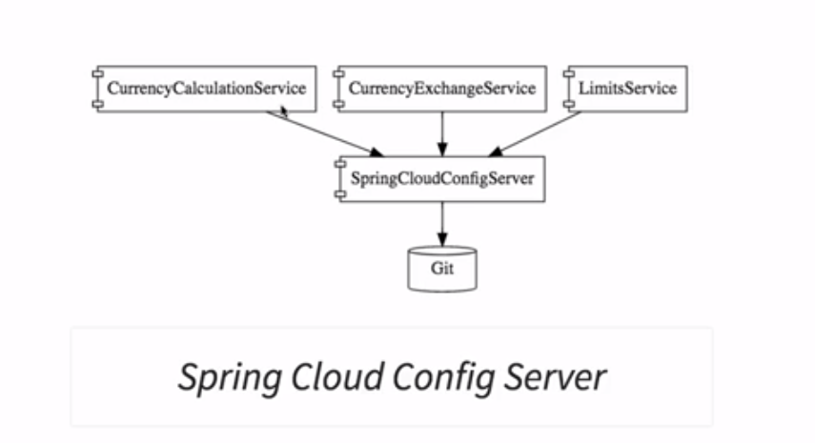
SPRING CLOUD
Spring Cloud provides tools for developers to quickly build some of the common patterns in distributed systems (e.g. configuration management, service discovery, circuit breakers, intelligent routing, micro-proxy, control bus, one-time tokens, global locks, leadership election, distributed sessions, cluster state).
Spring Cloud Config

Slide 13
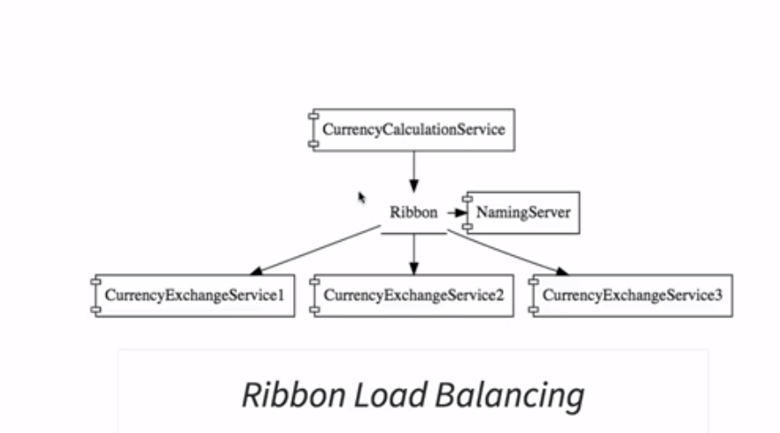
Dynamic scale up and down

Slide 14
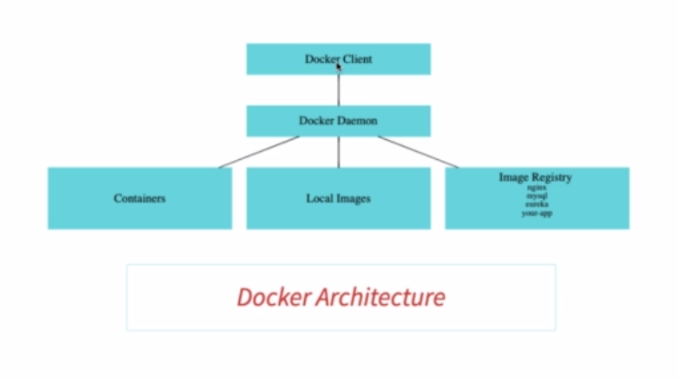
Docker Architecture

Slide 15
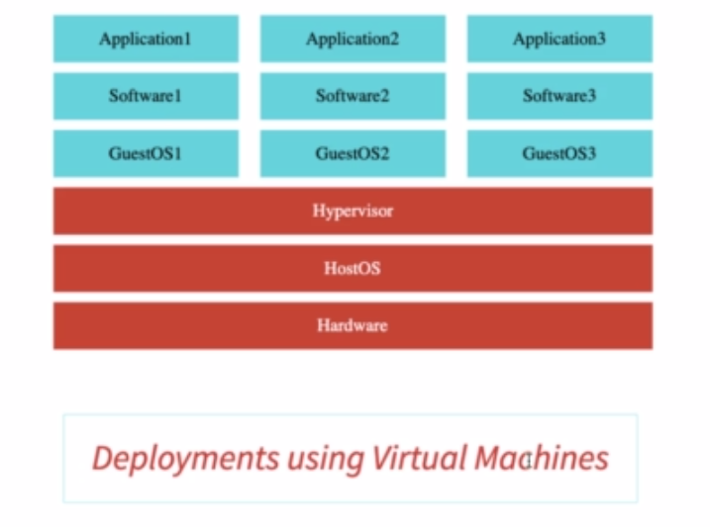
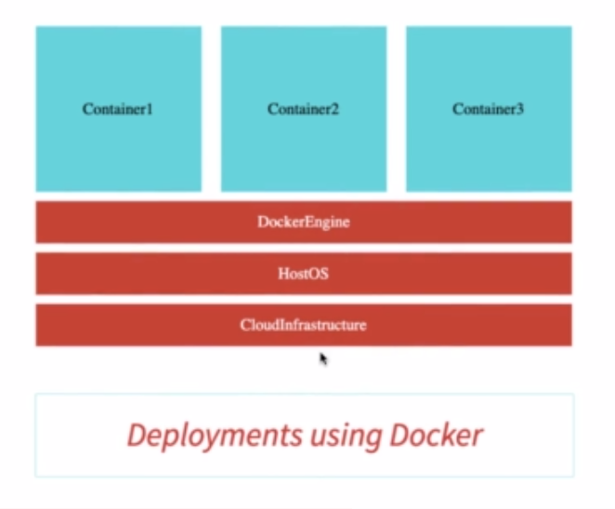
Virtual Machines Vs Docker

Slide 16
Resource Manager
As a distributed system, a cluster manager, a container platform, and an operating system.
Kubernetes
Docker Swarm
Mesosphere DC/OS
DC/OS features:
High resource utilization
Web interfaces
Elastic scalability
Zero downtime upgrades
distributed load balancing
Identity and Access Management

Slide 17
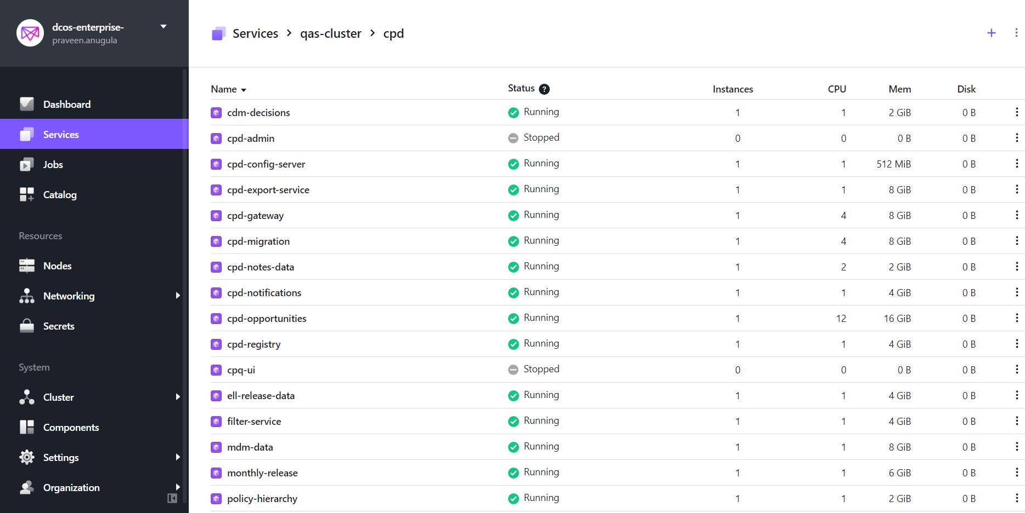
DC/OS

