Slide 1

A Vision-Based Motion-Detection Sytsem Combining MediaPipe with Optical Flow for Long-Term Coma Patient Monitoring
Author: Verena Grall
Supervisor: Dr. D. Pamela

Slide 2



Agenda
Background & Motivation
Objectives & Requirements
Methodology
System Architecture & Implementation
Validation, Results & Discussion
Deployments, Risks & Conclusion

Slide 3
Background & Motivation
Clinical need
detect rare, brief hand movements after long none-movement periods
Movement indicates, that the comatose patient is awake
Typical computer vision pipelines assume frequent/continuous motion
Foreground/action methods assume abundant motion
Design goal: precision in a small, semantically relevant ROI

Slide 4
Objectives & Non-Goals
Objectives
Non-Goals
Detect hand-localized motion in real-time
Unified trigger: alert + CSV + clip (pre-roll)
Debounce onset; cooldown determination; re-arming
Portable, CPU-only; deterministic & auditable
Clinical decision-making or diagnosis
Full-body/multi-patient tracking
Cloud services
Training new models in-scope

Slide 5
Key Requierments
Functional
Non-Functional
Single-hand ROI
Dense optical flow in ROI
Debounce triggers; pre-roll clips
Cooldown; re-arming; pause/grace
Clean shutdown
Cross-platform codecs and alerts
Timestamped filenames; CSV audit log

Slide 6
Method Overview
Localize hand ROI with MediaPipe Hands
Frame-level decision by area fraction
Temporal debounce (>=3 frames) before trigger
Compute Farnebäck dense optical flow in ROI
Threshold magnitude; morphology to denoise

Slide 7
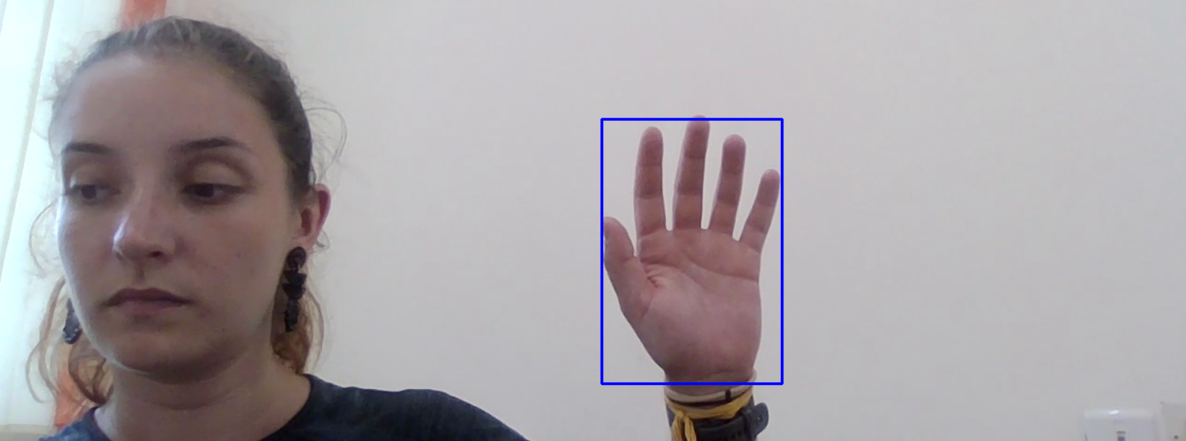
ROI Localization
Blue rectangle marks the hand-centric ROI (padding = 10 px).

Slide 8
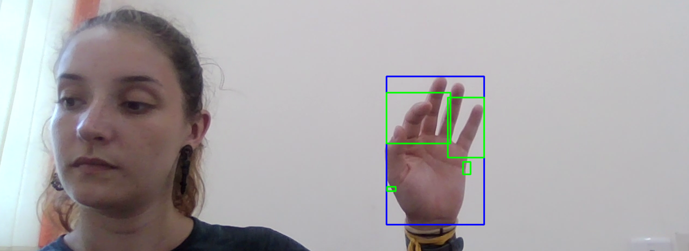
Motion Blobs with ROI
Green rectangles mark thresholded, morphologically cleaned motion inside the ROI

Slide 9
When motion is detected …
Trigger recording:
Open VideoWriter
Add pre-motion frames
record current frames until no motion + cooldown elapses
Trigger alert
Winsound on windows
Trigger CSV logging
Write new row in CSV with timestamp, filename and event
Re-arm after quiet period

Slide 10
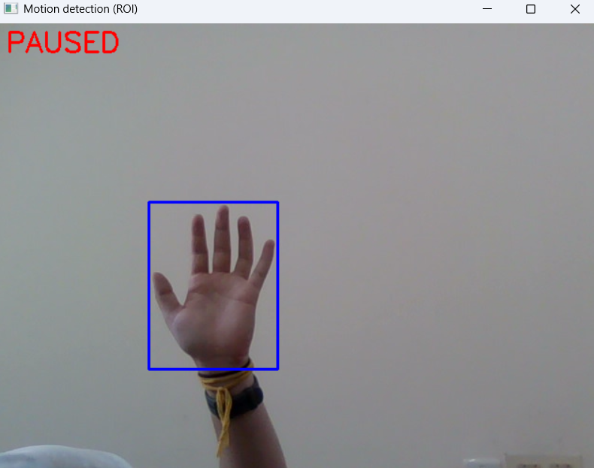
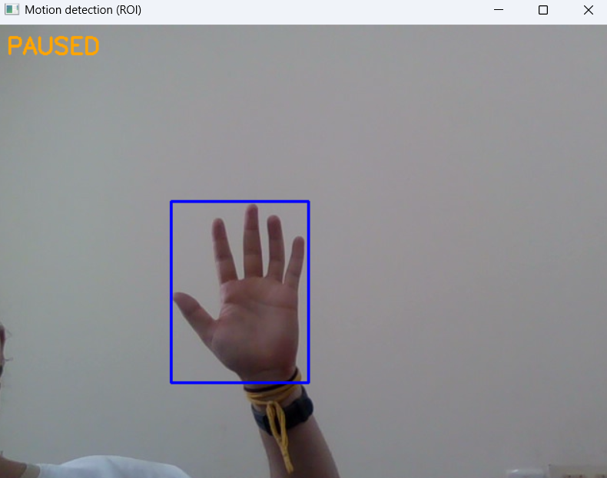
User Interface
Output frames are shown on screen
Stop with ESC-, ‚q‘-key, or closing the window
Pause/resume with ‚p‘-key
During resume grace, no motion is detected

Slide 11
Implementation Details
Python 3.x – OpenCV – MediaPipe – NumPy
Cross-platform codecs: XVID/AVI (windows), MP4V/MP4 (others)
Alert sink: winsound (windows) or WAV fallback
CSV logging with header auto-creation

Slide 12
Validation Plan (Tests)
V1: File-based determinism (idle baseline; scripted bursts)
Expect 0 events in idle baseline
V2: Live-loop sanity (re-arming; pause/grace behavior)
1 alert + 1 CSV + 1 clip per burst; pre-roll & tail check
V3: Edge & stress (ROI loss; planned: flicker, sweeps)
Metrics: trigger correctness, latency, integrity, stability

Slide 13
Results: Scripted-Burst Integrity
Clip | fps_nom | fps_real | rec_s | pre-roll (exp) | tail_s (min) | pre-roll_ok | tail_ok | PASS
movement_...38-04.avi | 30.01 | 28.48 | 6.81 | 60 (60) | 5.06 (5.00) | True | True | True
movement_...38-16.avi | 30.01 | 27.92 | 7.27 | 60 (60) | 5.05 (5.00) | True | True | True
movement_...38-29.avi | 30.01 | 28.26 | 8.74 | 60 (60) | 5.07 (5.00) | True | True | True
movement_...38-43.avi | 30.01 | 28.47 | 6.74 | 60 (60) | 5.04 (5.00) | True | True | True
movement_...38-56.avi | 30.01 | n/a | n/a | 60 (60) | 3.63 (5.00) | True | False | False

Slide 14
Results
Trigger correctness: 100% (5/5 events)
FAIL explained by video ending before cooldown
Pre-roll frames: 60/60 in all valid events
Lifecycle aligns alert/CSV/clip to same onset
Tail (time): mean 5.055 s, SD 0.011 s (4/5 valid)
Design meets integrity targets under constraints
Realized FPS: ~28–29 vs nominal 30; expected on CPU

Slide 15
Risks & Mitigations
Key Risks
Mitigations
Missed subtle motion (false negatives)
Lighting flicker inside ROI (false positives)
ROI loss/occlusion
Storage exhaustion; muted alerts
Tune threshold/kernel/FPS
Increase arm frames; stabilize lighting
Static-image mode; padding; last-seen ROI
Prune by age/size; WAV/OS notify fallback

Slide 16
Conclusion
ROI-restricted dense flow + debounce/cooldown works for sparse events
Unified trigger yields synchronized alert/log/clip with pre-roll
Engineering validation supports lifecycle correctness
Future: multi-ROI (hands, feet, eyes), adaptive sensitivity, alerting through e-mail/WhatsApp/SMS

Slide 17


Thank You
Verena Grall

