Slide 1

Visual Analytics SS 2024
Group 12
Vasco Cruz
Verena Grall

Slide 2


Motivation
Problem & Relevance
Start-up for battery cell transportation boxes
Strategic business decisions based on demands and manufacturing capacities and their locations
Visual Analytics
interactive map visualizing battery cell demand and manufacturing capacity data
zoom in - select variables – identify opportunities

Slide 3
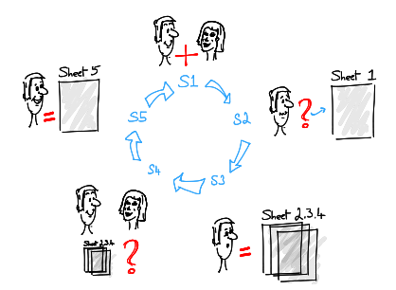
Design Process
Five Design-Sheet Methodology

Slide 4
Data
Source & Dataset
International Energy Agency (IEA): Battery demands (> 9500 rows)
Wiley & Statista: Demands, Manufacturer and Capacities
Start-up: Manufacturer & Capacities
Qualitative & Quantitative Data
Structured
Evaluation
Check for differences
Merge
Process Descriptive Statistics
Data Cleaning
Adding Columns (alpha3 Codes)
Predicting Missing Values

Slide 5
User
Task
Group of Users
Founder of a Start-Up for developing battery-transport boxes
People, who are interested in EV-demand and capacity
Skills and previous Knowledge
Basic knowledge about EVs
Basic Dashboard-Skills
Explore differences
Compare countries
Predict future demand/capacity
Identify potential customers
Understand production landscape
Analyze trends

Slide 6
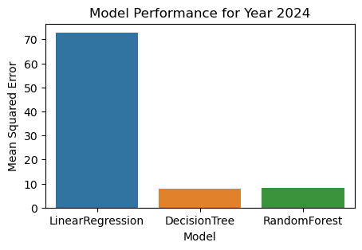
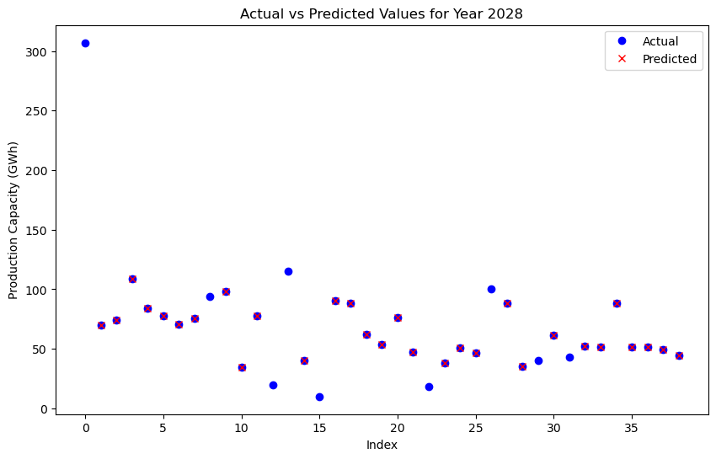
Development Environment
Backend
Language Python
Software JupyterNotebook & VisualStudioCode
Tasks Descriptive Statistics
Data Cleaning
Adding Columns (alpha3 Codes)
Predicting Missing Values

Slide 7
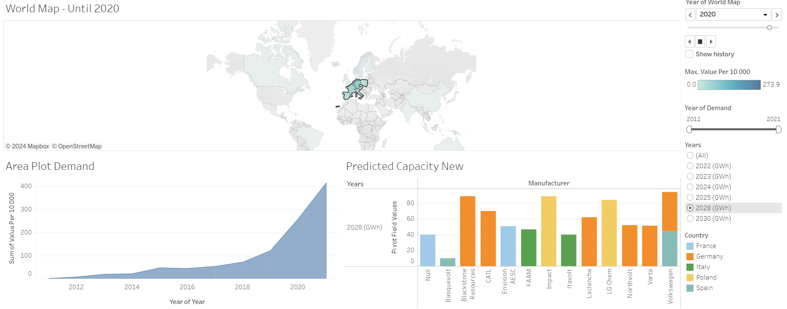
Development Environment
Frontend
Software Tableau
Tasks Visualizing Map
Adding Filters
Visualizing Selection Panel
Visualizing Information Panel

Slide 8
Discussion
Basis-Model for predicting values
Get more data
Visual overview of demand and capacity
Relatively easy to adjust
Too little data for capacity
Tool-Selection was quite demanding
Improve Dashboard Interactivity
Reduce Features
Debugging

