Slide 1

Predicting Hypertension Risk
USING MACHINE LEARNING TO DECODE LIFESTYLE, BEHAVIORAL, & SOCIOECONOMIC FACTORS
PRESENTER
PROGRAM
Gayathri Ramani
Springboard Data Science Program

Slide 2


Executive Summary
The Challenge & Data
Modeling & Results
Hypertension remains one of the most widespread but modifiable public health threats in the United States, yet millions are diagnosed too late.
Three algorithms were evaluated: Logistic Regression, Decision Tree, and Random Forest.
The Tuned Random Forest led in performance, delivering 72.3% test accuracy and a strong 0.789 ROC-AUC, validating that routine questionnaires contain robust signal for screening.
We utilized routine health survey answers from 436,781 adults (CDC 2021 BRFSS) to build predictive models without clinical readings or expensive laboratory diagnostic histories.
Notes:
Key Insight: Routine survey information holds deep predictive value, making scalable, digital health-driven preventative screening completely viable

Slide 3

The Burden of Hypertension
The Silent Threat
50%
Symptoms frequently stay hidden for decades until catastrophic cardiovascular or renal outcomes present. Proactive screening is critical.
Economic Load: Chronic management drives billions in yearly direct healthcare spending and heavy functional productivity losses.
U.S. Adults Affected
Strategic Shift: Population management systems are rotating rapidly towards value-based care, making upfront stratification a priority.

Slide 4






Data Source & Classification
CDC's 2021 Behavioral Risk Factor Surveillance System (BRFSS) was leveraged. 20 focused, non-clinical parameters were categorized across four key groups:
Demographic
Socioeconomic
Health Profile
Lifestyle & Diet
•
Age Categories
•
Education level
•
Body Mass Index (BMI)
•
Fruit Consumption
•
Biological Sex
•
Employment status
•
Physical Health Days
•
Vegetable Intake
•
Race/Ethnicity
•
Income Bracket
•
Health Insurance
•
French Fry Intake
•
Marital Status
•
Rural/Urban Status
•
Personal Health Provider
•
Active Exercise
Target Outcome: Respondent ever told by healthcare professional that they have hypertension (1=Yes, 0=No)

Slide 5










Analytical Workflow
Ingestion
Cleaning
EDA
Processing
ML Tuning
Targeted variable extraction from raw CDC survey database.
Removing physiological outliers and imputing missing data.
Uncovering trends in age, body mass, and dietary risk factors.
Feature engineering, encoding, and a stratified 80/20 train-test split.
Model development, validation, and hyperparameter search.

Slide 6


Data Cleaning & Imputation
Outlier Filtering
Missing Data Imputation
To prevent model skewing, we replaced physiologically impossible BMI values as missing and placed strict caps on highly inflated self-reported dietary consumption metrics:
Applied customized rules to handle non-random reporting missingness:
<2% Missing: Direct Mode imputation.
Capped Upper Limits: Fruit consumption capped at 10 servings/day, vegetables at 15 servings/day, and French fries at 3 servings/day.
2% - 20% Missing: Mode/Median replacement paired with dedicated missing indicator variables.
>20% (Income): Kept 'Unknown Income' as an explicit structural class to preserve social determinants data.

Slide 7
Data Snapshot
Sample Profile
Hypertension Patterns
436, 781 respondents
Mean Age → 55 years
Average BMI → 28 kg/m²
Slightly more men than women
Predominantly White, non-Hispanic
Majority in medium-income ($35K–$100K) or low-income (<$35K) groups
Predominantly from urban counties
39% hypertension prevalence
Similar prevalence by sex: Men 40% | Women 37%
Prevalence varied across racial and ethnic groups
Clear income gradient: ~50% low income → ~30% high income
Highest prevalence among those retired or unable to work (~60%)
Higher prevalence in rural (>40%) vs. urban counties
Notes:
Key Insight: Routine survey information holds deep predictive value, making scalable, digital health-driven preventative screening completely viable

Slide 8
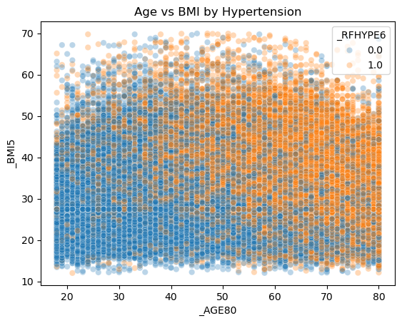
Primary Clinical Risk Drivers
Age & Weight Correlations
Exploratory data analysis demonstrates a steep, linear relationship between progressive age and high blood pressure prevalence, hitting its highest concentration at 65+.
Body Mass Index: Average BMI in the hypertensive cohort sits at 28.5 kg/m² (solidly within the medically overweight spectrum) compared to normotensive groups.
These strong clinical gradients match established epidemiological research, verifying the structural integrity of this self-reported questionnaire dataset.
Notes:
During exploratory data analysis, we verified that as expected, hypertension rates climb steadily as age increases. We also see an identical, stark upward trend when looking at Body Mass Index. This gave us strong confidence that the self-reported survey metrics were reliable inputs for predictive modeling

Slide 9
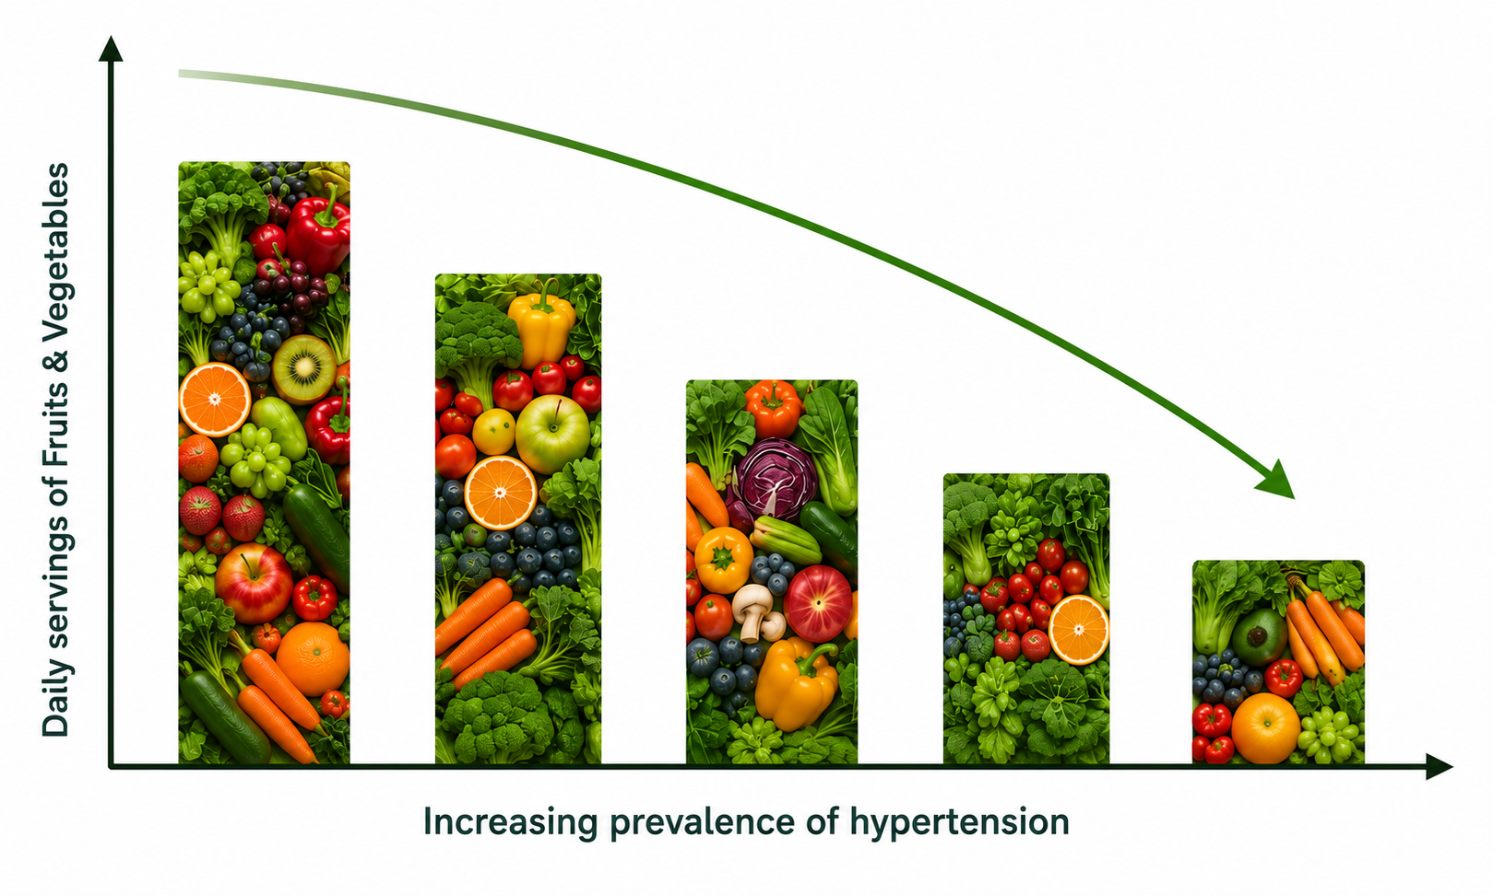
Dietary & Economic Risks
Social Determinants of Health
The Nutrition Gap: Survey analysis shows a strong, protective relationship linked to daily nutrition. Proactive fruit and vegetable intake correlates with lower diagnostic rates.
Economic Gradients: Respondents in lower income tiers and those currently unable to work report disproportionately higher rates of chronic hypertension.
Physical Inactivity: Inactive individuals (reporting zero moderate-to-vigorous physical exercise within the past 30 days) display heavily elevated diagnostic risks.
Feature Refinement: Dropped redundant features (e.g., dark green vegetables) to prevent multi-collinearity and optimize model performance.
Notes:
Beyond age and weight, lifestyle and environment matter. As shown in the graph on the left, lower fruit and vegetable intake correlates with higher hypertension rates. Crucially, we also saw socioeconomic patterns: individuals in lower-income tiers or those unable to work had much higher rates of the disease. This highlights that chronic disease is deeply tied to lifestyle and social determinants of health.

Slide 10
Feature Engineering and Pre-Processing
Preparing Survey Outputs for Predictive Modeling
Feature Engineering: Created income categories and missingness indicators to retain potentially informative patterns in the data.
Categorical Encoding: Applied One-Hot Encoding across multi-class categorical features (e.g., Marital status, Race, Employment status)
Continuous Feature Scaling: Standardized continuous features using StandardScaler (e.g., age, BMI, fruit and vegetable intake).
Class Distribution: Hypertension prevalence was 39%, compared with 61% without hypertension. Stratified train/test splitting was used to preserve this class distribution in both datasets.

Slide 11








Machine Learning Architecture
Logistic Regression
Decision Tree
Random Forest
Selected as our core baseline classifier due to its superior interpretability and rapid training cycle.
Implemented to map complex, non-linear feature pathways and interactions without imposing statistical assumptions.
Selected as our premium ensemble architecture, training multiple independent estimators to lower overall variance.
Provides highly transparent, mathematical feature weights of individual predictor impacts.
Tuned via GridSearchCV to optimize pruning depth and prevent overfitting.
Optimized using RandomizedSearchCV to identify peak splits across hundreds of estimators.

Slide 12
Hyperparameter Tuning Strategy
Decision Tree
Random Forest
Executed automated parameter tuning using GridSearchCV for the Decision Tree model
Executed automated parameter tuning using RandomizedSearchCV for the Random Forese model
Evaluated for criterion, max_depth, min_samples_split, min_samples_leaf
Evaluated for n_estimators, max_depth, min_samples_split, min_samples_leaf, max_features
Best parameters:
Criterion – Entropy
Max_depth – 10
Min_samples_lead – 10
Min_samples_split - 10
Best parameters:
N_estimators – 100
Max_depth - 20
Min_samples_split – 10
Min_samples_leaf – 10
Max_features – sqrt

Slide 13
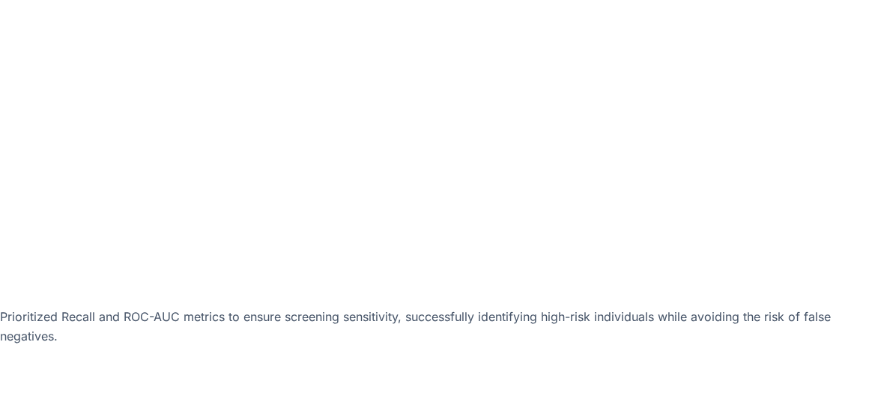

Performance Comparison
Model Archetype | Testing Accuracy | Precision | Recall (Sensitivity) | F1 Score | ROC-AUC
Logistic Regression | 72.0% | 66.2% | 59.0% | 0.624 | 0.786
Baseline Decision Tree | 63.2% | 53.3% | 53.8% | 0.535 | 0.615
Tuned Decision Tree | 71.6% | 64.8% | 61.4% | 0.630 | 0.779
Baseline Random Forest | 71.5% | 65.0% | 59.7% | 0.623 | 0.779
Tuned Random Forest | 72.3% | 66.1% | 60.9% | 0.634 | 0.789

Slide 14
Operational Implications
No Clinical Overhead Required
The Engineering Trade-Off
By bypassing laboratory requirements, predictive tracking is shifted up the patient funnel. Scale early-stage preventative flagging without requiring clinical draws or visits.
Choose Logistic Regression if complete feature transparency is mandatory for regulatory, compliance, or clinical explanation requirements.
Integrates instantly into simple portal questionnaires, onboarding assessments, or mobile wellness apps.
Choose Tuned Random Forest to prioritize highest operational discrimination, capturing nuanced risk factors across complex populations.

Slide 15
Study Limitations
Self-Reported Survey Basis: The BRFSS relies entirely on self-reports. This can naturally introduce behavioral recall and social desirability biases in diet, weight, and exercise entries.
Cross-Sectional Constraints: The CDC database captures a single point in time, proving strong and actionable predictive associations rather than establishing true medical causality.
Non-Clinical Design Limits: Engineered explicitly as a population risk-stratification screening tool. It is not designed to replace formal diagnostic exams.

Slide 16
Recommendations & Roadmap
Immediate Next Steps
Future Work
Preventative Screening Integration: Embed our questionnaire-driven predictive logic directly into mobile health application onboarding pipelines.
Multi-Year Training Cycles: Pool successive years of historical CDC data to track temporal behavior trends and solidify baseline predictions.
Holistic Intake Focus: Expand primary assessment collection protocols to capture vital socioeconomic and lifestyle determinants alongside standard medical charts.
Model Optimization: Execute aggressive feature selection analyses to isolate the absolute smallest set of questions needed to retain model stability.

Slide 17
Questions & Discussion

