Slide 1
GUIDO EXPRESSIONS

Slide 2
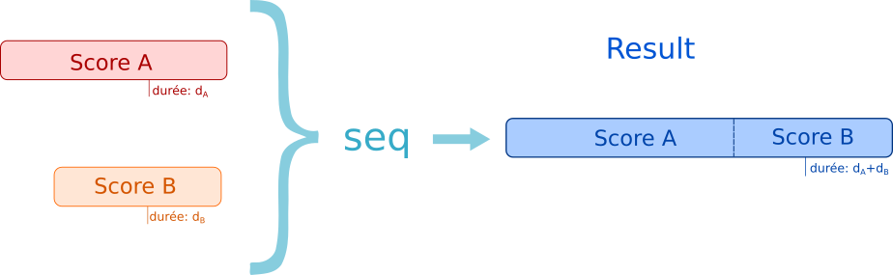
GuidoAR Operators

Slide 3
GuidoAR Operators
seq (sequence)
par (parallel)
head
tail
duration
applyRythm
top
bottom
transpose
applyPitch

Slide 4
General Syntax
expr( operator arg arg )
evaluation
Clean GMN String

Slide 5
General Syntax
expr( operator arg arg )
/ITL/scene/score set gmn expr(operator arg arg);
/ITL/scene/score set pianoroll expr(operator arg arg);

Slide 6
General Syntax
expr( operator arg arg )
expr( operator arg arg )
seq
par
head
tail
duration
applyRythm
top
bottom
transpose
applyPitch

Slide 7
General Syntax
expr( operator arg arg )
GMN String
/ITL/scene/score set gmn expr(seq "[a]" "[b]") ;
/ITL/scene/score set gmn "[ a b ]" ;

Slide 8
General Syntax
expr( operator arg arg )
GMN String
filepath
/ITL/scene/score set gmn expr(seq "[a]" score.gmn) ;

Slide 9
General Syntax
expr( operator arg arg )
GMN String
filepath
existing object
/ITL/scene/sample set gmn "[ {c,d,e} ]" ;
/ITL/scene/score set gmn expr(seq "[a]" sample) ;

Slide 10
General Syntax
expr( operator arg arg )
GMN String
filepath
existing object
Guido expression
/ITL/scene/score set gmn expr(seq "[a]" (seq "[b]" "[c]") ) ;

Slide 11
General Syntax
expr( operator arg arg )
GMN String
filepath
existing object
Guido expression

Slide 12
New Data Event
/ITL/scene/score watch newData ;
triggered when an object value change (set, write, update)
postponed to the next event loop to handle recursion

Slide 13
Expression Re-Evaluation
...
/ITL/scene/score set gmn expr(seq scoreA scoreB);
/ITL/scene/scoreA watch newData (
/ITL/scene/score set gmn expr(seq scoreA scoreB)
);
/ITL/scene/scoreB watch newData (
/ITL/scene/score set gmn expr(seq scoreA scoreB)
);
...
/ITL/scene/score set gmn expr(seq &scoreA &scoreB);
/ITL/scene/scoreA watch newData (
/ITL/scene/score expr reeval
);
/ITL/scene/scoreB watch newData (
/ITL/scene/score expr reeval
);
Notes:
Simpligying notation
to not repeat expression definition
-> One might want to update some objects but not other -> ampersand to specify object should be updated

Slide 14
Expressions Evaluation
reevaluation optimisation
value from the initial state can be stored
updates accordingly to the current
scoreA value
"[a]"
seq
&scoreA
seq
scoreA
keeps its initial value

Slide 15
Expression composition
/ITL/scene/score set gmn expr(seq &sample &sample) ;
/ITL/scene/result set gmn expr(par ~score ~score) ;
score
score
result
&sample
&sample
seq
&sample
~score
seq
&sample
seq
par
&sample
&sample
&sample
~score
seq
&sample

