Slide 1
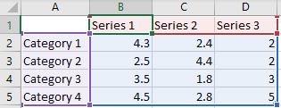
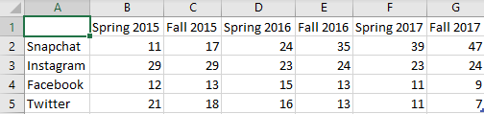
Chart examples
PPTXHandler lets you style update charts.
The original data is here:
We update this with the percentage of US teens who consider the following social networks their favorite.
Percentage of US teens who consider the following social networks their favorite
Inspiration: Makeover Monday Week 47
Data: Piper Sandler; Taking Stock with Teens

