Slide 1
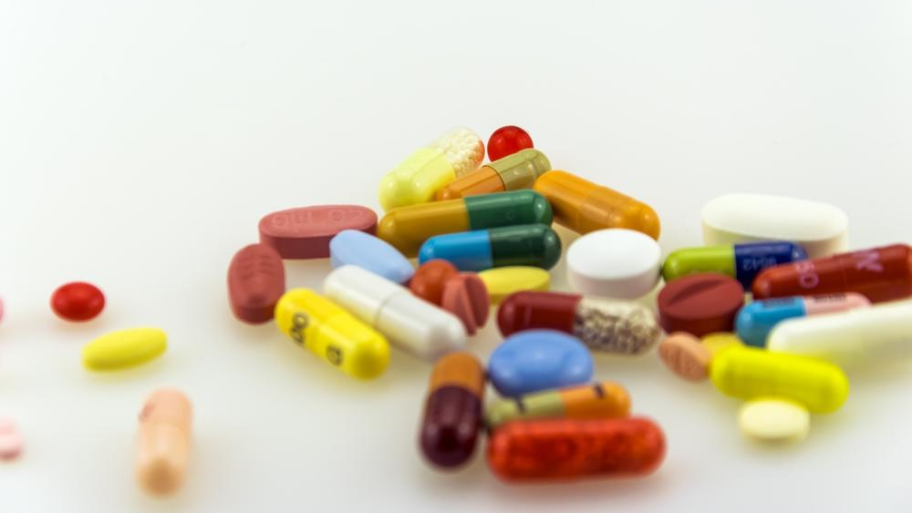
Best selling pharmaceuticals of 2018
Here are the biggest-selling drugs of 2018. Statins lead the list despite years of generic competition – which may be no surprise to pharma watchers. But the biggest gainer in 2018 was Keytruda, the cancer drug.
Drug | Indication
Source: Wikipedia

