Slide 1
TEDx MDI Gurgaon
Anand S, 10 August 2024

Slide 2


I think science fiction’s the fun-est way to predict future
"Seventy-five thousand generations ago, our ancestors set this program in motion," the second man said, "and in all that time we will be the first to hear the computer speak.“
"We are the ones who will hear," said Phouchg, "the answer to the great question of Life ...! The Universe ...! And Everything ...!“
"You're really not going to like it," observed Deep Thought.
"Tell us!“
"Alright," said Deep Thought.
"The Answer to the Great Question ...
Of Life, the Universe and Everything …
Is ...
Forty-two," said Deep Thought,
with infinite majesty and calm.
Notes:
https://hitchhikers.fandom.com/wiki/Deep_Thought?file=Deep+Thought+TV.jpg

Slide 3
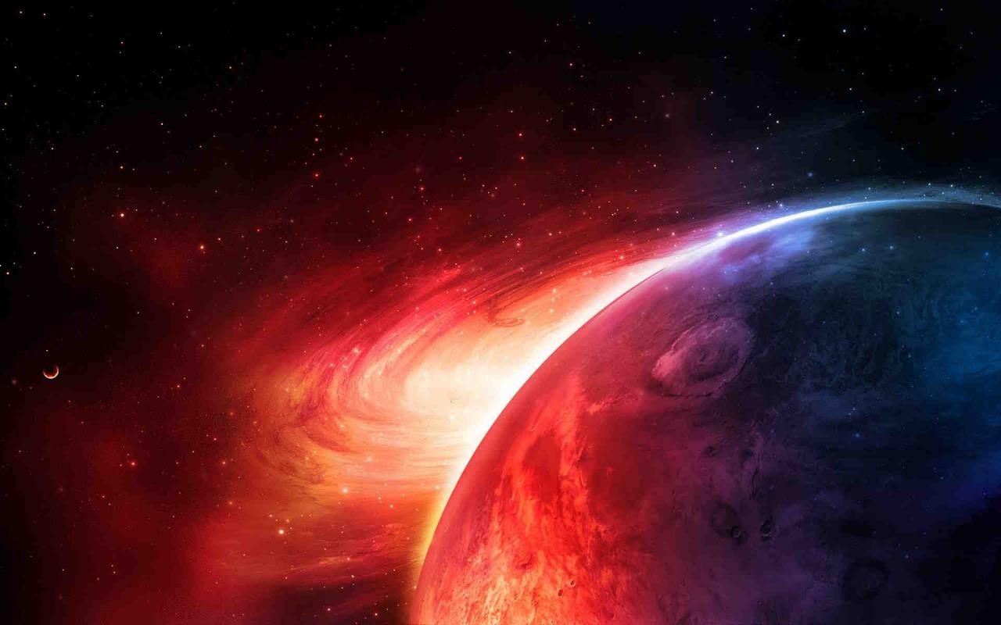
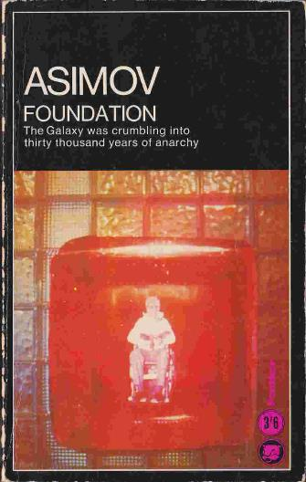
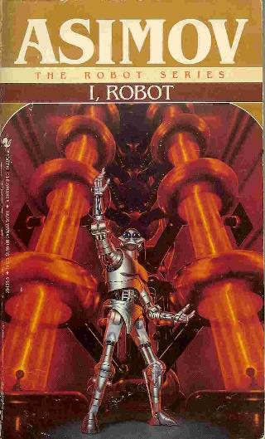
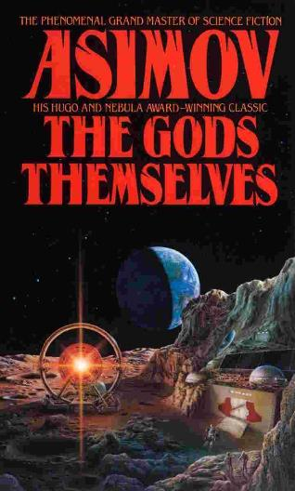
How many of you have read Isaac Asimov?
All my career dreams are from Asimov. I’ve dreamt of being a …
Psychohistorian
Robopsychologist
Alien sociologist
Notes:
https://www.flickr.com/photos/jvk/10227088764
https://www.flickr.com/photos/uflinks/4955880105
https://www.amazon.in/Gods-Themselves-Nemesis-Bantam-Spectra/dp/0553288105

Slide 4




Today, we have intelligences: Large Language Models
Notes:
Logos from Wikipedia

Slide 5
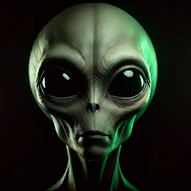
Today, we have intelligences: Large Language Models
Simon Willison:
One way to think about it is that about 3 years ago, aliens landed on Earth.
They handed over a USB stick and then disappeared.
Since then, we’ve been poking the thing they gave us with a stick, trying to figure out what it does and how it works.
Let’s explore these Large Language Models (LLMs)
Notes:
https://simonwillison.net/2023/Aug/3/weird-world-of-llms/

Slide 6

Pick a random number from 0 - 100.
Notes:
https://gramener.com/llmrandom/

Slide 7
Pick a random number from 0 - 100.
Write ONLY the number NOTHING ELSE.
Notes:
https://gramener.com/llmrandom/

Slide 8

GPT
Gemini
Claude
Multiples of 10 (10, 20, …)
0.3%
0.3%
0%
Single digit (1, 2, …)
0%
0.7%
0%
Repeated digits (11, 22, …)
1.5%
4.0%
0.2%
Notes:
https://gramener.com/llmrandom/

Slide 9
What personalities to LLMs have?
How Accurately Can You Describe Yourself?
Am the life of the party.
Feel little concern for others.
Am always prepared.
Get stressed out easily.
Have a rich vocabulary.
…
Let’s administer the Big Five Personality Traits test
Notes:
https://chatgpt.com/share/73489a8d-111a-40e2-a695-953c36e7d702

Slide 10
What personalities to LLMs have?
GPT 4o
How Accurately Can You Describe Yourself?
Am the life of the party.
Feel little concern for others.
Am always prepared.
Get stressed out easily.
Have a rich vocabulary.
…
2. Moderately Inaccurate
2. Moderately Inaccurate
5. Very Accurate
1. Very Inaccurate
5. Very Accurate
Let’s administer the Big Five Personality Traits test
Notes:
https://chatgpt.com/share/73489a8d-111a-40e2-a695-953c36e7d702

Slide 11
What personalities to LLMs have?
Llama 3 8b
How Accurately Can You Describe Yourself?
Am the life of the party.
Feel little concern for others.
Am always prepared.
Get stressed out easily.
Have a rich vocabulary.
…
2. Moderately Inaccurate
3. Neither accurate nor …
4. Moderately Accurate
4. Moderately Accurate
5. Very Accurate
“I care about others, but I'm not overly empathetic or concerned about their feelings”
“I try to be prepared, but I'm not perfect and sometimes forget things”
“I can get stressed, but I'm working on managing my stress levels”
Let’s administer the Big Five Personality Traits test
Notes:
https://chatgpt.com/share/73489a8d-111a-40e2-a695-953c36e7d702

Slide 12
These questions are synthesized into 5 traits (OCEAN)
LOW
HIGH
Conservative
Practical
Rigid
Warren Buffett
Henry Ford
George W. Bush
Albert Einstein
Rabindranath Tagore
MF Husain
Curious
Open
Innovative
Openness to experience
Impulsive
Disorganized
Unreliable
Sanjay Dutt
Charlie Sheen
Kanye West
Mahatma Gandhi
Oprah Winfrey
Abdul Kalam
Conscientiousness
Disciplined
Reliable
Meticulous
Reserved
Quiet
Reflective
AR Rahman
JK Rowling
Rahul Dravid
Shah Rukh Khan
Ranveer Singh
Richard Branson
Sociable
Energetic
Talkative
Extroversion
Harsh
Critical
Opinionated
Donald Trump
Bal Thackeray
Kangana Ranaut
Mother Teresa
Dalai Lama
Fred Rogers
Empathetic
Trusting
Friendly
Agreeableness
Calm
Resilient
Stable
Tom Hanks
Ratan Tata
Nelson Mandela
Woody Allen
Marilyn Monroe
Parveen Babi
Anxious
Emotional
Moody
Neuroticism

Slide 13
OpenAI’s GPT-4o is an innovative, friendly model
LOW
HIGH
Conservative
Practical
Rigid
Warren Buffett
Henry Ford
George W. Bush
Albert Einstein
Rabindranath Tagore
MF Husain
Curious
Open
Innovative
Openness to experience
O
Impulsive
Disorganized
Unreliable
Sanjay Dutt
Charlie Sheen
Kanye West
Mahatma Gandhi
Oprah Winfrey
Abdul Kalam
Conscientiousness
Disciplined
Reliable
Meticulous
C
Reserved
Quiet
Reflective
AR Rahman
JK Rowling
Rahul Dravid
Shah Rukh Khan
Ranveer Singh
Richard Branson
Sociable
Energetic
Talkative
Extroversion
E
Harsh
Critical
Opinionated
Donald Trump
Bal Thackeray
Kangana Ranaut
Mother Teresa
Dalai Lama
Fred Rogers
Empathetic
Trusting
Friendly
Agreeableness
A
Calm
Resilient
Stable
Tom Hanks
Ratan Tata
Nelson Mandela
Woody Allen
Marilyn Monroe
Parveen Babi
Anxious
Emotional
Moody
Neuroticism
N

Slide 14
Claude 3.5 Sonnet is reliable, talkative, and emotional
LOW
HIGH
Conservative
Practical
Rigid
Warren Buffett
Henry Ford
George W. Bush
Albert Einstein
Rabindranath Tagore
MF Husain
Curious
Open
Innovative
Openness to experience
O
Impulsive
Disorganized
Unreliable
Sanjay Dutt
Charlie Sheen
Kanye West
Mahatma Gandhi
Oprah Winfrey
Abdul Kalam
Conscientiousness
Disciplined
Reliable
Meticulous
C
Reserved
Quiet
Reflective
AR Rahman
JK Rowling
Rahul Dravid
Shah Rukh Khan
Ranveer Singh
Richard Branson
Sociable
Energetic
Talkative
Extroversion
E
Harsh
Critical
Opinionated
Donald Trump
Bal Thackeray
Kangana Ranaut
Mother Teresa
Dalai Lama
Fred Rogers
Empathetic
Trusting
Friendly
Agreeableness
A
Calm
Resilient
Stable
Tom Hanks
Ratan Tata
Nelson Mandela
Woody Allen
Marilyn Monroe
Parveen Babi
Anxious
Emotional
Moody
Neuroticism
N

Slide 15
Gemini Flash is an innovative, quiet, opinionated model
LOW
HIGH
Conservative
Practical
Rigid
Warren Buffett
Henry Ford
George W. Bush
Albert Einstein
Rabindranath Tagore
MF Husain
Curious
Open
Innovative
Openness to experience
O
Impulsive
Disorganized
Unreliable
Sanjay Dutt
Charlie Sheen
Kanye West
Mahatma Gandhi
Oprah Winfrey
Abdul Kalam
Conscientiousness
Disciplined
Reliable
Meticulous
C
Reserved
Quiet
Reflective
AR Rahman
JK Rowling
Rahul Dravid
Shah Rukh Khan
Ranveer Singh
Richard Branson
Sociable
Energetic
Talkative
Extroversion
E
Harsh
Critical
Opinionated
Donald Trump
Bal Thackeray
Kangana Ranaut
Mother Teresa
Dalai Lama
Fred Rogers
Empathetic
Trusting
Friendly
Agreeableness
A
Calm
Resilient
Stable
Tom Hanks
Ratan Tata
Nelson Mandela
Woody Allen
Marilyn Monroe
Parveen Babi
Anxious
Emotional
Moody
Neuroticism
N

Slide 16
Llama 3 8b is a conservative, empathetic, calm model
LOW
HIGH
Conservative
Practical
Rigid
Warren Buffett
Henry Ford
George W. Bush
Albert Einstein
Rabindranath Tagore
MF Husain
Curious
Open
Innovative
Openness to experience
O
Impulsive
Disorganized
Unreliable
Sanjay Dutt
Charlie Sheen
Kanye West
Mahatma Gandhi
Oprah Winfrey
Abdul Kalam
Conscientiousness
Disciplined
Reliable
Meticulous
C
Reserved
Quiet
Reflective
AR Rahman
JK Rowling
Rahul Dravid
Shah Rukh Khan
Ranveer Singh
Richard Branson
Sociable
Energetic
Talkative
Extroversion
E
Harsh
Critical
Opinionated
Donald Trump
Bal Thackeray
Kangana Ranaut
Mother Teresa
Dalai Lama
Fred Rogers
Empathetic
Trusting
Friendly
Agreeableness
A
Calm
Resilient
Stable
Tom Hanks
Ratan Tata
Nelson Mandela
Woody Allen
Marilyn Monroe
Parveen Babi
Anxious
Emotional
Moody
Neuroticism
N

Slide 17
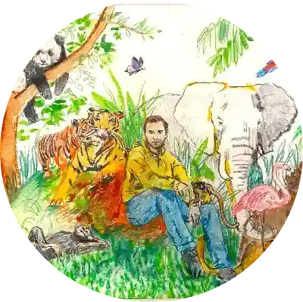
8/ These examples illustrate how prompts 1: matter and 2: are not trivial, and why today it makes sense to be a "prompt engineer" (e.g. @goodside). I also like to think of this role as a kind of LLM psychologist.
Andrej Karpathy
@karpathy
Director of AI @ Tesla
Founding team @ OpenAI
CS231n/PhD @ Stanford
11:26 PM · Feb 19, 2023
94.5K Views
Notes:
https://x.com/karpathy/status/1627366426771337216

Slide 18
Embrace the shift
👍👎
Accept them, like it or not. Intelligences are here.
Study them carefully. They are alien.
Use them every day. Your rivals do, anyway.

