Slide 1
Maps, Delimitation & Gerrymandering
That’s what I’ll be talking about
How to get insights by joining two maps

Slide 2
But first, some book-keeping
If you’re tweeting, tag
#PyConIndia2019 @sanand0
These slides are online at
github.com/gramener/pycon2019
If you take notes, you’ll remember more if you
Use paper & pen, not laptops
Source: https://bit.ly/2MwFh5a

Slide 3
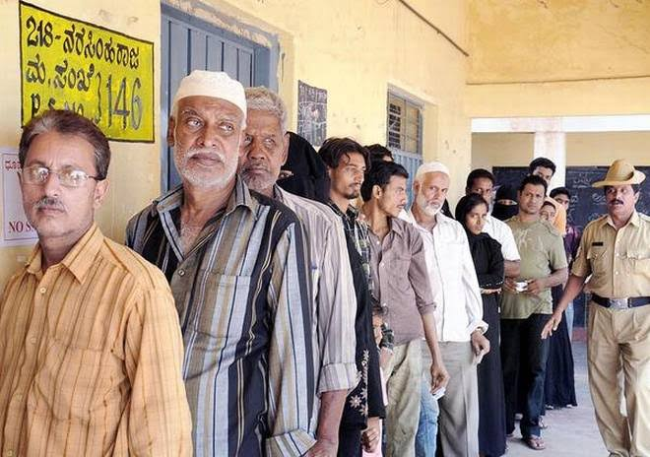
Our story begins at the Karnataka elections in 2018
13% of the voters in Karnataka are Muslim
Both Congress and JD(S) were trying to get their support
The BJP was taking potshots saying that they were appeasing the community
The Hindu wanted to write a piece on how large a factor this is, and where
Notes:
Image: https://www.thehindu.com/elections/karnataka-2018/karnataka-elections-2018-the-spin-around-the-muslim-vote/article23806580.ece

Slide 4
But we don’t know how many Muslims live in a constituency
We know the number of Muslims in each district from the 2011 census
We want the number of Muslims in each of the 224 constituencies

Slide 5
Take one district. This could overlap with many constituencies
Let’s say the population is 100
We need to split it evenly across

Slide 6
Take one district. This could overlap with many constituencies
This district covers multiple constituencies.
Some fully.
Some partially

Slide 7
Take one district. This could overlap with many constituencies
This constituency has 33% of the district’s area. So let’s say it has 33% of the population

Slide 8
Take one district. This could overlap with many constituencies
This part of the constituency has 20% of the district’s area. So let’s say this part has 20% of the population

Slide 9
We can break the map into fragments and re-assemble them
The assumption is that population is uniformly distributed

Slide 10
How can we do this in Python?

Slide 11
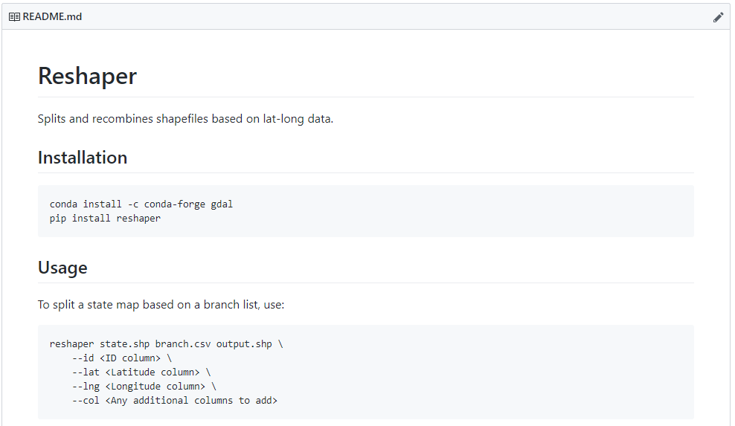
Reshaper is a Python library that does this
Link
github.com/gramener/reshaper
WARNING
The library is young and full of bugs.
Your help is most welcome!

Slide 12
What happened to the Muslim vote?

Slide 13
This let to the first Muslim voter map of Karnataka
% of Muslim voters in the constituency
0%
25%

Slide 14
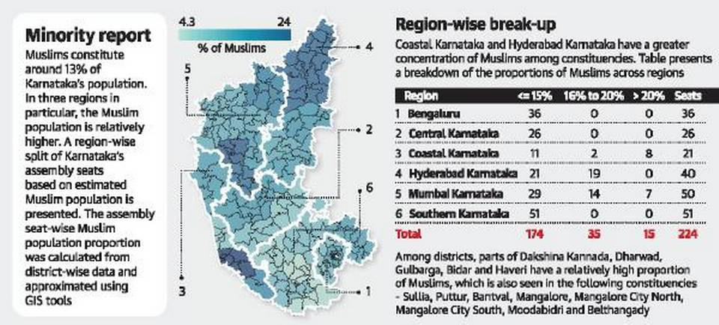
… and was published by The Hindu on 8 May 2018
Karnataka elections 2018: the spin around the Muslim vote
Afshan Yasmeen
Notes:
Source: https://www.thehindu.com/elections/karnataka-2018/karnataka-elections-2018-the-spin-around-the-muslim-vote/article23806580.ece

Slide 15
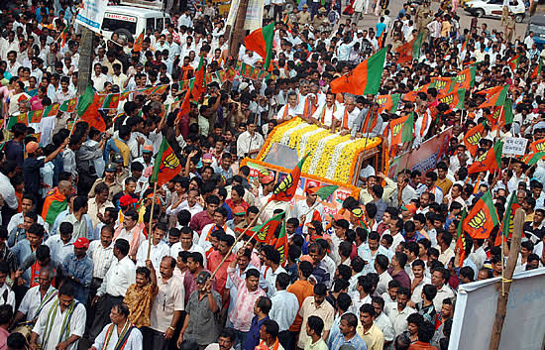
It also lets us answer questions that were impossible before
Notes:
1. https://www.livemint.com/Politics/QYQ2ioMh9XBklfMOtR04ZO/Karnataka-polls-Asaduddin-Owaisis-AIMIM-to-back-Janata-Dal.html

Slide 16
It also lets us answer questions that were impossible before
Both JD(S) and CONG wanted to ally with the AIMIM
The AIMIM planned to contest in 60 seats
But in Apr 2018, AIMIM decided back JD(S)
We can analyze the effectiveness of this alliance
Notes:
1. https://www.livemint.com/Politics/QYQ2ioMh9XBklfMOtR04ZO/Karnataka-polls-Asaduddin-Owaisis-AIMIM-to-back-Janata-Dal.html

Slide 17
JD(S) vote share dropped in Muslim constituencies
Vote %
Muslim %

Slide 18
Congress vote share was mildly higher
Vote %
Muslim %

Slide 19
BJP vote share was visibly higher
Vote %
Muslim %

Slide 20
So, what can we do with this?

Slide 21
India has 3 kinds of geographical hierarchies
Political Boundaries
Postal Code Boundaries
Administrative Boundaries
State
Zone
State
Parliamentary constituency
Sorting District
District
Assembly constituency
Post office
Sub-District
Municipality
Polling booth
PIN Code
Block
Zone
Village
Ward
Search for “Datameet maps” to find the (unofficial) maps

Slide 22
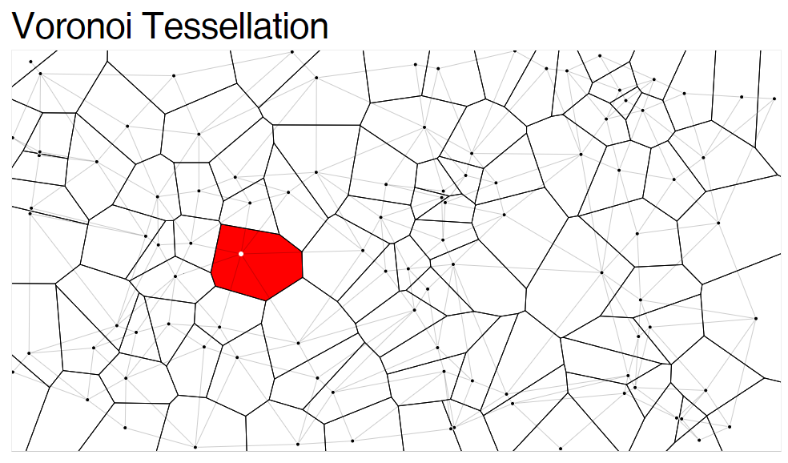
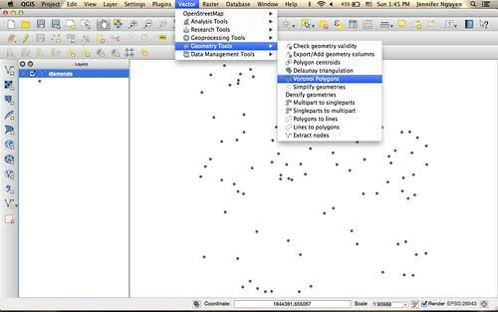
You can also create your own boundaries from locations
Link
QGIS creates these. So does reshaper.

Slide 23
This lets us join any of these datasets
Political Boundaries
Postal Code Boundaries
Administrative Boundaries
Location Boundaries
Example
Constituencies
PIN codes
Districts, Villages
Hospital, Bank, School
Owner
MP or MLA
-
Collector
Manager, Official
Datasets
Voter results
Addresses
Demographics
School data (DISE, …)
Asset ownership
Hospital data (NHRR)
Social & religious
Doctor data (Practo)
Economic indicators
Bank branch data
Household indicators
Petrol pump data
Scheme performance
Crime data
Banking data
Telecom data
Health data
Transportation data
Energy data
Retail data
… and more
… and more

Slide 24
This lets us join any of these datasets
Political Boundaries
Postal Code Boundaries
Administrative Boundaries
Location Boundaries
Example
Constituencies
PIN codes
Districts, Villages
Hospital, Bank, School
Owner
MP or MLA
-
Collector
Manager, Official
Datasets
Voter results
Addresses
Demographics
School data (DISE, …)
Asset ownership
Hospital data (NHRR)
Social & religious
Doctor data (Practo)
Economic indicators
Bank branch data
For example,
The Hindu found that the Congress did better in agrarian areas – by mapping
Census % of agricultural workers, and
Constituency vote share
Household indicators
Petrol pump data
Scheme performance
Crime data
Banking data
Telecom data
Health data
Transportation data
Energy data
Retail data
… and more
… and more

Slide 25
… and every combination is powerful
Administrative Boundaries
Location Boundaries
Districts, Villages
Hospital, Bank, School
Collector
Manager, Official
Demographics
School data (DISE, …)
Asset ownership
Hospital data (NHRR)
Social & religious
Doctor data (Practo)
Economic indicators
Bank branch data
Household indicators
Petrol pump data
Scheme performance
Crime data
Banking data
Telecom data
Health data
Transportation data
Energy data
Retail data
… and more
… and more

Slide 26
… and every combination is powerful
Administrative Boundaries
Location Boundaries
Districts, Villages
Hospital, Bank, School
Collector
Manager, Official
Demographics
Coverage: Where should we open new schools to improve population coverage?
School data (DISE, …)
Asset ownership
Hospital data (NHRR)
Social & religious
Doctor data (Practo)
Economic indicators
Bank branch data
Household indicators
Petrol pump data
Scheme performance
Crime data
Banking data
Telecom data
Health data
Transportation data
Energy data
Retail data
… and more
… and more

Slide 27
… and every combination is powerful
Administrative Boundaries
Location Boundaries
Districts, Villages
Hospital, Bank, School
Collector
Manager, Official
Demographics
School data (DISE, …)
Asset ownership
Hospital data (NHRR)
Social & religious
Behavior: Are bank branches distributed by wealth or by population?
Doctor data (Practo)
Economic indicators
Bank branch data
Household indicators
Petrol pump data
Scheme performance
Crime data
Banking data
Telecom data
Health data
Transportation data
Energy data
Retail data
… and more
… and more

Slide 28
… and every combination is powerful
Administrative Boundaries
Location Boundaries
Districts, Villages
Hospital, Bank, School
Collector
Manager, Official
Demographics
School data (DISE, …)
Asset ownership
Hospital data (NHRR)
Social & religious
Doctor data (Practo)
Economic indicators
Bank branch data
Household indicators
Petrol pump data
Scheme performance
Correlation: Does increase in a district’s wealth lead to more theft or less theft?
Crime data
Banking data
Telecom data
Health data
Transportation data
Energy data
Retail data
… and more
… and more

Slide 29
… and every combination is powerful
Administrative Boundaries
Location Boundaries
Districts, Villages
Hospital, Bank, School
Collector
Manager, Official
Demographics
School data (DISE, …)
Asset ownership
Hospital data (NHRR)
Social & religious
Doctor data (Practo)
Economic indicators
Bank branch data
Household indicators
Petrol pump data
Scheme performance
Crime data
Banking data
Telecom data
Health data
Causality: Does poor health lead to increase in retail pharmacies? Do pharmacies improve health?
Transportation data
Energy data
Retail data
… and more
… and more

Slide 30
… and every combination is powerful
Administrative Boundaries
Location Boundaries
Districts, Villages
Hospital, Bank, School
Collector
Manager, Official
Demographics
Coverage: Where should we open new schools to improve population coverage?
School data (DISE, …)
Asset ownership
Hospital data (NHRR)
Social & religious
Behavior: Are bank branches distributed by wealth or by population?
Doctor data (Practo)
Economic indicators
Bank branch data
Household indicators
Petrol pump data
Scheme performance
Correlation: Does increase in a district’s wealth lead to more theft or less theft?
Crime data
Banking data
Telecom data
Health data
Causality: Does poor health lead to increase in retail pharmacies? Do pharmacies improve health?
Transportation data
Energy data
Retail data
… and more
… and more

Slide 31
What can you do about it?
I’d love to see more of these hidden insights

Slide 32
Here are some things you can do now
Have ideas for joins?
Raise issue at github.com/gramener/pycon2019
Let's crowd-source and find which geo-joins are useful
Want to try it?
Build your portfolio?
Search for maps on Datameet
Find reshaper at github.com/gramener/reshaper
Share on Twitter, tag @sanand0. I’ll share it with media
Want to contribute?
Learn more?
Email: s.anand@gramener.com
I'll mail you details of the next workshop on geo-joins
Enjoy the talk?
Learnt something?
Tweet about it
Tag #PyConIndia2019 @sanand0

Slide 33
Happy mapping!

