Slide 1
Automatically Securing Linux Application Containers in Untrusted Clouds
Dmitrii Kuvaiskii & Anjo Vahldiek-Oberwagner
Notes:
Hello,
In this talk Dmitrii and I will present our recent work on shielding Linux application Containers in untrusted clouds.
In these untrusted clouds we have seen a surge of applications computing on sensitive and private data. With this sensitive data comes the risk of exposing said data.

Slide 2
Legal Disclaimers
Intel provides these materials as-is, with no express or implied warranties.
All products, dates, and figures specified are preliminary, based on current expectations, and are subject to change without notice.
Intel processors, chipsets, and desktop boards may contain design defects or errors known as errata, which may cause the product to deviate from published specifications. Current characterized errata are available on request.
Intel technologies' features and benefits depend on system configuration and may require enabled hardware, software or service activation. Performance varies depending on system configuration. No product or component can be absolutely secure. Check with your system manufacturer or retailer or learn more at http://intel.com.
Some results have been estimated or simulated using internal Intel analysis or architecture simulation or modeling, and provided to you for informational purposes. Any differences in your system hardware, software or configuration may affect your actual performance.
Intel and the Intel logo are trademarks of Intel Corporation in the United States and other countries.
*Other names and brands may be claimed as the property of others.
© Intel Corporation 2019
Notes:
Before I start with the presentation, it is important to note that this is a presentation by Intel with the following legal disclaimer.

Slide 3

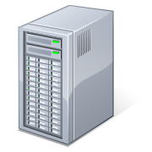
Data protection gap in an untrusted cloud
Encrypted!
SSL, VPN, etc
Encrypted!
SED, FDE, etc
Data in transit
Unencrypted!
Data, keys exposed
Data at rest
Data in use
Strong desire to compute on encrypted data
Notes:
This talk focuses on the data protection gap in an untrusted cloud.
Sensitive data is encrypted in transit and at rest, but is not while in use.
As a result, sensitive data may be exposed to the clouds infrastructure software while it is in use.
This gap creates a desire to protect against this exposure by computing on encrypted data.

Slide 4
Overcome an untrusted cloud
Encrypted!
SSL, VPN, etc
Encrypted!
SED, FDE, etc
Data in transit
Data at rest
Encrypted
Data in use
Confidential Computing (CC) protects data while it is being processed by CPU
Provides Confidentiality, Integrity and Replay Protection
Notes:
This new form of computing is called confidential computing.
It protects data confidentiality, integrity and replay protection for computations by encrypting the main memory and shielding accesses to the data.

Slide 5
Overcome an untrusted cloud
Trusted Execution Environments (TEE)
Maps to a secure portion of CPU and memory
The code and data inside TEE can not be accessed from outside
Can prove to 3rd party its identity via attestation
Application
Trusted Execution Environment
OS
CPU
Notes:
This new form of computing relies on trusted execution environments or TEEs.
TEE are typically implemented in hardware, in the case shown here the CPU.
The hardware is trusted to isolate the TEE from system software.
It does so by mapping the TEE to a secure portion of memory denying any access from non TEE executions.
In addition, the CPU attests the state of a TEE to a third party.
This allows an external verifier to provision secrets to the TEE.

Slide 6
Focus on Intel® SGX
Application is split into untrusted app and trusted enclave
Application builds trusted enclave with well-defined entry points
Attest enclave fingerprint to 3rd parties for verification and secrets provisioning
Attack surface with SGX Enclaves
Attack surface today
Proxy
App
Proxy
App
Proxy
App
OS
VMM
Hardware
Notes:
In this talk we focus on Intel’s TEE which is called Intel SGX.
Before looking at SGX in particular, lets consider the attack surface of an application.
This attack surface includes the entire system software such as the OS and VMM.
Intel SGX changes this attack surface.
SGX is implemented as an ISA extension.
SGX splits the application into an untrusted component and a trusted enclave. Shown in green squares in the application.
After this split the hardware ensures that neither the untrusted component of the application nor system software can access the trusted enclave’s memory.
In the SGX model, the untrusted application builds the trusted enclave’s initial state with well-defined entrypoints.
Before provisioning secrets to such a trusted enclave, a 3rd party verifies the attestation evidence of the enclave which includes a memory fingerprint with the well defined entrypoints.
This allows the 3rd party to trust that the enclave was build correctly and provide secrets.

Slide 7
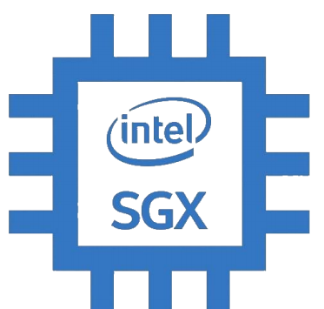
Extending Intel® SGX enclaves to run applications
Process
Heap/stack
Binary
System call Interface
Host OS
Notes:
While splitting an application into an untrusted application and a trusted enclave ensures a small TCB with strong security guarantees, it increases effort to build and maintain such a split.
In an untrusted cloud environment though, we’re using SGX not necessarily to split the application, but rather to shield the cloud’s system software from gaining access to sensitive data of our application.
This results in a design where the entire application runs inside the trusted enclave shielded against accesses by system software.
Unfortunately, the restrictive programming model of SGX denies system calls directly from the application.

Slide 8
Extending Intel SGX Enclaves to run applications
Process
Heap/stack
Binary
LibOS
System call Interface
Host OS
Notes:
To overcome this issue without requiring to modify the application, is to rely on library OSes.
They provide a the generic Linux system call API to the application while securely translating it through the SGX isolation boundary to the host OS.
The library OS we’ve been involved with is called Graphene.
It has been adopted to Intel SGX providing the interface to run unmodified Linux applications inside SGX.
Let me introduce you now to Dmitrii who is one of the core maintainers of Graphene.
He will provide details on Graphene before we apply Graphene to application containers.
Dmitrii please take it away…

Slide 9
Graphene LibraryOS
Process
Heap/Stack
Binary
~300 syscalls
Linux API
Graphene LibOS
~ 40 Host ABI
Graphene ABI
PAL
~ 50 syscalls
Syscall interface
Host OS
Notes:
Thank you Anjo for the kind introduction.
As already mentioned, Graphene is a Library Operating system that allows to run an unmodified application inside an SGX enclave. Graphene is an open-source community-supported project and is currently in the process of transitioning from a research proof of concept to production-ready software.
Graphene serves as a minimal bootloader and an emulation layer, sitting between the application and the underlying host OS. You can think of Graphene as a “minimal re-implementation of the Linux kernel” which strives to resolve most application requests (in the form of system calls and opened pseudo-files) in user space and occasionally resorting to host-OS provided resources (like network IO, actual file system IO, thread scheduling, process creation, and so on). Graphene additionally implements extensive checks on system call arguments and return values, helping to protect against maliciously crafted values.
By design, Graphene consists of two layers: the stateful Library OS layer that intercepts system call requests from the user application, verifies their inputs, processes these requests, verifies their outputs, updates its internal state, and gives the results back to the application. And the stateless Platform Adaptation Layer (PAL) which is invoked by the LibOS layer only when the host OS must be involved in request processing. As you can see, Graphene currently supports more than 300 Linux system calls, maps them to around 40 PAL ABI functions, and PAL uses around 50 actual system calls to communicate with the host OS.
Now this picture shows the non-SGX version of Graphene. Let us move to the SGX version.

Slide 10
Graphene LibraryOS with SGX backend
Process
Heap/Stack
Binary
~300 syscalls
Linux API
Graphene LibOS
~ 40 Host ABI
Graphene ABI
Trusted PAL
~ 40 SGX ocalls
Untrusted interface
Untrusted PAL
~ 50 syscalls
Syscall interface
Host OS
Notes:
When Graphene is run in Intel SGX mode, it loads itself and the application inside of the SGX enclave. The major parts of Graphene move inside the enclave. In particular, the LibOS layer and most of the PAL. However, PAL is now divided into two separate binaries: the untrusted PAL and the trusted PAL. The untrusted PAL is used to load and initialize the SGX enclave in the wrapper process and to issue system calls to the host OS on behalf of the enclave. It also serves as a glue code to enter enclave mode and exit it. Similarly to other layers, the interface between the trusted PAL (executing inside the enclave) and the untrusted PAL (executing outside) is kept minimal, with around 40 so-called SGX Out Calls (OCALLs) in total. Graphene takes additional precautions to harden this boundary between the trusted enclave and the untrusted environment.

Slide 11
Graphene-SGX Manifest
To configure the application environment and security policies, developers provide a manifest file for each application
python.manifest
loader.exec = file:/usr/bin/python3
loader.env.LD_LIBRARY_PATH = /lib
fs.mount.lib.type = chroot
fs.mount.lib.path = /lib
fs.mount.lib.uri = file:/graphene/Runtime
sgx.enclave_size = 1024M
sgx.thread_num = 8
sgx.trusted_files.libc = file:/graphene/Runtime/libc.so.6
…
Executable to load into SGX enclave
Environment variables are overwritten
Restrict mount points to a small subset of host-OS directories
SGX-specific limits like the maximum enclave size and number of threads
SGX-specific trusted files (securely hashed and verified at load time)
Notes:
As typical in security-critical environments, the application running inside Graphene and an SGX enclave must be accompanied by a security manifest. In fact, it is this security manifest (and not the application binary) that is given to Graphene as input.
This security manifest is a plaintext file in a simple TOML format. Here is a small example. First, the manifest must specify the actual executable to load and run – in this case, the Python3 executable. Next, the manifest may overwrite the required environment variables. The manifest should also specify a subset of host-OS directories to be mounted so that only they are visible to the enclavized application (possibly under a different name as shown in the example – here the Glibc libraries are silently replaced with Graphene-patched Glibc libraries). Next, the manifest contains some SGX-architecture-specific variables like the maximum enclave size and the maximum number of simultaneous enclave threads (these are the limitations of SGX version 1). Finally, this example shows how files to be consumed by the SGX enclave must be marked as trusted – in this case, Graphene calculates their secure hashes during build time, appends these hashes to the manifest, and during run-time Graphene will verify that the files were not modified. There are several more manifest options in Graphene, to enable some additional functionality.
The manifest is the single most important file when porting applications to Graphene and Intel SGX. Ultimately, the security and correct functioning of the application depends on how its manifest file is written.

Slide 12

Graphene Remote Attestation
Untrusted machine
Intel® Provisioning Certification Service
Register platform
Provisioning Certification Enclave
Notes:
A very important aspect of any Trusted Execution Environment is attestation. How can a remote user verify that her application actually runs in a correct up-to-date TEE, and that the code that runs inside the TEE is the actual user application? Moreover, how can the remote user provision any secret inputs to the application remotely and in a secure fashion and get the results of execution – also in a secure fashion – back?
Intel SGX, similarly to other TEEs, provides a way for the SGX enclave to attest itself to the remote user. This way the user gains trust in the SGX enclave running in an untrusted environment, ship the application code and data, and be sure that the results were executed inside a genuine SGX enclave.
We will show a complete (though slightly simplified) flow of remote attestation. Every SGX-enabled processor contains a key burnt into its fuses. The processor uses this secret key to encrypt all memory traffic leaving the CPU package. All manufactured SGX processors are listed in the web service maintained by Intel, called Intel Provisioning Certification Service. At deployment time, the new SGX machine is supposed to be registered with this service. There is a special SGX enclave called Provisioning Certification Enclave developed by Intel. This enclave is used to connect to the Intel Provisioning Certification Service, send the ID of the SGX processor and other identifying information, and receive the normal X.509 certificate for this machine signed with Intel public key. This certificate is used to prove that the SGX processor is genuine and up-to-date.

Slide 13
Graphene Remote Attestation
Untrusted machine
Intel® Provisioning Certification Service
Provisioning Certification Enclave
Trusted machine
Retrieve certificates,
CRLs and
TCB infos
Certificates
CRLs
Quote Verification
Notes:
Now the user wants to run an enclavized application with a security-sensitive workload. The user possesses a trusted machine (not needed to be SGX-enabled). The first thing the user must do before outsourcing her secure workload, is to contact the Intel Provisioning Certification Service to retrieve the required certificates, Certificate Revokation Lists, and other SGX-identifying information. This information can be cached in a local database, so that the user doesn’t have to establish internet connection to the Provisioning Certification Service every time she runs a workload on a remote untrusted machine. The user also installs Quote Verification software that runs all the required checks during remote attestation.

Slide 14

Graphene Remote Attestation
Untrusted machine
Intel® Provisioning Certification Service
Provisioning Certification Enclave
Trusted machine
Expected measurements
Secret Provider
Binary
Certificates
CRLs
Quote Verification
Graphene LibOS
Notes:
Now the user ships the application binary and the Graphene runtime to the remote untrusted machine. Note that no sensitive inputs are shipped to the remote machine just yet. The remote machine starts Graphene (which starts the application binary) inside of the SGX enclave.
The user also starts a Secret Provider application on her own machine. This application will connect to the remote machine, establish a secure communication channel, verify that the remote machine is a genuine SGX-enabled machine and that application and Graphene run in a genuine SGX enclave, and release secret inputs to this remote machine (secret inputs are represented as a key ring on the diagram). Note that since the user shipped Graphene and binary to the remote machine, the user knows their corresponding expected measurements.

Slide 15
Graphene Remote Attestation
Untrusted machine
Intel® Provisioning Certification Service
Provisioning Certification Enclave
Quoting Enclave
Trusted machine
Expected measurements
Secret Provider
Binary
Secret Prov lib
RA-TLS lib
Certificates
CRLs
Quote Verification
Graphene LibOS
Notes:
Intel SGX software infrastructure has another special enclave called Quoting Enclave. This enclave (with a reference implementation written by Intel) is used to create a special structure called the SGX Quote. This SGX Quote contains all the information about the particular enclave, including its hardware-generated measurements. You can think of the SGX Quote as a second-level certificate that proves the authenticity of the enclave.
Graphene contains two libraries that transparently add Remote Attestation to the application. The RA-TLS library augments normal SSL/TLS sessions with an SGX-specific handshake callback. The Secret Provisioning library builds on top of RA-TLS and runs before the application. First, the Secret Provisioning library instructs RA-TLS to collect all SGX-related certificates and create a normal X.509 certificate chain out of them.

Slide 16
Graphene Remote Attestation
Untrusted machine
Intel® Provisioning Certification Service
Provisioning Certification Enclave
Quoting Enclave
Trusted machine
Expected measurements
Secret Provider
Binary
RA-TLS cert
with SGX quote
Secret Prov lib
Secret Prov lib
RA-TLS lib
RA-TLS lib
Certificates
CRLs
Quote Verification
Graphene LibOS
Notes:
Then, Secret Provisioning library establishes a secure TLS channel with the user’s machine. During TLS handshake, RA-TLS library installs a special verification callback that receives the certificate chain (with three certificates: the leaf RA-TLS certificate, the second-level SGX quote identifying the enclave, and the top-level certificate identifying the SGX platform). Since the three certificates in the chain contain all SGX-related information, the user compares the retrieved measurements against the expected ones and decides whether to trust the remote enclave or not.

Slide 17
Graphene Remote Attestation
Untrusted machine
Intel® Provisioning Certification Service
Provisioning Certification Enclave
Quoting Enclave
Trusted machine
Expected measurements
Secret Provider
Binary
Secret Prov lib
Secrets
Secret Prov lib
RA-TLS lib
RA-TLS lib
Certificates
CRLs
Quote Verification
Graphene LibOS
Notes:
If the user-side verification finishes successfully, the user gains trust in the remote enclave and now, using the same Secret Provisioning library, sends the secret inputs into the SGX enclave. After this point, the secrets are injected in the application, and the application finally starts its execution. The same secure channel may be re-used to securely send application’s results back to the user.

Slide 18
Graphene Protected Files
Untrusted machine
Trusted machine
Secret Provider
Binary
Secret Prov lib
Secret Prov lib
Protected FS
Input file 1
Input file 2
Graphene LibOS
Notes:
Graphene also implements the feature of Protected Files. Since the user application runs on an untrusted machine, all input files as well as produced output files must be at least integrity-protected. And if user files contain sensitive information, they must also be encrypted.
With the Protected File System implemented in Graphene, all required files to run the workload are created by the user on her trusted premises first.

Slide 19
Graphene Protected Files
Untrusted machine
Input file 1
Input file 2
Trusted machine
Secret Provider
Binary
Secret Prov lib
Encryption key
Secret Prov lib
Protected FS
Input file 1
Input file 2
Graphene LibOS
Notes:
The files are then encrypted with a symmetric key. After that, the files may be shipped to the untrusted machine together with the application binary and Graphene. After the SGX enclave is created, Graphene needs to obtain the key used to encrypt the files. As explained previously, this key provisioning can be accomplished via Secret Provisioning with Remote Attestation. Once they key is securely provisioned inside the enclave, Protected FS subsystem of Graphene uses this key to decrypt the input files and run the workload.

Slide 20
Graphene Protected Files
Untrusted machine
Files transparently encrypted and integrity protected
Specified in manifest file
Format based on Intel SGX SDK
Input file 1
Input file 2
Output file
Trusted machine
Secret Provider
Binary
Secret Prov lib
Secret Prov lib
Protected FS
Input file 1
Input file 2
Output file
Graphene LibOS
Notes:
After the enclave is finished with the secure computation, the application typically produces an output file. This file is also transparently encrypted by the Protected FS with the same encryption key. Finally, the output file may be moved to the remote user, where it will be decrypted.
Graphene implements Protected Files as transparently encrypted and integrity protected files. The specific files (or whole directories) to be treated as protected must be specified in the manifest. The encryption format used in the Protected FS implementation is borrowed from the similar feature of Intel SGX SDK.

Slide 21


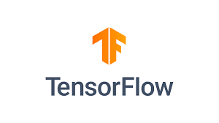


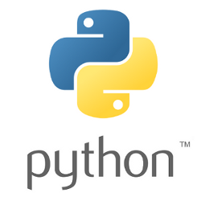



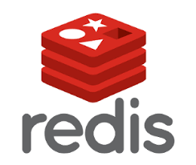


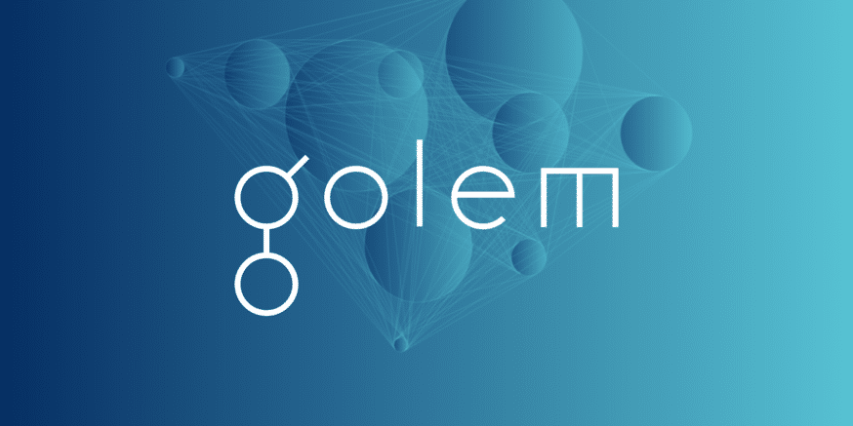
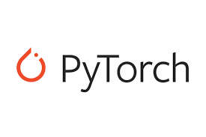
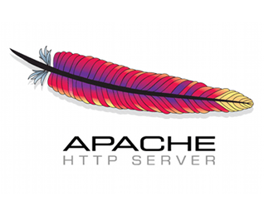


Graphene Community
Open Source Maintainer Community
Currently Supported Applications
ML Frameworks
Databases
Web Servers
Languages
… and growing
… and growing
Notes:
We would like to stress that Graphene is an open-source project maintained by a dedicated community, with contributors from several companies and universities. We successfully enabled several widely used applications in Graphene across several domains, and hope to support more use cases as we grow.
At this point, I would like to give the mic back to Anjo.

Slide 22
Running Application Containers in untrusted Cloud
Notes:
Thank you for the introduction of Graphene!
We will now switch gears and look at the use of Graphene for application containers.

Slide 23
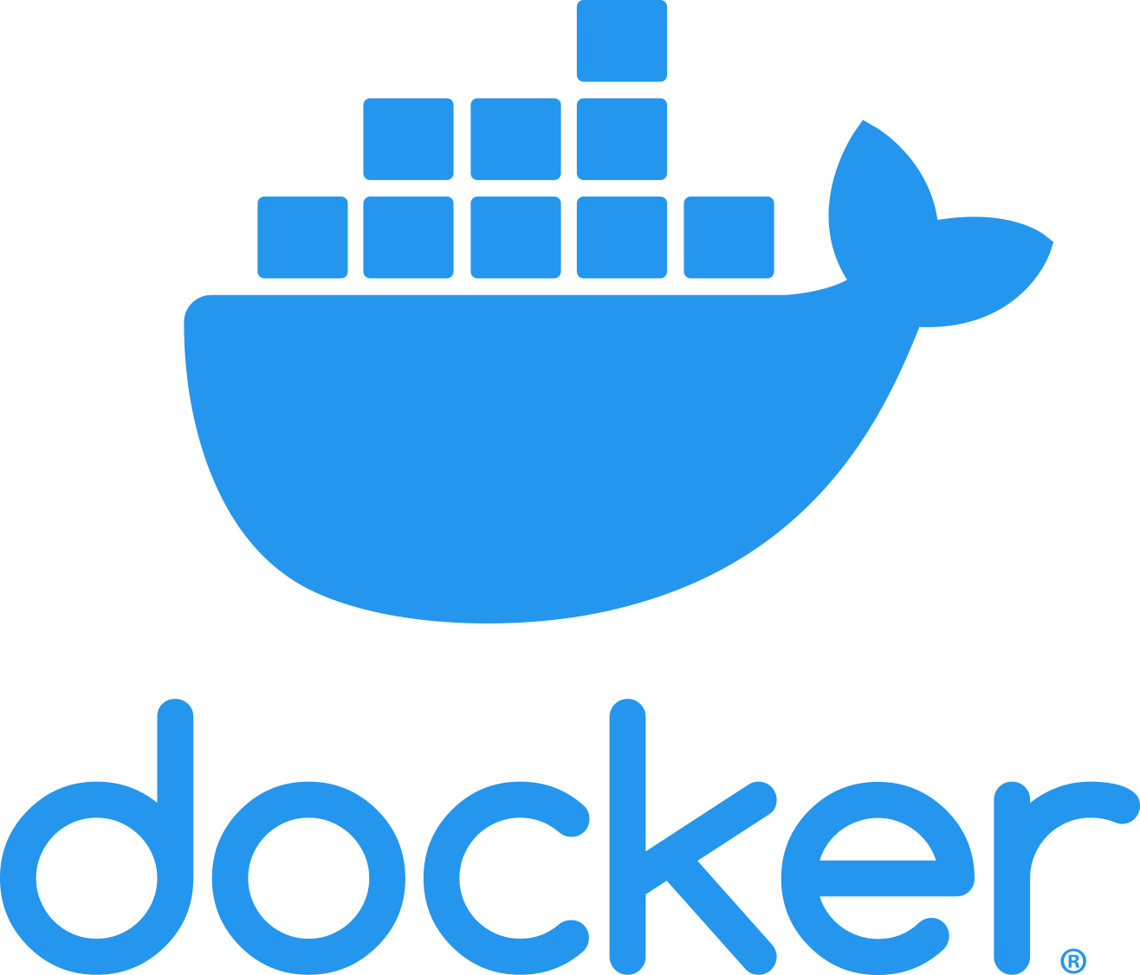
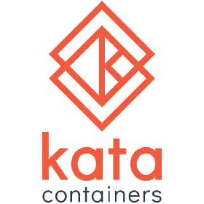
Containers are deployment model for cloud
Containers have become the defacto deployment model besides VMs
Small memory footprint
Fast startup
Obstacles:
Graphene does not provide an interface to create Docker images/containers
Minimize burden to craft application manifest
Notes:
Containers have become the defacto deployment model for the cloud besides VMs.
They provide a small memory footprint and fast startup time.
We cannot apply Graphene to Container frameworks immediately, first we have to overcome two main obstacles.
First, Graphene does not provide an interface to create Docker images/containers with Graphene as a LibraryOS.
Second, while providing a hand crafted manifest file is possible, it’s a huge burden on the application developer.
To encourage usage of our container integration, we have to simplify the manifest drastically.

Slide 24
Graphene Shielded Containers (GSC) in a Nutshell
Docker Image
Memory & Parallelism Requirements
Docker Container
Application
Application
GSC
Graphene Runtime
Manifest
1. Build
Graphenized Docker Image
Graphenized Docker Image
2. Sign Image
Signed
3. Docker run
Application
Graphene Runtime
Application
Graphene Runtime
Manifest
Manifest
Notes:
For this purpose we created Graphene Shielded Containers or GSC
It takes as an input a regular Docker image with an application and optionally a minimal application manifest detailing the memory and parallelism requirements.
These two are given to GSC to build a graphenized Docker image.
This image includes the application, the Graphene runtime, and the a generated manifest file based on the user’s input as well as the Docker image including the application.
All SGX applications have to be signed by the developer.
GSC signs the application, G runtime and manifest in a second step to ensure that the users signing key is never part of the persistent image.
The signed image can then be started via a regular docker run command which starts the Graphene runtime.
The runtime loads the manifest, builds an enclave and starts the application.

Slide 25
Automatically generating Graphene manifest
Key observation: Containers define minimal runtime environment of an application including
Dependencies
Script files
Static inputs
Notes:
On the previous slide, I simplified the manifest file generation quite a bit.
Let me explain how we more or less automatically generate the manifest file for a Docker image.
We base our automation on the observation that the Container defines the minimal runtime environment of an application.
This means that files included in the container are the dependent libraries, required script files, static inputs or particular configuration arguments.

Slide 26
Automatically generating Graphene manifest
Generate manifest from a Docker application image:
Executable and arguments:
Detect using image configuration parameters entrypoint and CMD
File system mount point:
Overestimate to root of container FS aka ‘/’
Dependencies
Overestimate to all files within the Docker image
Notes:
Using this observation we can generate the majority of fields required for a manifest file.
These are just a few examples for manifest fields.
The executable and its arguments are specified as part of each Docker image’s entrypoint and CMD configuration.
We repurpose these configuration fields to generate the executable and its arguments in the manifest file.
In addition, each manifest includes a description of the file system layout.
Since we consider the entire file system a dependency of the application, we simply set the file system root to the root of the container.
Lastly, each application will open files in particular any dependent shared libraries.
Without specifying each dependency as a trusted file, Graphene will deny any access.
This is to ensure that the opened file matches a prerecorded SHA 256 hash ensuring it was not tampered with.
We overestimate this set of files to all files in the container.

Slide 27

GSC Cloud Deployment Scenario I
CSP
Docker Image
Image Registry
GSC
Graphenized Docker Image
Push Image
Build & Sign
Application-specific Manifest
Pull Image
Docker container
Docker Run
Notes:
Using GSC we have developed 3 of cloud deployment scenarios.
In the first scenario the client builds the Graphenized Docker image on premise and uploads it to the CSPs image registry.
Afterwards the client can then rely on the existing Docker run infrastructure to create Graphenized Docker images

Slide 28
GSC Cloud Deployment Scenario II
CSP
Docker Image
1. Push
Image Registry
Push Image
Application-specific Manifest
2. Build & sign
Graphenized Docker Image
GSC
Docker container
3. Run
Notes:
In the second scenario, the client uploads the application Docker image.
Subsequently, she graphenizes the Image via a CSP’s infrastructure interface.
And again may use the Docker run infrastructure to deploy the graphenized Docker image.

Slide 29
GSC Cloud Deployment Scenario III
Docker Image
Push
CSP
Image Registry
GSC
Docker container
Graphenized Docker Image
Build & sign
Application-specific Manifest
Docker run runtime = GSC
Docker Runtime
Notes:
In the third example the client uploads the image again to the cloud’s registry.
Instead of graphenizing the image though, the client directly runs the Docker image specifying a runtime.
This runtime uses GSC to translate the regular image into a graphenized Docker image.
This approach lowers the required changes to the client’s software to a minimal change of the Docker run command.

Slide 30

End-to-End Use Case using Pytorch
Docker Container
Pytorch Object Detection
Verifier
Graphene Runtime
Notes:
Before I show a quick demo of GSC, I’d like to provide and end-to-end use case which is made possible by attestation, protectFS and GSC.
In this use case GSC is used to package and deploy Graphene with a Pytorch object detection application.
We’re assuming the model, input, and output to be secrets.
Therefore, the runtime first has to obtain a provision key to access the model and input data.
We do so by generating the attestation and sending it to the verifier.
After validating the attestation, the verifier release the provision secret.

Slide 31
End-to-End Use Case using Pytorch
Docker Container
Encrypted ProtectFS
Files
Pytorch Object Detection
Output/ Decision
Model
Input/Image
Model
Input/Image
Graphene Runtime
Model
Input/Image
Output/ Decision
Notes:
We then use the provisioned key to access the model and input in the encrypted protectFS using the provision secret.
This allows Graphene to transparently decrypt inputs without application change.
Pytorch detects objects within the input image and generates the inferred objects.
The decision is then stored securely within the encrypted protectFS.
This use cased combined various techniques to protect the confidentiality and integrity of the model, input images and the inferred objects as output.

Slide 32


Slide 33
Graphene Futures
First major release in 2019
Planning second major release in late Q2 or early Q3 2020
Remote attestation
Exitless
ProtectedFS
Graphene Shielded Containers
Secure multi-process support using encrypted IPC
Accepted at Confidential Compute Consortium (CCC) pending legal review
Notes:
Before concluding, I’d like to highlight the current and future directions of Graphene.
Graphene had a first major release last year and we’re in the process finishing the next release which includes
Remote attestation
Exitless
ProtectedFS
GSC
Secure multi-process support using excrypted IPC
In addition, Graphene has been accepted to the CCC which is part of the Linux Foundation.

Slide 34
Automatically Securing Linux Application Containers in Untrusted Clouds
Dmitrii Kuvaiskii & Anjo Vahldiek-Oberwagner
Graphene Project: http://www.grapheneproject.io
Graphene Shielded Container: https://graphene.readthedocs.io/en/latest/manpages/gsc.html
Notes:
Thank you very much.
I’d like to invite your questions and leave you with a couple of links to find out more about the project.

