Slide 1
Biodiversity Portfolio Project
By Gerardo Ramírez

Slide 2
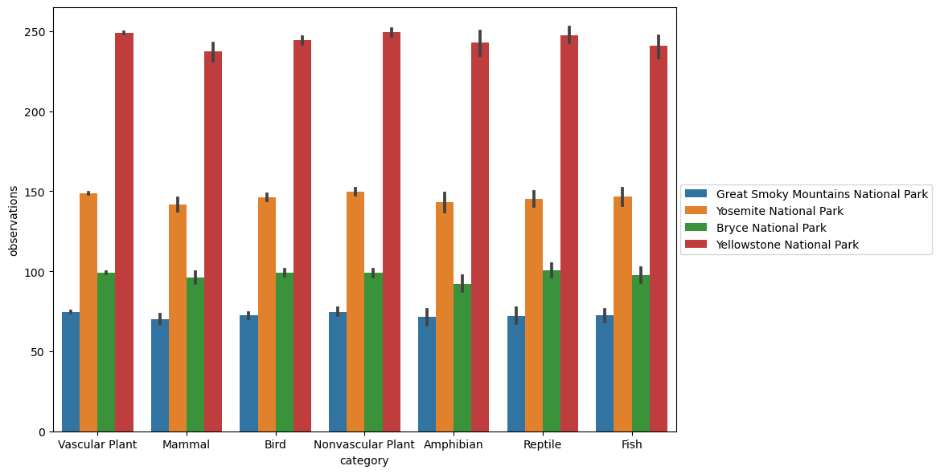
Observations by category and park
Yellowstone 8,991 km²
Yosemite 3,027 km²
Great Smoky Mountains 760 km²
Bryce 145 km²

Slide 3
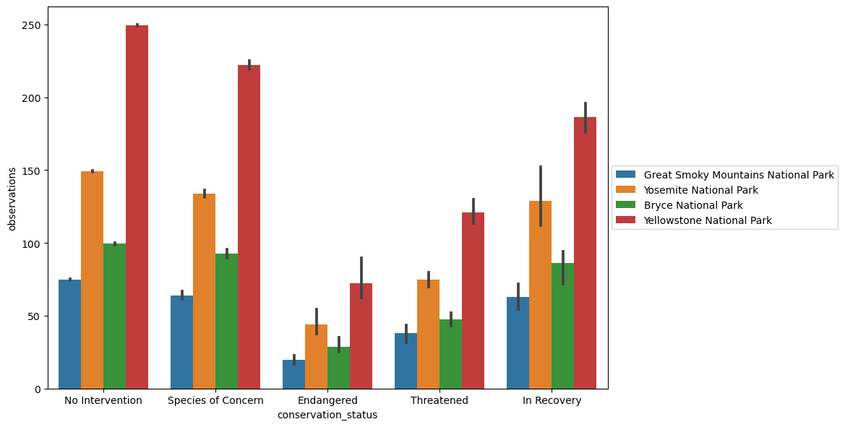
Observations by conservation status and park

Slide 4
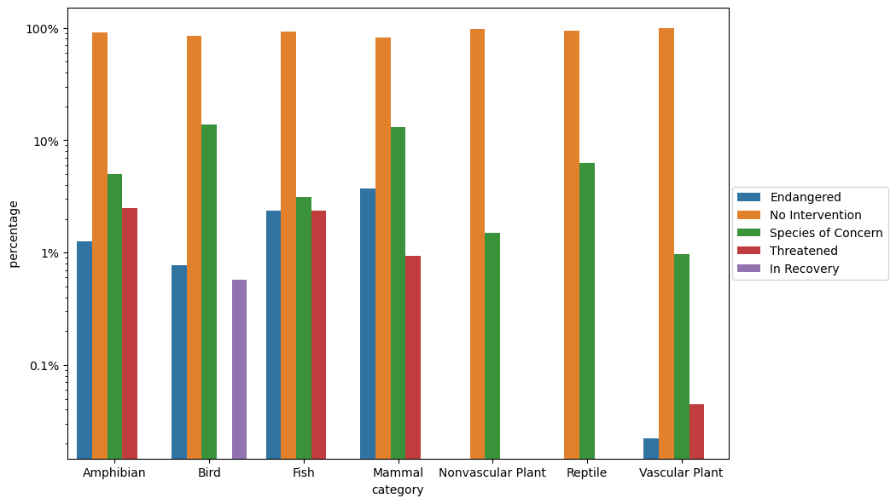
Conservation status by category

Slide 5
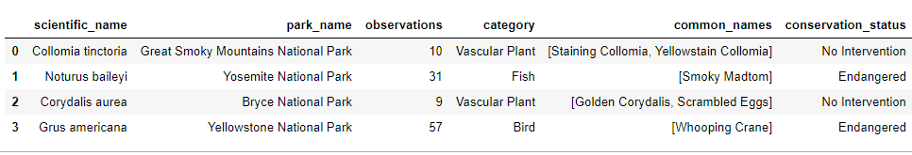
The least observed species
Notes:
Collomia tictiria and Corydallis aurea are the least observed species but are not endangered.

Slide 6
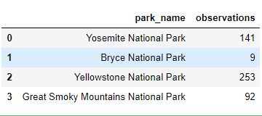
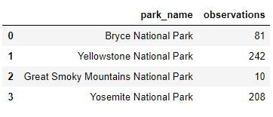
Just checking
Corydalis aurea
Collomia tinctoria
Notes:
Checking why Corydalis aurea and Collomia tinctoria are not endangered species.

Slide 7
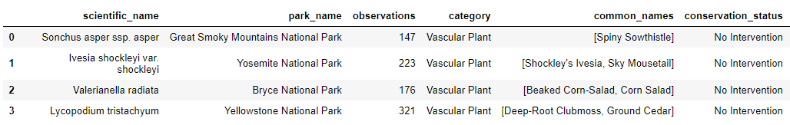
The most observed species

Slide 8
Conclusions
Yellowstone National Park has the most observations for all categories
Great Smoky Mountain National Park has the least observations despite is not the smallest park
The mammals are the category with more endangered species
Of the categories with endangered species, the amphibean and vascular plant are the least endangered
There is no endangered reptiles nor non vascular plants
Corydalis aurea, in Bruce National Park, is the least observed specie despite are not endangered.
Collomia tinctoria, in Great Smoky Mountain National, is the second least observed specie despite are not endangered.

Slide 9
Actions
Put atention on Great Smoky Mountain National Park to recover endangered species
Take special care about the mammals
Take care of Corydalis aurea, in Bruce National Park
Take care of Collomia tinctoria, in Great Smoky Mountain National

