Slide 1
Arrowhead 4.0 C++ client skeleton
Tamás Tóthfalusi tothfalusi@aitia.ai

Slide 2
To run this code, you need libraries…
Install the following Linux packages (sudo apt-get install on Raspbian):
openssl, libgnutls28-dev, libgnutlsxx28, libssl1.1, libssl1.0-dev, libcurl3, libcurl3-gnutls, libcurl4-gnutls-dev, libcrypto++-dev, libcrypto++-utils, libcrypto++6, libgpg-error-dev, automake, texinfo, g++
The project uses (or tested with) libmicrohttpd-0.9.59. Download, compile and install it from source with HTTPS support.
https://ftp.gnu.org/gnu/libmicrohttpd/
Use the following commands:
tar -xvzf libmicrohttpd-0.9.59.tar.gz
./configure --with-gnutls
make
sudo make install
Create libmicrohttpd.so.12 file in /usr/lib or usr/local/lib directory (or where the ”ldd ProviderExample” command points):
cd /usr/lib
sudo ln –s /usr/local/lib/libmicrohttpd.so.12.46.0 libmicrohttpd.so.12

Slide 3
Source code structure
ApplicationService.ini
Configuration file (HTTP server details: IP, port, etc.)
Source:
Security folder: Arrowhead token handling, openssl handling
Do not modify!
Provider folder: main.cpp, ProvidedService objects and logic
Need to modify, insert application service content, i.e. REST service and measurements from HW sensors
Arrowhead registration details
Interface folder: interfaces towards Arrowhead, HTTP(S) server instantiation
Only modify, if other HTTP method is required than HTTP GET
Code is commented with TODOs, and „do not touch below” remarks

Slide 4
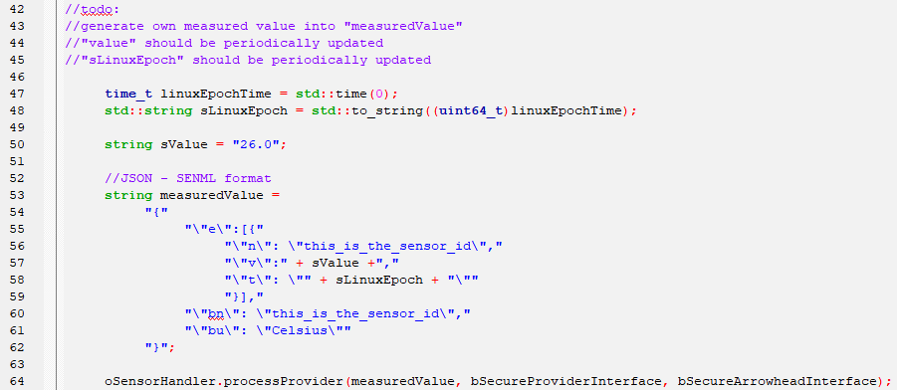
ProviderExample.cpp
Generation of sensor value (e.g. from HW) and timestamping

Slide 5
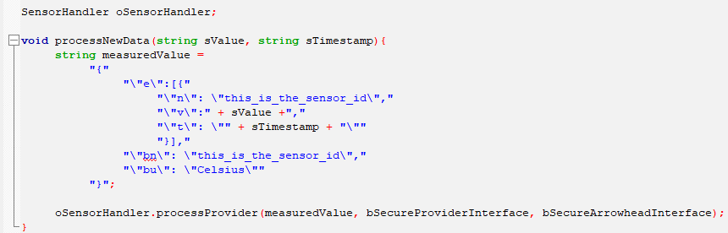
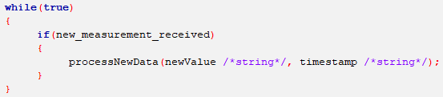
ProviderExample.cpp – Example code – periodic data reception from HW and processing into measurement object

Slide 6
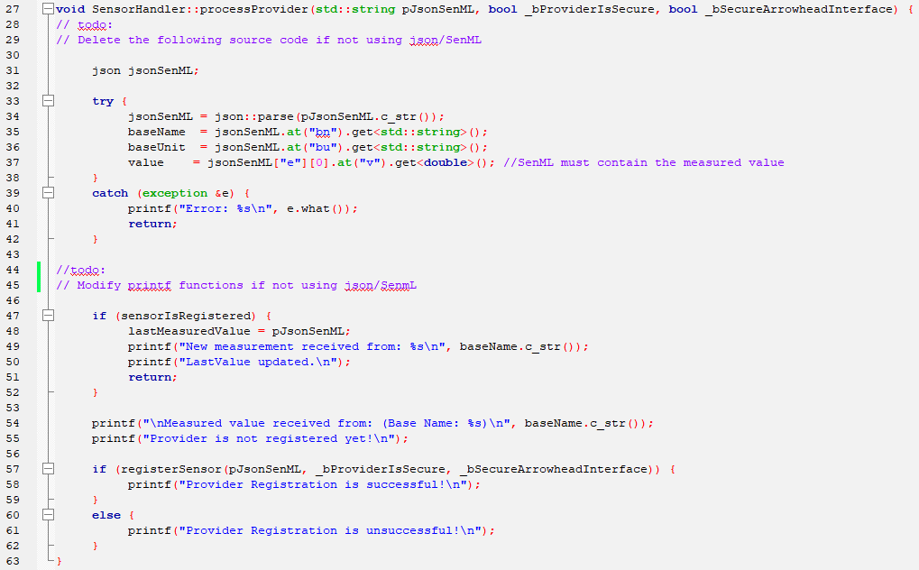
SensorHandler.cpp: needs to be edited, if not SenML format will be provided too!

Slide 7
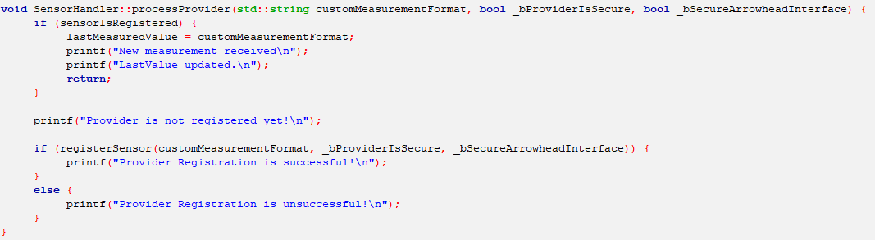
SensorHandler.cpp – Example code – Processing custom measurement format Confer with previous slide!

Slide 8
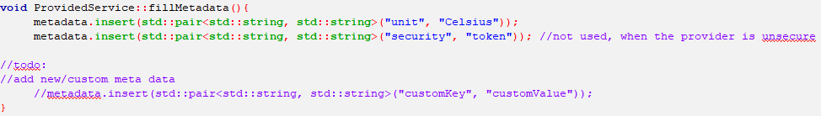
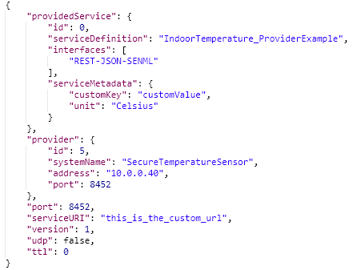
ProvidedService.cpp – Add new key-value pair as service metadata (that will be submitted to the ServiceRegistry!
HTTP GET to …/serviceregistry/mgmt/all
You can check your registration in the ServiceRegistry!

Slide 9
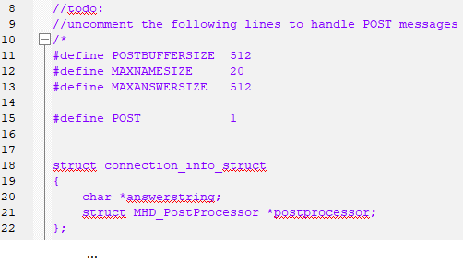
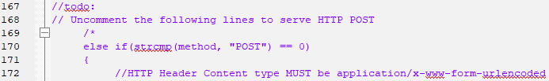

HTTP_Handler.cpp – Serve POST messages, the HTTP server has to be modified accordingly!
HTTP POST callback has to be implemented!

