Slide 1
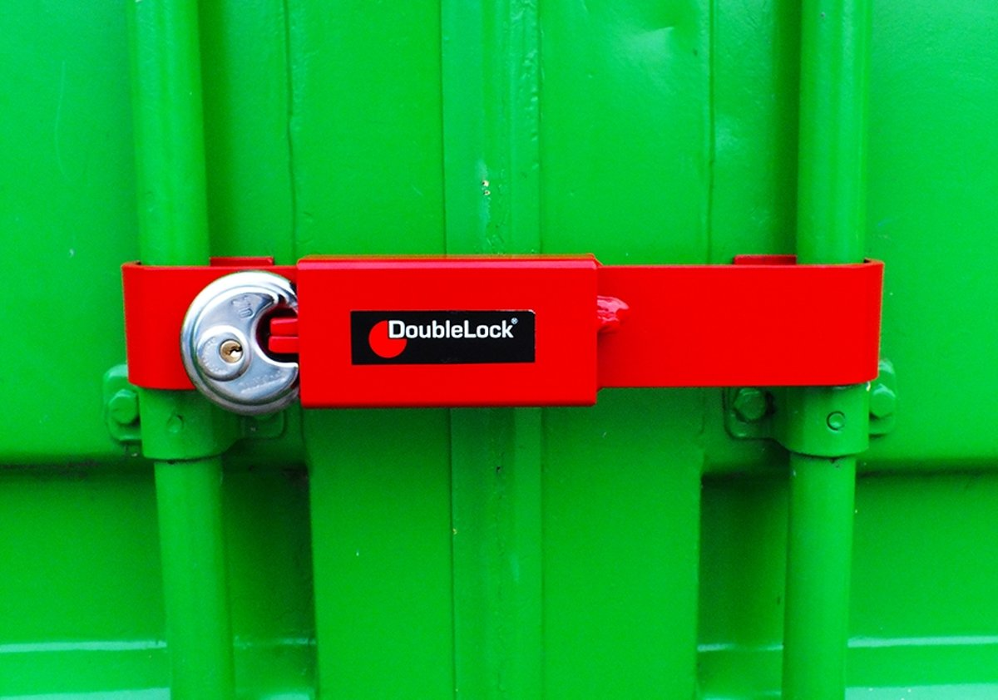
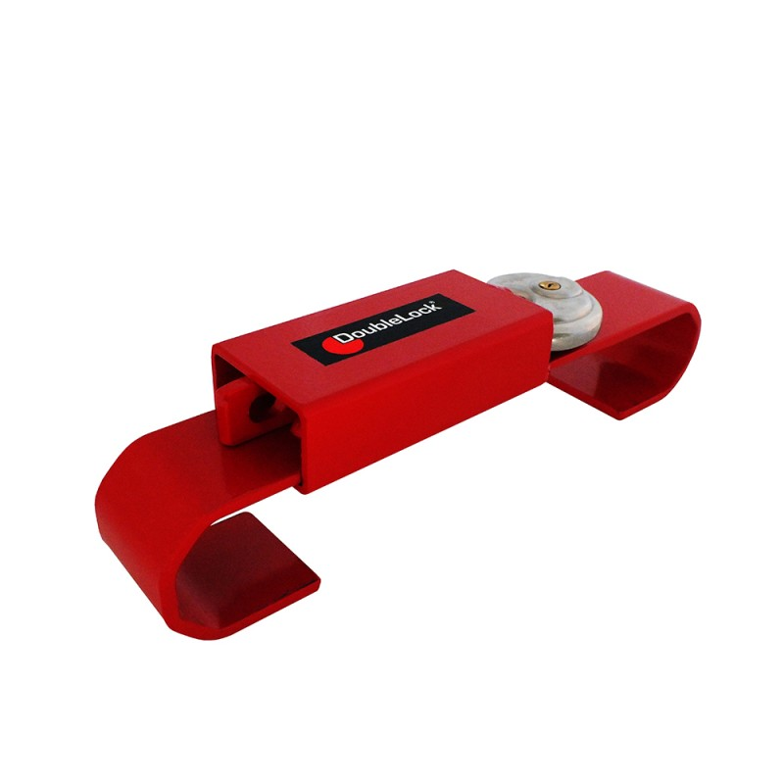
What‘s this?

Slide 2
Thesis defense
Lukas Grams, 2019-09-16

Slide 3
Agenda
Initial goals
Schedule
Updated goals
Representation in thesis
Demo time
Recap

Slide 4
Initial goals
Identify generic security risks
Rate security risks
How to mitigate (including best practices)
Compare on-prem & public cloud solutions
Optional: Compare to cloud-hosted, self-managed solutions

Slide 5
Schedule
Research, practical tests
Attack vectors & mitigation pointers
Built from scratch to meet requirements
Risk analysis & comparison
Extensive risk model tailoring was necessary
Highly dependent on specific solutions
Practical implementation & best practice derivement
Reduced due to time constraints
Write out notes into full thesis

Slide 6

Updated goals
Initial
Updated
Identify generic security risks
Rate security risks
How to mitigate (including best practices)
Compare on-prem & public cloud solutions
Optional: Compare to cloud-hosted, self-managed solutions
Identify generic security risks
Rate security risks
Pointers on how to mitigate (including some best practices)
Compare OCP 3.11 & AKS 1.11
Optional: Compare to cloud-hosted, self-managed solutions
Template for risk comparison & management

Slide 7
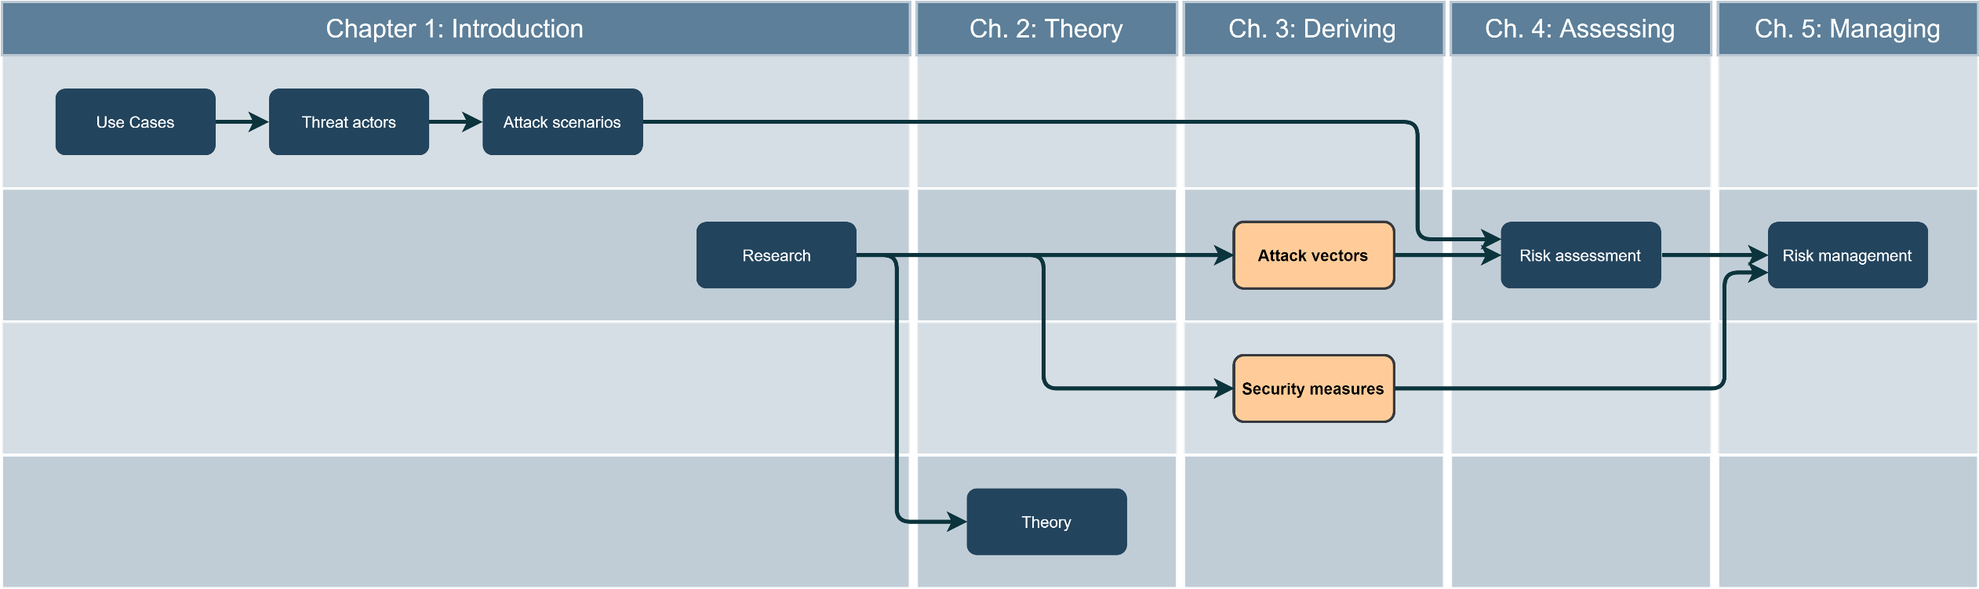
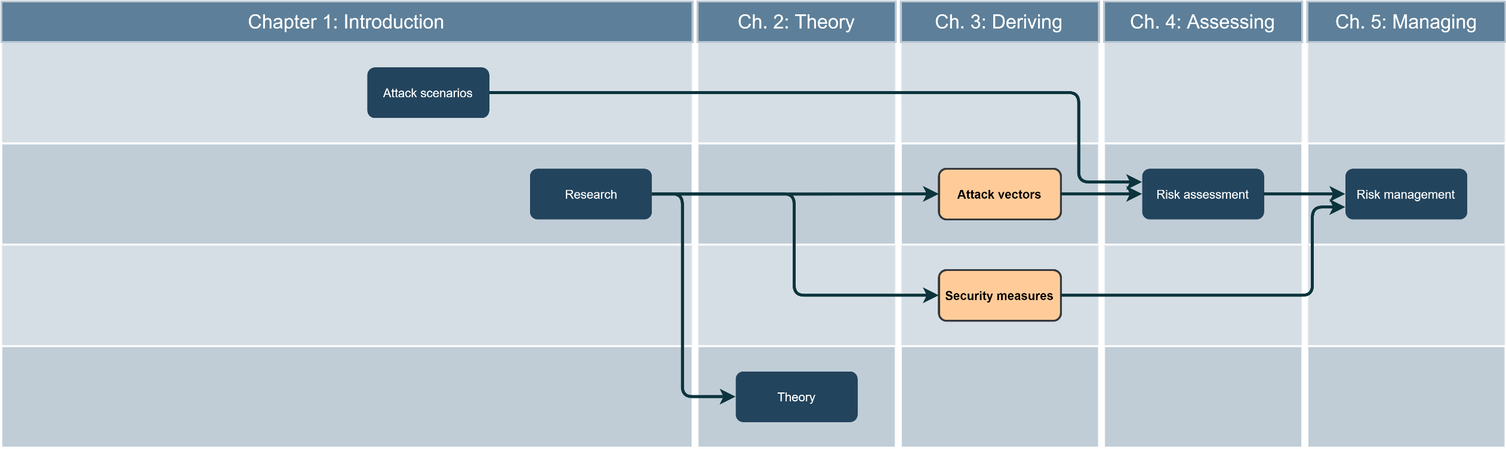
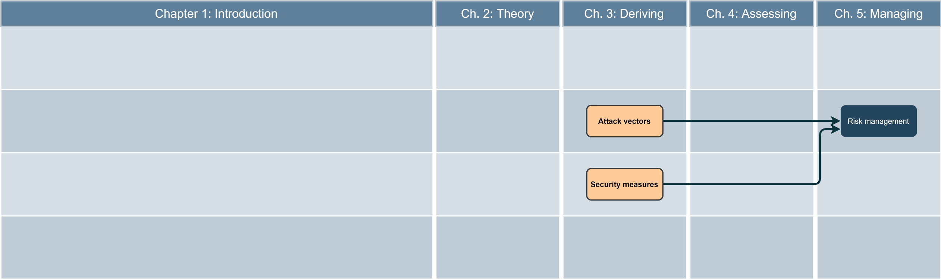
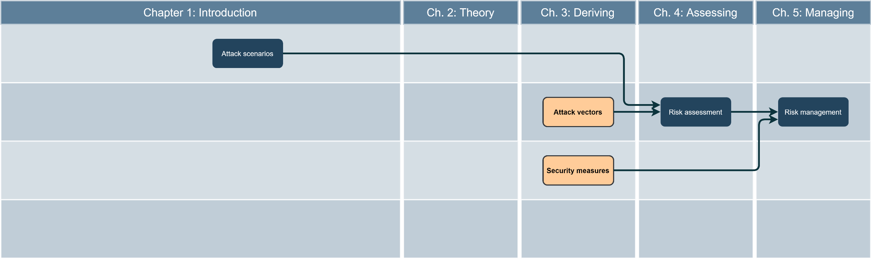
Representation in thesis
Notes:
Saved in:
https://www.draw.io/#G1PW9zWLcipewTwEsIq0NilWvQ-aI9OuEY

Slide 8
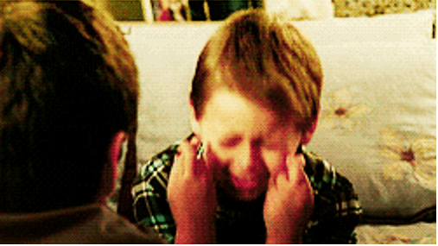
Demo time
(please work)
Notes:
Source: Giphy
https://giphy.com/gifs/justin-hope-hoping-fingers-crossed-l0NwNrl4BtDD7JCx2

Slide 9
Recap
Considerable additional work
Resulting shift in goals
Lessons Learned
Start at the beginning
Good end result
Viability confirmed in practice
Notes:
„At the beginning“ = use case, not risk mgmt.
- Practical part too small for my taste
- Struggling with technology > Struggling with scope definition
- Huge scope -> not much detail possible

Slide 10
Thanks for your attention!

Slide 11
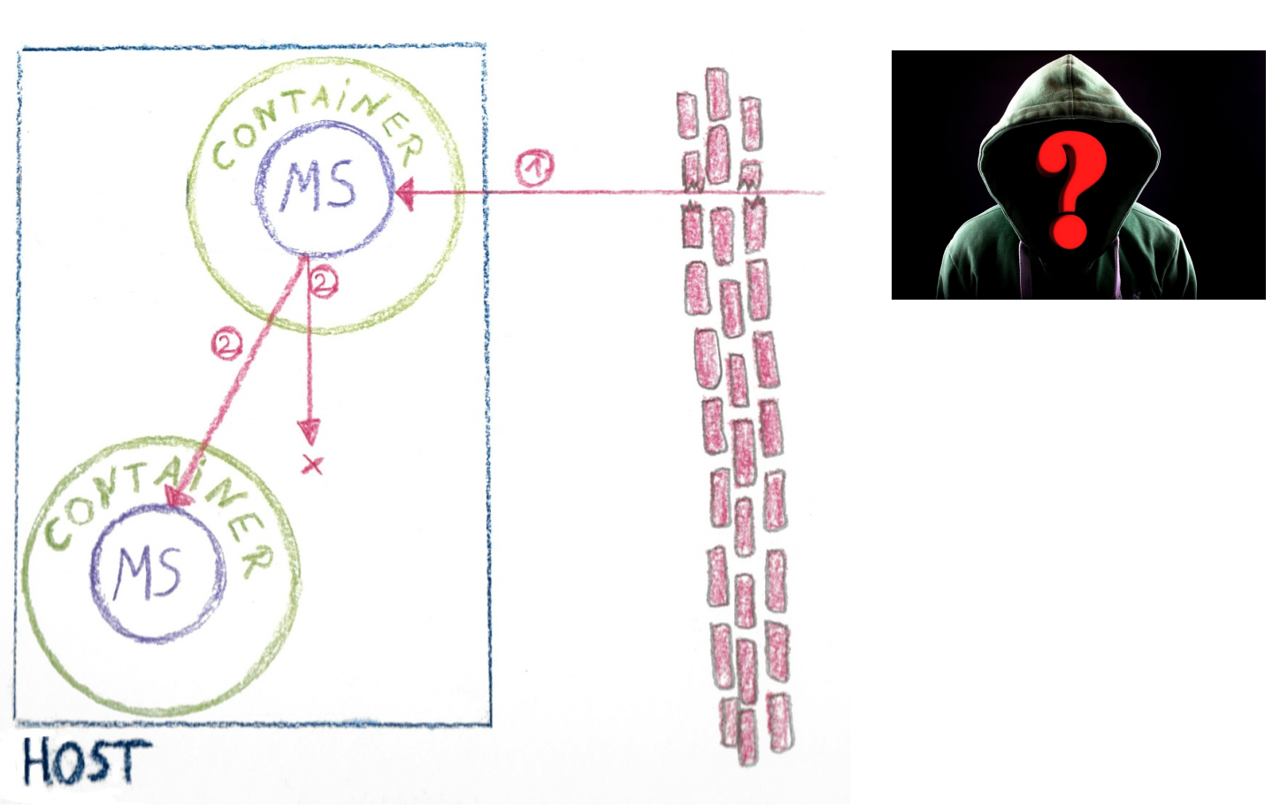
Backup slide – Demo attack illustrated
Notes:
MS = Microservice
Source: Dirk Wetter, OWASP
https://www.owasp.org/images/f/fd/Dirk_Wetter_-_Docker_Top10-OWASP_KA.pdf (Slide 7)

Slide 12
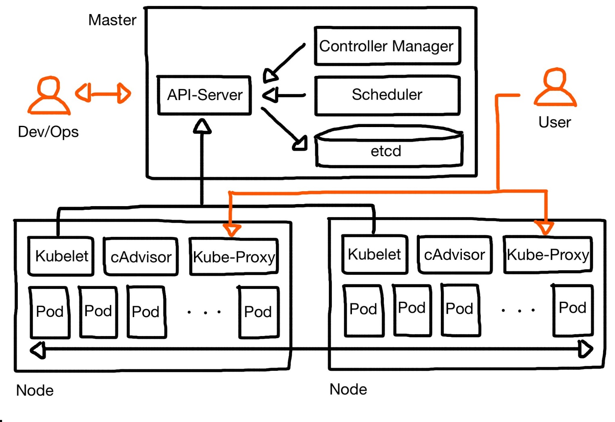
Backup slide – Kubernetes components
Notes:
Source: Niko Meisenzahl, Azure Meetup RO

Slide 13
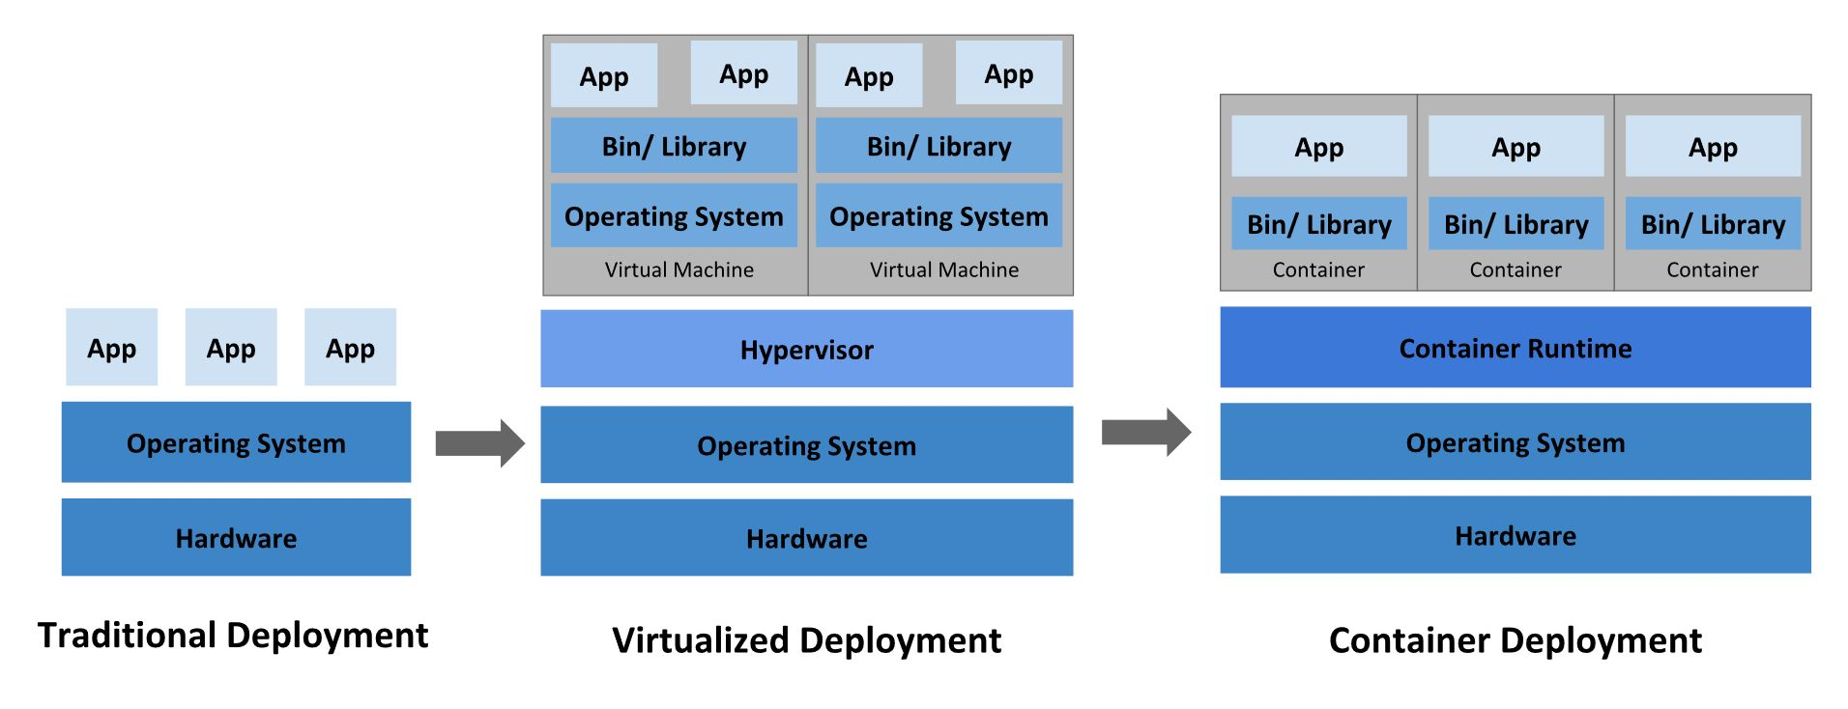
Backup slide – Container overview
Notes:
Source: K8s Docs, see thesis sources

Slide 14
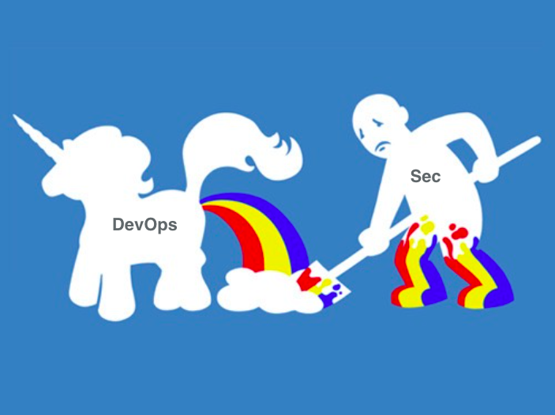
Bonus slide - Industry snapshot
Notes:
Credit: Pete Cheslock on Twitter
https://twitter.com/petecheslock/status/595617204273618944

